Slide 1
EDRMS Utilization Report
Reconfirmation Workshop (R2026.4)
August 2026

Slide 2
Agenda
1
The proposal
Two dashboards as the MVP for this release
2
The data we have today
Four sources, what each gives us, how each is produced
3
Feeding and maintaining the report
How the sources reach the report and who keeps them current
4
Bank-wide Oversight
Section by section: the term, what it means, where it comes from
5
Department Insights
Section by section: the term, what it means, where it comes from
6
Terminology to confirm
Words that change the figure depending on how you read them
7
Next steps and decisions
What we need from each party, and by when

Slide 3
Two dashboards as the MVP for this release
THE PROPOSAL
Nothing is removed from scope. The remaining four are parked for a future release.
IN THIS RELEASE
PARKED, STILL IN SCOPE
1
Bank-wide Oversight
Project Insights
Waits on a site to project register
2
Department Insights
Institutional File Plan
Waits on the file plan term list
Retention and Disposal
Retention works. Disposal has its own release
Available from the sources we hold today
The two the team most needs to use now
Delivered to a finished standard, not a partial one
Records and Archives Holdings
Waits on a physical archive system
THE DECISION WE NEED TODAY
Option A
Option B
Bank-wide Oversight and Department Insights as the MVP for this release, with the other four parked in scope for a future release.
All six dashboards in one release.

Slide 4
The four sources we have today
AVAILABLE DATA
Everything on the two MVP dashboards is built from these. Nothing else is assumed.
Source | What it gives us | How it is produced | How current
EDRMS Database | Declared records, physical counterparts, retention labels, disposal due dates, who declared and when | Written by EDRMS itself as records are declared. Read directly by query. | Live. No manual step.
AvePoint Cloud Governance | The EDRMS compliant site list, department, site owner, site status, storage used, last active time | Cloud Governance > Directory > Workspace report > Export report | On demand today. Can be scheduled.
Microsoft 365 SharePoint reports | Site usage: file count, page views, visited pages, storage. Activity: per user last activity date | M365 admin centre > Reports > Usage > SharePoint site usage, and SharePoint activity | Windows of 7, 30, 90 or 180 days. Nothing longer is offered.
Site lookup file (from ITD) | Site to department, division and library mapping, plus a production flag separating live sites from demo and UAT | Maintained by the BA team. Currently an Excel file on the project site. | Manual. This is the one that can go stale.
Sample of each report: [ LINK TO BE PASTED HERE ] so you can see the columns each one returns and how it is generated.
The lookup file currently covers 92 sites, of which 38 are production. Extending it to the full estate is the single request that most increases what we can report on.

Slide 5
How the report is fed, and who keeps it current
THE PIPELINE
Every figure is a join between these sources. The join key is the site.
EDRMS Database
Cloud Governance
Microsoft 365
ITD lookup file
Records, counterparts,
retention, disposal dates
Site list, department,
owner, status, storage
Usage and activity,
7 to 180 day windows
Department, division,
library, production flag
Joined on the site, then grouped by department or division
Bank-wide Oversight and Department Insights
Source | Who keeps it current | What that person has to do
EDRMS Database | Nobody. EDRMS writes it. | Nothing. The figure appears because a record was declared.
Cloud Governance | Whoever provisions the site | Set department and division when a site is created. Left blank, that site drops out of every departmental figure without any error showing.
Microsoft 365 | Nobody. Microsoft generates it. | Nothing, but the window cannot be widened beyond 180 days.
ITD lookup file | BA team today | Keep the mapping current as sites are created, renamed or retired. Proposed to move into the EDRMS database with an admin page so RAC can maintain it.

Slide 6
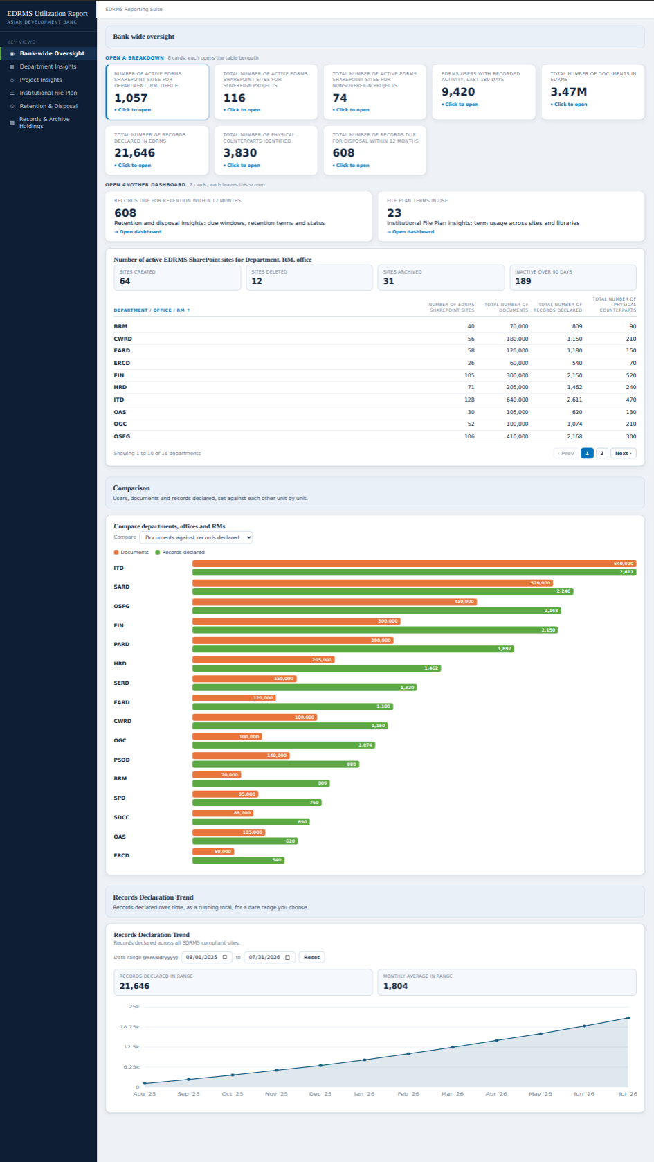
Bank-wide Oversight
MVP DASHBOARD 1
1
How much is in EDRMS, and who is using it, for the whole bank on one page.
1
Top panel
Ten tiles. Eight open a table below. Two navigate to another dashboard.
2
2
Overview of EDRMS sites
Every department, office and RM with its sites, documents, records and counterparts.
3
Comparison
Documents set against records declared, so you can see who is storing but not declaring.
3
4
Records declaration trend
A running total over time, with a date range you choose.
4

Slide 7
Bank-wide Oversight: the top panel
WHAT EACH ITEM MEANS AND WHERE IT COMES FROM
Your term | What it counts | Source | Status
Active EDRMS SharePoint sites | EDRMS sites, grouped by department, office or RM | Cloud Governance, with department and division backfilled | Define
Total number of EDRMS users | People with recorded SharePoint activity in the window | SharePoint activity log | Define
Total number of documents | File count per site, rolled up | SharePoint site usage, joined to the Cloud Governance site list | Available
Total number of records declared | Declared records, counted once each | EDRMS database | Available
Total physical counterparts | Declared records flagged as having a paper counterpart | EDRMS database | Available
Records due for disposal | Records reaching their disposal due date in a window | EDRMS database | Define
Sovereign and nonsovereign project sites | Sites belonging to a project | No source. Out of scope for this release. | No source
Raised by your own review
“All records have a due date for disposal. What does due for disposal mean? Due in the next 30, 60 or 90 days?”
“Is this user with access to EDRMS sites?”
Both change the figure entirely. We need one answer each before these tiles can be built.
Available
Sourced and buildable today
Define
Term is ambiguous. What it means changes the figure
No source
Nothing available produces this

Slide 8
Bank-wide Oversight: tables, indicators and trend
WHAT EACH ITEM MEANS AND WHERE IT COMES FROM
Your term | What it counts | Source | Status
Department / office / RM | The owning unit of each site | Cloud Governance. Department is set at provisioning; division needs backfilling | Define
Sites created, deleted, archived | Site lifecycle counts | Cloud Governance site status | Define
Inactive site for 90 days | Sites with no activity in the window | SharePoint site usage, last activity date | Available
Never accessed EDRMS | People with access to a site who have never opened it | Site permissions checked against the activity log | Define
Staff, contractors, consultants | Users split by employment type | No source. Needs a user register with employment type. | No source
Completion of training | Users who completed EDRMS training | Held by the learning team. Owner identified, file not yet supplied. | No source
New documents month on month | Documents added in each month | Needs a document level scan that does not exist yet | No source
Records declaration trend | Declared records as a running total over time | EDRMS database | Available
Never accessed: agreed in the technical session that this means people who have access to the site and have never opened it, checked against the site's own members, owners and visitors rather than the whole tenant. Please confirm that is your intent.
Available
Sourced and buildable today
Define
Term is ambiguous. What it means changes the figure
No source
Nothing available produces this

Slide 9
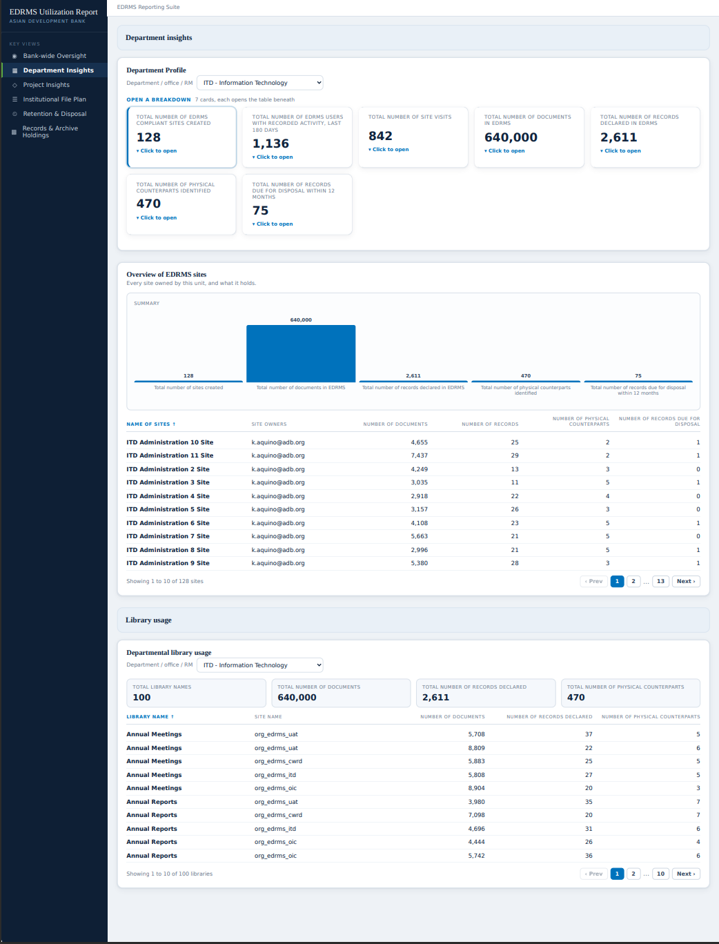
Department Insights
MVP DASHBOARD 2
One unit's own view. Pick a department, office or RM and everything below refreshes for it.
1
1
Department profile
Seven tiles for the selected unit, each opening its own table.
2
2
Overview of EDRMS sites
Every site the unit owns, with its owner, documents, records and counterparts.
3
3
Site visits
Page views and visited pages per site, over a window you choose.
4
Library usage
Libraries inside the unit's sites, grouped by file plan category.
4

Slide 10
Department Insights: the profile tiles
WHAT EACH ITEM MEANS AND WHERE IT COMES FROM
Your term | What it counts | Source | Status
EDRMS compliant sites created | Sites provisioned to this unit | Cloud Governance | Define
Total number of EDRMS users | People with recorded activity for this unit | SharePoint activity log | Define
Total number of site visitors | Page views and visited pages, not distinct people | SharePoint site usage | Define
Total number of documents | File count across the unit's sites | SharePoint site usage | Available
Total number of records declared | Declared records for the unit's sites | EDRMS database | Available
Total physical counterparts | Declared records flagged as having a paper counterpart | EDRMS database | Available
Records due for disposal | Records reaching their due date in a window | EDRMS database | Define
Go-Live date | When the unit went live on EDRMS | No source. Nothing records it. | No source
Thank you for the review. All 79 rows on this dashboard now carry your assessment, and the table above follows it. Most of it agrees with ours. A small number of source attributions differ and we will reconcile those row by row.
Available
Sourced and buildable today
Define
Term is ambiguous. What it means changes the figure
No source
Nothing available produces this

Slide 11
Department Insights: sites, visits and libraries
WHAT EACH ITEM MEANS AND WHERE IT COMES FROM
Your term | What it counts | Source | Status
Name of sites, site owners | Each site the unit owns and who owns it | Cloud Governance | Available
Number of documents per site | File count for that site | SharePoint site usage | Available
Number of records, counterparts | Declared records and paper counterparts per site | EDRMS database | Available
Page views, visited pages | Visit activity per site in the window | SharePoint site usage, 7 to 180 days | Available
Visitors internal and external | Visits split by where the person comes from | No available report splits this | No source
Access requests granted, denied | Requests to join a site and their outcome | Site access request summary page, to be confirmed | Define
Library names | Libraries inside each site | ITD lookup file | Available
Number of documents per library | Documents inside each library | Needs a document level scan. Nothing reports below site level today. | No source
Number of users per library | People using each library | No source will ever produce this. Activity is never reported per library. | No source
Worth a decision now: users per library cannot be produced by any source, now or later. We suggest dropping it rather than leaving it open.
Available
Sourced and buildable today
Define
Term is ambiguous. What it means changes the figure
No source
Nothing available produces this

Slide 12
Terminology to confirm
WORDS THAT CHANGE THE FIGURE
Each of these reads more than one way. Which one you mean decides what the report counts.
Term | It could mean | Our proposal
EDRMS user | Anyone with access to an EDRMS site · anyone who used it · anyone who declared a record | Someone who declared a record. It is the only one countable today.
Due for disposal | Every record has a due date, so all of them are due eventually. In 30, 60, 90 days, or overdue? | Show it in windows: due within 30 days, 90 days and 12 months.
Never accessed | Never at all · not in the last 180 days, which is as far back as the report reaches | People with access to the site who have never opened it, from site permissions.
Department | The HQ office only · the whole department including its RMs, offices and divisions | Two levels: department, then division. Countries, RMs and offices are divisions.
Sites created, deleted, archived | All SharePoint sites · EDRMS compliant sites only | EDRMS sites only. Confirmed in the workshop that the other sites stay out.
Visitors | Distinct people who came · the number of visits, which is what the report counts | Site visits, and label it that way.
Users creating documents | People who created a document · people who uploaded one · both | Needs your answer before it can be built either way.
Unit | Your own review asks what unit means in “clickable into that unit's dashboard” | We read it as the department, office or RM on that row.

Slide 13
Next Steps
RAC reviews the two MVP dashboards
The review pack lists every item with its source and what it costs to maintain. Comments go in the two response columns.
1
RAC settles the terminology
The eight terms on the previous slide. Each one decides what a figure counts.
2
ITD confirms the lookup file
Extend it to the full estate, add the site identifier, and agree where it lives and who maintains it.
3
We match requirements to sources
Every item is marked available, needs a definition, or has no source.
4
The team decides on what remains
Where no source can be provided, we agree together whether the item is dropped or deferred.
5

Slide 14
Thank You!

