Slide 1


RECO: A lost or stolen property recovery system
Student Name: Perez Kariuki
Supervisor name: Mr. Daniel Kurui

Slide 2


RECO is a web application that allows users to post an item that they have lost or an item that was stolen. In addition, it also provides a platform that allows people to post an item that they have found misplaced.
Problem solved
Location of an item owner.
Mistakenly handling of stolen property.
Selling of stolen items e.g., phone, laptops.
Trust of secondhand products.
Funding of illegal groups through the sell of stolen properties.

Slide 3
List of functional requirements
Authentication
The Administration will have the ability to create an account for a new user. The users will also be able to create their own account in which all accounts will be accessible through the input of right credentials i.e., email/phone number and a password.
Make report
Incase of a lost or stolen item the Users can fill a document that describes the item that was lost or stolen.
Search report
The search functionality will enable the user to input a unique identifier of the item they are looking for e.g., EMEI number.
Provide feedback
The administrator ,finder and owner are allowed to give feedback on a lost item or stolen item through a live chat.
View report
Finder, owner and administrators can view lost or stolen items.

Slide 4

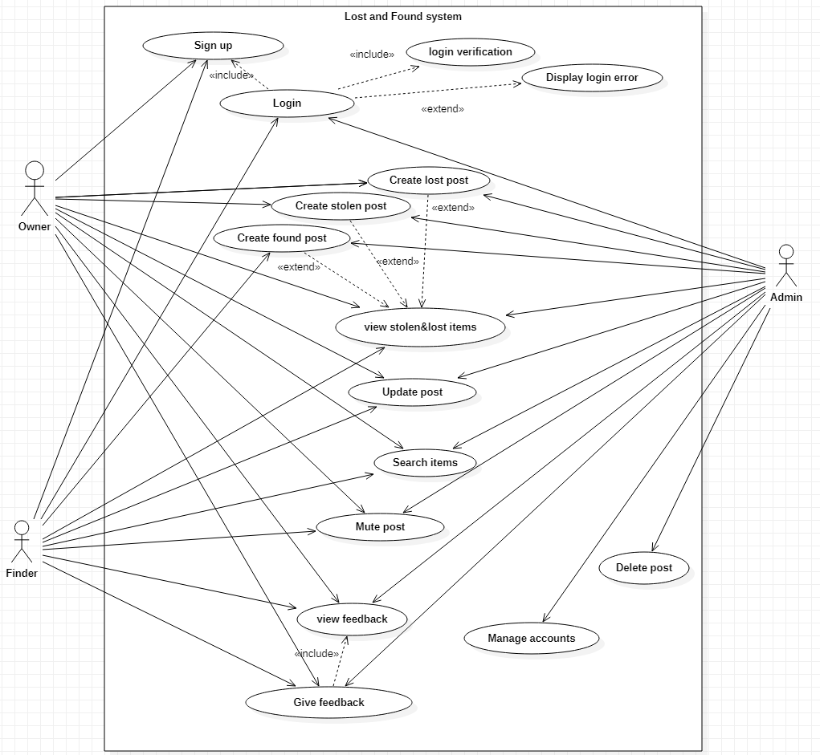
Usecase Diagram

Slide 5
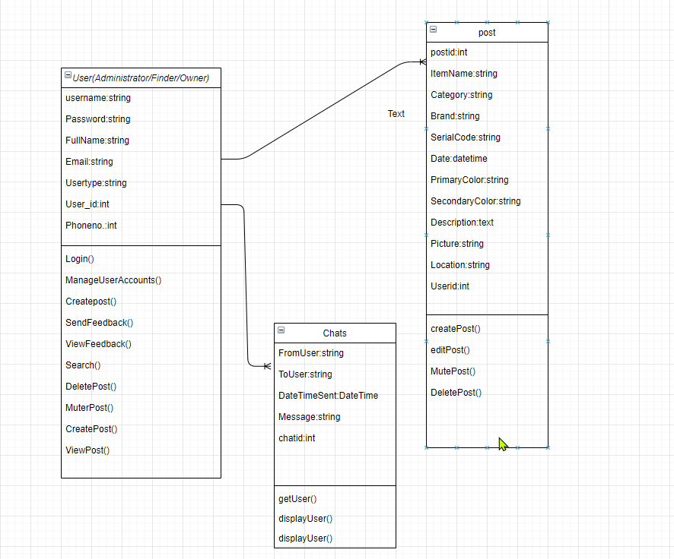
Class Diagram

Slide 6
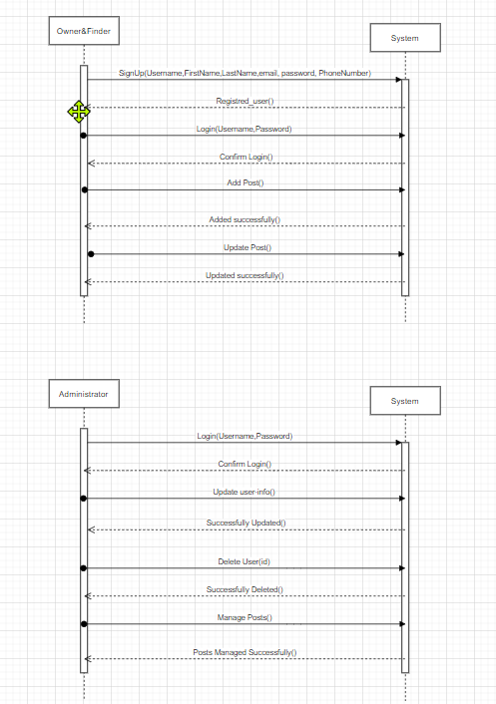
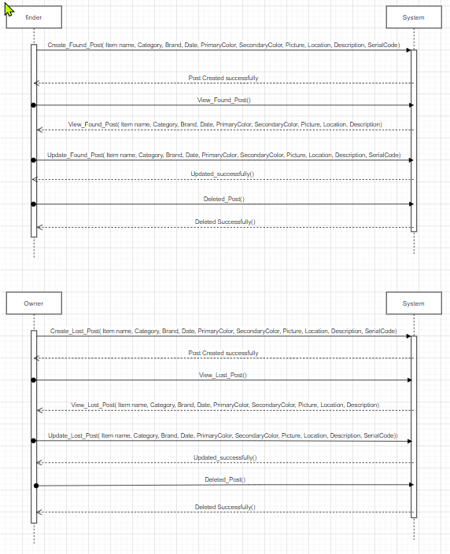
Sequence diagram

Slide 7
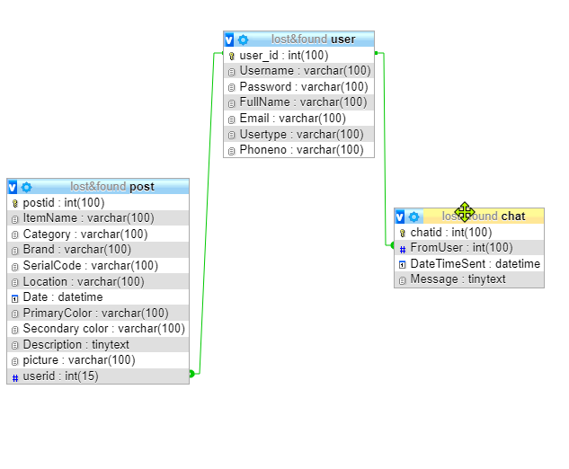
Database Schema

Slide 8
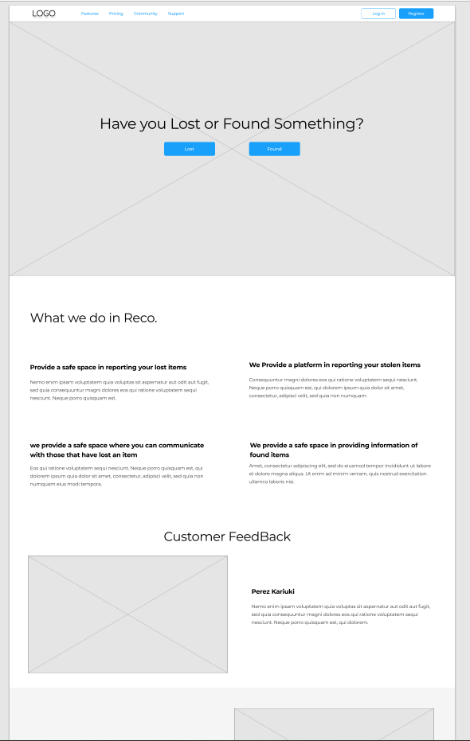
Wireframe
Home page

Slide 9
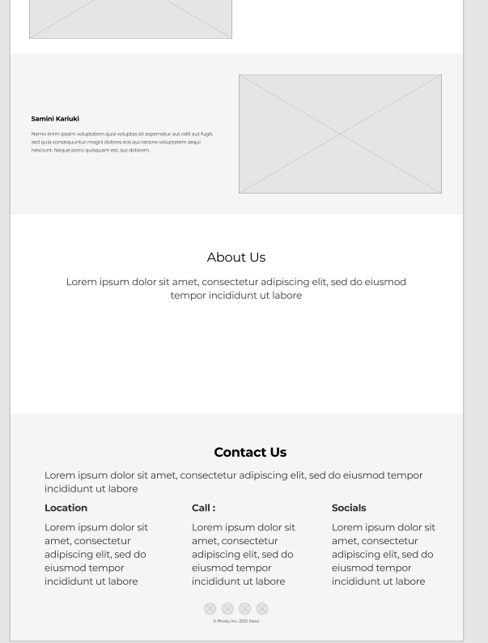
Home page (continuation)

Slide 10
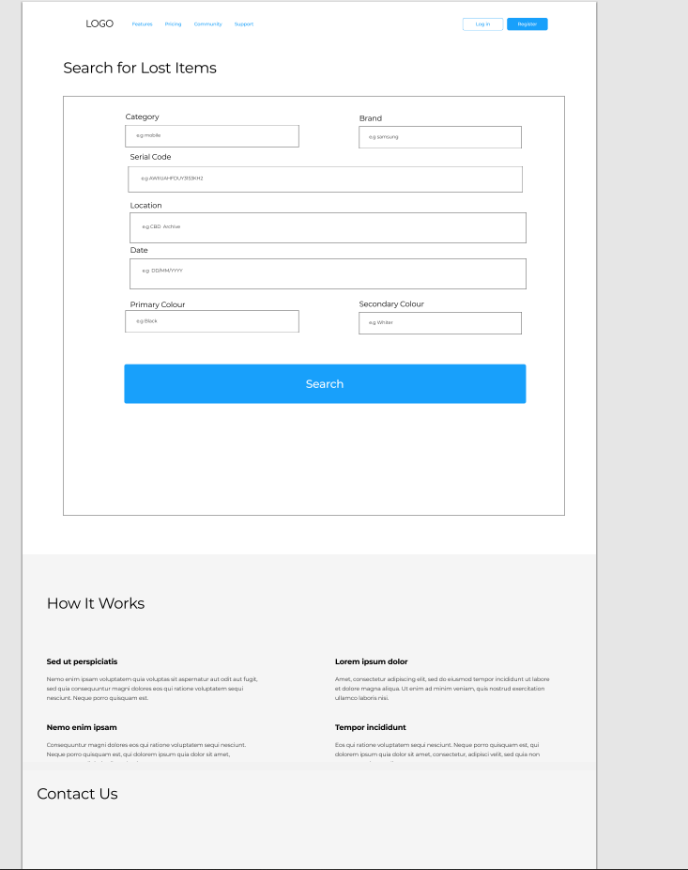
Search portal

Slide 11
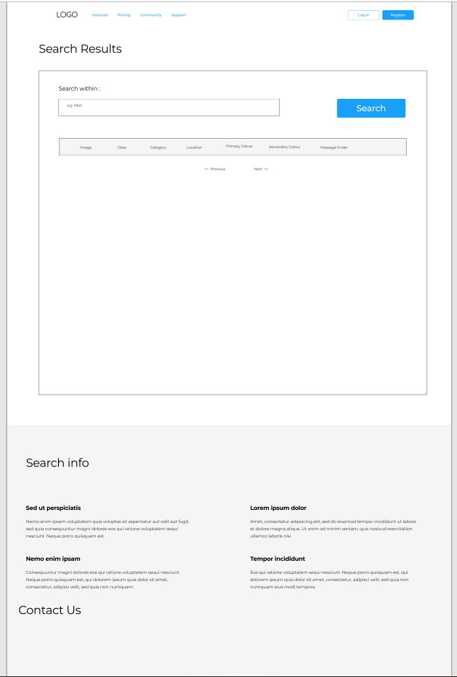
Search results

Slide 12
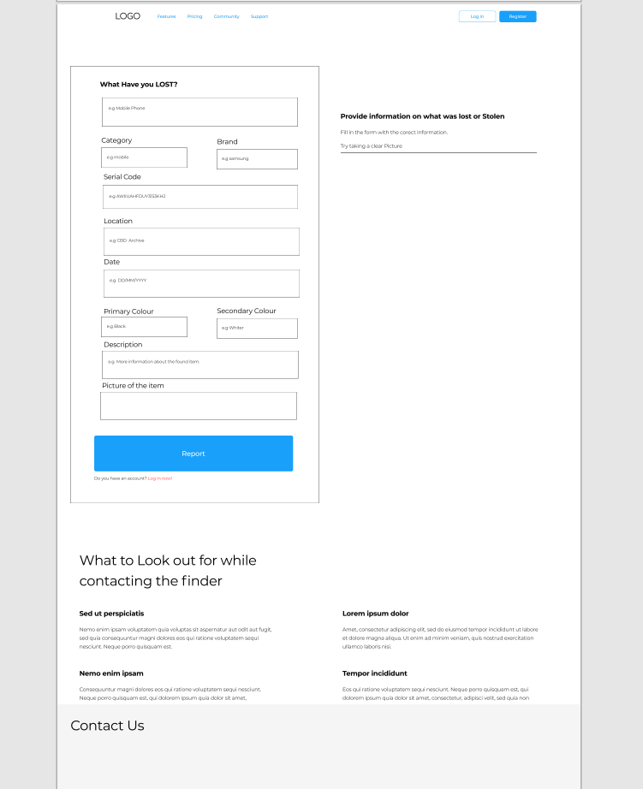
Lost Form

Slide 13
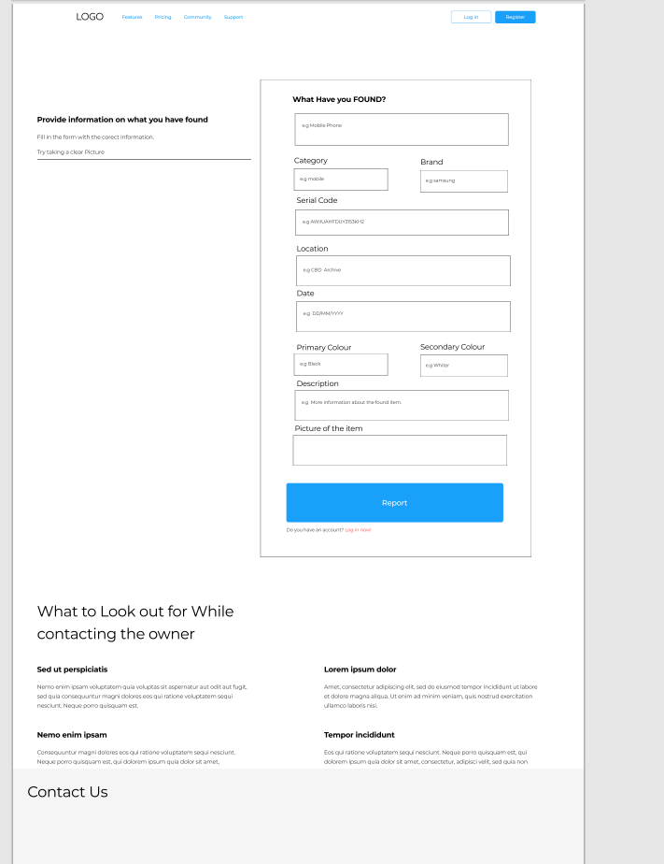
Found Form

Slide 14
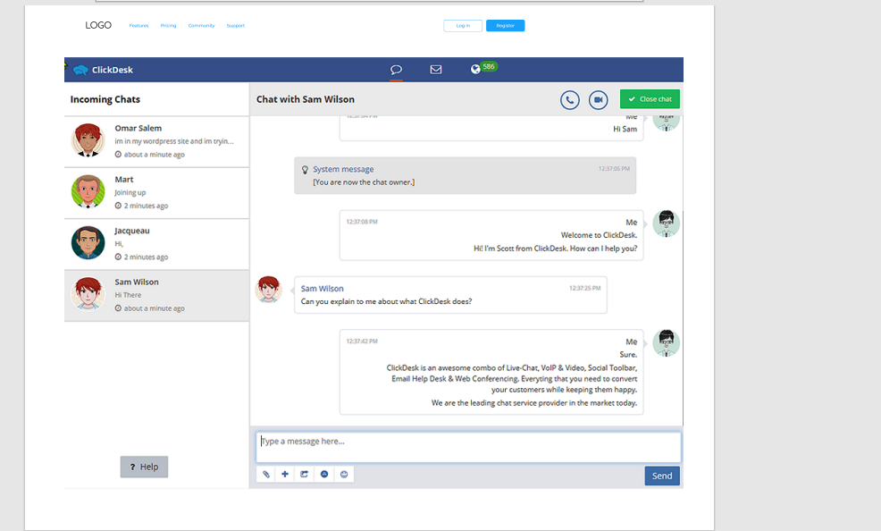
Chat View

