Slide 1
Good Morning

Slide 2

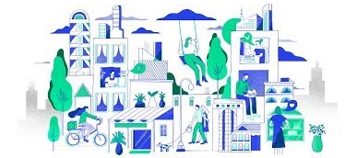
Brazilian E-Commerce Purchase Trend
Capstone Three
Rose Mary Perez

Slide 3
Overview
Olist is an online marketplace that enables small brick-and-mortar retailers to sell their products. The startup was founded in 2015.
Olist has an estimated annual revenue of $1.8m in US dollars.
They currently have an entire area dedicated to customer onboarding. It focus on teaching their customers to thoroughly understand what Olist is and what it does. In order to grow, it’s essential that the user has the necessary knowledge of the platform and their business.

Slide 4
Project Goal
The goals of the project is to build a regression model to predict how much a new customer will spend in their first six months.
Tasks:
Distinguish active customers from inactive customers.
Generate transaction forecasts for individual customers.
Predict the purchase volume of the entire customer base.

Slide 5
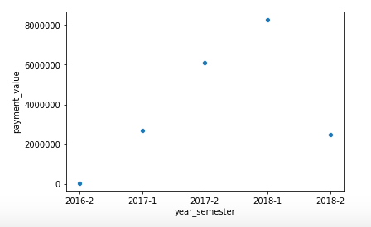
The Data
There is only two years worth of data and not a true place to start the calculation
Source: https://www.Kaggle.com/olistbr/Brazilian-ecommerce

Slide 6
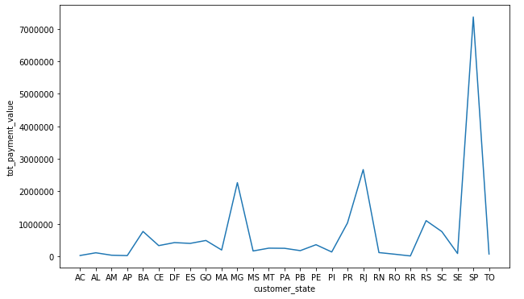
60% of traffic was concentrated in San Paulo 8% in Rio de Janeiro 32% among the states of Minas Gerais, Santa Catarina, Goias, and Rio Grande do Sul
Testing top sales by state.
Source: https://www.Kaggle.com/olistbr/Brazilian-ecommerce

Slide 7
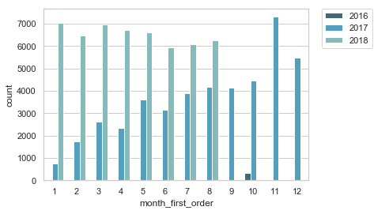
2016 short on data 2017 shows a steady increase of customers 2018 the year start strong and drops off
New customers by month and year
Source: https://www.Kaggle.com/olistbr/Brazilian-ecommerce

Slide 8
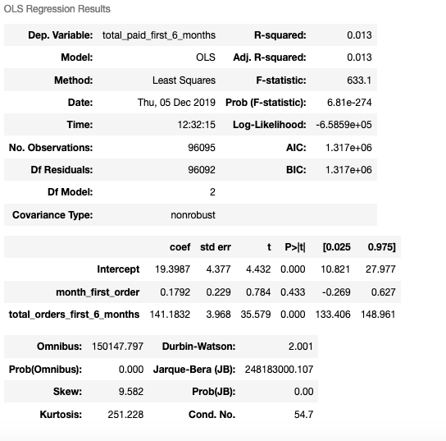
Regression Models
The observations of the relationship between new customers and future spending within six month
Source: https://www.Kaggle.com/olistbr/Brazilian-ecommerce

Slide 9
Conclusion
We explored the database made public by Olist and found that the techniques to predicting is endless.
The project give us the opportunity to learn how to merge tables, clean data and use other tools for visualization.
Working with 9 tables to figure out what to select as dependent and independent takes practice. Selecting the right regression model is a matter of how deep you want to investigate a dataset and how to relate the data.

Slide 10
Thank you!
For more information on this project or other project I’ve worked on visit:
https://github.com/perezrm Cap3_Brazilian_ecommerce
Or let’s connect via:
www.linkedin.com/in/perezrosemary

