Slide 1
Good Morning

Slide 2


Brazilian E-Commerce Purchase Trend
Capstone Three
Rose Mary Perez

Slide 3
Overview
The startup was founded in 2015. Olist is an online marketplace that enables small brick-and-mortar retailers to sell their products.
Olist as an estimated annual revenue of $1.8m in US dollars.
The goals of the project is to predict the customer Lifetime Value for the first six-moth of their initial sign on.
Tasks:
Distinguish active customers from inactive customers.
Generate transaction forecasts for individual customers.
Predict the purchase volume of the entire customer base.

Slide 4
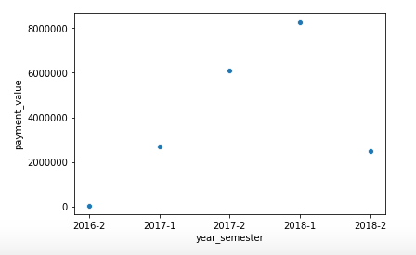
The Data
There is only two years worth of data and not a true place to start the calculation

Slide 5
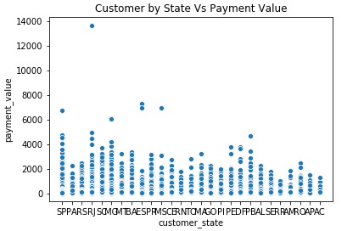
The Data
Testing top sale by state.

Slide 6
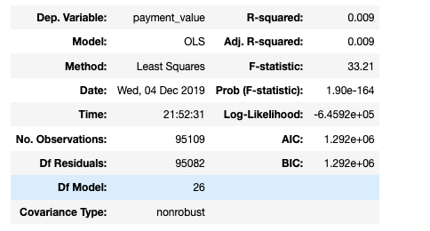
Regression Models
Frist model predicting relation with customer by state
formula = 'payment_value ~ C(customer_state)'
fitted_model = smf.ols(formula=formula, data=olist_data).fit()
fitted_model.summary()

Slide 7
Conclusion
The techniques to predict is endless.
Working with 9 tables to figure out what to select as dependent and independent take practice and selecting the right Regression model is a matter of how deep you investigate.

Slide 8
Thank you!

