Slide 1
STACKS / LIBRARY MANAGEMENT
Frontend
walkthrough
B
UI screens / File guide / Complete source appendix
FIELD GUIDE / 2026

Slide 2
SYSTEM MAP
How the frontend works
The UI owns presentation and interactions; the API owns validation and persistent data.
REACT UI
API CLIENT
EXPRESS API
MONGODB
LibraryApp.jsx
lib/api.js
backend/routes + controllers
Mongoose models
Screens, forms, local state
JSON + JWT requests
Auth, checks, business rules
Users, books, issues
Authentication is stored as a signed token; protected API requests send it in the Authorization header.
STACKS / FRONTEND WALKTHROUGH
02

Slide 3
LIVE INTERFACE
Overview dashboard
Collection health, loans, availability, members, and recent activity in one place.
01
Four live metrics summarize copies, shelf availability, loans, and readers.
02
Collection-health bars update from MongoDB-backed totals.
03
Quick actions route directly to catalog, members, and circulation.
STACKS / FRONTEND WALKTHROUGH
03

Slide 4
COLLECTION MANAGEMENT
Book catalog
Search and maintain titles, ISBNs, categories, and copy availability.
01
Search matches title, author, or ISBN.
02
Category and availability filters narrow the table.
03
Add, edit, and delete actions use the protected books API.
STACKS / FRONTEND WALKTHROUGH
04

Slide 5
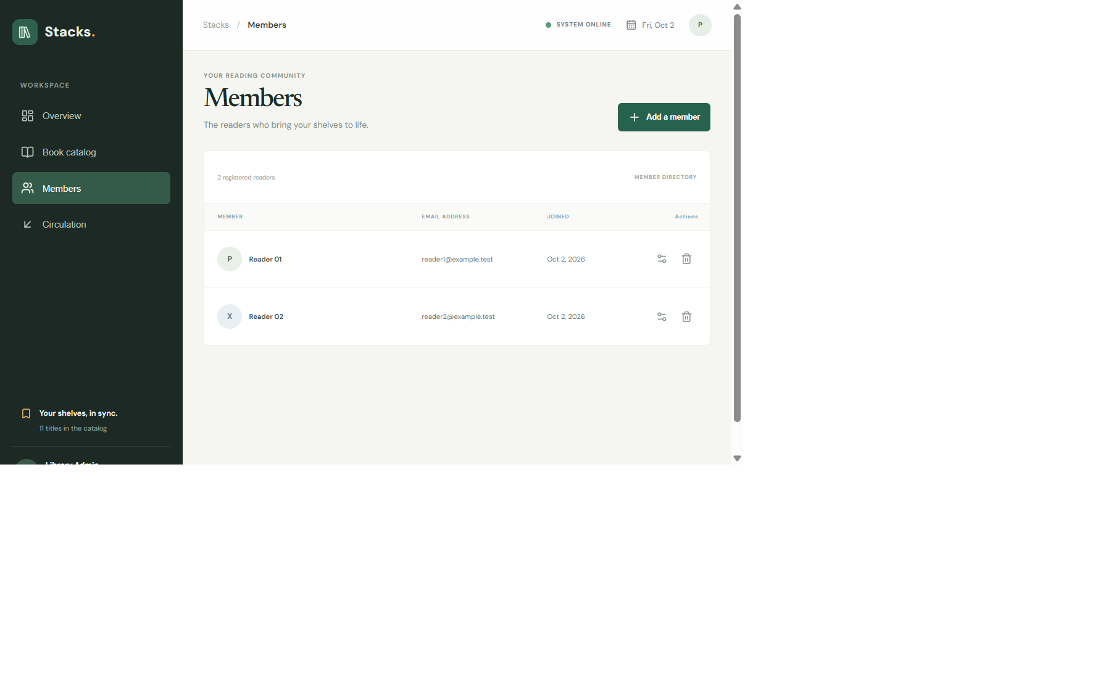

PEOPLE + CIRCULATION
Members and book loans
Member records and check-in history are kept separate but connected by each issue record.
Members: create, edit, and remove accounts. Open loans block deletion.
Circulation: check out available copies, track due dates, and check books back in.
STACKS / FRONTEND WALKTHROUGH
05

Slide 6
ADMIN WORKFLOW
Add and edit forms
Dialogs gather structured data, validate required fields, and report API errors.
01
Book form records title, author, ISBN, category, and copy count.
02
Member form creates accounts with hashed passwords.
03
Checkout form requires a member, an available book, and a future due date.
STACKS / FRONTEND WALKTHROUGH
06

Slide 7
SMALL-SCREEN LAYOUT
Responsive workspace
On narrow screens the sidebar collapses to an icon rail and remains visible while scrolling.
01
Navigation stays available in the sticky side rail.
02
Tables scroll inside their own region instead of widening the full page.
03
Forms stack vertically on small screens.
STACKS / FRONTEND WALKTHROUGH
07

Slide 8
FILE-BY-FILE GUIDE
Core runtime files
Complete text sources are reproduced after the presentation in the PDF appendix.
package.json
Frontend scripts and React, Vite, and icon dependencies.
.gitignore
Prevents generated frontend files from being committed.
.oxlintrc.json
Oxlint configuration used by the frontend lint command.
README.md
Vite starter documentation; app-specific setup is in the root README.
index.html
Browser document shell, page title, metadata, and React mount node.
vite.config.js
Enables the React plugin and configures Vite.
src/main.jsx
Bootstraps React and mounts LibraryApp into #root.
STACKS / FRONTEND WALKTHROUGH
Main UI: auth, dashboard, catalog, members, circulation, forms, and actions.
08
src/LibraryApp.jsx
src/lib/api.js
Fetch wrapper: API base URL, bearer token, JSON requests, and errors.

Slide 9
FILE-BY-FILE GUIDE
Styles, assets, and starter files
Complete text sources are reproduced after the presentation in the PDF appendix.
src/App.jsx
Unused Vite starter demo; main.jsx imports LibraryApp directly.
src/index.css
Global base styles from the Vite starter; loaded before app styles.
src/LibraryApp.css
Visual system and responsive styles for the Stacks workspace.
src/WorkspaceLayout.css
Pins the workspace navigation rail during page scrolling.
src/App.css
Unused Vite starter stylesheet; not imported by the running app.
src/assets/react.svg
Unused React starter illustration.
src/assets/vite.svg
Unused Vite starter illustration.
STACKS / FRONTEND WALKTHROUGH
Unused Vite starter raster image; binary asset, not code.
09
src/assets/hero.png
public/favicon.svg
Public SVG favicon asset; not source logic.
public/icons.svg
Public icon sprite from the Vite starter; not used by the app.

Slide 10
READING THE SOURCE
One action, end to end
01
02
03
04
05
Admin clicks
Form is checked
Request is sent
Data is saved
UI refreshes
LibraryApp.jsx
HTML + API validation
lib/api.js + JWT
Express + MongoDB
Dashboard and tables
Build the app: npm run build • Rebuild this guide: npm run documentation:build
STACKS / FRONTEND WALKTHROUGH
10

