Slide 1

Unbalanced gender ratio in technical field
TEAM 1:
1964_Lê THÀNH AN;
1971_LÊ NGUYỄN CÔNG HẬU;

Slide 2
Agenda
Introduction 3
Facts 15
Reasons 19
Solution 34

Slide 3
INTRODUCTION
Why choose this topic:
-Relevant in today’s society.
-Practice 5whys method.

Slide 4
FACTS
The statistics of women taking careers in computing reveal we’re not having enough of their input. Even more interesting is the statistics of the ratios of women employed by the largest tech firms. We’re missing a great opportunity.

Slide 5
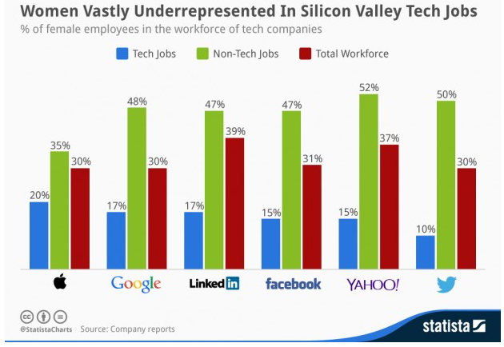
FACTS

Slide 6
FACTS
“ Women bring a unique perspective to different economic and social challenges by the way our minds work,” says Barbara Birungi, founder of Women in Technology Uganda.
“Having diversity in any environment will yield far better results than in a different situation. If we have more women tinkering, we will see an increase in the number of innovations solving societal challenges that have stood for decades because these challenges mainly affect women” Ms. Birungi said

Slide 7
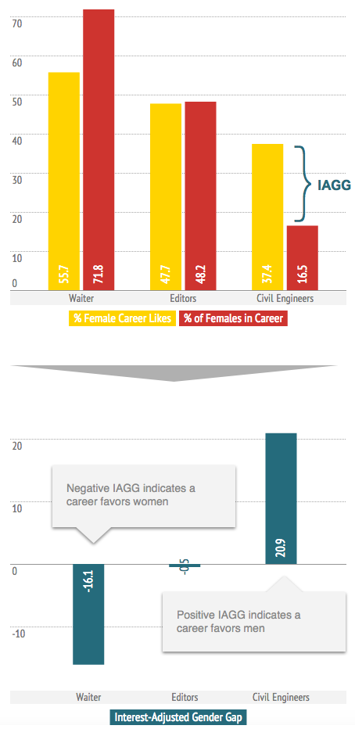
Facts

Slide 8
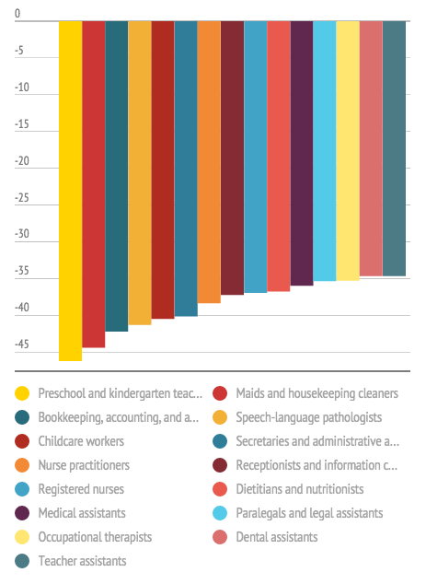
Facts

Slide 9
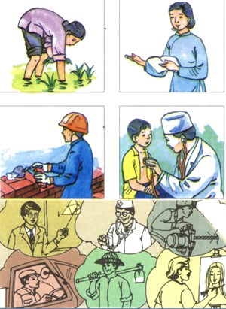
REASONS
Tradition

Slide 10
Reason
In many offices or any other working place, the old ideology that women are weak and cannot be equal to men has been making the rules.
Traditional role for women in society: Housewife.

Slide 11

REASONS
Conception

Slide 12
Solution
Promote & Educate
Change conception
Environment
Prioritize women attendants/employees.
Promotes equality

Slide 13

REASONS (Continued)
Job Characteristic

Slide 14
Reason
Long working hour. Requires good endurance.
Have to adapt to new ideas/technologies frequently. Requires good mentality.

Slide 15
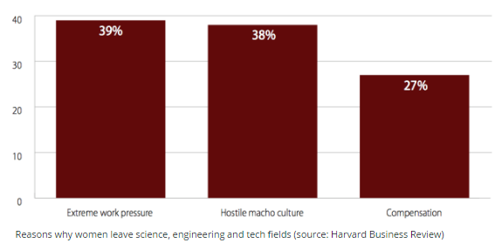
REASONS (Continued)

Slide 16
REASONS (Continued)
Trait

Slide 17
Solution
Company
De-stress. Create bonds between women and companies.
Encourage flexible working schedules.
Women
Exercise to improve physical condition.

Slide 18
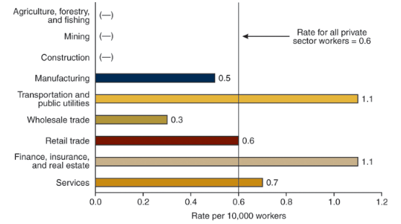
REASONS (Continued)
According to the National Institute for Occupational Health and Safety (NIOSH) the rate of anxiety, stress and neurotic disorders among American workers was 0.6 per 10,000 full time workers as of 2001. Three industries reported incidents above this mean. Those industries included finance, insurance and real estate, transportation, public utilities and services

Slide 19

Solution
Improved working conditions:
Employers must ensure that there are adequate bathrooms, toilets at the workplace. Encourage the flexible working schedules to suit the aspirations of women workers

Slide 20

Solution
Health care conditions:
During periodical health examination, the obstetric and gynecological specialist shall be examined.
During the menstrual period, allowed to rest 30 minutes per day, minimum 03 days per month with full paid.
Female laborers who are raising children under 12 months of age shall be entitled to 60 minutes of rest per day to breastfeed, squeeze(??? milk ???), store milk and rest with full paid.

Slide 21

solution

Slide 22
solution

Slide 23

Solution
The right to unilaterally terminate or postpone the performance of the laSupported by the employer in the construction of kindergartens or part of the cost of sending children to kindergartenbor contract, if certified by a competent medical examination and treatment establishment on that if continued work will adversely affect the unborn child.
Supported by the employer in the construction of kindergartens or part of the cost of sending children to kindergarten

Slide 24

solution

Slide 25

solution

Slide 26

Solution

Slide 27
reference
http://thoughtcatalog.com/lorenzo-jensen-iii/2015/06/13-real-differences-between-male-and-female-brains/
https://www.sokanu.com/blog/gender-and-career-choice/
https://engineering-jobs.theiet.org/article/why-women-don-t-want-to-work-in-engineering/
http://kenh14.vn/kham-pha/su-khac-nhau-thu-vi-trong-nao-bo-dan-ong-va-phu-nu-201429223952303.chn
http://www.apa.org/news/press/releases/stress/2010/gender-stress.aspx

