Slide 1

Real time clock
manual Investigation
GROUP 2
MARCH 2017

Slide 2
Table of contents
Introduction.
Register & I/O
RTC Operation
Modes.
Flow and registers of time setting.
Background of Time-Error Adjustment and Alarm function.
What we have learned and how we did it.

Slide 3

INTRODUCTION
Rtc module
FUNCTIONALITY

Slide 4
RTC MODULE
RTC stands for Real Time Clock.
Managing tasks related to controlling, observing and setting TIME.
Combine or join with other modules for more complicated system.

Slide 5
FUNCTIONALITY
The RTC is capable of counting 100 years from year 00 to year 99. The order of hundreds and thousands are assumed as 20 and the leap years from the year 2000 to 2099 are automatically corrected.
The source to drive counting of the time counters is selectable as the sub-clock or a main clock.

Slide 6
FUNCTIONALITY
With the source for counting pre-scaled to produce a 128-Hz clock signal as the base clock, cycles of this signal are counted in year, month, date, day of the week, a.m. or p.m. (in 12-hour mode), hour, minute, second, and 1/128 second units.

Slide 7
Register & I/O
RTC BLOCK DIAGRAM
Rtc registers

Slide 8
Internal peripheral bus 2
Bus interface
1-Hz output
RCR2
Each function
RTCOUT
Pre-scaler
128 Hz
Time counter
Alarm function
XCIN
Sub-clock
32.768 kHz
XCOUT
Interrupt control
ALM
PRD
EXTAL
Main-clock
Up to 16 MHz
CUP
XTAL
Time capture control unit
Time capture event input pins
RTCTC0
RTCTC1
RTCTC2
INPUT
RTC Block Diagram
OUTPUT

Slide 9
Rtc register
RSECCNT: Second counter
RMINCNT: Minute counter
RHRCNT: Hour counter
RWKCNT: Day-of-week counter
RDAYCNT: Date counter
RMONCNT: Month counter
RYRCNT: Year counter
R64CNT: 64-Hz counter
RFRH/L: Frequency register
RSECAR: Second alarm register
RMINAR: Minute alarm register
RHRAR: Hour alarm register
RWKAR: Day-of-week alarm register
RDAYAR: Date alarm register
RMONAR: Month alarm register
RYRAR: Year alarm register
RYRAREN: Year alarm enable register
RTCCR0/1/2: Time capture control register 0/1/2
RSECCP0/1/2: Second capture register 0/1/2
RMINCP0/1/2: Minute capture register 0/1/2
RHRCP0/1/2: Hour capture register 0/1/2
RDAYCP0/1/2: Date capture register 0/1/2
RMONCP0/1/2: Month capture register 0/1/2
RCR1: RTC control register 1
RCR2: RTC control register 2
RCR3: RTC control register 3
RCR4: RTC control register 4
RADJ: Time error adjustment register

Slide 10
RTC Operation

Slide 11
Power On
Set the clock
Setting of clock signal distribution and reset by RTC software.
Set the time
Time setting in the clock counter and initial
setting of the time-error adjustment register
Set the alarm
Set the interrupt
Initial setting of the alarm register
Initial setting of the interrupt control register
Set the time capture control register
Initial setting of the time capture control register

Slide 12
MODES

Slide 13
modes
Low power
Software standby mode
Deep software standby mode
Battery backup
Hour mode

Slide 14
Time setting
TIME SETTING Flow CHART
REGISTERS FOR TIME SETTING

Slide 15
Time setting Flow CHART
RCR2.START = 0
No
RCR2.START = 0 ?
Yes
START_TIME_SETTING
RCR2.START = 0
While( RCR2.START != 0 )
;
RCR2.RESET = 1
Set_Subclock_Oscillator
Set_Time
if ( RCR4.RCKSEL )
Set_Time_Error_Adjment
RCR2.START = 1
while( RCR2.START != 1 )
;
END_TIME_SETTING
RCR2.RESET = 1
Set RCR3 (Sub-clock oscillator)
Set RSECCNT, RMINCNT, RHRCNT, RWKCNT, RDAYCNT, RMONCNT,RYRCNT (Counter Registers)
RCR4.RCKSEL = 0 ?
No (main-clock)
Yes (sub-clock)
Set RADJ (Time Error Adjustment)
RCR2.START = 1
RCR2.START = 1 ?
No
Yes

Slide 16
Registers FOR TIME SETTING
Control Registers
RTC Control Register 2 (RCR2)
RTC Control Register 3 (RCR3)
RTC Control Register 4 (RCR4)
Time Error Adjustment Register (RADJ)
Counter Registers
R64CNT
RSECCNT, RMINCNT, RHRCNT, RHRCNT
RWKCNT, RDAYCNT, RMONCNT, RYRCNT

Slide 17
ALARM FUNCTION
Flow chart alarm function
PROCEDURE FOR DISABLING ALARM INTERRUPT

Slide 18


Flow chart alarm function
RCR2[0]=1?
IR92.IR = 1?
ALM:Alarm interrupt (IR92.IR)
PRD:Periodic interrupt (IR93.IR)
CUP:Carry interrupt (IR62.IR)
Clock running
IER0B.IEN
7 6 5 4 3 2 1 0
CLR1 IER0B.IEN4
SET1 IER0B.IEN4
ENABLE ALARM INTERRUPT REQUEST(ICU)
 |  |  | 0
SET ALARM TIME…
CLR1 IR92.IR
ALWAYS CLEAR WHEN FLAG’VE BEEN SET WHILE ALARM TIME BEING SET PREVENT MATCHING CLOCK
SET1 RCR1.AIE
MOV RCR1.PES , #8H
WAIT FOR PERIODIC INTERRUPT TWICE 64Hz( COMPLETE INTERRUPT)
1 | 0 | 0 | 0 | - | - | - | 1
EN RTC ALM INT REQUEST

Slide 19
ALARM FUNCTION
PROCEDURE FOR DISABLING ALARM INTERRUPT

Slide 20
PROCEDURE FOR DISABLING ALARM INTERRUPT
SET1 RCR1.AIE
ENABLE ALARM INTERRPUT
CLR1 IER0B.IEN4
DISABLE THE ALARM INTERUPT REQUEST OF THE ICU
CLR1 RCR1.AIE
DISABLE THE ALARM INTERUPT REQUEST OF THE RTC
CLR1 RCR1.AIE?
Wait for the AIE bit in the RCR1 register to be cleared to 0
CLR1 IR92.IR
Until the AIE bit in the RCR1 register is cleared to 0,
clear the alarm flag with consideration that the
IR92.IR flag of the ICU is set

Slide 21
Background of Time-Error Adjustment function
Select automatic adjustment
Adjustment by software

Slide 22
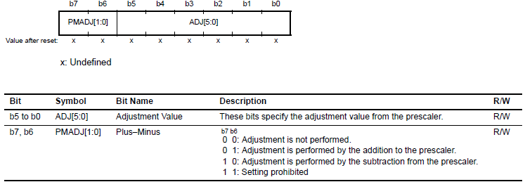
Select automatic adjustment (SET1 RCR2.AADJE )
every time the adjustment period selected by the AADJP bit in RCR2 elapses
Using :
RCR2.AADJP (0/1): Adjustment every minute or every 10 minute.
RADJ.PMADJ
RADJ. ADJ

Slide 23
Select automatic adjustment (SET1 RCR2.AADJE )
CLR1 RCR2.AADJP (adjustment every minute)
MOV RADJ.PMADJ , #2H (subtraction RADJ.PMADJ[1:0])
MOV RADJ. ADJ , #3CH ( ADD 30 SECOND TO RADJ. ADJ[5:0] )
SET1 RCR2.AADJP (adjustment every 10 seconds)
MOV RADJ.PMADJ , #1H (addition)
MOV RADJ.ADJ , #14H

Slide 24
Adjustment by software(CLR1 RCR2.AADJE )
at the time of execution of an instruction for writing to the RADJ register.
Using :
RADJ.PMADJ
RADJ. ADJ

Slide 25
Adjustment by software(CLR1 RCR2.AADJE )
RADJ.PMADJ[1:0] = 10b (subtraction)
RADJ.ADJ[5:0] = 1 (01h)
This is written to the RADJ register once per 1-second interrupt.

Slide 26
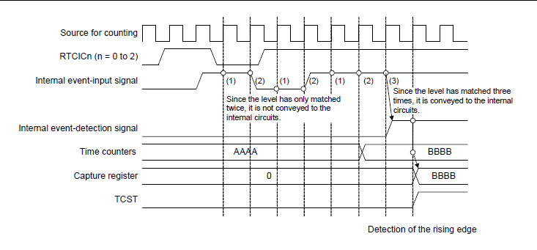
Capturing the Time ( Apendix)
storing the month, date, hour, minute and second by detecting an edge of a signal on a time-capture event-input pin.
Also using Noise filter for more exactly!

Slide 27
HOW TO INVESTIGATE HW MANUAL QUICKLY AND EFFICIENTLY
We must know the target what we looking for ( what module: RTC or A&D, …).
Find the content related to target that we looking for on Bookmarks.
Overview that we looking for module include: Specification and Block Diagram to understand operation of module.
Research each registers and interrupts of module to code for module.

