Slide 1
CALBENCH
TORQUE CALIBRATION CERTIFICATES, LABELS & TRACEABILITY
A working prototype covering data entry, calibration maths, BS EN ISO 6789 certificates, Code 128 barcode labels, and a searchable SQLite store — built to demonstrate software engineering ability alongside torque and force metrology experience.
PROTOTYPE · DEMONSTRATION DATA ONLY

Slide 2
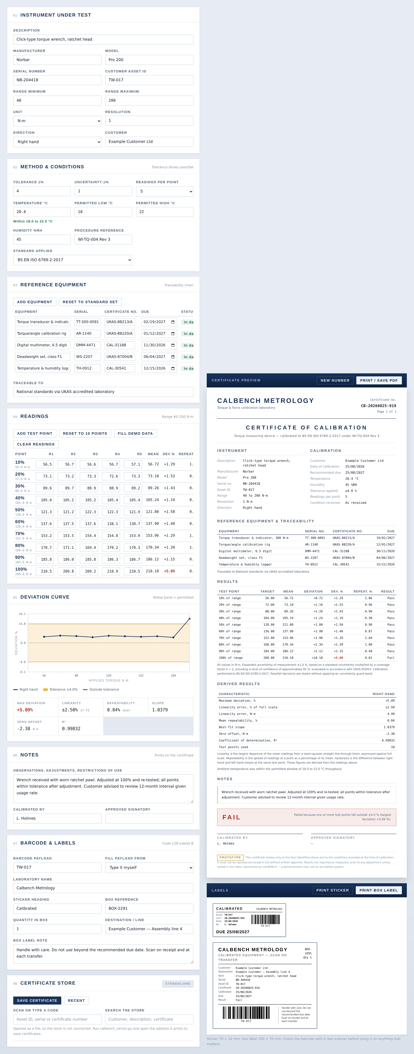
OVERVIEW
One tool, three real jobs
Most calibration labs run this as three separate, disconnected processes: a spreadsheet for readings, a Word template for the certificate, and a label printer's own software. CALBENCH treats it as one flow — enter readings once, and the calculation, the certificate and the labels all stay in sync.
01
Capture
Ten-point readings, both directions, live pass/fail against a configurable tolerance.
02
Certify
A BS EN ISO 6789 certificate that calculates linearity, repeatability and hysteresis from the readings — not typed in.
03
Trace
A barcode that follows the instrument through production, and a database that answers “what did this standard underwrite?”
CALBENCH — Demonstration Project
2

Slide 3
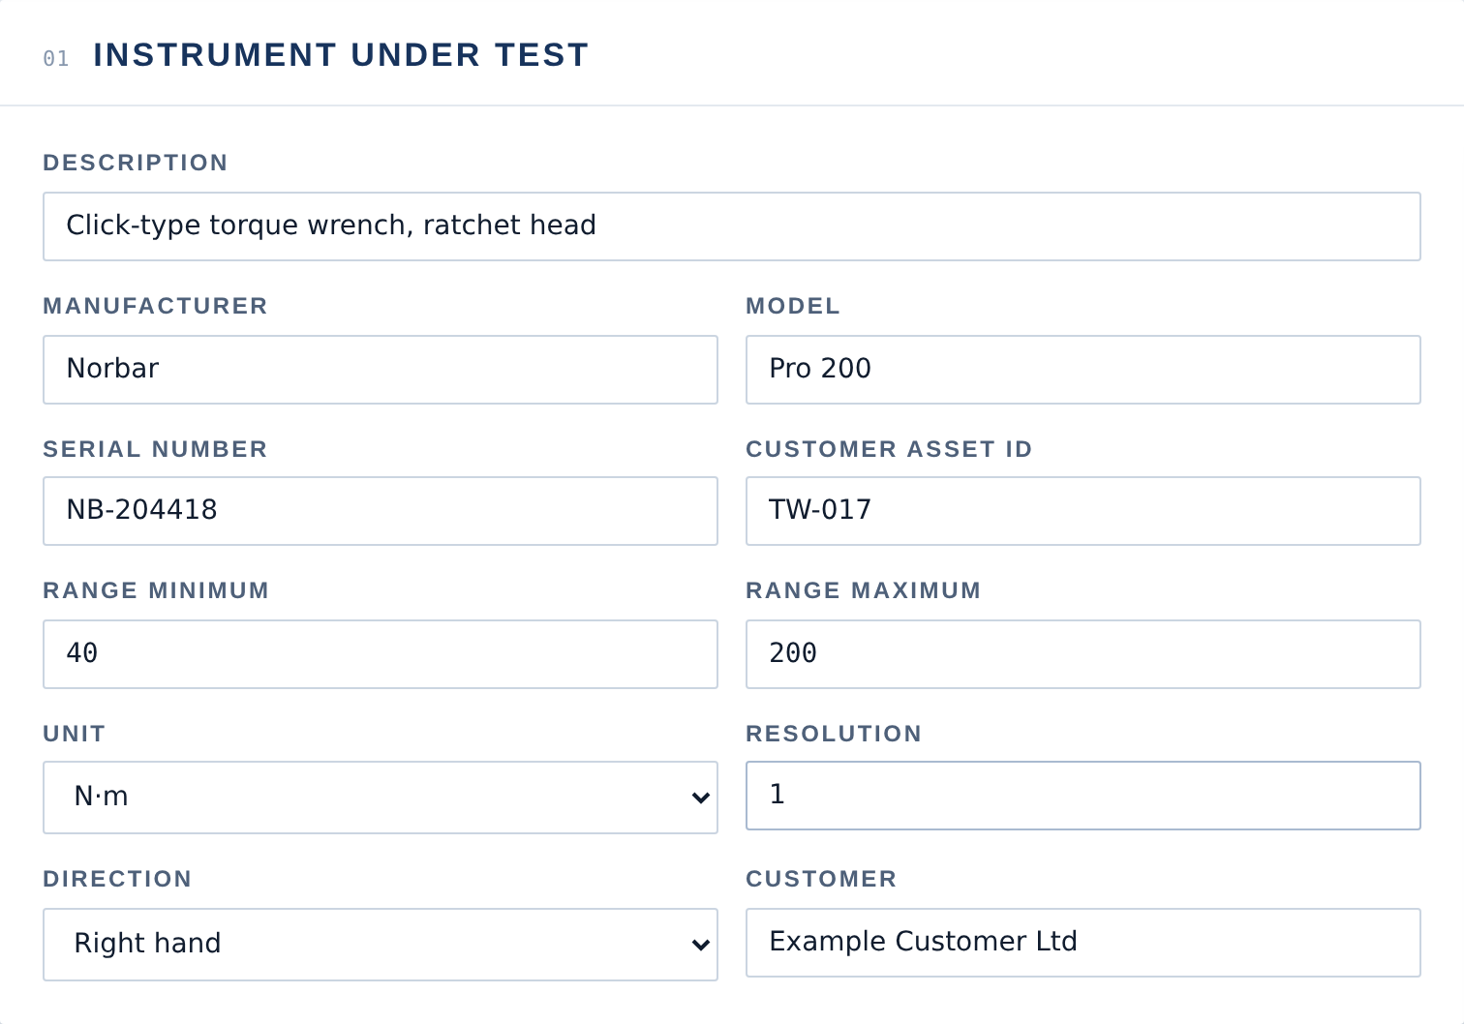
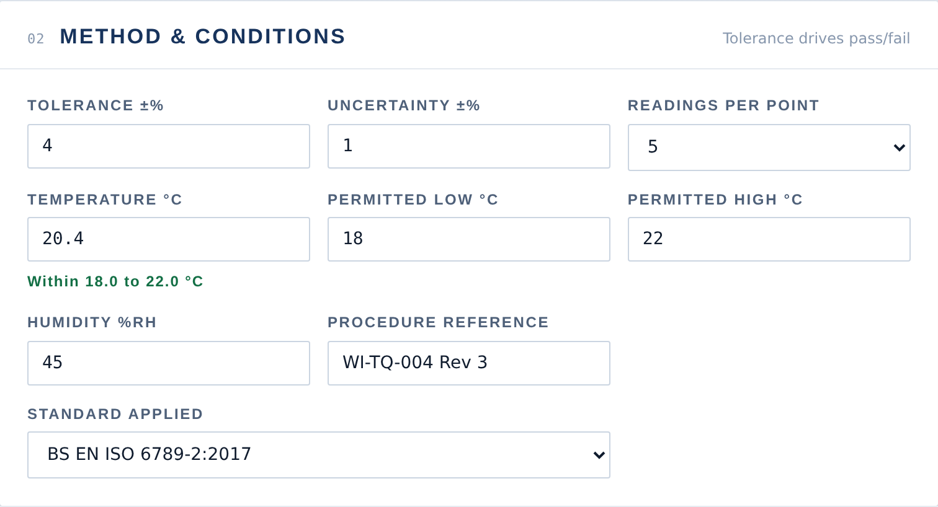
SECTION 01 · 02
Instrument, method & conditions
Every field a UKAS-style certificate needs: the instrument under test, the procedure it's calibrated to, and the conditions it was calibrated in. Ambient temperature is checked live against a permitted window — outside it, the certificate fails automatically, because the method wasn't followed regardless of how the readings looked.
CALBENCH — Demonstration Project
3

Slide 4
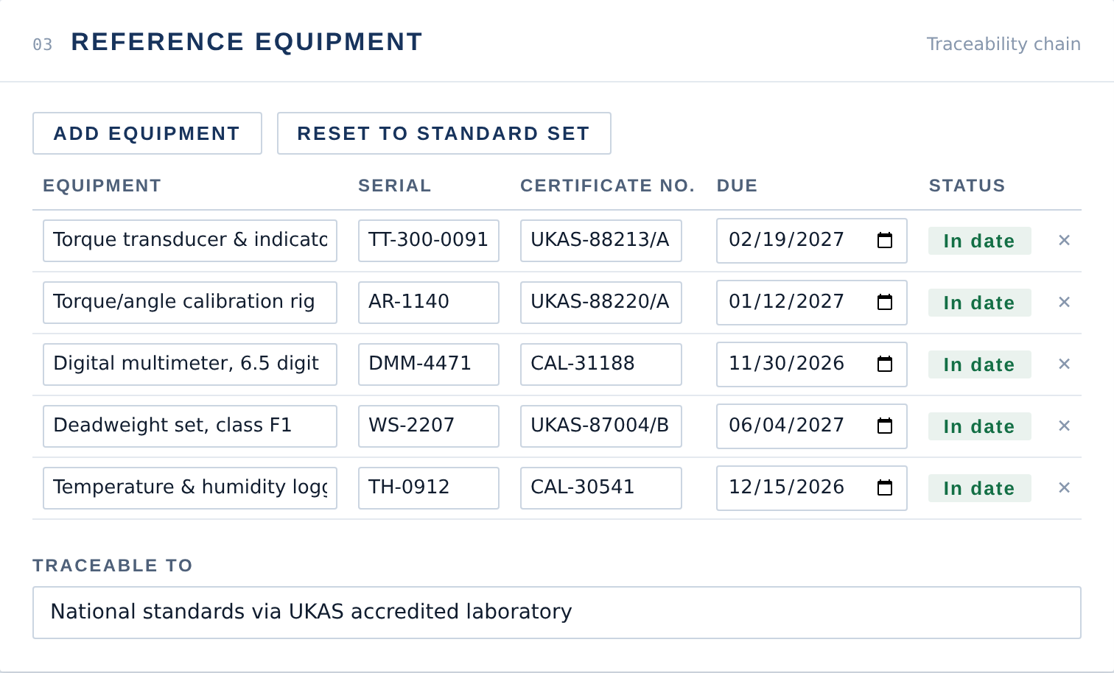
SECTION 03
The whole traceability chain, not one line
A calibration is only as good as the standards behind it. Most certificates name one reference item; a real lab uses several — a transducer, a rig, a multimeter, a weight set. Each has its own serial and certificate, and each is checked here against the calibration date: an expired standard is flagged automatically, because a standard out of calibration can't underwrite the certificate it appears on.
CALBENCH — Demonstration Project
4

Slide 5
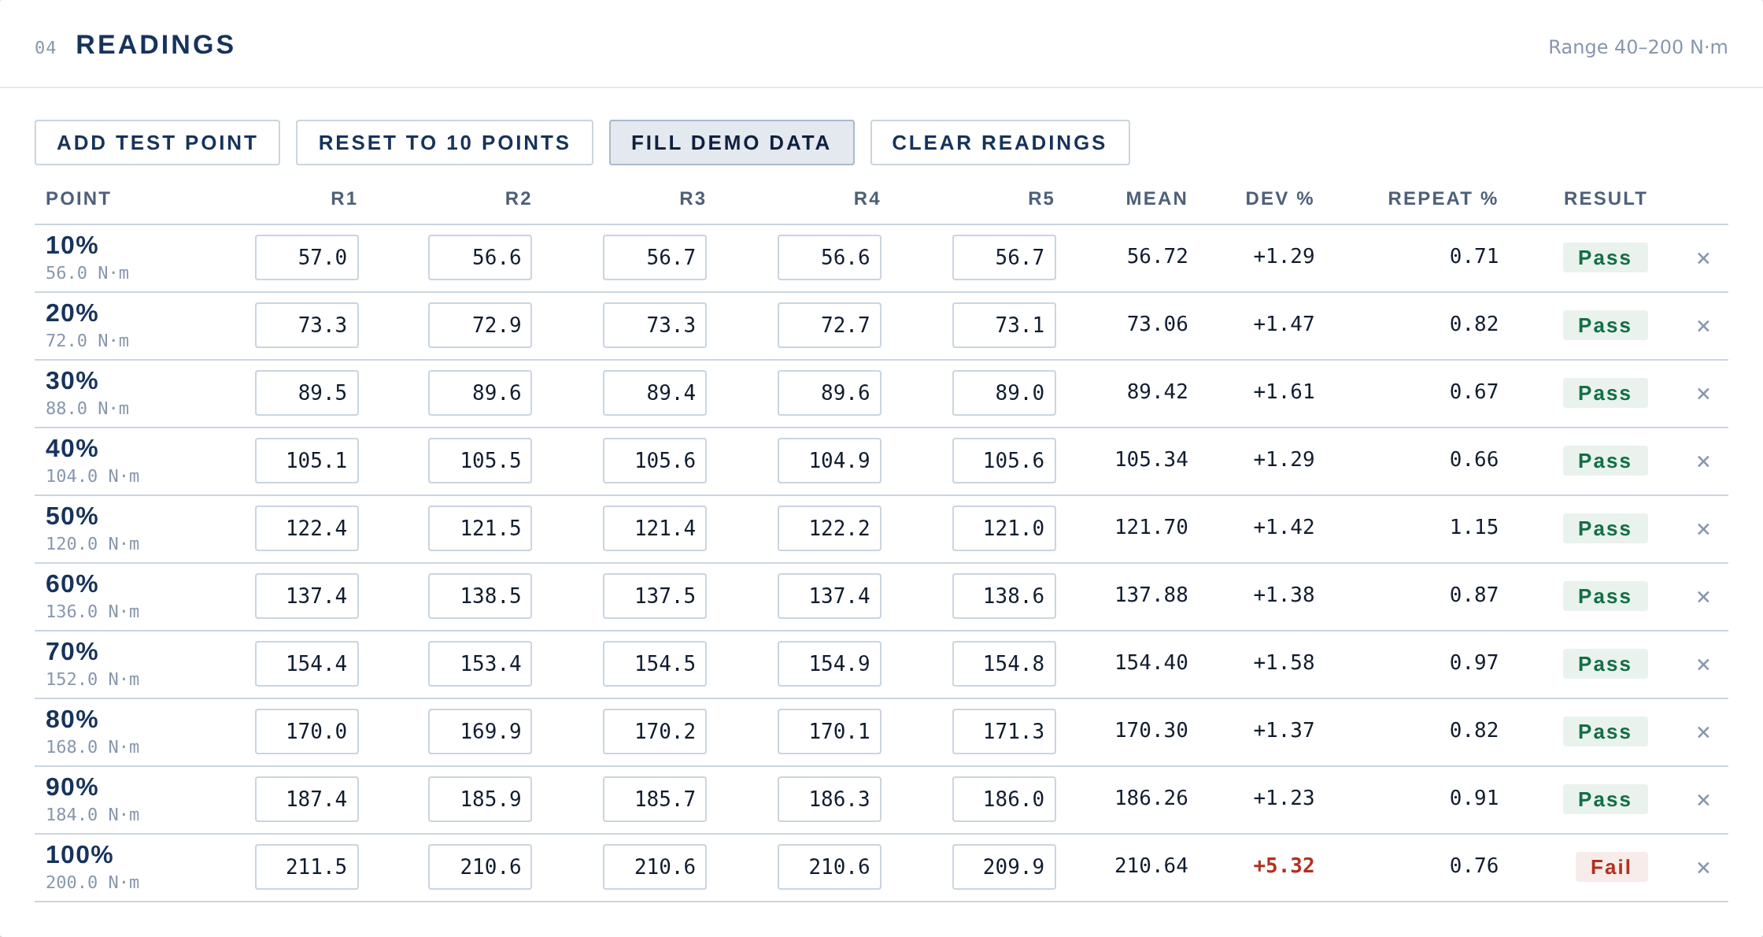
SECTION 04
Ten test points, both directions
Right hand, left hand, or both — with both selected, every point gets its own readings, mean and verdict per direction, so a wrench that's fine one way and drifting the other doesn't get averaged into a false pass.
CALBENCH — Demonstration Project
5

Slide 6
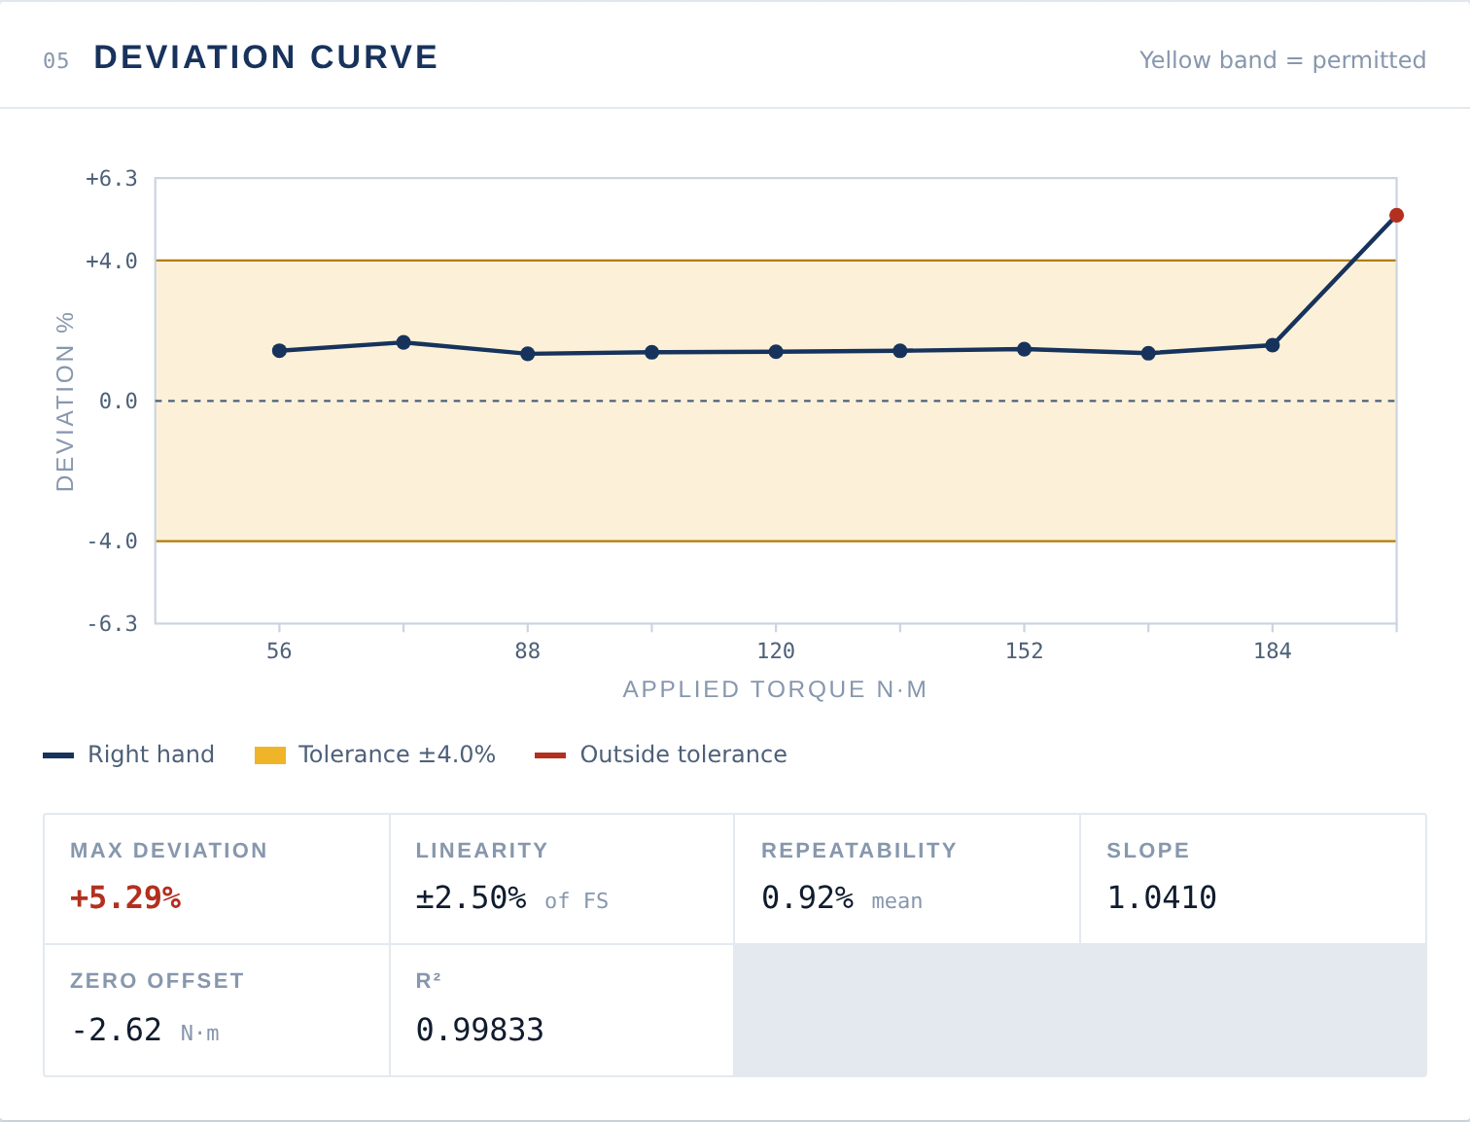
SECTION 05
The reading that tells the story in one glance
Linearity, repeatability, hysteresis, best-fit slope, R² — every figure here is calculated from the raw readings, never typed in. The chart plots deviation against applied torque with the tolerance band shaded behind it; the point that has drifted past 100% of range is picked out in red the moment it happens.
CALBENCH — Demonstration Project
6

Slide 7
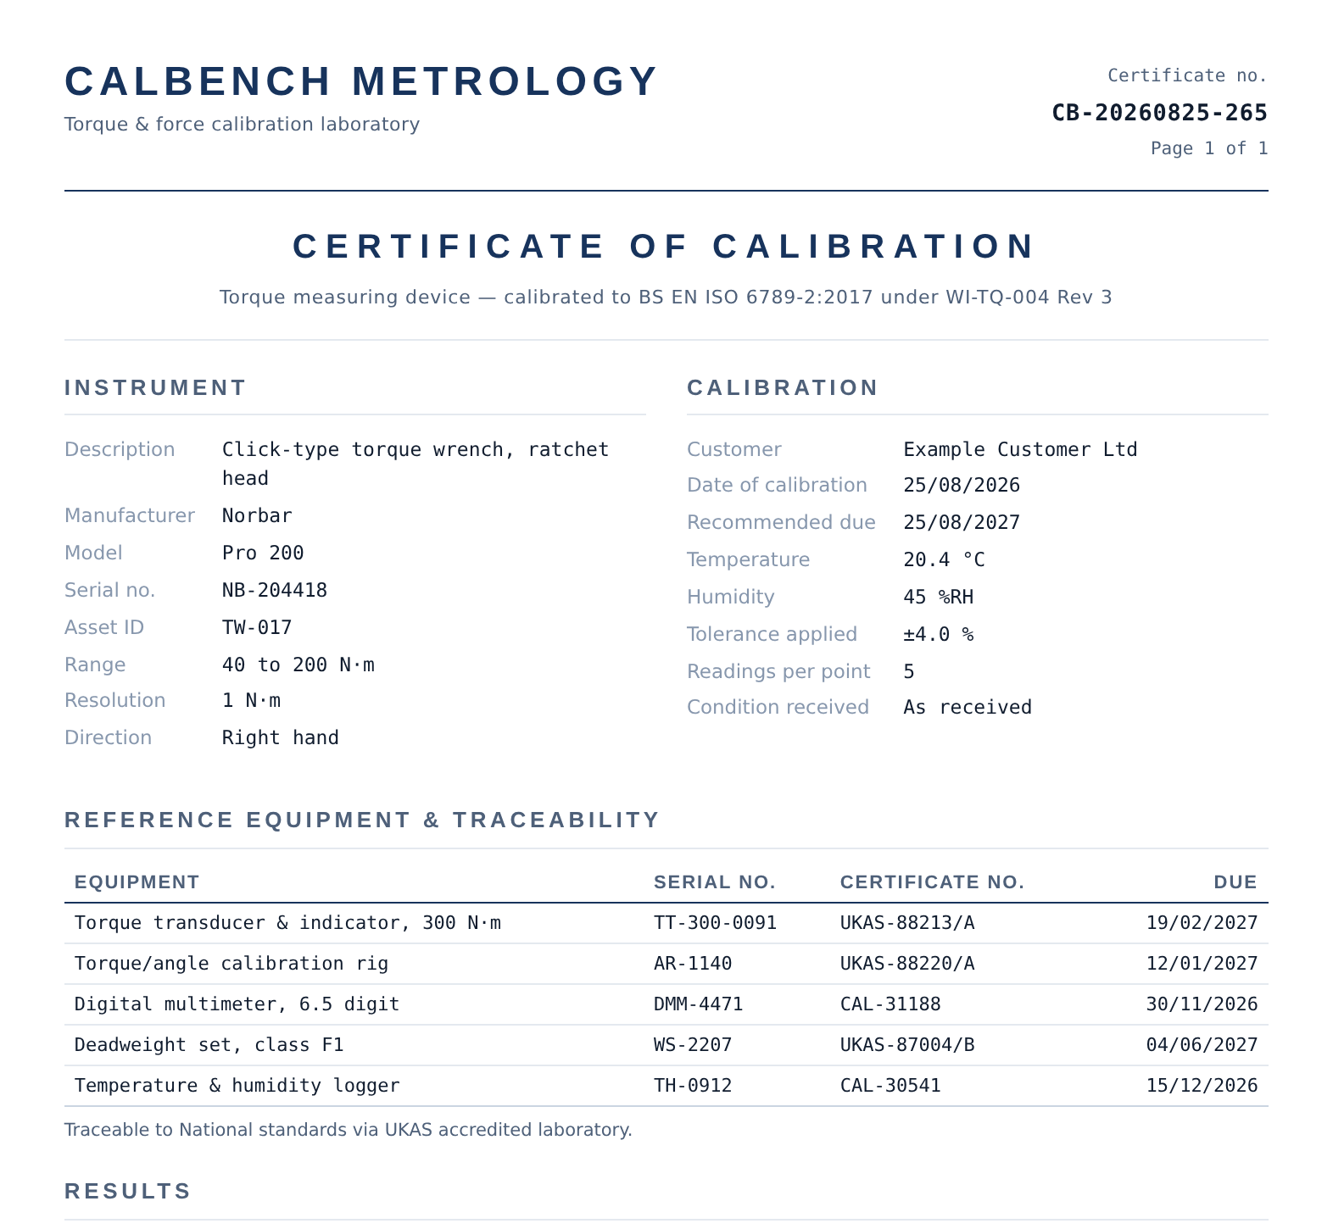
OUTPUT
A certificate that reads as a real document
Masthead, instrument, calibration conditions, the full reference-equipment table, and results — laid out to BS EN ISO 6789, with an uncertainty statement referencing UKAS M3003. Prints straight to A4 with the interface stripped out.
Linearity, repeatability & hysteresis, calculated and shown on the certificate itself
Reference equipment table with an expired-standard warning built in
Environmental failure stated as its own reason, distinct from a tolerance failure
CALBENCH — Demonstration Project
7

Slide 8
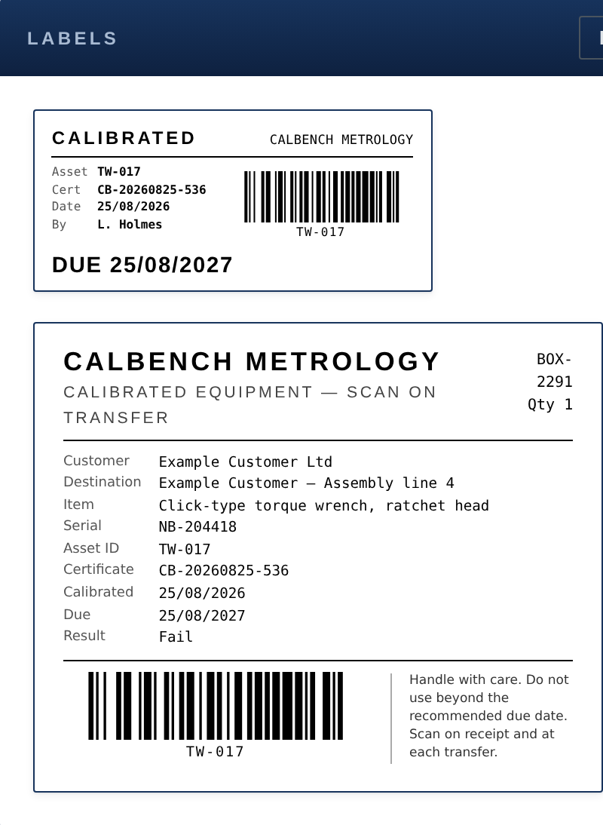
OUTPUT
One barcode, from goods-in to dispatch
Code 128 generated in the page itself — no library, no CDN, no internet connection required. The same payload prints on a 70×32mm instrument sticker and a 100×70mm box label, so one scan follows the item through the whole process.
CALBENCH — Demonstration Project
8

Slide 9
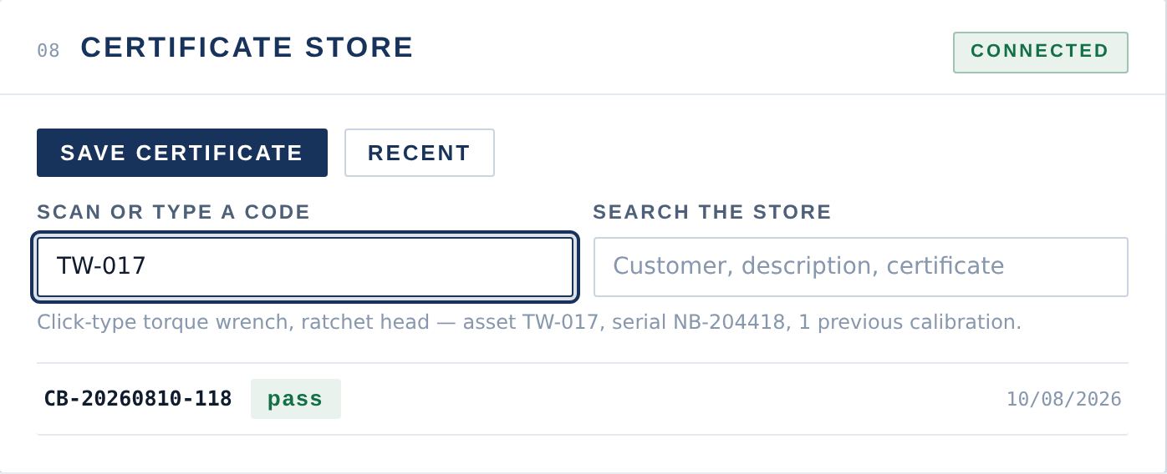
SECTION 08
A scan answers the question paper can't
Every certificate and every reference item lives in SQLite. Scan a code — most scanners just type it and press Enter, so this needs no driver — and it returns the instrument plus its full calibration history. Search reaches into the reference-equipment table too: enter a standard's serial number and get back every certificate it underwrote, which is exactly the query you need when a standard turns out to be faulty.
CALBENCH — Demonstration Project
9

Slide 10
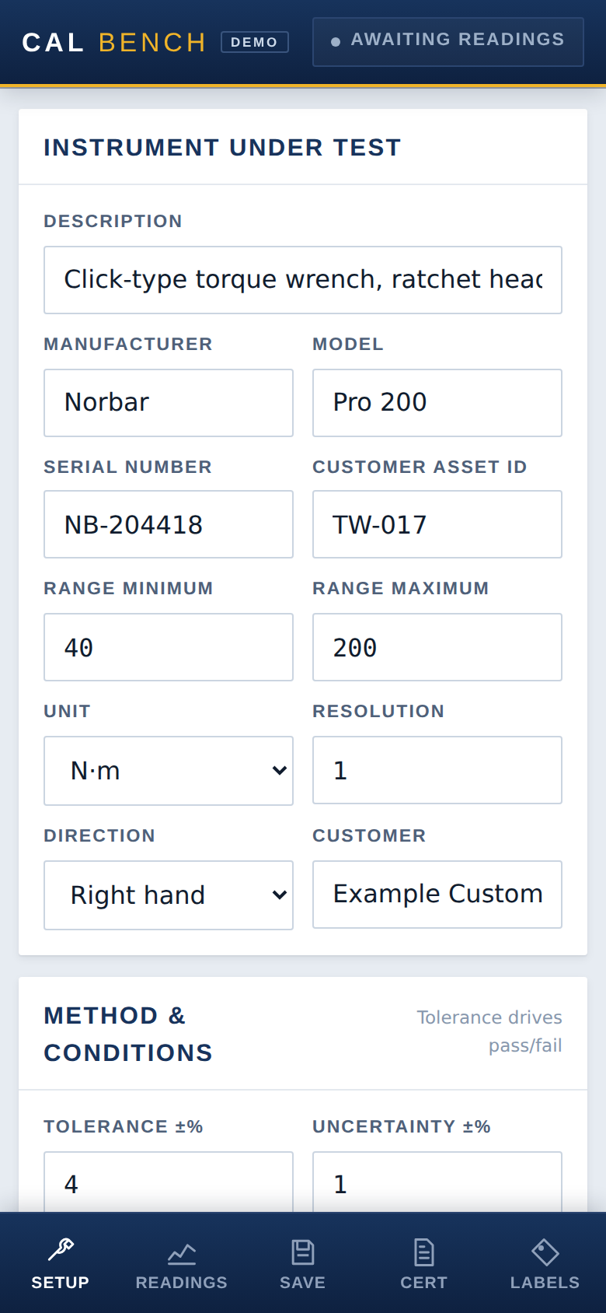
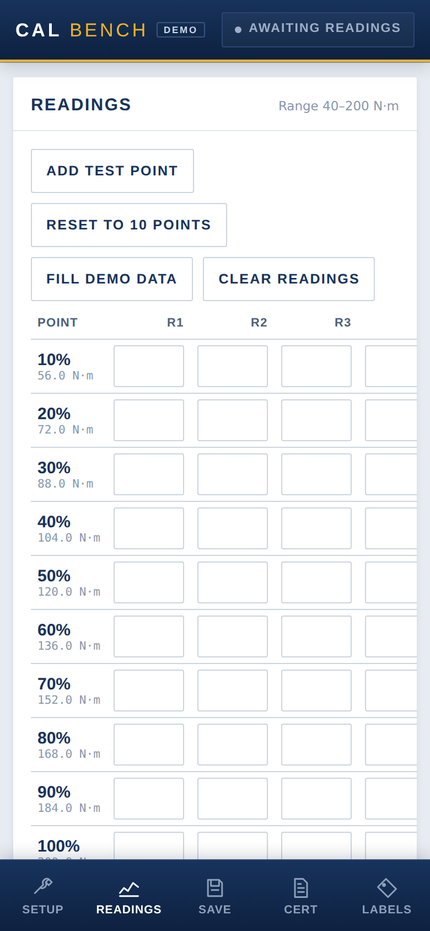
ALSO
The same tool, built again for the workbench
A separate build for the phone — not the desktop layout squeezed down, but a genuine mobile shell: a bottom tab bar, one full-height view at a time, 44px touch targets, and 16px inputs so Safari doesn't zoom on focus. Every calculation and every API call is the exact same code as the desktop build; only the shell differs. A certificate saved from a phone and one saved from a laptop are identical in the database.
CALBENCH — Demonstration Project
10

Slide 11
BUILT WITH
Deliberately ordinary tools, deliberately used well
FRONT END
BACK END
ENGINEERING JUDGEMENT
Plain HTML, CSS and JavaScript — no build step, no framework
Code 128 barcode encoder written from scratch
SVG deviation chart with a least-squares linearity fit
Two builds sharing one application core: desktop and a native-feeling mobile shell
Python standard library only — zero pip installs, runs on a locked-down PC
SQLite with a proper schema: instruments, certificates, readings, equipment
Server re-derives every verdict from stored readings — the client is never trusted
A small HTTP API: search, scan-lookup, save, load
Every pass/fail traced to a specific standard — tolerance, temperature, equipment expiry
Reverse traceability: find every certificate a given standard underwrote
Verified with synthetic data — a perfectly linear instrument returns R² = 1.0 exactly
Built iteratively against real feedback on what a working lab actually needs

