Slide 1
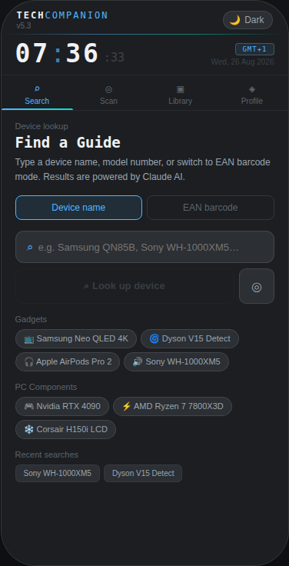
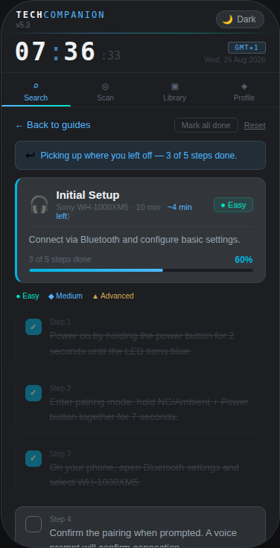
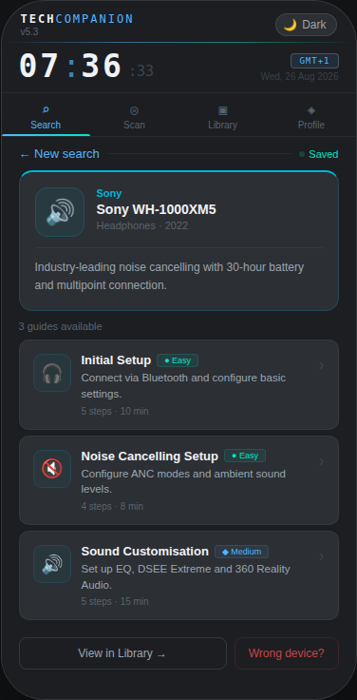
TECH
COMPANION
App UI Walkthrough
v5.3 · Every screen explained
16 slides · Real app screenshots · May 2026
TechCompanion · UI Walkthrough · v5.3

Slide 2
How TechCompanion Works — The Complete Flow
⌕
🤖
📋
☑
✓
Search
or Scan
Claude AI
Generates
Guides
Returned
Walkthrough
Steps
Task
Complete
Type a name, model, EAN barcode, or scan with camera
Claude Haiku AI identifies the device and writes guides
3 guides returned: setup, config, maintenance
Tick off steps one by one with live progress tracking
Guide saved to library — revisit any time offline
Real-time AI · Claude Haiku
Streaming (live % counter)
Ghost-result validation
Auto-saves to Library
Works offline after save

Slide 3
Screen 1 — Search · The Starting Point
1
TECHCOMPANION Header + Live Clock
Orbitron monospace brand font. Clock updates every second showing hours, minutes, seconds, date and timezone. Theme toggle top right.
2
Mode Toggle — Device name / EAN barcode
Switches the input method. 'Device name' is full text search. 'EAN barcode' opens numeric input with real-time GS1 checksum validation. Switching clears input and errors.
3
Search Input + Look up device button
Type any device name or model number. The blue button only activates when text is present. The ◎ icon opens the Scanner tab.
4
Example Chips — Gadgets and PC Components
Quick-launch buttons grouped by category. Tapping fires a real Claude AI lookup immediately without typing anything.
5
Recent Searches
Last 8 successful lookups stored locally. Tap any chip to re-run the search instantly.

Slide 4
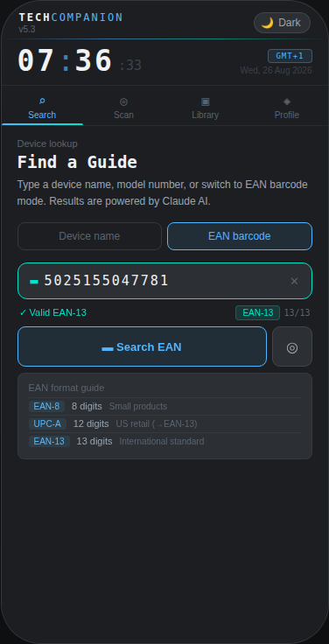
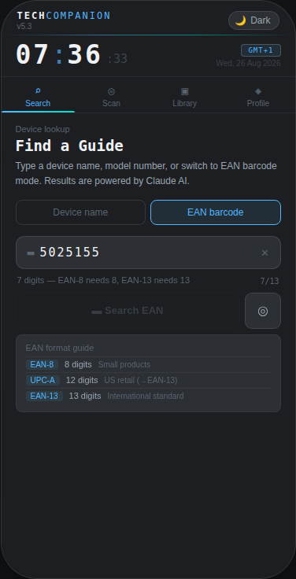
Screen 2 — EAN Barcode Mode · Type or Paste a Barcode Number
How EAN Barcode Mode works
1
Real-time GS1 checksum validation
Every keystroke runs the GS1 check digit algorithm. Invalid barcodes are flagged instantly — before a single API call is made.
2
Format detection + digit counter
Automatically identifies EAN-8 (8 digits), UPC-A (12 digits), or EAN-13 (13 digits). Counter adjusts: 8/8, 12/12, or 13/13.
3
Brand hint pill
When the first 6–7 digits match a GS1 company prefix (e.g. Dyson, Apple, Sony), a pill appears naming the manufacturer before the search fires.
4
Search button gated on valid
The Search EAN button stays disabled until parseEANInput returns 'valid'. Impossible to send a malformed barcode to the API.
Formats: EAN-8 · UPC-A (auto-converted to EAN-13) · EAN-13
✓ Valid EAN-13 — Dyson brand confirmed
Partial — user still typing

Slide 5
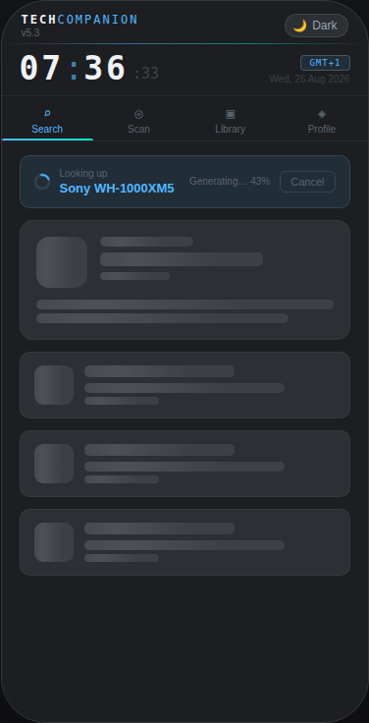
Screen 3 — Loading · Live AI Generation in Progress
1
Device name banner + Cancel
Shows the device being looked up in accent blue with a spinning indicator. A Cancel button aborts the stream at any point — the app returns cleanly to the search state.
2
Live Generating… % counter
As Claude Haiku streams tokens back via SSE, the status message updates in real time. Users see 'Generating… 43%' counting up — not a frozen spinner.
3
Skeleton shimmer placeholders
Product card and three guide card outlines pulse with a shimmer animation. Sets user expectation of what's coming — search result, not a generic loading screen.
4
Reassurance at 6 seconds
If the response takes longer than 6 seconds (slow network, long product name), the message changes to 'Almost there…'. Fires well before users abandon.
Claude Haiku: ~200 tok/s · Typical response: 2–4s · max_tokens: 1024 · Streaming via Anthropic SSE API

Slide 6
Screen 4 — Results · Product Card and Guides
1
Product card
Brand, name, model number (monospace), category and year. Colour-coded top border. Pulsing green 'Saved' dot confirms auto-save to Library.
2
Guide cards
Up to 5 guides with: emoji icon, title, difficulty badge (● Easy ◆ Medium ▲ Advanced), one-line summary, and step count + duration. Tap any to open.
3
Exact match badge
Only shows when confidence === 'exact' AND product.model is present. Claude omits model numbers when guessing — so this badge is a proxy for verified knowledge.
4
Wrong device?
Reports an incorrect result. Removes the library entry, clears product state, and returns to Search pre-filled with the original query for instant retry.
5
View in Library →
Navigates to the Library tab. The result persists — switching tabs and coming back keeps the product loaded.

Slide 7
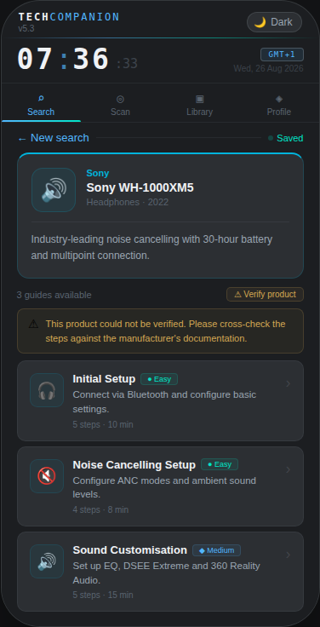
Screen 4b — Results · Amber Warning When AI Confidence Is Low
Ghost-Result Prevention — G-04 and G-05
When the AI cannot verify a product with certainty, the app signals this honestly rather than showing false confidence.
1
Missing model number (G-04)
If Claude guesses rather than recalls, it typically omits product.model. The badge gates on model being present — absent model means amber ⚠ badge.
2
GS1 brand mismatch (G-05)
For barcodes: if the GS1 prefix says 'Dyson' but Claude returns brand:'Sony', confidence is downgraded to 'unknown' automatically.
⚠ Banner: "This product could not be verified. Please cross-check steps against the manufacturer's documentation."
Guides are still shown — the user gets information with an honest signal about its reliability. The guides are not suppressed.

Slide 8
Screen 5 — Walkthrough · Step-by-Step with Live Progress
1
Continuation banner
Returning to a partially done guide shows: 'Picking up where you left off — 3 of 5 done.' Progress saved in localStorage per product/guide pair.
2
Guide header card
Title, product, total duration, estimated time remaining, difficulty badge, live progress bar, and percentage. All update on every step tap without a page refresh.
3
Difficulty legend
● Easy ◆ Medium ▲ Advanced shown as a colour-coded reference row below the header card. Consistent across all guides.
4
Step items — tap to toggle
Tap any step to tick or untick. Done steps: filled checkbox, strikethrough text, 45% opacity. Undone: open checkbox, full opacity. Haptic feedback on native.
5
Mark all done + Reset buttons
Mark all done completes every step in one tap. Reset clears all ticks and localStorage progress for this guide.

Slide 9
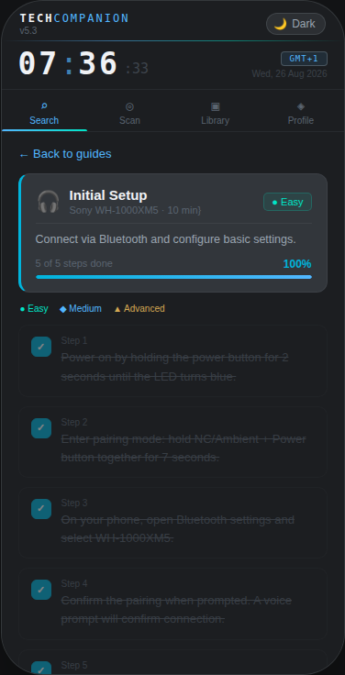
Screen 5b — Walkthrough Complete · Celebration Card
The Completion Experience
When every step is ticked, the step list slides out and a completion card fades in.
1
🎉 Celebration card
Teal-tinted full-width card with 🎉 emoji, 'All done!' headline, and the guide title. Animation: fadeIn 0.4s ease.
2
← Back button
Returns to the results screen showing all available guides for the same device. The user can immediately start another guide.
3
Start again button
Resets all step checkboxes and clears localStorage progress for this guide. Lets the user walk through it a second time.
Progress is keyed by: product.name + guide.title. Each unique guide on each unique device has independent progress — opening a different guide starts fresh.

Slide 10
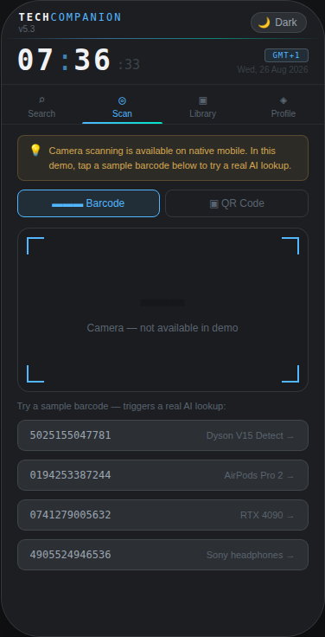
Screen 6 — Scanner · Camera Scanning + Sample Barcodes
1
Demo notice banner
Explains camera requires the native app. Amber tone — informational, not an error. Tells the user exactly what to do next.
2
Barcode / QR mode tabs
Switches the expected scan format. Barcode active by default. QR Code mode shows an informational message directing to the native app.
3
Viewfinder with corner guides
L-shaped corner brackets mark the scan zone. On native Android/iOS this is a live camera feed via Capacitor ML Kit supporting EAN, UPC, QR, Data Matrix.
4
Sample barcodes — real lookups
Five hardcoded barcodes trigger actual Claude AI lookups when tapped, complete with product name hints. Demonstrates the full barcode-to-guide flow without a camera.
Native: Capacitor ML Kit · EAN-13, UPC-A, EAN-8, QR Code, Data Matrix · Haptic feedback on successful scan

Slide 11
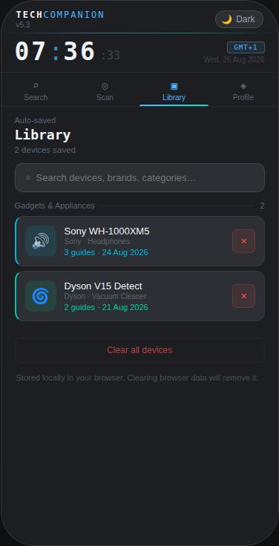
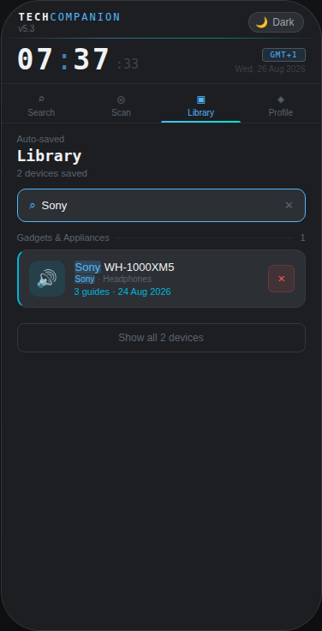
Screen 7 — Library · Auto-Saved Devices with Live Search
1
Auto-save on every lookup
Every successful AI lookup is saved automatically — no manual action needed. Organised into Gadgets & Appliances and PC Components.
2
Coloured left borders
Each card has a left border in the brand's accent colour, matching the product card on Results. Makes entries instantly scannable at a glance.
3
Live search
Type to filter all sections simultaneously by name, brand, or category. Matching text is highlighted blue. Sections with no results disappear entirely.
4
Tap to reopen
Tapping an entry loads the product and guides back to Results without a new API call. Tab navigation preserves the loaded state.
5
Two-step clear confirmation
✕ removes one entry. 'Clear all' opens an inline confirmation card counting the devices and warning about walkthrough progress loss.
All saved devices
Filtered by 'Sony'

Slide 12
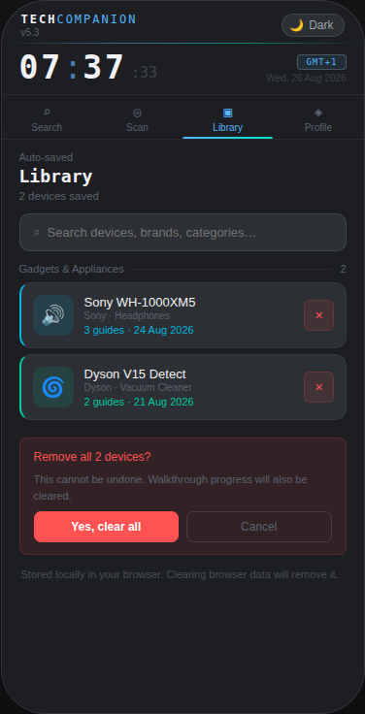
Screen 7b — Library · Two-Step Destructive Action Safety
BUG-02 Fix — Destructive Action Protection
The original demo cleared all data in a single tap with no confirmation. A software testing audit caught this as a HIGH severity bug. The fix adds an inline two-step confirmation.
1
Step 1 — Tap 'Clear all devices'
The button does nothing destructive. It sets confirmClear:true and re-renders, replacing itself with a confirmation card.
2
Confirmation card content
Shows: exact device count, warning that walkthrough progress is also cleared, a full-width red confirm button, and an equal-size Cancel button.
3
Cancel is equal priority
Both buttons are the same width and height. The design intentionally does not funnel the user toward the destructive action.
This pattern (confirmClear state + inline card) replaces the original window.confirm() which was blocked on iOS Safari and visually inconsistent with the app's design.

Slide 13
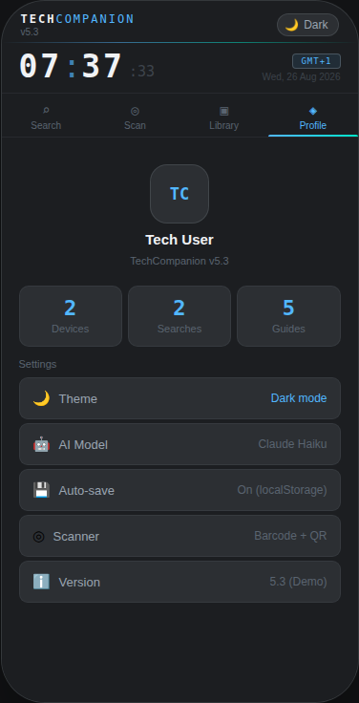
Screen 8 — Profile · Usage Stats and Settings
1
TC Avatar + version
Rounded-rectangle avatar with TC initials in Orbitron. App version shown below the user label — updates automatically from the APP_VERSION constant.
2
Live usage statistics
Three stat cards: Devices (library size), Searches (history length), Guides (total across all saved entries). All update in real time as the user interacts.
3
Theme row — tappable
Tapping Theme calls toggleTheme() — same function as the header button. Instant full-palette swap between Dark (#1C1E21) and Light (#EEF3F8).
4
AI Model and Storage info
Shows the active Claude model (Haiku) and storage engine (localStorage). Reads from config — change the constant and it updates here automatically.
5
Version number
Shows the current APP_VERSION constant. No manual maintenance needed — update the constant in source and the profile reflects it.

Slide 14
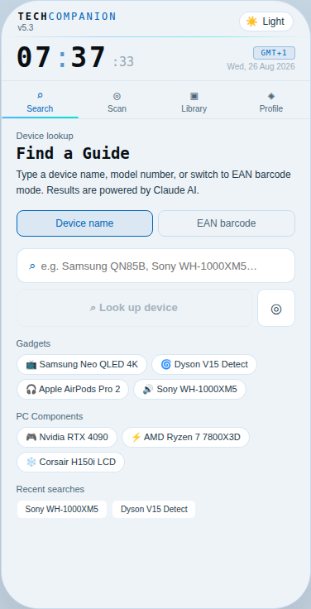
Screen 9 — Light Theme · Complete Palette Swap
Two complete colour systems
Every colour in the app is a theme token. Toggling swaps the entire palette in a single renderCurrent() call — no component re-architecture needed.
Token
🌙 Dark
☀️ Light
Background
#1C1E21
#EEF3F8
Card
#2C2F33
#FFFFFF
Accent
#52B7FF
#0066BB
Teal
#00E5C8
#007A68
Text primary
#F0F2F5
#0A0F14
Text muted
#9AA5B1
#1E3A4A
Theme preference saved to localStorage. Restored automatically on next open.

Slide 15
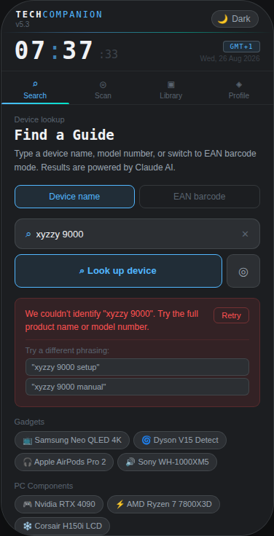
Screen 10 — Error Handling · Clear Feedback, Not Dead Ends
1
Red error banner
Error shown in a red-tinted card with plain language. Message varies by error type: device not found, offline, rate-limited, or API error.
2
Retry button inside the card
When a query is present, a Retry button sits inside the error card. One tap re-runs the same lookup without retyping.
3
Reformulation suggestions
For 'couldn't identify' errors, two alternative phrasings are generated automatically (e.g. 'xyzzy 9000 setup', 'xyzzy manual'). Tapping fires the lookup.
4
Error types handled
Not found: unknown device or not consumer/PC hardware
Offline: navigator.onLine check before every API call
Rate-limited: RATE_LIMITED action → upgrade card shown
API error: message shown with retry option
5
Ghost-result validation errors
G-01/G-02: if the API returns an empty product name or guides with trivial steps, the error path fires — same as product not found.

Slide 16
Every Screen at a Glance
Search
Home
EAN
Barcode
Loading
Skeleton
Results
Screen
Unverified
Result
Walkthrough
Active
Open techcompanion-demo.html in Chrome to interact with every screen live
Guide
Complete
Camera
Scanner
Library
Full
Library
Search
Profile
& Stats
Light
Theme

