Slide 1
Power BI Embedded for Fun and Profit
SQL Saturday BI
Oct 19, 2019

Slide 2
Samara Soucy
@oneangrypenguin samara.soucy@microsoft.com
Software Engineer – Microsoft
MCP – C#

Slide 3
What the Heck is Power Bi Embedded?
Power BI Embedded allows you to display reports and visuals that are hosted in the Power BI service in another application.

Slide 4
Sharing Power BI Content – Inside Power BI
Desktop and template files
Users with Pro licenses within Power BI service workspaces (share button)
Read only apps in the service with Premium nodes
Power BI Report Server

Slide 5
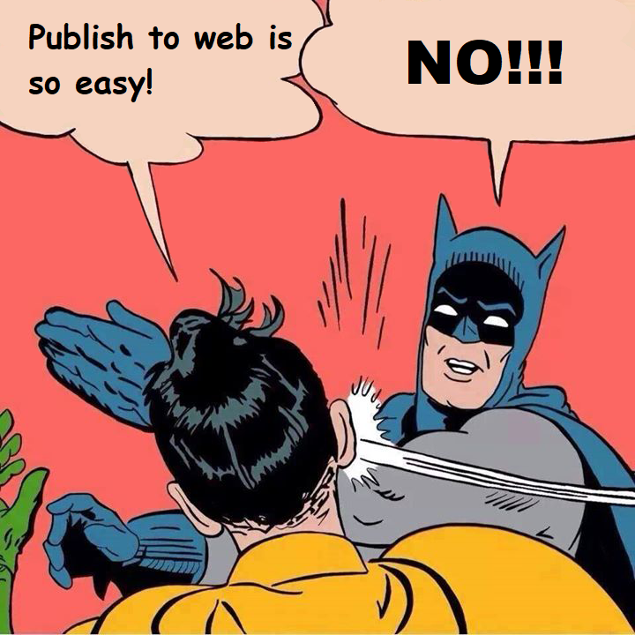
Sharing Power BI Content – Outside Power BI
Publish to Web
  No security! Meant for public facing websites
PBI Report Server iframe/API
PBI Service Iframe
  Users must log in every time, even if they are already logged in
Power BI Embedded
  Put Power BI content wherever you want, with security intact

Slide 6
What can you do with Embedded?
Pretty much anything you can do in the Power BI Service and then some
  Display reports, dashboards and tiles
  Control navigation and controls like hiding the filter pane
  Set the filter/slicer state, navigation
  Show bookmarks or navigate through them
  Allow users to view, edit and even create new reports
  “Export” the data – load into a JS object that you can act on or save to a file
ttps://microsoft.github.io/PowerBI-JavaScript/demo/v2-demo/index.html

Slide 7
Who “owns” the data?
App owns Data
User Owns Data
Users do not have to have an Azure Active Directory account or a Power BI license
Authentication is handled by your organization’s API using either a Power BI Pro user account or a Service Principal
Users must have a Power BI license. Whether they need a Pro license is based on the sku
Authentication is handled by user, but your API also passes an App ID to AAD to ensure that the app is allowed to embed content.
  “On Behalf Of Flow”

Slide 8
How does the API Authenticate?
Power BI Pro Account
Service Principal
Create a service account and assign it a Pro license
Application passes in the account’s user name and password when requesting access to the Power BI API
Create an App account in Azure Active directory
Turn on the preview feature in the Power BI tenant – under tenant settings
Manage privileges by adding the account to a security group
App authenticates using App ID and App Secret

Slide 9
Power BI Embedded and RLS
Good news! RLS works in both App Owns Data and User Owns Data
User Owns Data – RLS works inherently as the user is passed in through the authentication workflow
App Owns Data – Pass in user name, role, and dataset in the body of the request between your application and the Power BI API
  Works with Power BI imported, Analysis Services, and SQL Azure (Preview)
  Analysis Services also allows custom properties
  SQL Azure Direct Query involves a data blob representing the OAuth token to be passed to the database

Slide 10
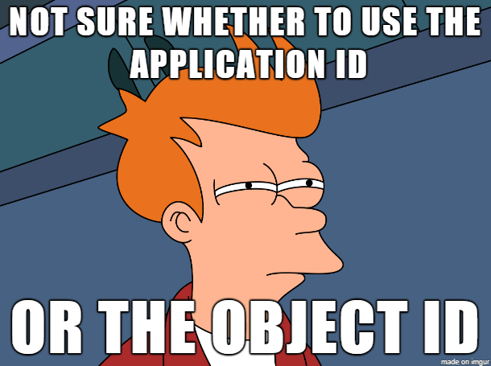
So many IDs!!!
Tenant ID: ID for your entire organization
Subscription ID: Groups resources into separate billing groups
App (client) ID: Globally unique ID for your app
Object ID: Tenant object that is assigned permissions. (Service Principal)
Workspace/Dashboard/Report ID: ID for an object within the Power BI service

Slide 11
Power BI SKU Types
Dedicated capacity is required for embedding!
A (Azure) Sku
Same resource allocation as EM and P skus, but only allows App Owns Data scenario
Can be paused and scaled at will
Purchased through the Azure portal
EM (Embedded) Sku
Allows for App Owns Data and User Owns Data
Embed in Sharepoint or Office 365 for internal users
Purchased through O365 with a yearly commitment
P (Premium) Sku
Does everything the EM sku does, but has more resources and some additional features
Allows free users to consume content in the Power BI portal using read-only apps
Purchased through O365 with a yearly commitment

Slide 12
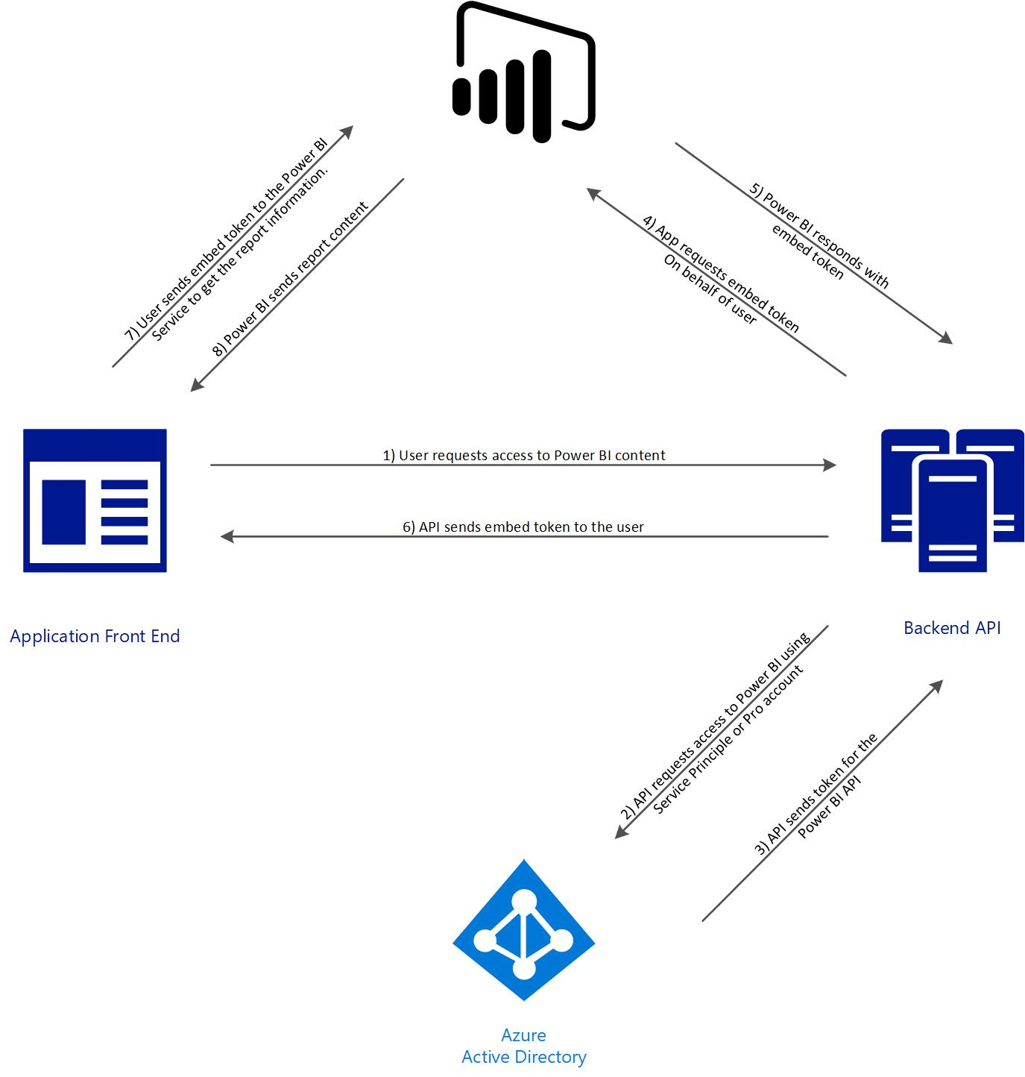
How Does it work?
App owns data

Slide 13
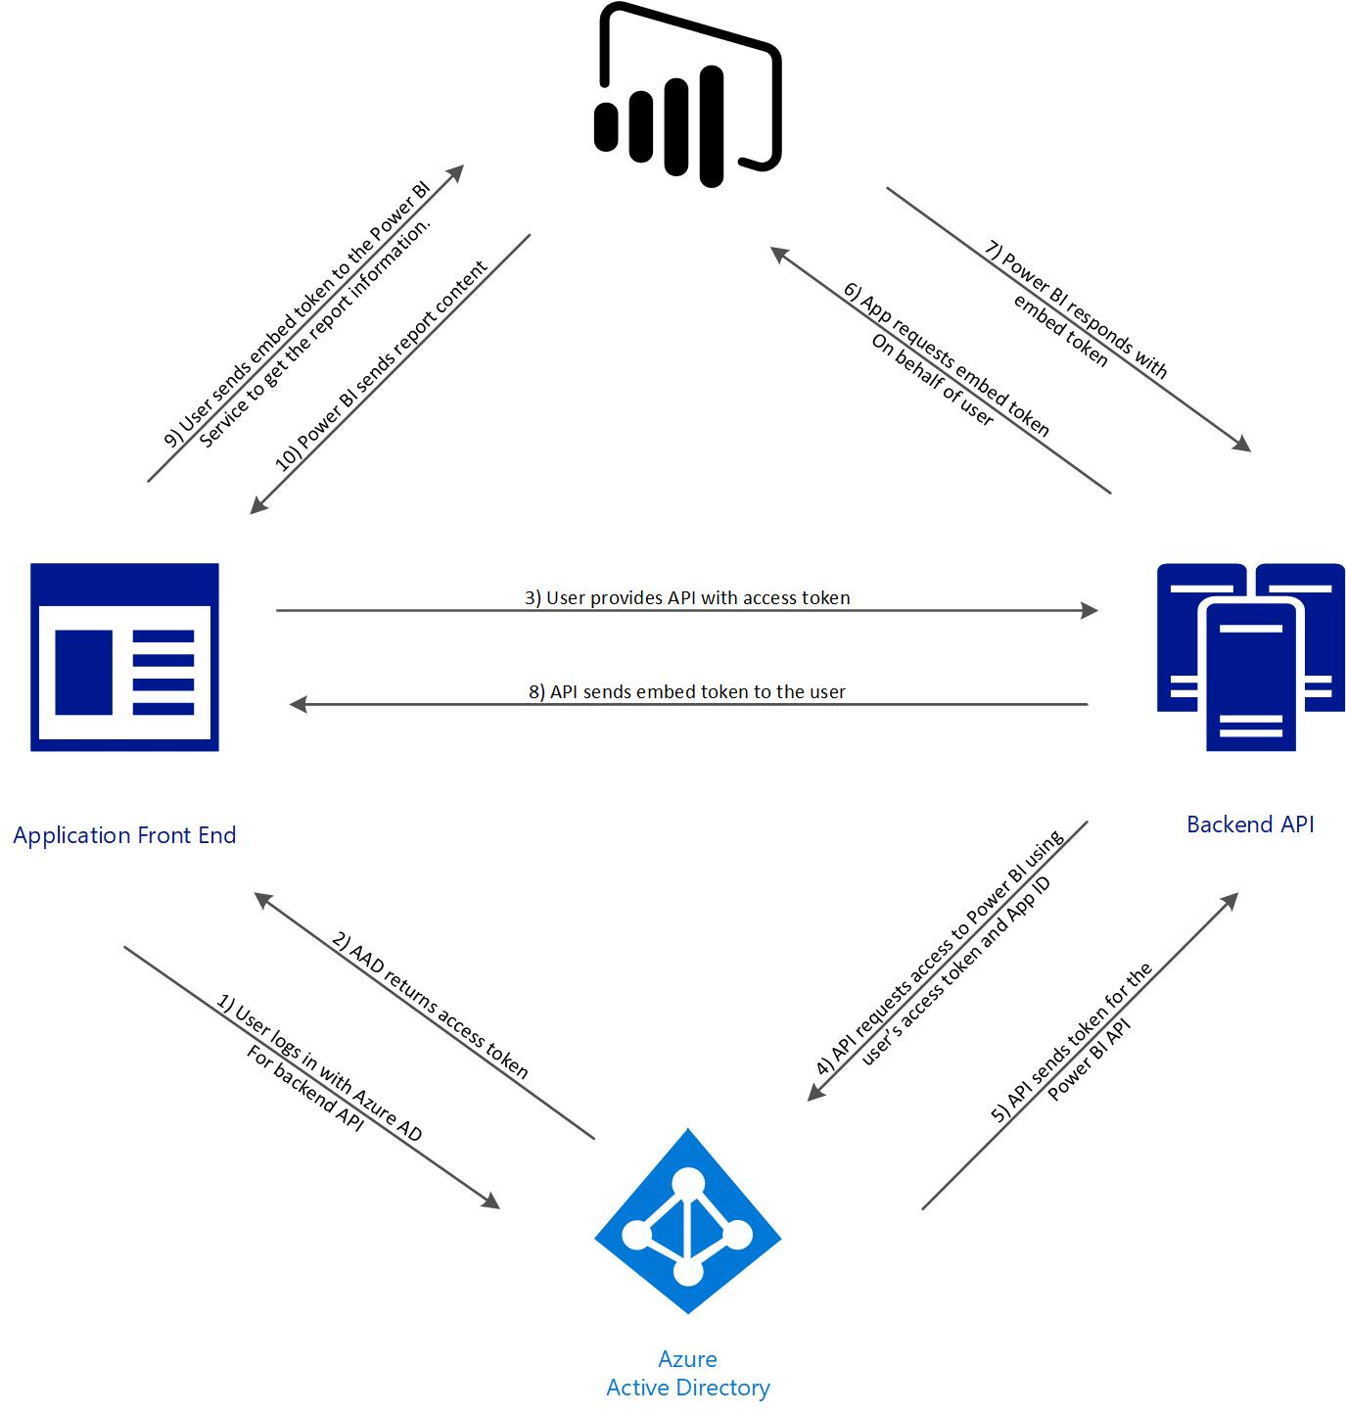
How Does it work?
User owns data

Slide 14


Slide 15
Resources
PBI Embedded Docs: https://docs.microsoft.com/en-us/power-bi/developer/embedding
Power BI Playground: https://microsoft.github.io/PowerBI-JavaScript/demo/v2-demo/index.html
Demo Repo: https://github.com/Microsoft/PowerBI-CSharp
Link to materials: www.oneangrypenguin.com/presentations

