Slide 1
Azure Data Lake for First Time Swimmers
SQL Saturday Atlanta 2018

Slide 2
Samara Soucy
Microsoft Certified Specialist, Programing in C#
Software Development Consultant – Innovative Architects
#worksomeplaceawesome
samarasoucy@gmail.com
@oneangrypenguin
Oneangrypenguin.com

Slide 3

What is a Data Lake?
A data lake is a centralized store of data in it’s raw format, both processed and unprocessed.
Contains structured, semi-structured, unstructured and binary data.
Usually built on Hadoop.
Allows analysts to easily create new metrics and reporting.

Slide 4
Data Lake vs. Data Warehouse
Data Lake
Data Warehouse
Raw and processed data, may not be structured
Data is structured for reports as needed
Inexpensive storage for massive amounts of data
Data sets may be created for end users, but power users and data scientists will be most at home
Highly structured and transformed
Data usage is usually defined ahead of time
Expensive for large data volume
Easy for users to access and work with

Slide 5

Why Use a Data Lake?
How “messy” is my data? (Will it fit neatly into a database/ work with other tools like SSIS?)
What is the scale of my data?
Do I know what I need to extract from this data?

Slide 6
Azure Data Lake Technology
Lake-in-a-Box: Azure Data Lake Store & Azure Data Lake Analytics
Managed: HDInsight
Integrated Tech: Blob Storage, SQL Server, Azure Data Warehouse, Azure SQL, Data Factory, Stream Analytics, Power BI, SSIS, PolyBase, R Server, Cognitive Services, anything* that works with Hadoop (Hive, Pig, Storm, Spark, Sqoop…)

Slide 7

Architecting a Successful Data Lake
(Don’t Make a Data Swamp)

Slide 8





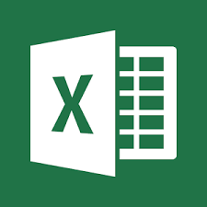
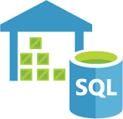
Data Lake Organization
Raw Data
Native format
May contain sensitive data
Cleaned
Remove sensitive data such as SS numbers
Process out corrupt and unusable data
Processed
Outputs from previous report processing
Available for users to create their own reports or moved into data warehouse
Data scientists mine for useful data
Landing Zone

Slide 9
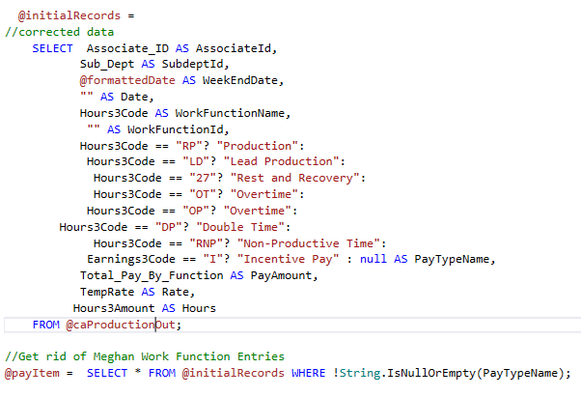
ADLA & USQL Components
Job Based System
Scripts – Job definition file. (.usql or .txt)
  Extract Data
  Transform data
  Output Data
Class Library – Custom C# code that can be shared between scripts
Test Project – Unit testing for USQL Class Libraries
Databases – Acts similar to SQL Database, but is stored in the file system
  Used to register custom assemblies
  Store Cleaned Data
  Reference External DBs
Able to reference and use Python and R scripts, As well as Azure Cognitive Services

Slide 10
Resources
Data Lake Tools for Visual Studio and Visual Studio Code
SQLServerCentral.com Stairway to USQL
USQL GitHub repository
MSDN USQL Language Reference
MSDN Azure Data Lake Blog
https://gist.github.com/serri588/ff9e3047d8341398df4aea7557f0a82c
https://github.com/serri588/USQLDemoApp

