Slide 1


Data-Parallel Deep Learning
Efficient DL, Episode IV, 2025
Yandex
Research

Slide 2
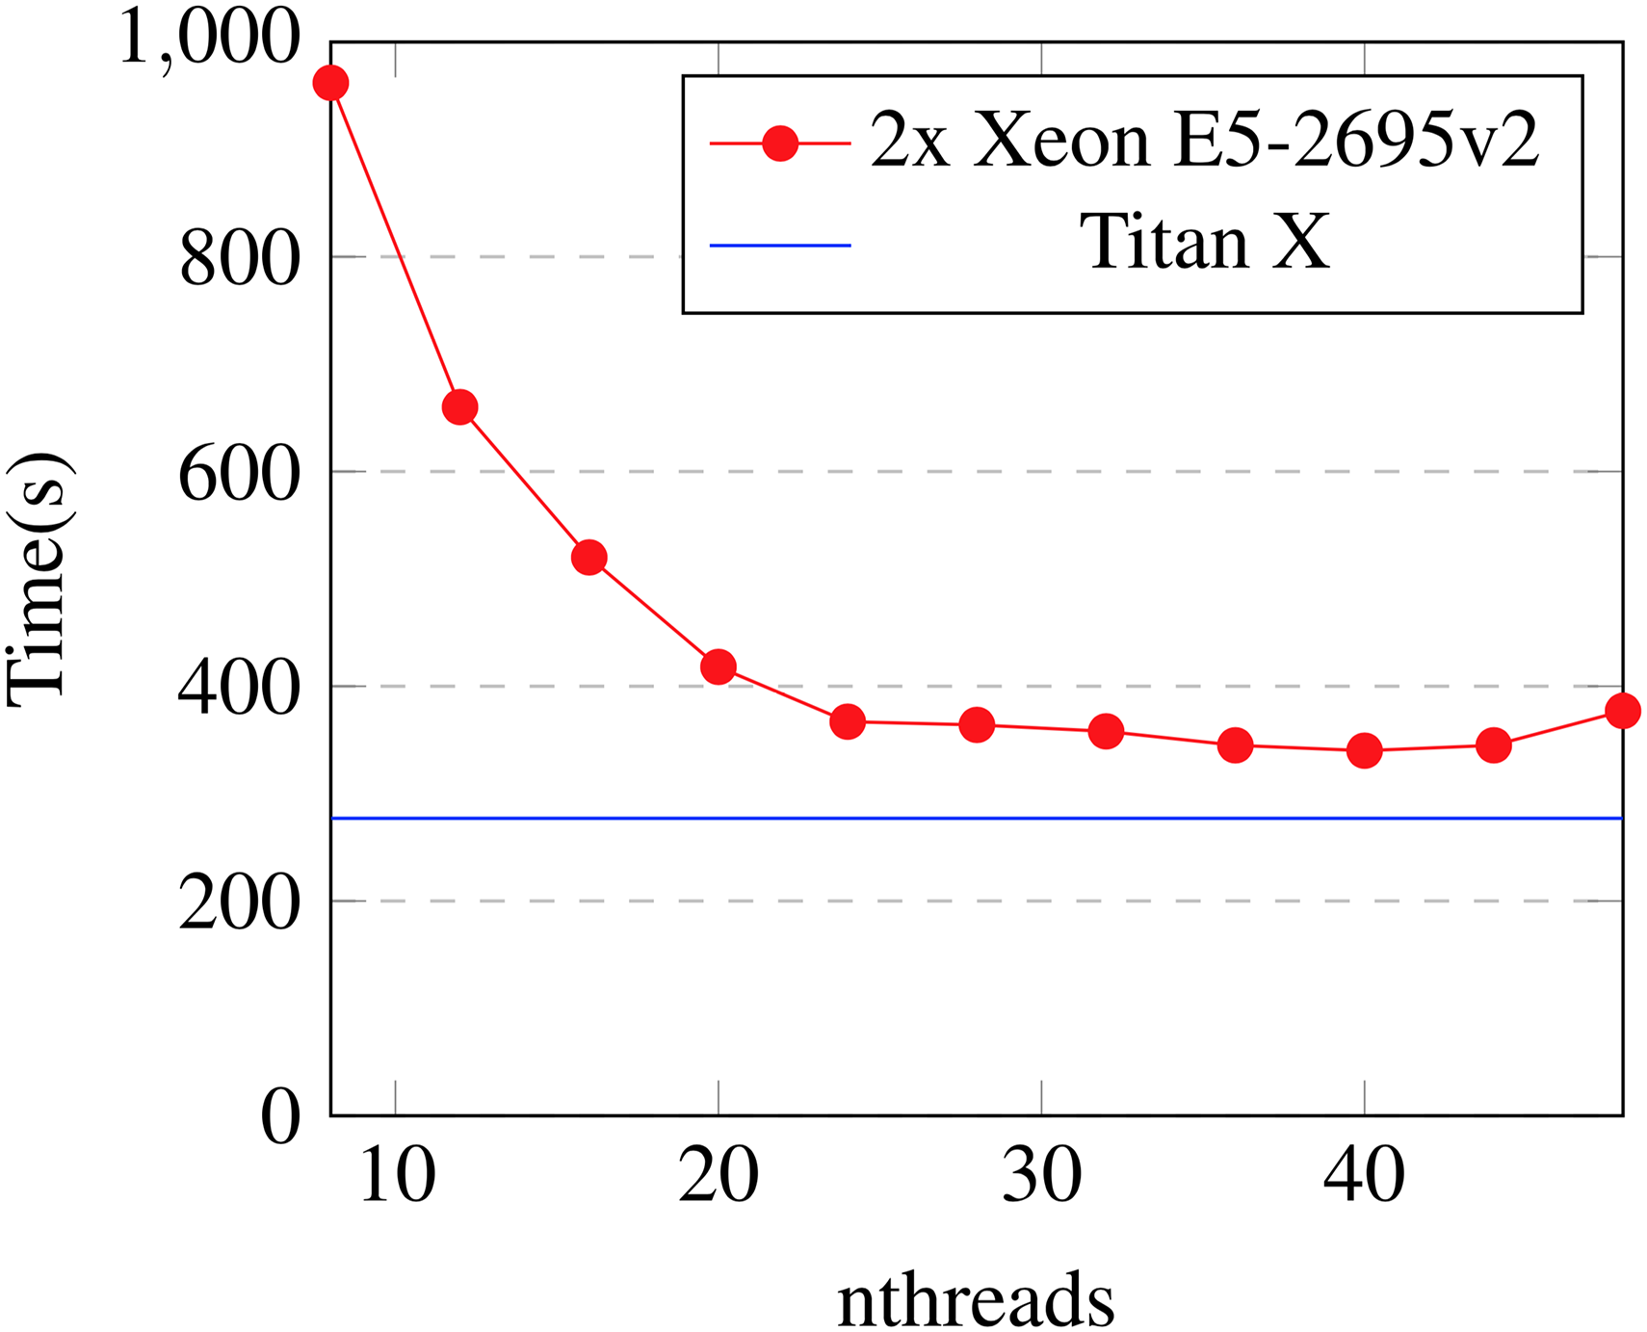
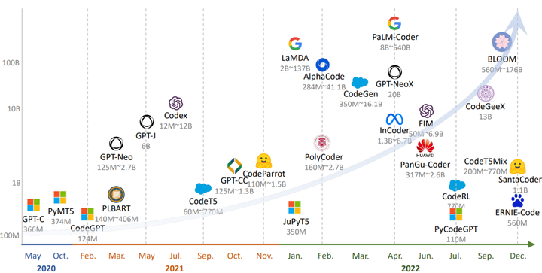
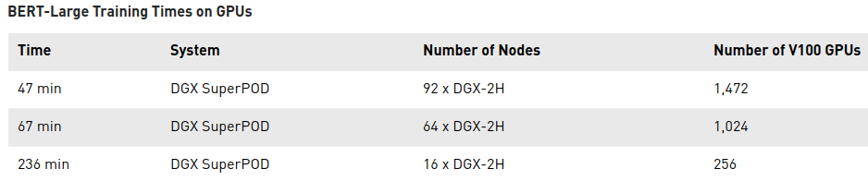
Зачем это всё?
XGBoost training time
parameters vs time
Model size trend up to 2022
nthreads
(single GPU – over 2 weeks)

Slide 3
Зачем это всё?
XGBoost training time
parameters vs time
Model size trend up to 2022
As of ’25: trillions of params,
1-2 oom more flops
nthreads
(single GPU – over 2 weeks)

Slide 4
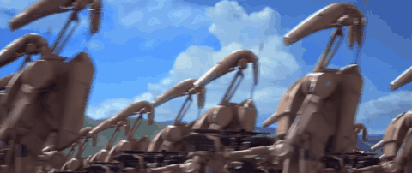
Зачем мы тут?
Заставить много железяк вместе учить одну модель

Slide 5
Зачем мы тут?
Заставить много железяк вместе учить одну модель
понять общие подходы
закодить своими руками
на python / pytorch
Notes:
НЕ про частные случаи. Потому что они скучные и вы и так их знаете. Вместе придумать про random forest

Slide 6
TL;DR our plan lectures 4,5,6
- Data-parallel deep learning
Train BERT-base on wikipedia in 20 minutes or less
- Model-parallel deep learning
Fine-tune and deploy models with 100B+ parameters
like OPT, Llama, Qwen, DeepSeek R1, ...
- Advanced techniques
Sharding (FSDP), mixed / hybrid parallelism, practice

Slide 7
TL;DR our plan lectures 4,5,6
- Data-parallel deep learning
Train BERT-base on wikipedia in 20 minutes or less
- Model-parallel deep learning
Fine-tune and deploy models with 100B+ parameters
like OPT, Llama, Qwen, DeepSeek R1, ...
- Advanced techniques
Sharding (FSDP), mixed / hybrid parallelism, practice

Slide 8
TL;DR our plan lectures 4,5,6
- Data-parallel deep learning
Train BERT-base on wikipedia in 20 minutes or less
- Model-parallel deep learning
Fine-tune and deploy models with 100B+ parameters
like OPT, Llama, Qwen, DeepSeek R1, ...
- Advanced techniques
Sharding (FSDP), mixed / hybrid parallelism, practice

Slide 9
Rules: Channel / Pipe
Process A:
foo
bar
baz
qux
result
Process B:
func
otherfunc
Channel (pipe):
Communication in O(message size)
Asynchronous read/write

Slide 10
Data-parallel training (naive)
cs.cmu.edu/~muli/file/parameter_server_osdi14.pdf
Host
model
CPU
θ
Devices
.cuda()
GPU1
θ

Slide 11
Data-parallel training (naive)
cs.cmu.edu/~muli/file/parameter_server_osdi14.pdf
Host
model
batch
CPU
θ
. . .
x
Devices
.cuda()
.cuda()
GPU1
θ
x
forward pass
backward pass
∇θL(x1)

Slide 12
Data-parallel training (naive)
cs.cmu.edu/~muli/file/parameter_server_osdi14.pdf
Host
model
batch
CPU
θ
. . . prepare next batch
x
Devices
.cuda()
.cuda()
new model
GPU1
θ
x
forward pass
backward pass
∇θL(x1)
step
θ

Slide 13
Data-parallel training (naive)
cs.cmu.edu/~muli/file/parameter_server_osdi14.pdf
Host
model
CPU
θ
Devices
replicate
GPU1
θ
GPU2
θ
GPU3
θ
GPU4
θ

Slide 14
Data-parallel training (naive)
cs.cmu.edu/~muli/file/parameter_server_osdi14.pdf
Host
model
batch
CPU
θ
x1
x2
x3
x4
Devices
replicate
scatter
GPU1
θ
x1
GPU2
θ
x2
GPU3
θ
x3
GPU4
θ
x4

Slide 15
Data-parallel training (naive)
cs.cmu.edu/~muli/file/parameter_server_osdi14.pdf
Host
model
batch
CPU
θ
. . .
x1
x2
x3
x4
Devices
replicate
scatter
GPU1
θ
x1
forward pass
backward pass
∇θL(x1)
GPU2
θ
x2
forward pass
backward pass
∇θL(x2)
GPU3
θ
x3
forward pass
backward pass
∇θL(x3)
GPU4
θ
x4
forward pass
backward pass
∇θL(x4)

Slide 16
Data-parallel training (naive)
cs.cmu.edu/~muli/file/parameter_server_osdi14.pdf
Host
model
batch
full grad
new model
CPU
θ
. . .
θ
x1
x2
x3
x4
∇θL(x)
step
Devices
replicate
scatter
reduce (sum)
replicate
GPU1
θ
x1
forward pass
backward pass
∇θL(x1)
θ
GPU2
θ
x2
forward pass
backward pass
∇θL(x2)
θ
GPU3
θ
x3
forward pass
backward pass
∇θL(x3)
θ
GPU4
θ
x4
forward pass
backward pass
∇θL(x4)
θ

Slide 17
All-Reduce data parallel
arxiv.org/abs/1706.02677
Idea: get rid of the host, each gpu runs its own computation
Q: why will weights be equal after such step?
Data
Get full grads on each device
new θ are equal across devices
Devices
θ
A
L
L
R
E
D
U
C
E
θ
GPU1
x1
forward pass
backward pass
∇θL(x1)
∇θL(x)
step
GPU2
θ
x2
forward pass
backward pass
∇θL(x2)
∇θL(x)
step
θ
GPU3
θ
x3
forward pass
backward pass
∇θL(x3)
∇θL(x)
step
θ
GPU4
θ
x4
forward pass
backward pass
∇θL(x4)
∇θL(x)
step
θ

Slide 18
Faster allreduce
Input: each device has its its own vector
Output: each device gets a sum of all vectors
Devices
A
L
L
R
E
D
U
C
E
GPU1
∇θL(x1)
∇θL(x)
GPU2
∇θL(x2)
∇θL(x)
GPU3
∇θL(x3)
∇θL(x)
GPU4
∇θL(x4)
∇θL(x)

Slide 19
Faster allreduce
Input: each device has its its own vector
Output: each device gets a sum of all vectors
Naive implementation
Devices
GPU1
∇θL(x1)
Sum
∇θL(x)
GPU2
∇θL(x2)
∇θL(x)
GPU3
∇θL(x3)
∇θL(x)
GPU4
∇θL(x4)
∇θL(x)

Slide 20
Faster allreduce
Input: each device has its its own vector
Output: each device gets a sum of all vectors
Q: Can we do better?
Devices
GPU1
∇θL(x1)
Sum
∇θL(x)
GPU2
∇θL(x2)
∇θL(x)
GPU3
∇θL(x3)
∇θL(x)
GPU4
∇θL(x4)
∇θL(x)

Slide 21
Faster allreduce
Input: each device has its its own vector
Output: each device gets a sum of all vectors
Tree-allreduce
Devices
GPU1
∇θL(x1)
Sum
Sum
∇θL(x)
∇θL(x)
GPU2
∇θL(x2)
∇θL(x)
GPU3
∇θL(x3)
Sum
∇θL(x)
∇θL(x)
GPU4
∇θL(x4)
∇θL(x)

Slide 22
Faster allreduce
Input: each device has its its own vector
Output: each device gets a sum of all vectors
Butterfly-allreduce – split data into chunks (ABCD)
Devices
Part A
GPU1
∇θL(x1)
Sum
A
GPU2
∇θL(x2)
GPU3
∇θL(x3)
GPU4
∇θL(x4)

Slide 23
Faster allreduce
Input: each device has its its own vector
Output: each device gets a sum of all vectors
Butterfly-allreduce – split data into chunks (ABCD)
Devices
Part A
GPU1
∇θL(x1)
Sum
A
GPU2
∇θL(x2)
Sum
B
GPU3
∇θL(x3)
Sum
C
GPU4
∇θL(x4)
Sum
D

Slide 24
Faster allreduce
Input: each device has its its own vector
Output: each device gets a sum of all vectors
Butterfly-allreduce – split data into chunks (ABCD)
Devices
Part A
GPU1
∇θL(x)
∇θL(x1)
Sum
A
concat
∇θL(x)
GPU2
∇θL(x2)
Sum
B
GPU3
∇θL(x3)
Sum
C
GPU4
∇θL(x4)
Sum
D

Slide 25
Faster allreduce
Input: each device has its its own vector
Output: each device gets a sum of all vectors
Ring-allreduce – split data into chunks (ABCD)
Devices
Part A
GPU1
∇θL(x1)
Sum
A
concat
∇θL(x)
GPU2
∇θL(x2)
Sum
B
concat
∇θL(x)
GPU3
∇θL(x3)
Sum
C
concat
∇θL(x)
GPU4
∇θL(x4)
Sum
D
concat
∇θL(x)

Slide 26
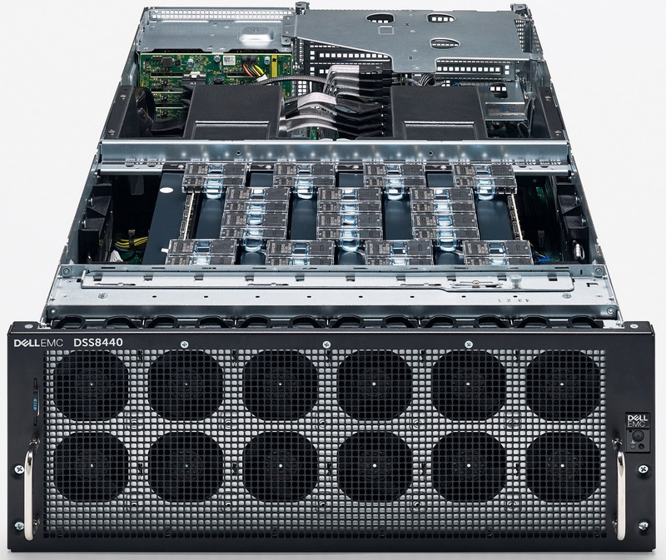
Ring allreduce
Bonus quest: you can only send data between adjacent gpus
GPU1
GPU2
GPU3
GPU4
Ring topology
Image: graphcore IPU server
Answer & more: tinyurl.com/ring-allreduce-blog

Slide 27
Ring allreduce
Bonus quest: you can only send data between adjacent gpus
[Time to use the whiteboard]
Answer & more: tinyurl.com/ring-allreduce-blog

Slide 28
All-Reduce data parallel
arxiv.org/abs/1706.02677
Idea: get rid of the host, each gpu runs its own computation
Q: why will weights be equal after such step?
Data
Get full grads on each device
new θ are equal across devices
Devices
θ
A
L
L
R
E
D
U
C
E
θ
GPU1
x1
forward pass
backward pass
∇θL(x1)
∇θL(x)
step
GPU2
θ
x2
forward pass
backward pass
∇θL(x2)
∇θL(x)
step
θ
GPU3
θ
x3
forward pass
backward pass
∇θL(x3)
∇θL(x)
step
θ
GPU4
θ
x4
forward pass
backward pass
∇θL(x4)
∇θL(x)
step
θ

Slide 29
</Data-parallel>
+ easy to implement
+ can scale to 100s of gpus
+ can be fault-tolerant
- model must fit in 1 gpu
- large batches aren’t always
good for generalization
2-4 GPUs & no time – naive data parallel tinyurl.com/torch-data-parallel
4+ GPUs or multiple hosts – distributed (allreduce) github.com/horovod/horovod
  Intro to pytorch distributed: tinyurl.com/distributed-dp or in 15 minutes!
Somewhat faulty GPU/network: synchronous data parallel + drop stragglers
Very faulty or uneven resources: asynchronous data parallel (more later)
Efficient training with large batches: LAMB https://arxiv.org/abs/1904.00962
Dynamically adding or removing resources: https://tinyurl.com/torch-elastic

Slide 30
Decentralized training vs real-world tasks
arxiv.org/abs/1706.02677
Each gpu has different processing time & delays
Q: can we improve device utilization?
Data
Devices
θ
A
L
L
R
E
D
U
C
E
GPU1
x1
forward pass
backward pass
∇θL(x1)
GPU2
θ
x2
forward
backward
∇θL(x2)
GPU3
θ
x3
forward pass
backward pass
∇θL(x3)
θ
network delay
x4
forward pass
backward pass
GPU4
∇θL(x4)

Slide 31
Recap: Parameter Server
HOGWILD! arxiv.org/abs/1106.5730
Idea: remove synchronization step alltogether, use parameter server
Model parameters
Devices
GPU1
θ
Train step
∇θL
θ
Train step
∇θL
GPU2
. . .
θ
Train step
θ
Train step
Train step
∇θL
∇θL
. . .
GPU3
Train step
. . .
Train step
. . .
Train step
. . .
Problem: parameter servers need to ingest tons of data over training

Slide 32
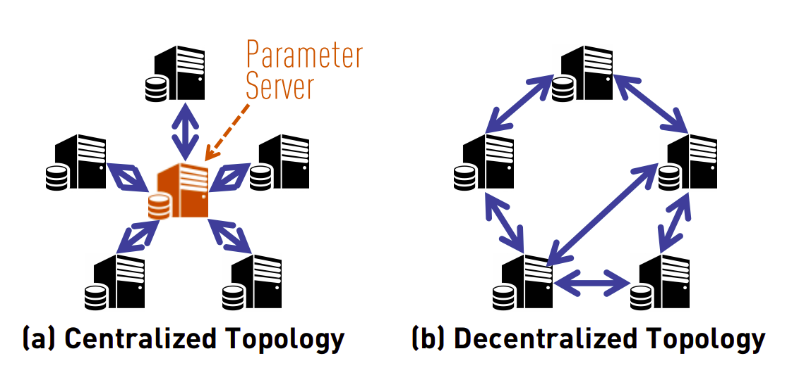
Decentralized Training with Gossip
Gossip (communication): https://tinyurl.com/boyd-gossip-2006
Gossip outperforms All-Reduce: https://tinyurl.com/can-dsgd-outperform

Slide 33
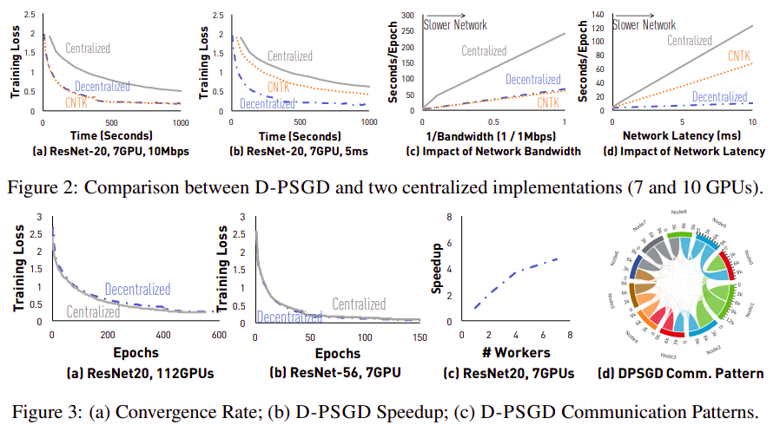
Decentralized Training with Gossip
Source: https://tinyurl.com/can-dsgd-outperform

Slide 34
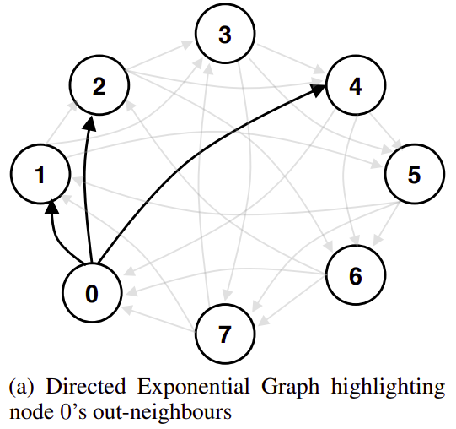
Stochastic Gradient Push
Source: https://arxiv.org/abs/1811.10792

Slide 35
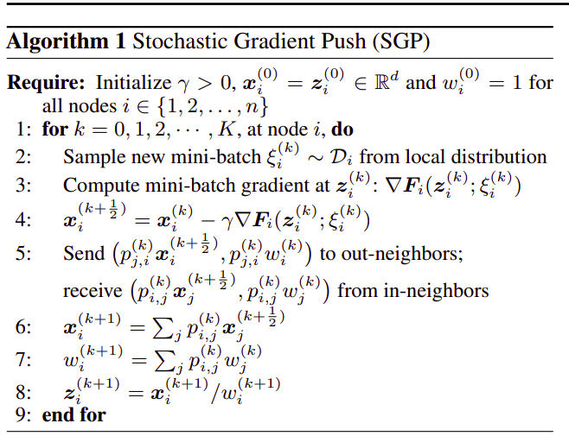
Stochastic Gradient Push
Source: https://arxiv.org/abs/1811.10792
<to be continued>

Slide 36
Stochastic Gradient Push
Source: https://arxiv.org/abs/1811.10792
<to be continued>
normal GD step

Slide 37
Stochastic Gradient Push
Source: https://arxiv.org/abs/1811.10792
<to be continued>

Slide 38
Stochastic Gradient Push
Source: https://arxiv.org/abs/1811.10792
weighted
average

Slide 39
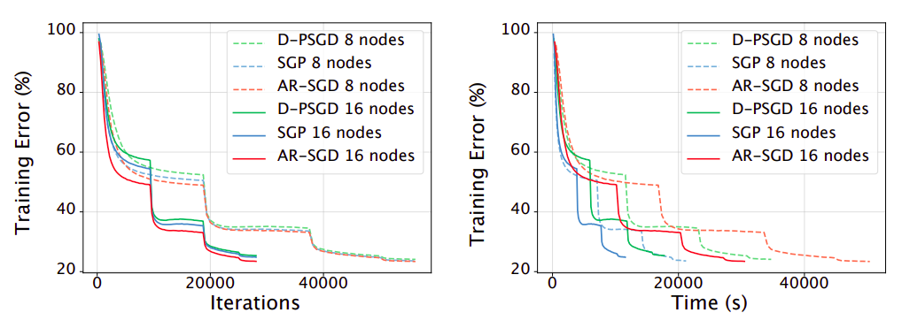
Stochastic Gradient Push
Source: https://arxiv.org/abs/1811.10792
SGP vs ImageNet (ResNet50 + SGD w/ momentum)

Slide 40
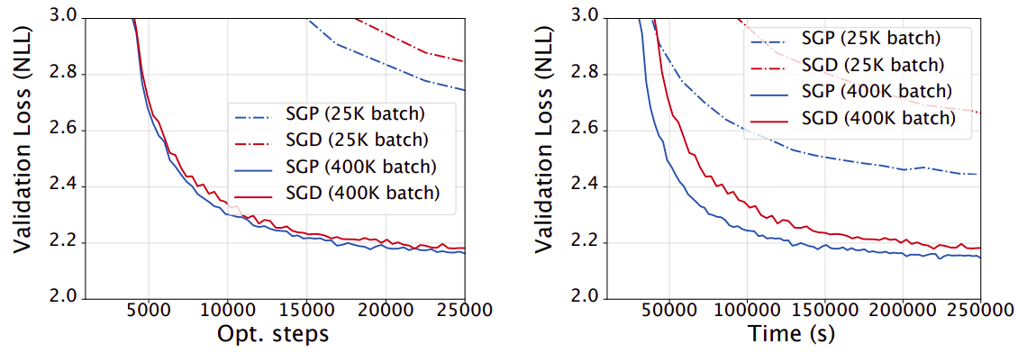
Stochastic Gradient Push
Source: https://arxiv.org/abs/1811.10792
SGP vs WMT English-German (Transformer, Adam)

Slide 41
Gossip vs All-Reduce
Your thoughts?

Slide 42
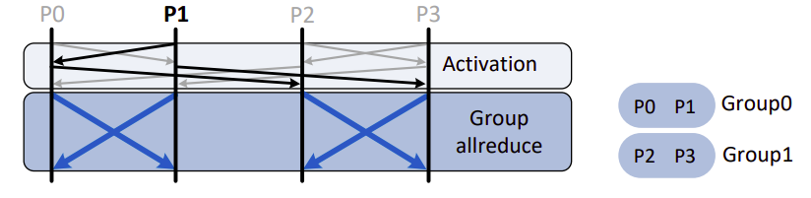
Gossip + All-Reduce
Source: arxiv.org/abs/2005.00124
Core idea: run all-reduce in independent groups
You only have to synchronize for your small group
Swap groupmates between iterations

Slide 43
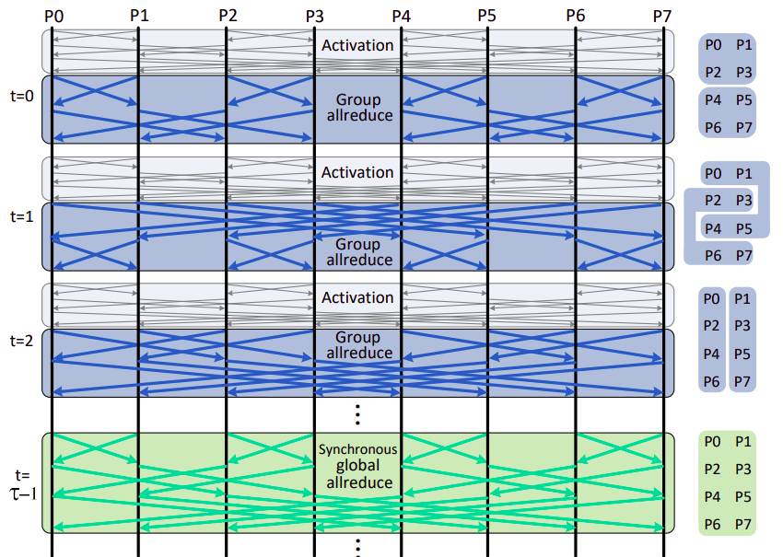
Gossip + All-Reduce
Source: arxiv.org/abs/2005.00124
Core idea: run all-reduce in independent groups
You only have to synchronize for your small group
Swap groupmates between iterations

Slide 44
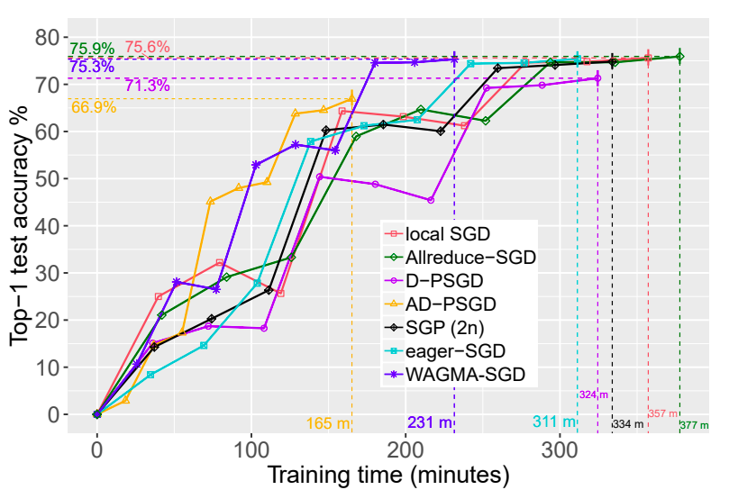
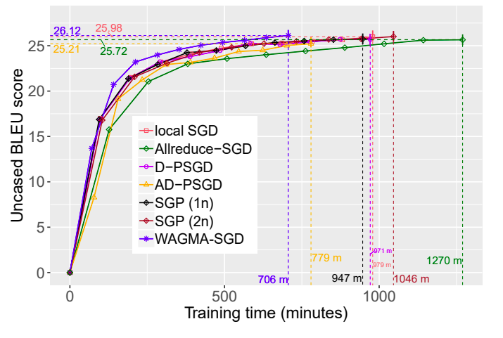
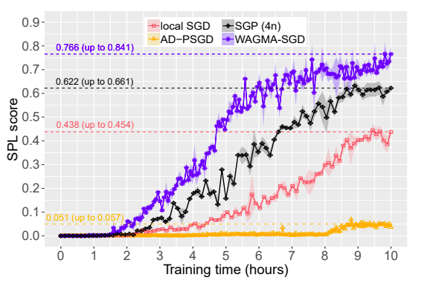
Gossip + All-Reduce
Source: arxiv.org/abs/2005.00124
Experiment setup: up to 1024 GPU,
Natural (or emulated) network latency
Image Classification
ResNet50 @ ImageNet
Machine Translation
Transformer @ WMT17
Reinforcement Learning
DDPO on Habitat

Slide 45
Q: what if sending tensors during
AllReduce takes too long?

Slide 46
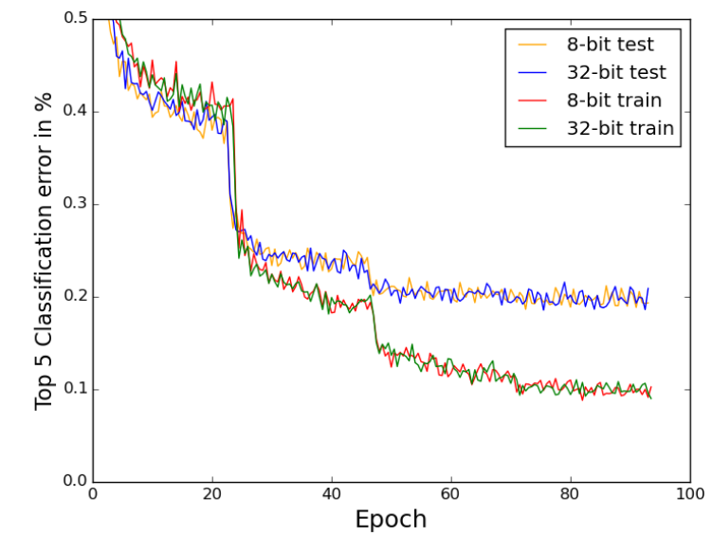
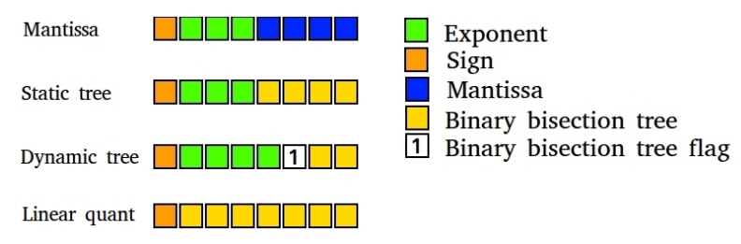
Quantized communication
https://arxiv.org/abs/1511.04561
TL;DR
- send data in 8-bit
- all computations in 32-bit
- choose best data format
PROFIT: same quality as float16

Slide 47
Can we compress further? without losing quality

Slide 48
Error Feedback + PowerSGD
https://arxiv.org/abs/1901.09847 - EF theory
https://arxiv.org/abs/1905.13727 - PowerSGD
TL;DR - use extreme compression, e.g. 1-bit or top-5% gradients
- if you lose something in compression, reuse it on the next step
compute
local grad
ϴ
g
time flows left to right

Slide 49
Error Feedback + PowerSGD
https://arxiv.org/abs/1901.09847 - EF theory
https://arxiv.org/abs/1905.13727 - PowerSGD
TL;DR - use extreme compression, e.g. 1-bit or top-5% gradients
- if you lose something in compression, reuse it on the next step
compute
local grad
ϴ
g
time flows left to right
C(g)
Compress!
Use C(g) in AllReduce or Gossip

Slide 50
Error Feedback + PowerSGD
https://arxiv.org/abs/1901.09847 - EF theory
https://arxiv.org/abs/1905.13727 - PowerSGD
TL;DR - use extreme compression, e.g. 1-bit or top-5% gradients
- if you lose something in compression, reuse it on the next step
compute
local grad
ϴ
compression
error
g
e=g - C(g)
C(g)
C(g)
Compress!

Slide 51
Error Feedback + PowerSGD
https://arxiv.org/abs/1901.09847 - EF theory
https://arxiv.org/abs/1905.13727 - PowerSGD
TL;DR - use extreme compression, e.g. 1-bit or top-5% gradients
- if you lose something in compression, reuse it on the next step
compute
local grad
next
local grad
ϴ
compression
error
ϴ
g
g + e
e=g - C(g)
e=g - C(g)
C(g)
C(g)
C(g)
“Feed” the error
back to grads!
C(g)
Compress!

Slide 52
Error Feedback + PowerSGD
https://arxiv.org/abs/1901.09847 - EF theory
https://arxiv.org/abs/1905.13727 - PowerSGD
TL;DR - use extreme compression, e.g. 1-bit or top-5% gradients
- if you lose something in compression, reuse it on the next step
compute
local grad
next
local grad
ϴ
compression
error
ϴ
g + e
g + e
e=g - C(g)
e=g - C(g)
C(g)
C(g)
Error from the
previous step!
C(g)
“Feed” the error
back to grads!
C(g)

Slide 53
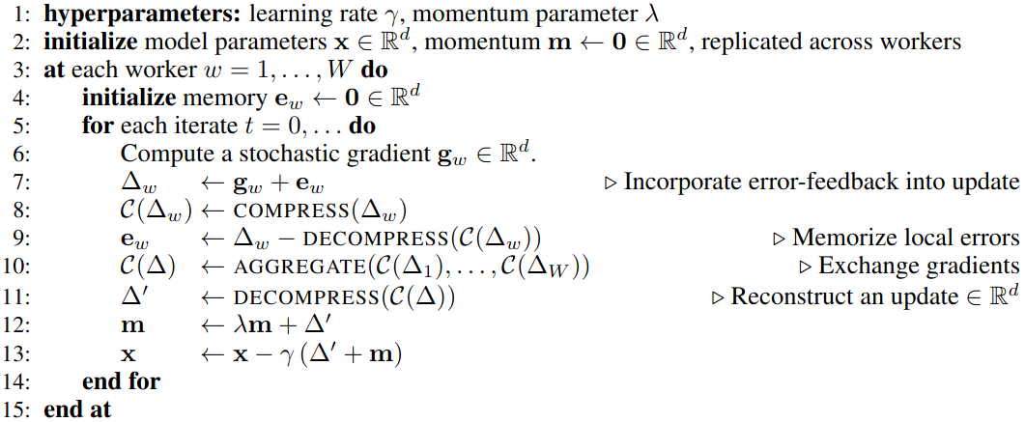
Error Feedback + PowerSGD
https://arxiv.org/abs/1901.09847 - EF theory
https://arxiv.org/abs/1905.13727 - PowerSGD

Slide 54
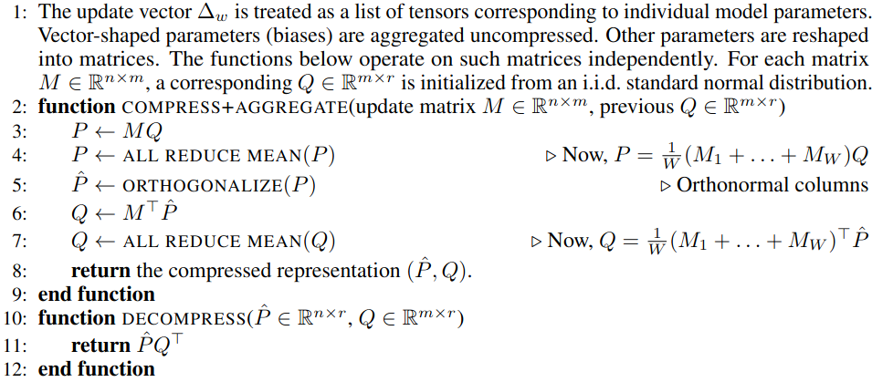
PowerSGD: low-rank approx grads + Error Feedback
https://arxiv.org/abs/1901.09847 - EF theory
https://arxiv.org/abs/1905.13727 - PowerSGD

Slide 55
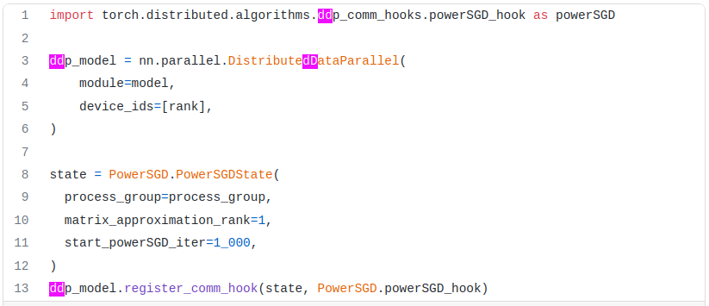
Read More: gradient compression
https://arxiv.org/abs/2106.05203 - better EF’21
https://arxiv.org/abs/2110.03294 - more EF’21
https://arxiv.org/abs/1901.09847 - EF theory
https://arxiv.org/abs/1905.13727 - PowerSGD

Slide 56


Slide 57
Summary: operation parallelism
Data-parallel: ???
Model-parallel: ???

Slide 58
Summary: operation parallelism
Data-parallel: one process applies all model on partial data
Model-parallel: one process applies partial model on all data
best for smaller model, more computations
best for larger model, fewer computations
Which one is better..
for ResNet50?
for Llama 70B?
In general?

Slide 59
Summary: operation parallelism
Data-parallel: one process applies all model on partial data
Model-parallel: one process applies partial model on all data
best for smaller model, more computations
best for larger model, fewer computations
Which one is better..
for ResNet50?
In Llama 70B?
It depends…
- on model size
- on compute

