Slide 1

Model-Parallel Deep Learning
Efficient DL, Episode ++i ‘26
Yandex
Research

Slide 2
Dealing with large models
Model-Parallel Deep Learning
Efficient DL, Episode ++i ‘26
Yandex
Research

Slide 3
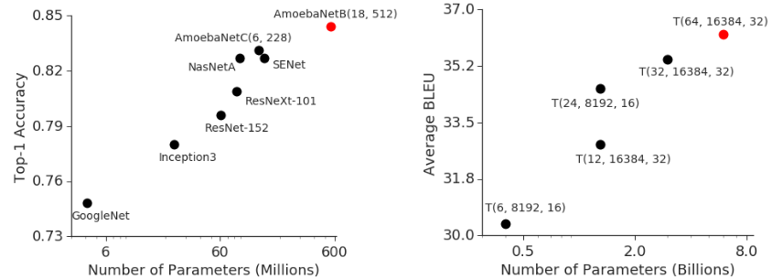
Recap: large models
Image Classification
ImageNet
Machine Translation
average over WMT
Source: https://arxiv.org/abs/1811.06965

Slide 4
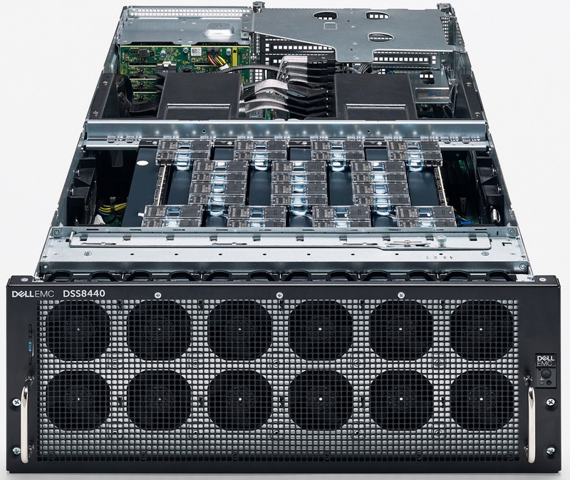
Recap: Ring allreduce
Bonus quest: you can only send data between adjacent gpus
GPU1
GPU2
GPU3
GPU4
Ring topology
Image: graphcore ipu server
Answer & more: tinyurl.com/ring-allreduce-blog

Slide 5
Recap: All-Reduce SGD
arxiv.org/abs/1706.02677
Idea: get rid of the host, each gpu runs its own computation
Q: why will weights be equal after such step?
Data
Get full grads on each device
new θ are equal across devices
Devices
θ
A
L
L
R
E
D
U
C
E
θ
GPU1
x1
forward pass
backward pass
∇θL(x1)
∇θL(x)
step
GPU2
θ
x2
forward pass
backward pass
∇θL(x2)
∇θL(x)
step
θ
GPU3
θ
x3
forward pass
backward pass
∇θL(x3)
∇θL(x)
step
θ
GPU4
θ
x4
forward pass
backward pass
∇θL(x4)
∇θL(x)
step
θ

Slide 6
Q: What if a model is larger than GPU?

Slide 7
Q: What if a model is larger than GPU?
easy mode: cannot fit the right batch size
hard mode: cannot fit a single sample
expert mode: not even parameters!

Slide 8

Q: What if a model is larger than GPU?
easy mode: cannot fit the right batch size
hard mode: cannot fit a single sample
expert mode: not even parameters!
Ideas?

Slide 9
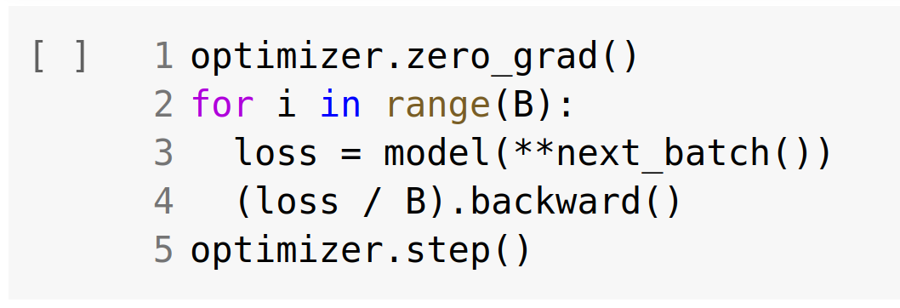
Q: What if a model is larger than GPU?
easy mode: cannot fit the right batch size
hard mode: cannot fit a single sample
expert mode: not even parameters!
Solution: accumulate
grads from several
training batches

Slide 10
Q: What if a model is larger than GPU?
easy mode: cannot fit the right batch size
hard mode: cannot fit one training sample
expert mode: not even parameters!

Slide 11
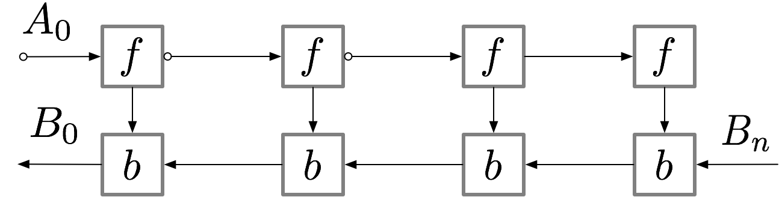
Gradient checkpointing
aka rematerialization
Paper (DL): arxiv.org/pdf/1604.06174.pdf
TF: github.com/cybertronai/gradient-checkpointing
Pytorch: pytorch.org/docs/stable/checkpoint.html

Slide 12
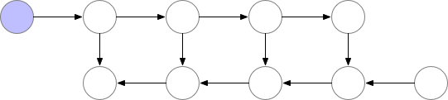
Gradient checkpointing
Normal backprop
Paper (DL): arxiv.org/pdf/1604.06174.pdf
TF: github.com/cybertronai/gradient-checkpointing
Pytorch: pytorch.org/docs/stable/checkpoint.html

Slide 13
Gradient checkpointing
Full rematerialization
Paper (DL): arxiv.org/pdf/1604.06174.pdf
TF: github.com/cybertronai/gradient-checkpointing
Pytorch: pytorch.org/docs/stable/checkpoint.html

Slide 14
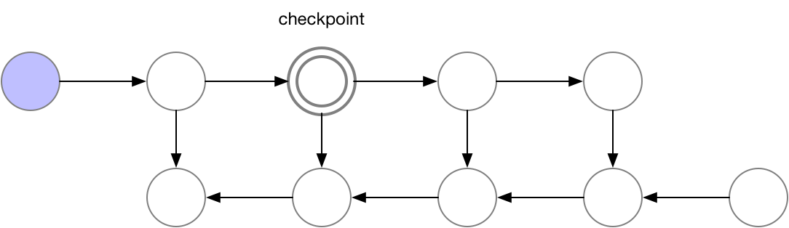
Gradient checkpointing
Single checkpoint
Paper (DL): arxiv.org/pdf/1604.06174.pdf
TF: github.com/cybertronai/gradient-checkpointing
Pytorch: pytorch.org/docs/stable/checkpoint.html

Slide 15
Gradient checkpointing
Single checkpoint
Paper (DL): arxiv.org/pdf/1604.06174.pdf
TF: github.com/cybertronai/gradient-checkpointing
Pytorch: pytorch.org/docs/stable/checkpoint.html

Slide 16



Q: What if a model is larger than GPU?
easy mode: cannot fit batch size 1
expert mode: not even parameters!
You still have one GPU… (but not only a GPU)

Slide 17
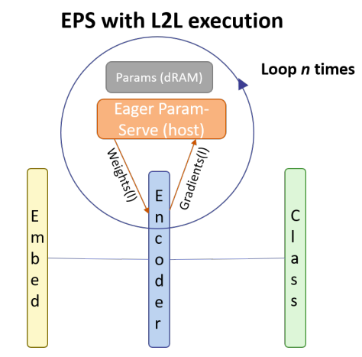
Memory offloading
L2L: https://arxiv.org/abs/2002.05645
Initialize all layers on CPU
Move k layers at a time to GPU
Remove layers after computation
Fetch k+1-st layer while k-th runs
Still 20-50% overhead

Slide 18
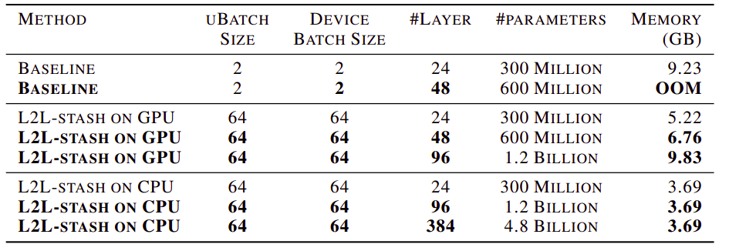
Memory offloading
L2L: https://arxiv.org/abs/2002.05645

Slide 19
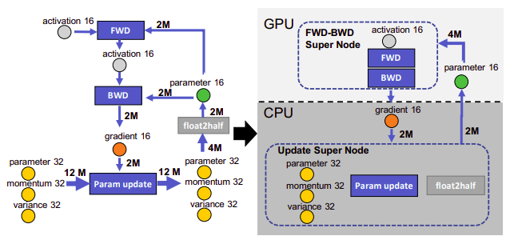
Memory offloading
ZeRO-offload: https://arxiv.org/abs/2101.06840

Slide 20
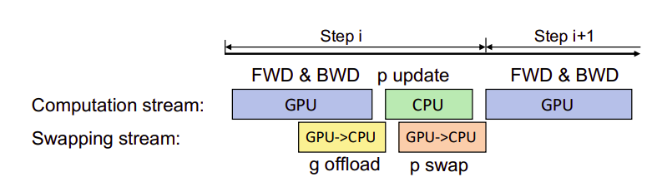
Memory offloading
ZeRO-offload: https://arxiv.org/abs/2101.06840
Offload in parallel with computation
Use gradient checkpointing
Delayed parameter update

Slide 21
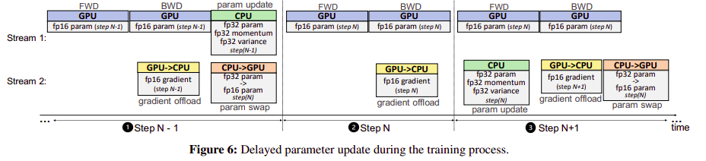
Memory offloading
ZeRO-offload: https://arxiv.org/abs/2101.06840
Offload in parallel with computation
Use gradient checkpointing
Delayed parameter update

Slide 22
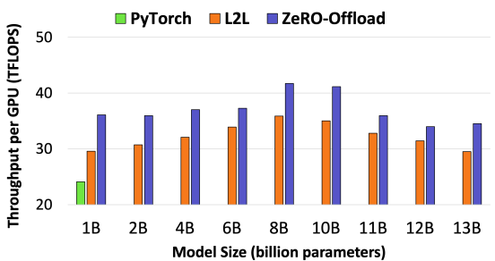
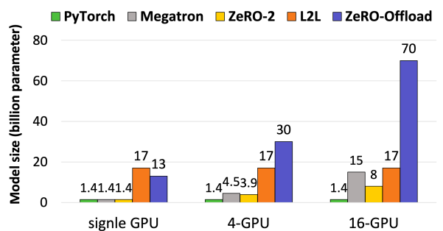
Memory offloading
ZeRO-offload: https://arxiv.org/abs/2101.06840
Offload in parallel with computation
Use gradient checkpointing
Delayed parameter update

Slide 23
Q: What if a model is larger than GPU?
easy mode: cannot fit batch size 1
expert mode: not even parameters!
Can we do it better with multiple GPUs?

Slide 24
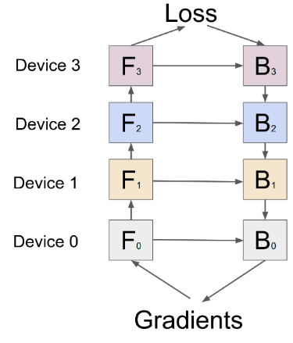
Model-parallel training
Q: What if a model is larger than GPU?

Slide 25
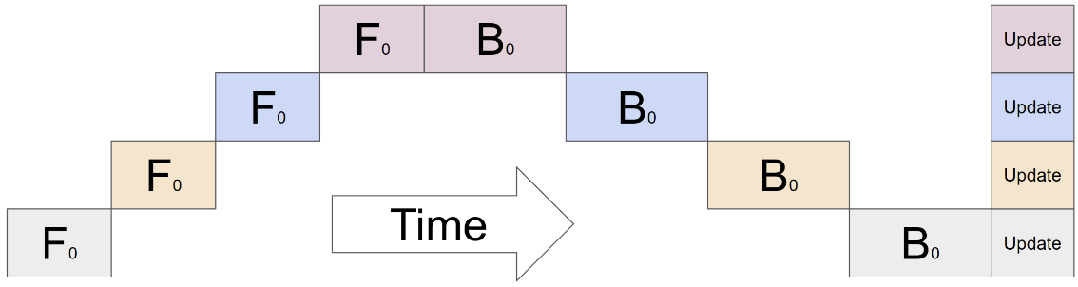
Model-parallel training
Q: What if a model is larger than GPU?
model size: O(N)
throughput: O(1)
Q: Can we go faster?

Slide 26
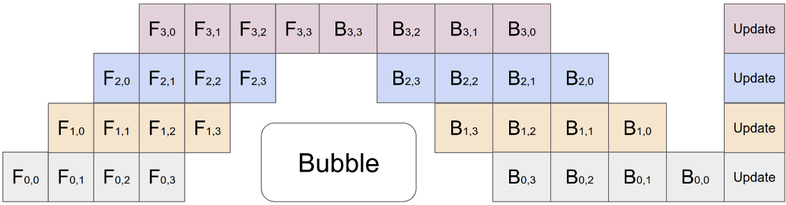
Pipelining
Idea: split data into micro-batches and form a pipeline (right)
GPipe: arxiv.org/abs/1811.06965 – good starting point, not the 1st paper
model size: O(n)
throughput: O(n) – with caveats

Slide 27
Pipelining
Idea: split data into micro-batches and form a pipeline (right)
GPipe: arxiv.org/abs/1811.06965 – good starting point, not the 1st paper
model size: O(n)
throughput: O(n) – with caveats
Q: Even faster?

Slide 28
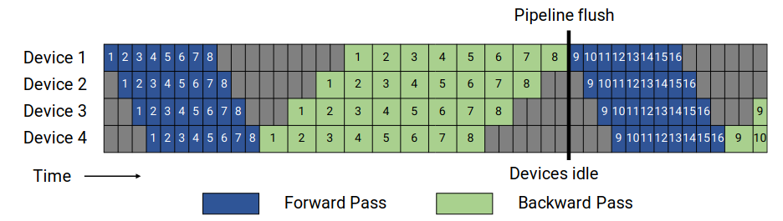
Reducing the bubble
GPipe: arxiv.org/abs/1811.06965
GPipe:
… to be improved in a moment
Note: backward takes longer than forward in practice
E.g. linear forward has one matmul,
backward has two matmuls (dW and dX)

Slide 29

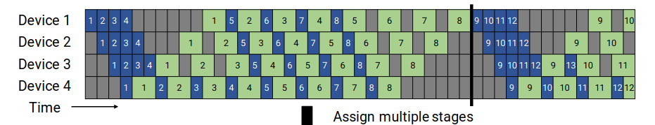

Reducing the bubble
1F1B pipeline from Megatron: https://arxiv.org/abs/2104.04473
GPipe:
Colocate forward with backward
1F1B:

Slide 30
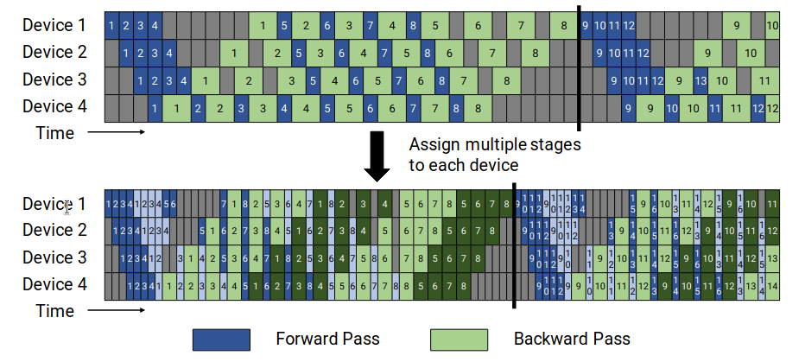
Reducing the bubble
(further)
1F1B pipeline from Megatron: https://arxiv.org/abs/2104.04473
1F1B:
1F1B interleaved:

Slide 31
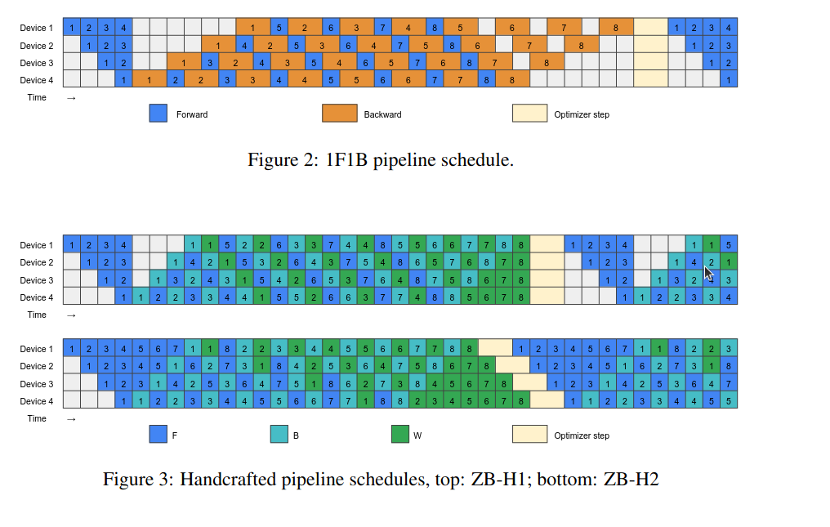
Reducing the bubble
(furtherer)
ZB1P: “almost zero bubble” https://arxiv.org/abs/2401.10241
Idea: split backward into two ops:
- w.r.t inputs and w.r.t. weights
Grad w.r.t. weights doesn’t block
backward pass to prev stage

Slide 32
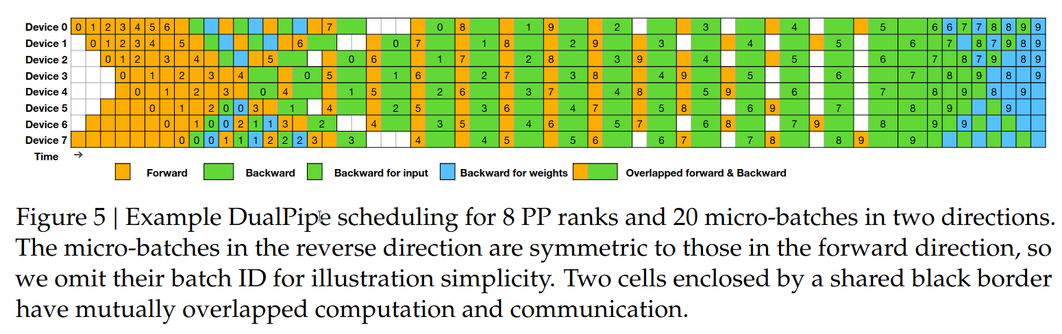
Reducing the bubble
(furtherer yet)
Deepseek V1 schedule: https://arxiv.org/abs/2412.19437

Slide 33
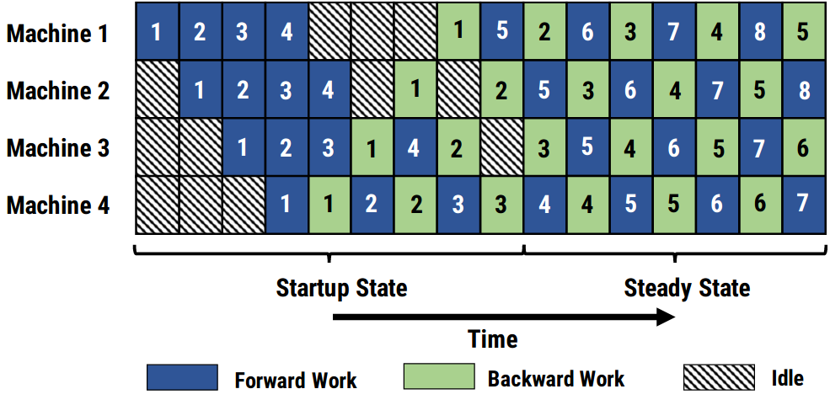
Asynchronous Pipelining
Idea: apply gradients with every microbatch for maximum throughput
PipeDream: arxiv.org/abs/1806.03377
Also neat:
  Automatically partition layers to GPUs via dynamic programming
  Store k past weight versions to reduce
  gradient staleness
  Aims at high latency

Slide 34
Pipelining Recap
When to use:
- model doesn’t fit on GPU; have multiple GPUs
- if model fits, but not the activations: ???
- if model doesn’t fit, but you only have one GPU: ???
How to use:
(just a moment...)

Slide 35
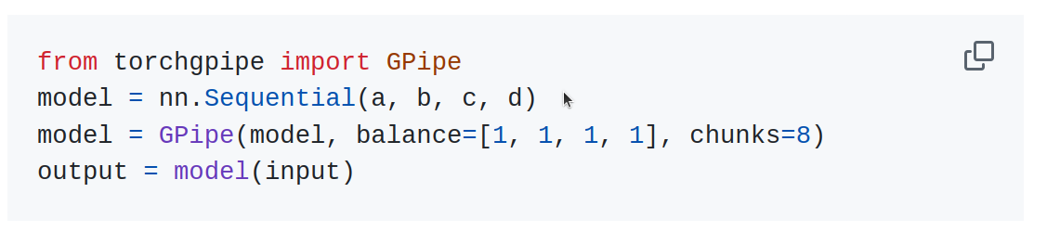
Pipelining Recap
When to use:
- model doesn’t fit on GPU; have multiple GPUs
- if model fits, but not the activations: just do grad checkpointing!
- if model doesn’t fit, but you only have one GPU: offloading!
How to use:
- Basic implementation (GPipe): github.com/kakaobrain/torchgpipe

Slide 36
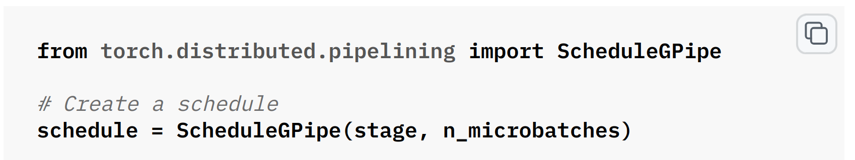
Pipelining Recap
When to use:
- model doesn’t fit on GPU; have multiple GPUs
- if model fits, but not the activations: just do grad checkpointing!
- if model doesn’t fit, but you only have one GPU: offloading!
How to use:
- Basic implementation (GPipe): github.com/kakaobrain/torchgpipe
- PyTorch built-in: pytorch.org/tutorials/intermediate/pipelining_tutorial.html
uses torch.distributed (torchrun) | supports GPipe, 1F1B, extendable!

Slide 37
Pipelining Recap
When to use:
- model doesn’t fit on GPU; have multiple GPUs
- if model fits, but not the activations: just do grad checkpointing!
- if model doesn’t fit, but you only have one GPU: offloading!
How to use:
- Basic implementation (GPipe): github.com/kakaobrain/torchgpipe
- PyTorch built-in: pytorch.org/tutorials/intermediate/pipelining_tutorial.html
- DeepSpeed: https://deepspeed.readthedocs.io/en/latest/pipeline.html
Custom pipelines in many applications
- Megatron-LM: https://github.com/NVIDIA/Megatron-LM (transformer-specific)
- Megablocks: https://github.com/databricks/megablocks (mixture-of-experts)

Slide 38
Pipelining Recap
When to use:
- model doesn’t fit on GPU; have multiple GPUs
- if model fits, but not the activations: just do grad checkpointing!
- if model doesn’t fit, but you only have one GPU: offloading!
How to use:
- Basic implementation (GPipe): github.com/kakaobrain/torchgpipe
- PyTorch built-in: pytorch.org/tutorials/intermediate/pipelining_tutorial.html
- DeepSpeed: https://deepspeed.readthedocs.io/en/latest/pipeline.html
Problems:
- Bubbles = wasted compute time (duh)
- What if model layers aren’t symmetric? (e.g. LLM “head”, local attn, ViT pooling)
Balancing a pipeline is a world of hurt.

Slide 39
[short break]
How else can we run a large model
over multiple GPUs / hosts?

Slide 40
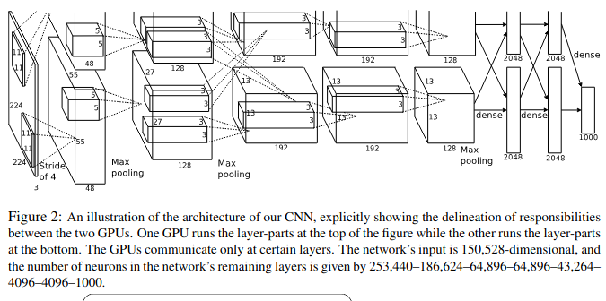
Tensor-parallel training
https://papers.nips.cc/paper/4824-imagenet-classification-with-deep-convolutional-neural-networks
See also: DP + TP https://arxiv.org/abs/1404.5997

Slide 41
Tensor-parallel training
Multiply by a
part of matrix
Partial
product
Scatter
-reduce
Device
input
all-gather
WEIGHT
MATRIX
x
=
∑
GPU1
x
=
∑
GPU2

Slide 42
Tensor-parallel training
Q: find AllReduce op here
Multiply by a
part of matrix
Partial
product
Scatter
-reduce
Device
input
all-gather
WEIGHT
MATRIX
x
=
∑
GPU1
x
=
∑
GPU2

Slide 43
Tensor-parallel training
Q: find AllReduce op here
Multiply by a
part of matrix
Partial
product
Scatter
-reduce
Device
input
all-gather
WEIGHT
MATRIX
x
=
∑
GPU1
to next step ...
x
=
∑
GPU2

Slide 44
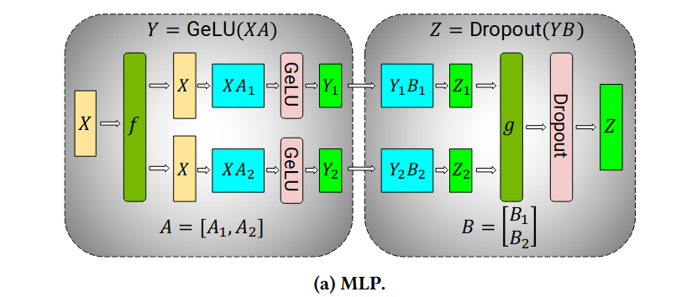
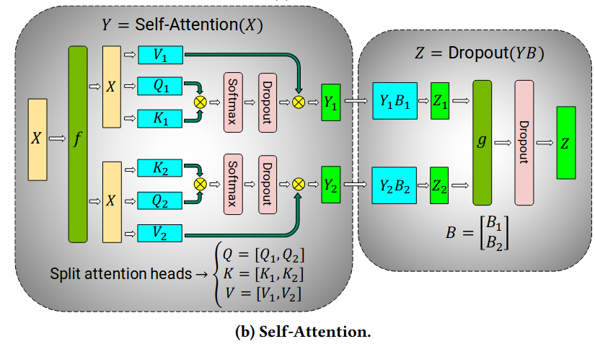
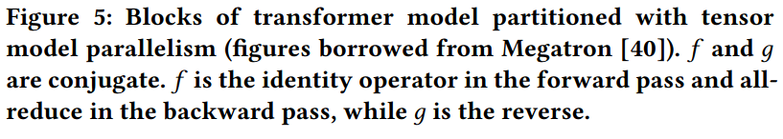
Tensor-parallel training
https://arxiv.org/pdf/2104.04473
Mix and match parallelism directions to reduce synchronization
MLP: split over neurons
Attention: split over heads

Slide 45
Tensor-parallel training
https://arxiv.org/pdf/2104.04473
Mix and match parallelism directions to reduce synchronization
MLP: split over neurons
Attention: split over heads

Slide 46
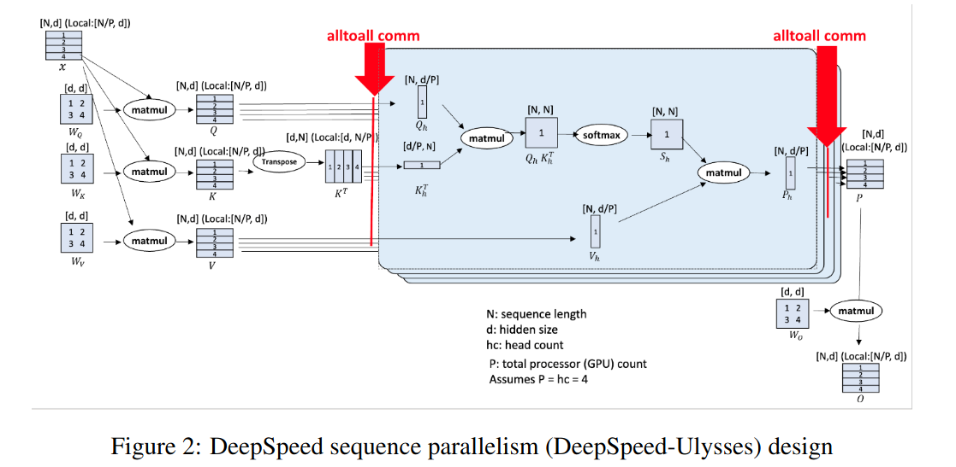
Sequence Parallelism
https://arxiv.org/abs/2309.14509
Avoid storing the all activations on every device

Slide 47
Sequence Parallelism
[MOAR]
Early mention of parallelism over sequences
https://arxiv.org/abs/2105.05720
DeepSpeed Ulysses – the method from previous slide
https://arxiv.org/abs/2309.14509
Ring Attention – compute attention dot / softmax in parallel
https://arxiv.org/abs/2310.01889
FLUX – overlap computation and communication with custom kernelshttps://arxiv.org/abs/2406.06858

Slide 48
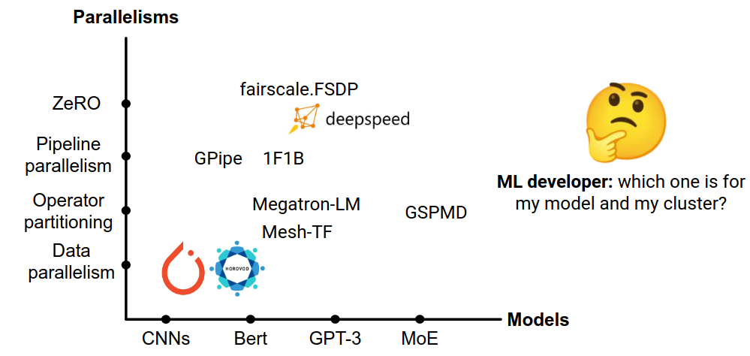
Automated parallelism source: https://sites.google.com/view/icml-2022-big-model

Slide 49
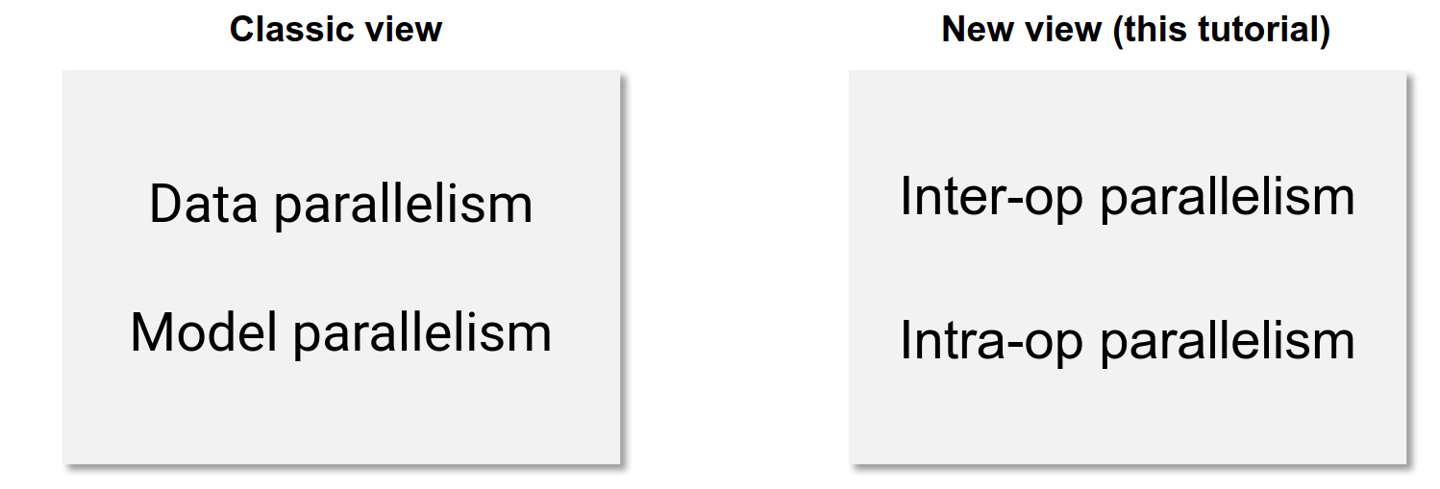
Automated parallelism source: https://sites.google.com/view/icml-2022-big-model

Slide 50
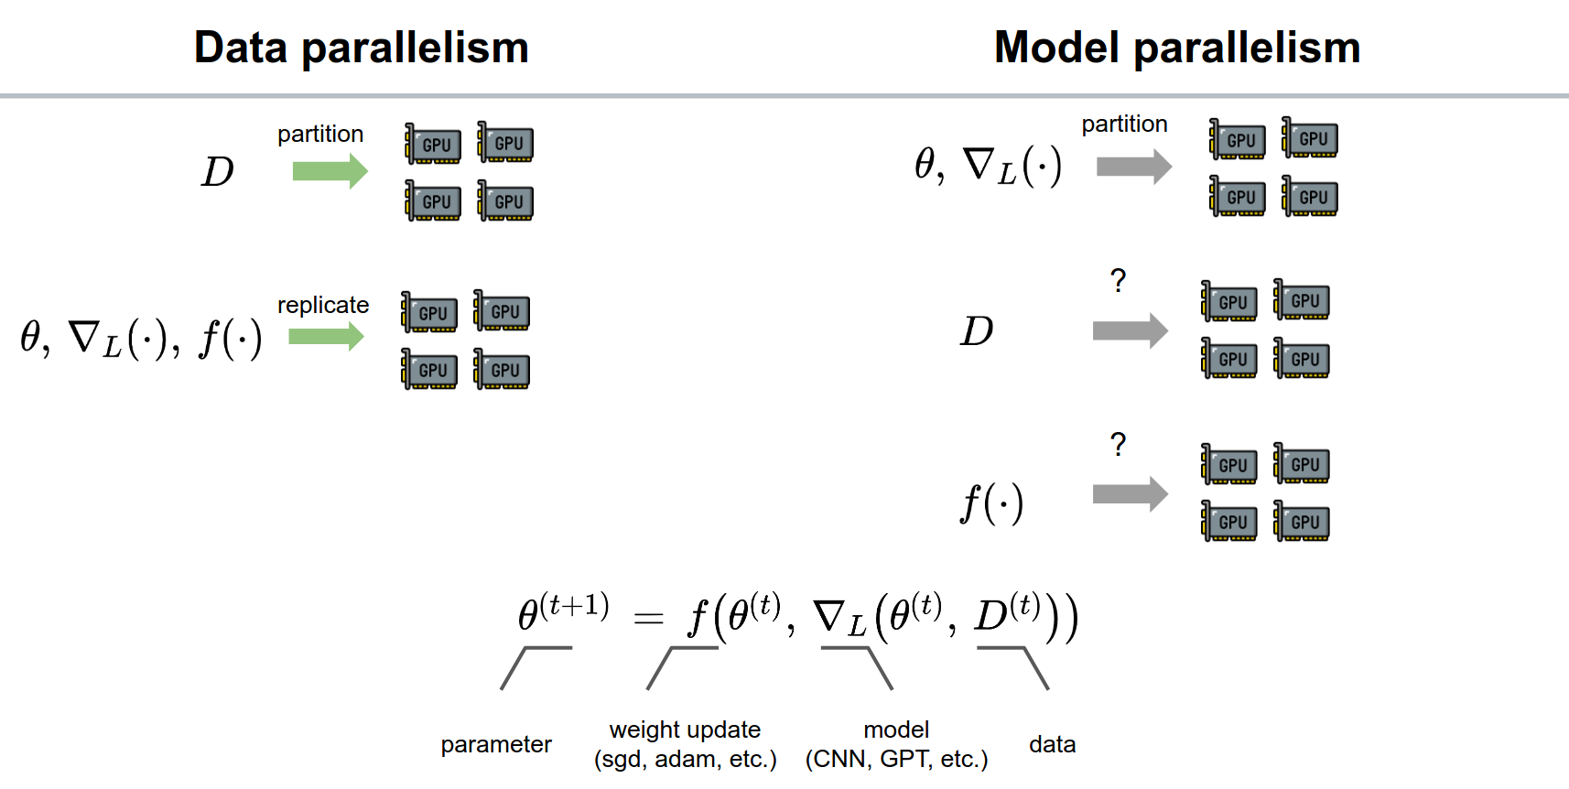
Automated parallelism source: https://sites.google.com/view/icml-2022-big-model

Slide 51
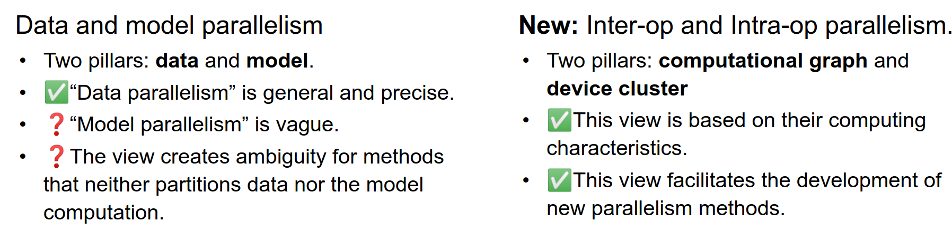
Automated parallelism source: https://sites.google.com/view/icml-2022-big-model

Slide 52
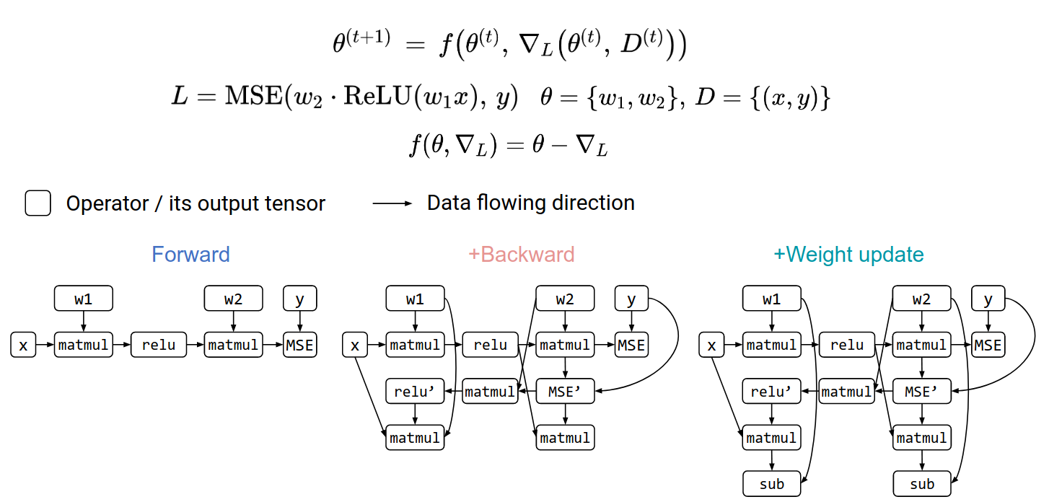
Automated parallelism source: https://sites.google.com/view/icml-2022-big-model

Slide 53
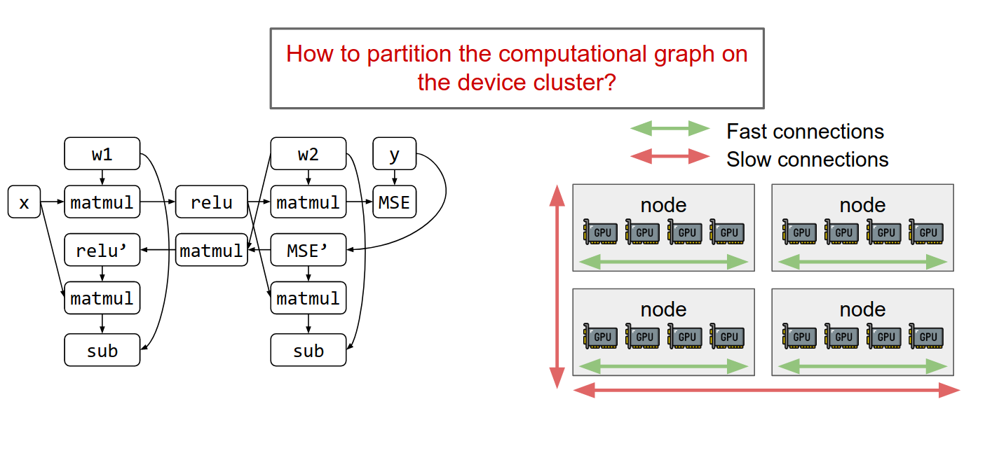
Automated parallelism source: https://sites.google.com/view/icml-2022-big-model
Compute graph
Device cluster

Slide 54
Automated parallelism source: https://sites.google.com/view/icml-2022-big-model
Q: How to partition the graph on the device cluster?

Slide 55
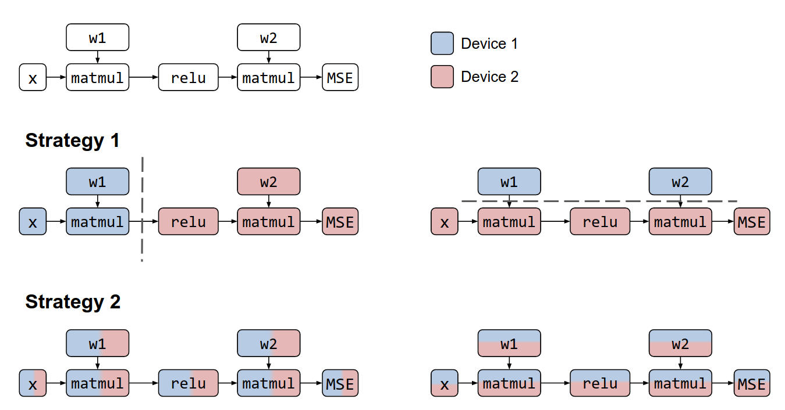
Automated parallelism source: https://sites.google.com/view/icml-2022-big-model
Strategy 1
Strategy 2
Strategy 3
Strategy 4

Slide 56
Automated parallelism source: https://sites.google.com/view/icml-2022-big-model
Q: have you seen S1/2/3/4 before?
Strategy 1
Strategy 2
Strategy 3
Strategy 4

Slide 57
Automated parallelism source: https://sites.google.com/view/icml-2022-big-model
Pipeline MP
DP with offloading or PS
Tensor-parallel v1
Tensor-parallel v2
Strategy 4

Slide 58
Automated parallelism source: https://sites.google.com/view/icml-2022-big-model
Inter-op parallelism
Pipeline MP
DP with offloading or PS
Intra-op parallelism
Tensor-parallel v1
Tensor-parallel v2
Strategy 4

Slide 59
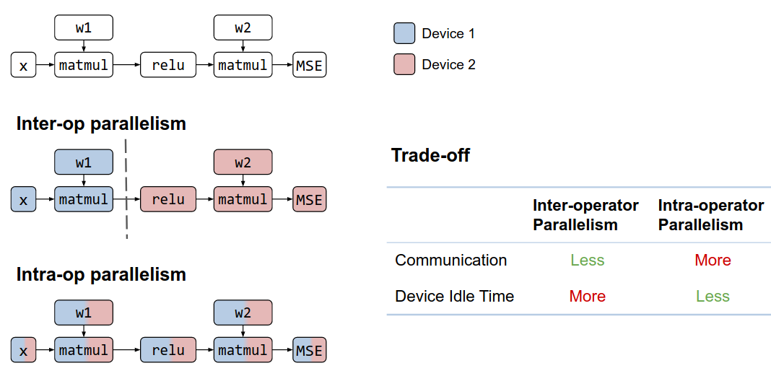
Automated parallelism source: https://sites.google.com/view/icml-2022-big-model

Slide 60
Automated parallelism source: https://sites.google.com/view/icml-2022-big-model
Q: how do we find the best strategy
for partitioning the graph?

Slide 61
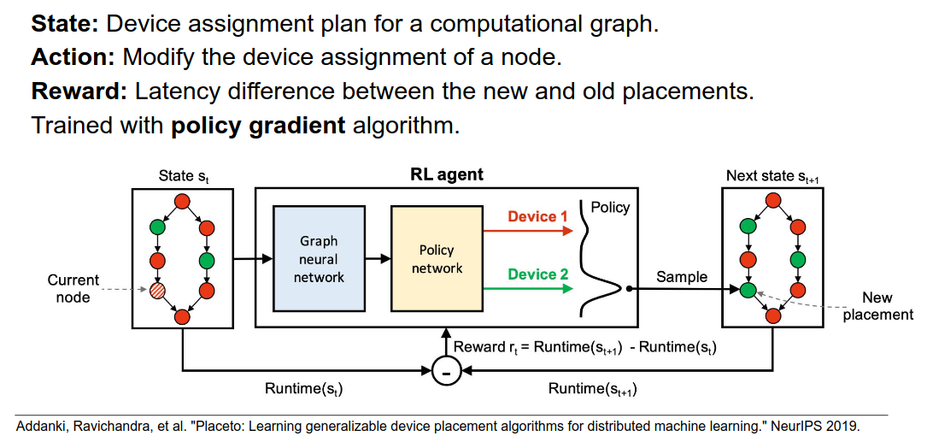
RL-based partitioning https://people.csail.mit.edu/hongzi/content/publications/placeto-neurips19.pdf

Slide 62
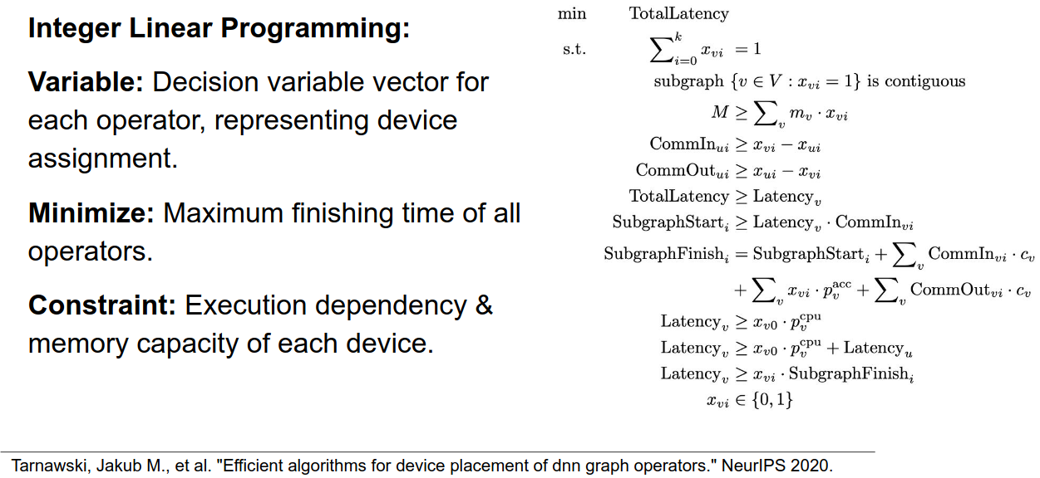
Optimization-based partitioning https://arxiv.org/abs/2006.16423

Slide 63
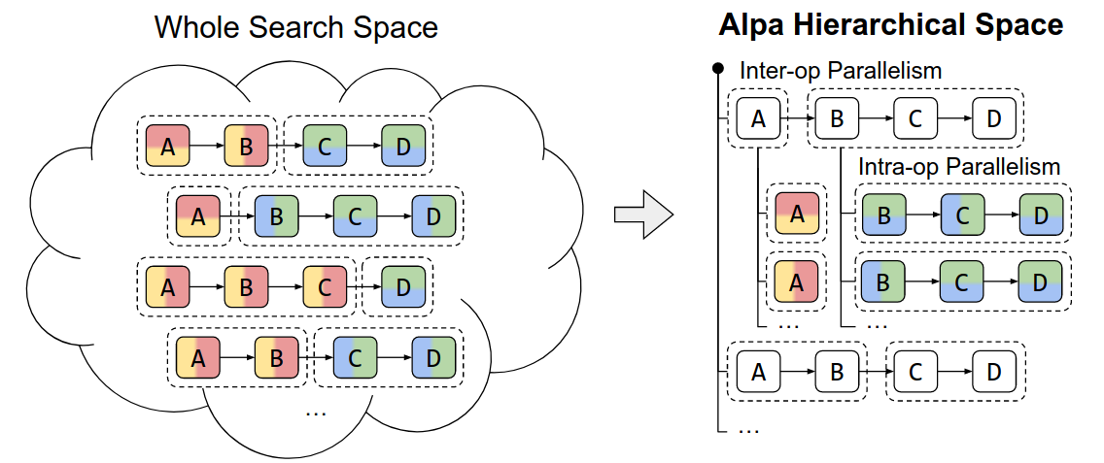
Alpa: optimization-based + reduced search space
https://arxiv.org/abs/2201.12023

Slide 64
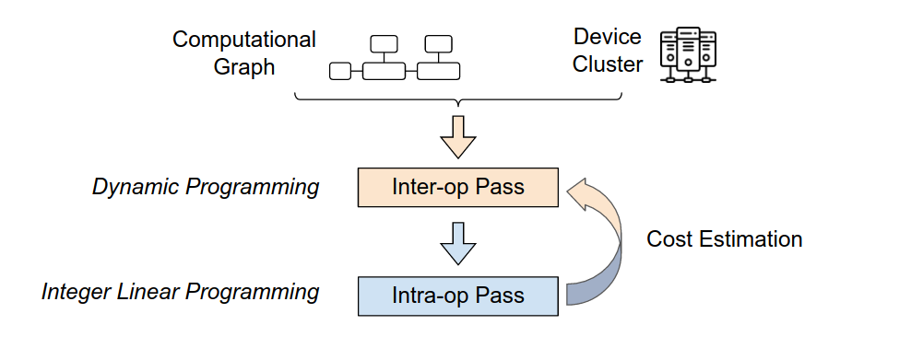
Alpa: optimization-based + reduced search space
https://arxiv.org/abs/2201.12023

Slide 65
Alpa: optimization-based + reduced search space
https://arxiv.org/abs/2201.12023
More details of each pass:
https://sites.google.com/view/icml-2022-big-model

Slide 66
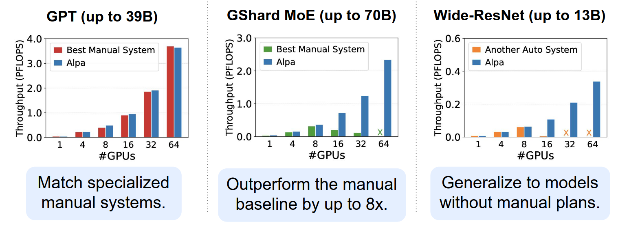
Alpa: optimization-based + reduced search space
https://arxiv.org/abs/2201.12023
Not the first algorithm for auto-parallelism…
but the first one that is usable* (* - most of the time)
(benchmarks on AWS V100)

Slide 67
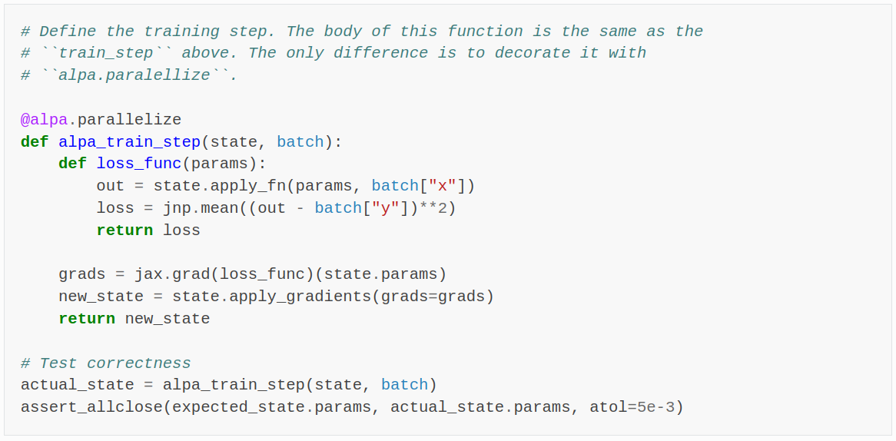
Alpa: optimization-based + reduced search space
https://arxiv.org/abs/2201.12023
Not the first algorithm for auto-parallelism…
but the first one that is usable* (* - most of the time)
auto best strategy
works in jax

Slide 68
Alpa: optimization-based + reduced search space
https://arxiv.org/abs/2201.12023
Not the first algorithm for auto-parallelism…
but the first one that is usable* (* - most of the time)
Alpa was deprecated in 2024, but successors exist
Jax: use pjit/xmap with improved XLA optimizations
PyTorch: https://docs.pytorch.org/xla/master/spmd.html
… but for standard models, DeepSpeed is often enough.
auto best strategy
works in jax

Slide 69
</part 2>
+ model larger than GPU
+ faster for small
* typical size: 2-8 gpus
- model partitioning is tricky
tensor parallelism is easier, but requires ultra low latency
- latency is critical, go buy nvlink
except for PipeDream
- often combined with gradient checkpointing
Tutorials:
  Simple pipelining in PyTorch – tinyurl.com/pytorch-pipelining
  Distributed model-parallel with torch RPC - https://tinyurl.com/torch-rpc
  Minimalistic tensor parallelism pip install tensor_parallel

Slide 70
</part 2>
+ model larger than GPU
+ faster for small
* typical size: 2-8 gpus
- model partitioning is tricky
tensor parallelism is easier, but requires ultra low latency
- latency is critical, go buy nvlink
except for PipeDream
- often combined with gradient checkpointing
Tutorials:
  Simple pipelining in PyTorch – tinyurl.com/pytorch-pipelining
  Distributed model-parallel with torch RPC - https://tinyurl.com/torch-rpc
  Automatic tensor parallelism pip install tensor_parallel
Q: what if you have 1024 GPUs, but the model fits on 8?

Slide 71
</part 2>
+ model larger than GPU
+ faster for small
* typical size: 2-8 gpus
- model partitioning is tricky
tensor parallelism is easier, but requires ultra low latency
- latency is critical, go buy nvlink
except for PipeDream
- often combined with gradient checkpointing
Tutorials:
  Simple pipelining in PyTorch – tinyurl.com/pytorch-pipelining
  Distributed model-parallel with torch RPC - https://tinyurl.com/torch-rpc
  Automatic tensor parallelism pip install tensor_parallel
Large-scale training: combine model- and data-parallel

Slide 72
So far we’ve been trying to partition for existing models…
Perhaps there are models that are easier to partition?

Slide 73
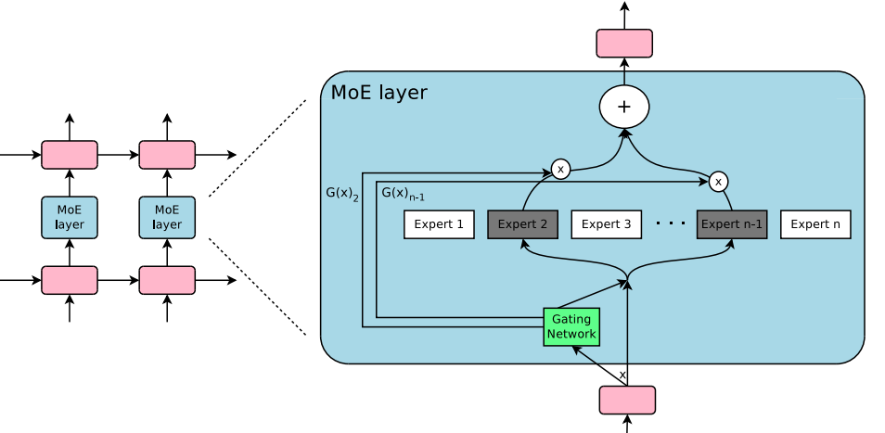
Expert Parallelism
Sparsely gated MoE: https://arxiv.org/pdf/1701.06538.pdf

Slide 74
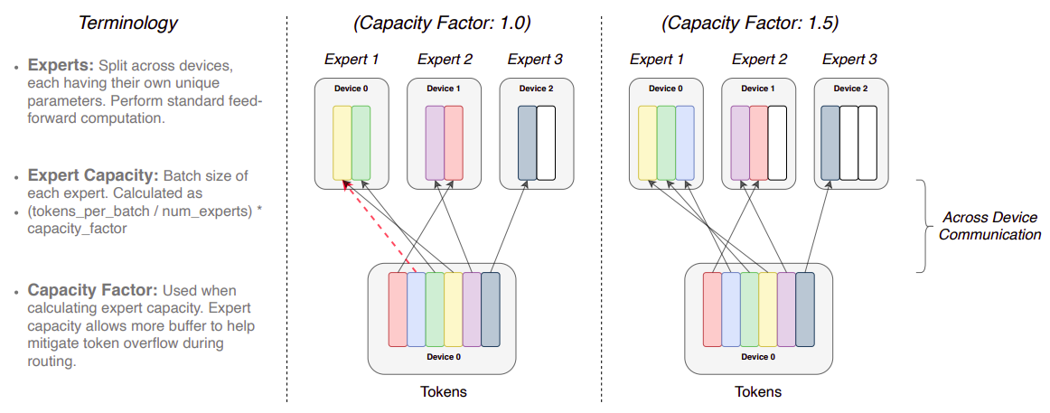
MoE Variant: Switch Transformer
Switch: https://arxiv.org/pdf/2101.03961.pdf

Slide 75
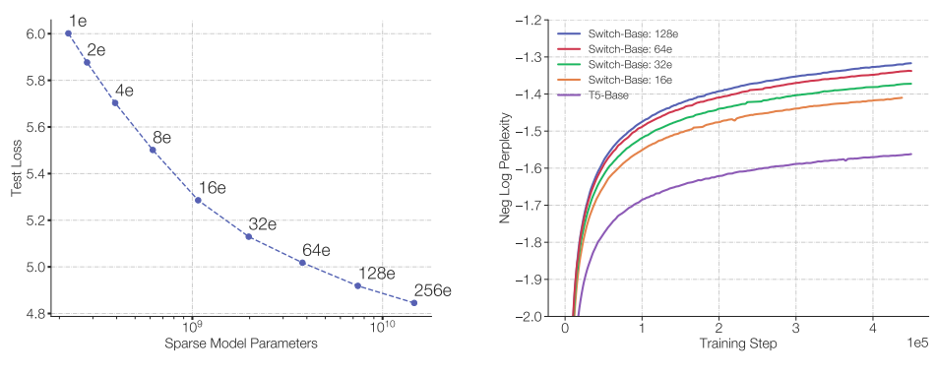
MoE Variant: Switch Transformer
Switch: https://arxiv.org/pdf/2101.03961.pdf
MLM pre-training objective [BERT-like]

Slide 76
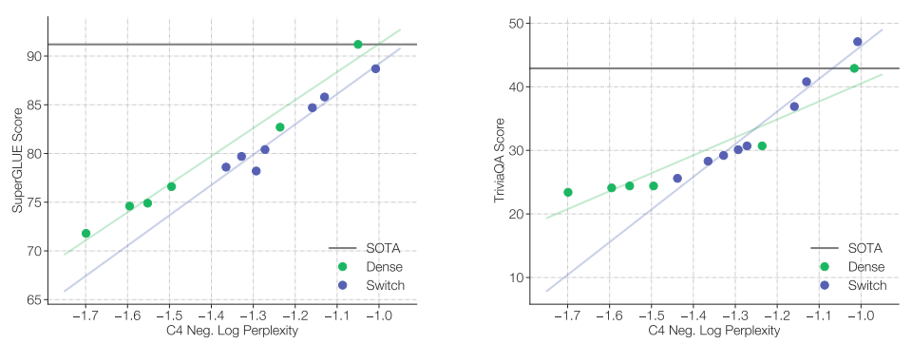
MoE Variant: Switch Transformer
Switch: https://arxiv.org/pdf/2101.03961.pdf
Pre-training vs downstream quality

Slide 77
Alternative: FSDP
Source: microsoft

Slide 78
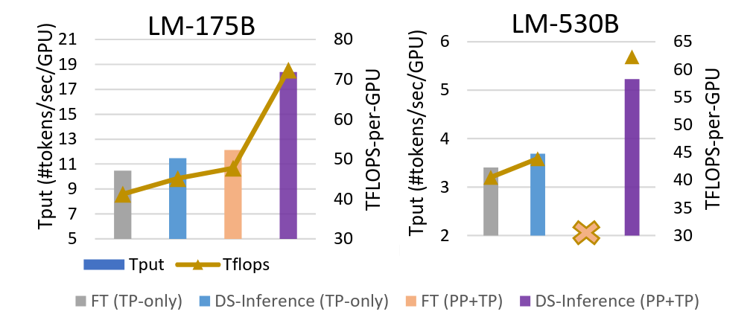
DeepSpeed Inference
Paper: https://arxiv.org/abs/2207.00032
Same techniques, but for inference
Offloading, tensor- & pipeline-parallel
… and a ton of hacks

Slide 79
</ZeRO>
Multi-GPU strategies:
* Pipeline model-parallel – allocate layers on different GPUs
* Sharded data-parallel – split optimizer state and/or parameters
Single GPU strategies:
* Small model – gradient checkpointing & virtual batch
* Large model – optimizer state sharding (keep parameters on GPU)
Implementations:
  DeepSpeed– sharded DP, offload, tensor parallelism, active development
      Offload – https://www.deepspeed.ai/news/2021/03/07/zero3-offload.html
  FSDP – most of DeepSpeed features with native PyTorch API
  Model-specific implementations– https://github.com/NVIDIA/Megatron-LM

Slide 80
If we have time…
(if not, skip)

Slide 81
</lecture>
Example configuration:
Several GPU w/ 24GB memory | 128GB system memory | 16GBps interconnect
16GB model and optimizer, 128GB activations (batch 32) → grad accumulation
16GB model and optimizer, 16GB activations → DDP + gradient checkpointing
32GB model and optimizer, 1GB activations → it depends…
DDP + offloading | FSDP (ZeRO) | Pipeline-parallel | Tensor-parallel
???

Slide 82
</lecture>
Example configuration:
Several GPU w/ 24GB memory | 128GB system memory | 16GBps interconnect
16GB model and optimizer, 128GB activations (batch 32) → grad accumulation
16GB model and optimizer, 16GB activations (batch 1) → grad checkpointing
32GB model and optimizer, 1GB activations → it depends…
DDP + offloading | FSDP (ZeRO) | Pipeline-parallel | Tensor-parallel
???

Slide 83
</lecture>
Example configuration:
Several GPU w/ 24GB memory | 128GB system memory | 16GBps interconnect
16GB model and optimizer, 128GB activations (batch 32) → grad accumulation
16GB model and optimizer, 16GB activations (batch 1) → grad checkpointing
32GB model and optimizer, 1GB activations → it depends…
???

Slide 84
</lecture>
Example configuration:
Several GPU w/ 24GB memory | 128GB system memory | 16GBps interconnect
16GB model and optimizer, 128GB activations (batch 32) → grad accumulation
16GB model and optimizer, 16GB activations (batch 1) → grad checkpointing
32GB model and optimizer, 1GB activations → it depends…
DDP + offloading | FSDP (ZeRO) | Pipeline-parallel | Tensor-parallel
?
When is this the best option?

Slide 85
</lecture>
Example configuration:
Several GPU w/ 24GB memory | 128GB system memory | 16GBps interconnect
16GB model and optimizer, 128GB activations (batch 32) → grad accumulation
16GB model and optimizer, 16GB activations (batch 1) → grad checkpointing
32GB model and optimizer, 1GB activations → it depends…
DDP + offloading | FSDP (ZeRO) | Pipeline-parallel | Tensor-parallel
e.g. if too few GPUs for other methods
?
When is this the best option?

Slide 86
</lecture>
Example configuration:
Several GPU w/ 24GB memory | 128GB system memory | 16GBps interconnect
16GB model and optimizer, 128GB activations (batch 32) → grad accumulation
16GB model and optimizer, 16GB activations (batch 1) → grad checkpointing
32GB model and optimizer, 1GB activations → it depends…
DDP + offloading | FSDP (ZeRO) | Pipeline-parallel | Tensor-parallel
e.g. if too few GPUs for other methods
no custom model code,
best for large batches
?
When is this the best option?

Slide 87
</lecture>
Example configuration:
Several GPU w/ 24GB memory | 128GB system memory | 16GBps interconnect
16GB model and optimizer, 128GB activations (batch 32) → grad accumulation
16GB model and optimizer, 16GB activations (batch 1) → grad checkpointing
32GB model and optimizer, 1GB activations → it depends…
DDP + offloading | FSDP (ZeRO) | Pipeline-parallel | Tensor-parallel
e.g. if too few GPUs for other methods
no custom model code,
best for large batches
communication-efficient
sequential model
?
When is this the best option?

Slide 88
</lecture>
Example configuration:
Several GPU w/ 24GB memory | 128GB system memory | 16GBps interconnect
16GB model and optimizer, 128GB activations (batch 32) → grad accumulation
16GB model and optimizer, 16GB activations (batch 1) → grad checkpointing
32GB model and optimizer, 1GB activations → it depends…
DDP + offloading | FSDP (ZeRO) | Pipeline-parallel | Tensor-parallel
e.g. if too few GPUs for other methods
no custom model code,
best for large batches
communication-efficient
sequential model
minimal latency
non-symmetric model
Mix and match: TP within one server, minimal PP between servers, DDP between groups
Parallel code: manual (e.g. Megatron-LM) vs automated (alpa, FSDP, tensor_parallel)
Unconventional hardware: hivemind, petals, varuna, etc

Slide 89
</lecture>
Example configuration:
Several GPU w/ 24GB memory | 128GB system memory | 16GBps interconnect
16GB model and optimizer, 128GB activations (batch 32) → grad accumulation
16GB model and optimizer, 16GB activations (batch 1) → grad checkpointing
32GB model and optimizer, 1GB activations → it depends…
DDP + offloading | FSDP (ZeRO) | Pipeline-parallel | Tensor-parallel
If the model does not fit, you can also quantize it into submission!
(more on model compression in a future lecture)
e.g. if too few GPUs for other methods
no custom model code,
best for large batches
communication-efficient
sequential model
minimal latency
non-symmetric model
Mix and match: TP within one server, minimal PP between servers, DDP between groups
Parallel code: manual (e.g. Megatron-LM) vs automated (alpa, FSDP, tensor_parallel)
Unconventional hardware: hivemind, petals, varuna, etc

Slide 90

</lecture>

