Slide 1

Creating a P4DTG Plugin:
Integrating Perforce and Defect Trackers
Alan H. Teague
Perforce Software

Slide 2
Agenda
Perforce Defect Tracking Gateway
  Goals
  Architecture
  Behavior
Anatomy of a P4DTG Plugin
  Structure
  Design Decisions
What is the P4DTG SDK
  Examples
  MyDTS

Slide 3
Goals
Primary
  Automatic linking of fix information
  Third party defect tracker integration
  Robust and scalable
Secondary
  Customizable replication
  Easy to adopt and maintain

Slide 4
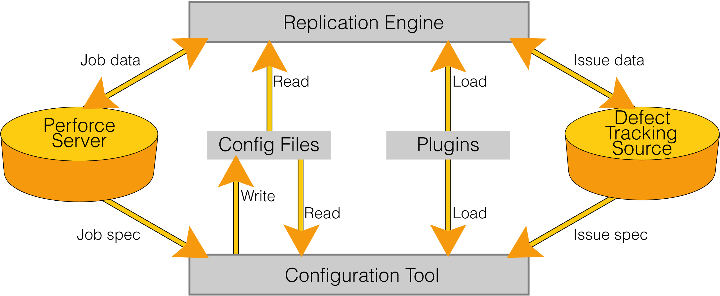
Perforce Defect Tracking Gateway

Slide 5
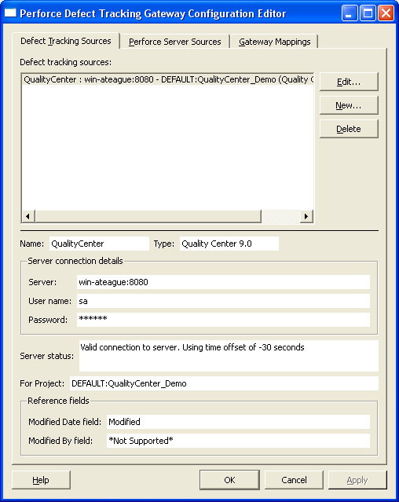
Configuration File: Data Sources
<DTGConfiguration>
<DataSource
type="DTS"
plugin="Quality Center 9.0"
nickname="QualityCenter"
server="win-ateague:8080"
user="sa"
password="******"
module=
"DEFAULT:QualityCenter_Demo"
moddate_field="Modified"
moduser_field="*Not Supported*" />
</DTGConfiguration>

Slide 6
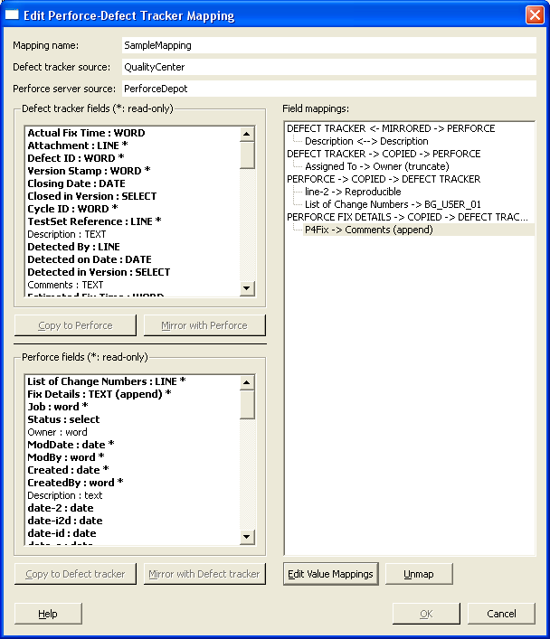
Configuration File: Data Mappings
<DTGConfiguration>
<DataMapping
id="SampleMapping"
scm_id="PerforceDepot"
dts_id="QualityCenter"
mirror_conflicts="ERROR">
<FixRule
dts_field="Comments"
copy_type="APPEND"
file_list="1"
change_number="1"
description="1"
fixed_by="1"
fixed_date="1" />
<MirrorRules>
<CopyRule
scm_field="Description"
dts_field="Description"
copy_type="TEXT"
truncate="0" />
...

Slide 7
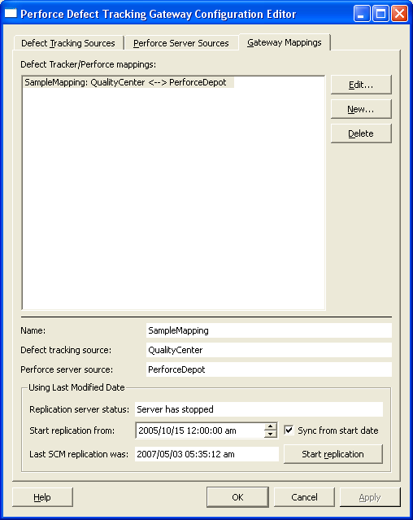
Configuration File: Replication Settings
<DTGGateway>
<DTGSettings
id="SampleMapping"
force="1">
<LastUpdateSCM>
<Date
year="2007"
month="5"
day="3"
hour="5"
minute="35"
second="12" />
</LastUpdateSCM>
<LastUpdateDTS>
...
</LastUpdateDTS>
<StartingDate>
...
</StartingDate>
</DTGSettings>
</DTGGateway>

Slide 8
Structure of a Plugin
Shared Library
C Functional Interfaces
  Library
  Server
  Project
  Defect
Opaque Types: Connection, Project, Defect

Slide 9
Design Decisions
Level of Integration
  DTS vs Database API
  C/C++ Level vs Interpreted vs Webservices
Workflow Impacts
  Defect state vs Development process
Data Field Mapping
  5 types: DATE, WORD, LINE, TEXT, SELECT
  Read/Write vs Read Only
Authentication
Platform

Slide 10
P4DTG SDK
Example Plugins
  Perforce
  Bugzilla
MyDTS Framework
  Exported C Functions
  MyDTG, MyDTGProject, MyDTGDefect Classes
  MyDTS Class
Command-line test tool
Supports Windows XP, Visual Studio 2003/2005

Slide 11
MyDTS Framework Architecture

Slide 12
Step by Step
Compile framework and test tool
Code incrementally
Test at each stage
Key areas
  Connection
  Data type mapping
  Listing changed defects

Slide 13
Wrap up and Questions
P4DTG links defects with fix information
P4DTG uses plugins to connect to DTS
Plugins are dynamic shared libraries
P4DTG SDK provides a complete framework
SDK is in limited beta
Contact: partners@perforce.com
Questions...

