Slide 1

Perforce Defect Tracking Gateway:
Support Training
Alan H. Teague
Perforce Software

Slide 2
Agenda
Perforce Defect Tracking Gateway
  Architecture
  Behavior
P4DTG Software Developers Kit
  Package
  Plugins
Support Support
Unsupported Support
Questions

Slide 3
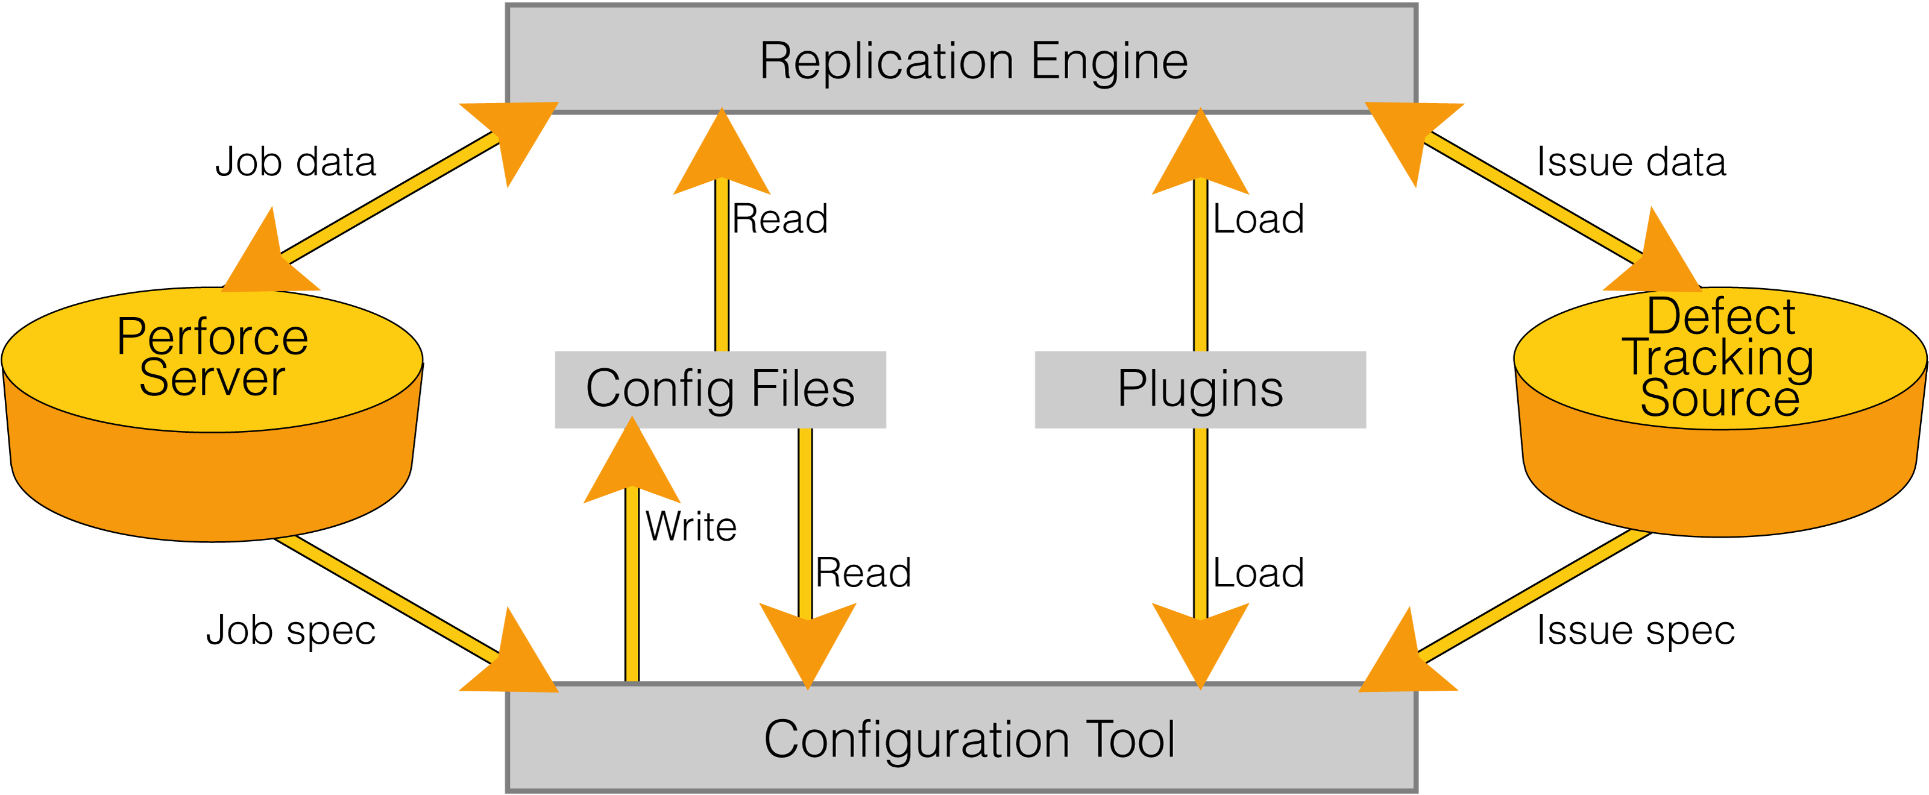
Perforce Defect Tracking Gateway

Slide 4
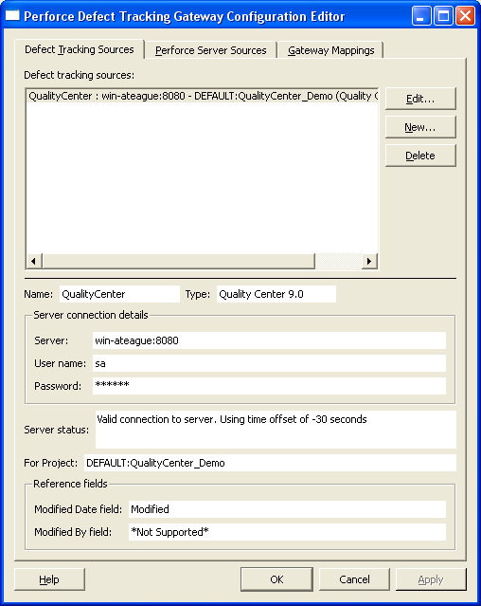
Configuration File: Data Sources
<DTGConfiguration>
<DataSource
type="DTS"
plugin="Quality Center 9.0"
nickname="QualityCenter"
server="win-ateague:8080"
user="sa"
password="******"
module=
"DEFAULT:QualityCenter_Demo"
moddate_field="Modified"
moduser_field="*Not Supported*" />
</DTGConfiguration>

Slide 5
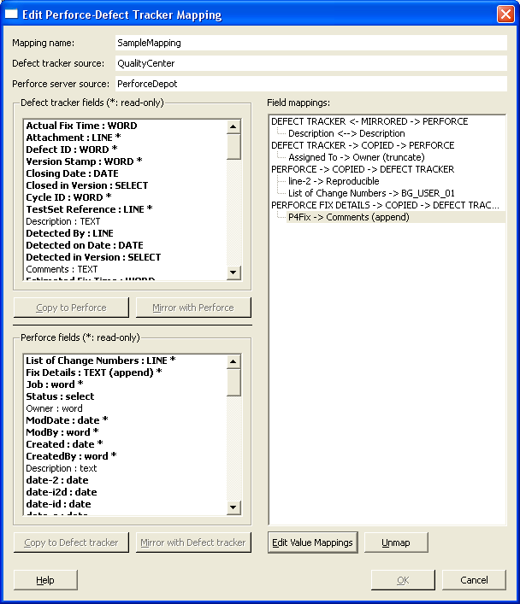
Configuration File: Data Mappings
<DTGConfiguration>
<DataMapping
id="SampleMapping"
scm_id="PerforceDepot"
dts_id="QualityCenter"
mirror_conflicts="ERROR">
<FixRule
dts_field="Comments"
copy_type="APPEND"
file_list="1"
change_number="1"
description="1"
fixed_by="1"
fixed_date="1" />
<MirrorRules>
<CopyRule
scm_field="Description"
dts_field="Description"
copy_type="TEXT"
truncate="0" />
...

Slide 6
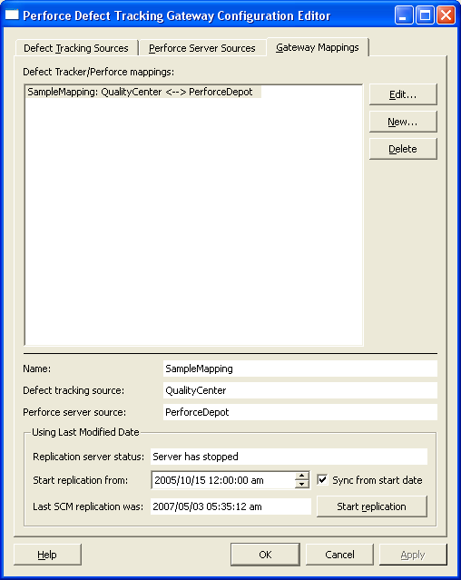
Configuration File: Replication Settings
<DTGGateway>
<DTGSettings
id="SampleMapping"
force="1">
<LastUpdateSCM>
<Date
year="2007"
month="5"
day="3"
hour="5"
minute="35"
second="12" />
</LastUpdateSCM>
<LastUpdateDTS>
...
</LastUpdateDTS>
<StartingDate>
...
</StartingDate>
</DTGSettings>
</DTGGateway>

Slide 7
P4DTG SDK
Example Plugins
  Perforce
  Bugzilla
  Mantis
MyDTS Framework
  Exported C Functions
  MyDTG, MyDTGProject, MyDTGDefect Classes
  MyDTS Class
Command-line test tool
Supports Windows XP, Visual Studio 2003/2005

Slide 8
Structure of a Plugin
Shared Library (.so .dll)‏
C Functional Interfaces
  Library
  Server
  Project
  Defect
Opaque Types: Connection, Project, Defect

Slide 9
Support Tools
Version Information
  p4dtg-config - About page in help
  Windows explorer - Properties on executables
Configuration Files – config/* directory
  src-SOURCE.xml
  map-MAPNAME.xml
  set-MAPNAME.xml
  src-MAPNAME
Log/Status Files – repl/* directory
  log-MAPNAME
  err-MAPNAME
  (run|stop)-MAPNAME
p4dtg-test
  Type 'h'
p4dtg@perforce.com

Slide 10
What could possibly go wrong?
Installation
    TDConnect, Jobspec,
p4dtg-config
  Connection failures, incomplete mappings, hacked xml, memory leaks,
p4dtg-repl / p4dtg-service
  Same user, old select values, clashing changes, network outages, rejected updates, startup order, other perforce/plugin errors
SDK
  Initial build, p4jobdt build, bugzilla build, design questions, design problems, coding problems

Slide 11
What more could someone want?
Triggers
    Prevent p4 job creation
    Map bug id to job
    State transition
Plugins
  Bugzilla, TeamTrack, C-Pine, Jira, Fogbugz
Features
  Filtered replication, many-to-many support
  Configurable polling, reset period, logging
  Unicode?

Slide 12
Magic Beans for Map Files
<Attributes>
<DataAttr name=”log_level” value=”0” /> [0-3]
<DataAttr name=”sleep_dur” value=”5” /> [1-100]
<DataAttr name=”query_limit” value=”1000” /> [1+]
</Attributes>
  Log: 0 - Errors, 1 - Warnings, 2 - Details, 3 – Info
FILTERING IS CHANGING

Slide 13
Wrap up and Questions
P4DTG links defects with fix information
P4DTG uses plugins to connect to DTS
Plugins are dynamic shared libraries
P4DTG SDK provides a complete framework
SDK is in limited beta
Contact: partners@perforce.com
Questions...

Slide 14
Beyond here lie monsters...

Slide 15
Goals
Primary
  Automatic linking of fix information
  Third party defect tracker integration
  Robust and scalable
Secondary
  Customizable replication
  Easy to adopt and maintain

Slide 16
Design Decisions
Level of Integration
  DTS vs Database API
  C/C++ Level vs Interpreted vs Webservices
Workflow Impacts
  Defect state vs Development process
Data Field Mapping
  5 types: DATE, WORD, LINE, TEXT, SELECT
  Read/Write vs Read Only
Authentication
Platform

Slide 17
MyDTS Framework Architecture

Slide 18
Step by Step
Compile framework and test tool
Code incrementally
Test at each stage
Key areas
  Connection
  Data type mapping
  Listing changed defects

