Slide 1
Applications and container monitoring with Performance Co-Pilot
Zabbix Summit 2018, Riga, Latvia
Andrew Nelson
Senior Consultant
Friday, October 5, 2018

Slide 2

Introduction
Senior Consultant with Red Hat in North America
8 Years with Red Hat
Zabbix user for over 15 years
Author of zbxapi, an API library for Ruby
Occasional juggler and weekend woodworker

Slide 3

What is Performance Co-Pilot
“ A System Performance and Analysis Framework “
A framework for system-level performance analysis
For the collection, monitoring, and analysis of system metrics
Uses a distributed architecture
Provides a full API (C, Python, Perl)
Easily extensible and flexible
Often just referred to as PCP
It is recommended to use “Performance Co Pilot” when searching for information online

Slide 4
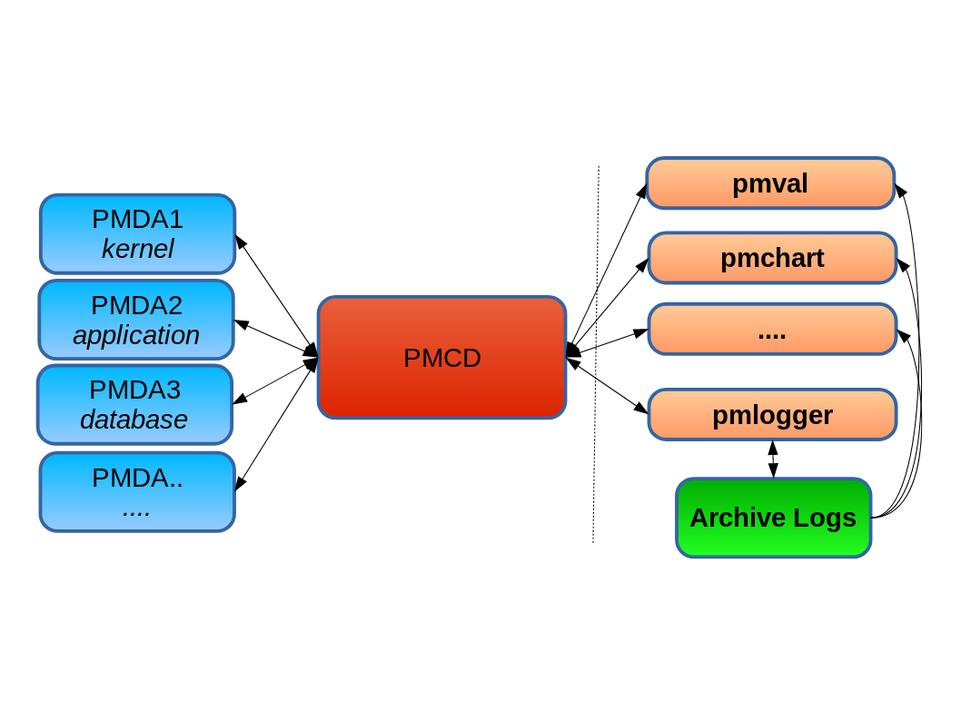
What is Performance Co Pilot
The core components
pmcd - Performance Metrics Collector Daemon
pmdas - Performance Metrics Domain Agents
pmns - Performance Metrics Name Space
Clients

Slide 5
What is Performance Co Pilot
A small sample of the PMDAs available
Activemq
Apache
Docker
Ds389
Elasticsearch
Freebsd
Nginx
KVM
Linux
Mysql
Postgresql
memory-mapped-values
prometheus endpoints
Perfevent
nfs clients
Redis
Samba
SNMP
Solaris
VMware
Windows
Red Hat products:
Satellite 6.4 (NEW!)
Gluster
Red Hat Directory Server (core to Red Hat IdM)

Slide 6
Using PCP
pmprobe
[root@elliot pmcd]# pmprobe libvirt.domstats.net
libvirt.domstats.net.name 3
libvirt.domstats.net.all.tx.drop 3
libvirt.domstats.net.all.tx.errs 3
libvirt.domstats.net.all.tx.pkts 3
libvirt.domstats.net.all.tx.bytes 3
libvirt.domstats.net.all.rx.drop 3
libvirt.domstats.net.all.rx.errs 3
libvirt.domstats.net.all.rx.pkts 3
libvirt.domstats.net.all.rx.bytes 3
libvirt.domstats.net.all.name 3
libvirt.domstats.net.count 3
...

Slide 7
Using PCP
pminfo
[root@elliot pmcd]# pminfo -dtfT libvirt.domstats.net.all.tx.pkts
libvirt.domstats.net.all.tx.pkts [VM NICs, total tx pkts]
Data Type: 64-bit unsigned int InDom: 140.0 0x23000000
Semantics: counter Units: count
Help:
VM NICs, total tx pkts
inst [0 or "923e087e-f0bb-49cd-b91f-8f42f9c07712"] value 12541241
inst [1 or "d771652b-bf82-40bc-ae61-4d06398ed9dc"] value 899528
inst [2 or "7e3b727b-1a82-43df-84d6-2bfbad174496"] value 3567731

Slide 8
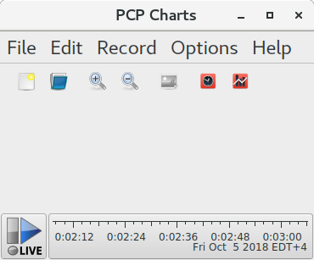
Using PCP
pmchart

Slide 9
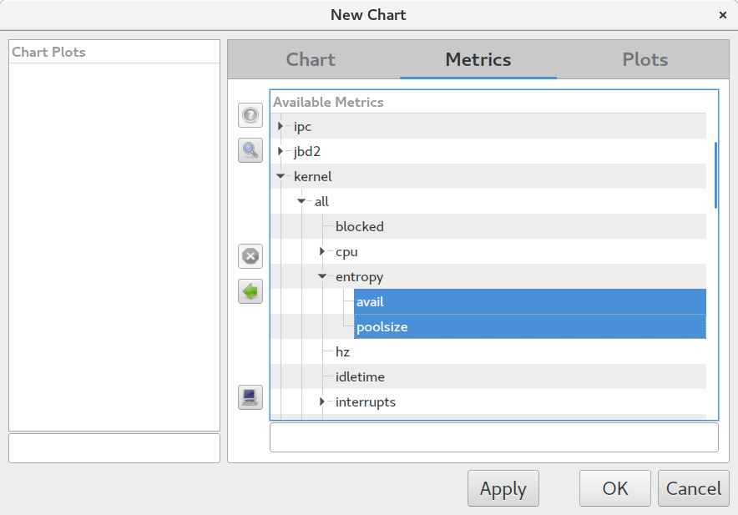
Using PCP
pmchart

Slide 10
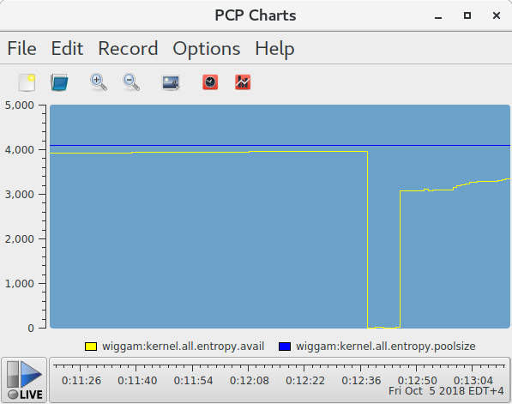
Using PCP
pmchart

Slide 11
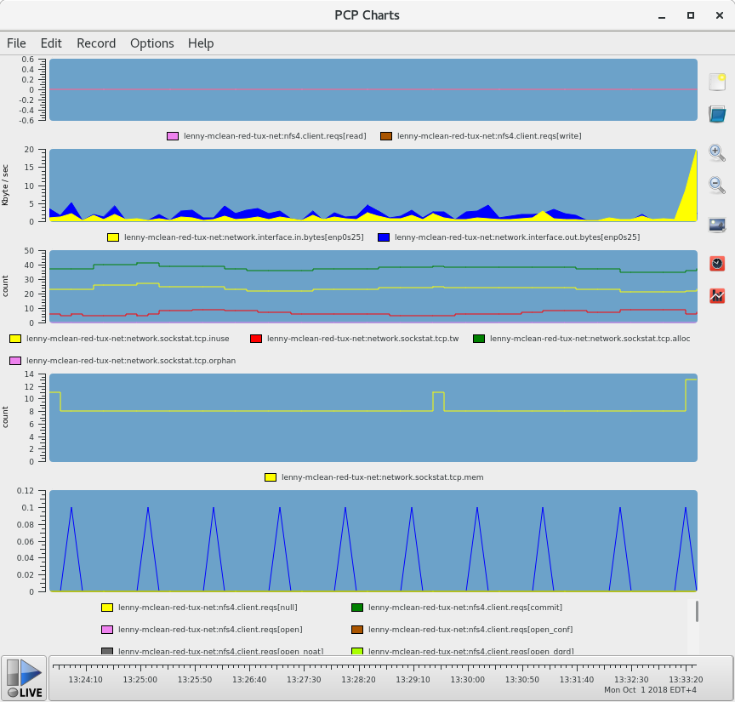
Using PCP
pmchart
NFS4 Reads/Writes
Network bytes In(yellow)/Out(Blue)
TCP Sockets:
Inuse (Yellow)
Time Wait (Red)
Allocated (Green)
Orphan (Purple)
TCP Socket memory
Various NFS Operations

Slide 12
Link Zabbix with Performance Co Pilot
Install PCP (On RHEL7 enable the optional repository)
# yum install pcp pcp-export-zabbix-agent
Enable PCP
# systemctl enable pmcd
# systemctl start pmcd
Add PCP export module to your zabbix agent config file
LoadModule=zbxpcp.so
TEST!
# zabbix_agentd -t pcp.kernel.all.sysfork
pcp.kernel.all.sysfork [u|17068591]

Slide 13
Let’s monitor something with PCP
Monitor the network for a guest from the hypervisor
[root@elliot pmcd]# pminfo -F libvirt.domstats.net.rx.pkts
libvirt.domstats.net.rx.pkts
inst [0 or "d771652b-bf82-40bc-ae61-4d06398ed9dc::net0"] value 1513252
inst [1 or "923e087e-f0bb-49cd-b91f-8f42f9c07712::net0"] value 14469116
inst [2 or "7e3b727b-1a82-43df-84d6-2bfbad174496::net0"] value 4542744
First we need to find figure out the UUIDs for the guests

Slide 14
Let’s monitor something with PCP
Monitor the network for a guest from the hypervisor
[root@elliot libvirt]# virsh list --uuid --name
d771652b-bf82-40bc-ae61-4d06398ed9dc Tower
923e087e-f0bb-49cd-b91f-8f42f9c07712 Zabbix
7e3b727b-1a82-43df-84d6-2bfbad174496 gitlab
Alternatively...
[root@elliot pmcd]# pminfo -F libvirt.dominfo.name
libvirt.dominfo.name
inst [0 or "923e087e-f0bb-49cd-b91f-8f42f9c07712"] value "Zabbix"
inst [1 or "d771652b-bf82-40bc-ae61-4d06398ed9dc"] value "Tower"
inst [2 or "7e3b727b-1a82-43df-84d6-2bfbad174496"] value "gitlab"

Slide 15
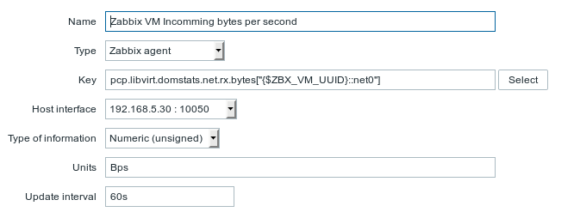
Let’s monitor something with PCP
Monitor the network for a guest from the hypervisor
Don’t forget to add a pre-processor to convert the value to bytes to bytes per second.

Slide 16
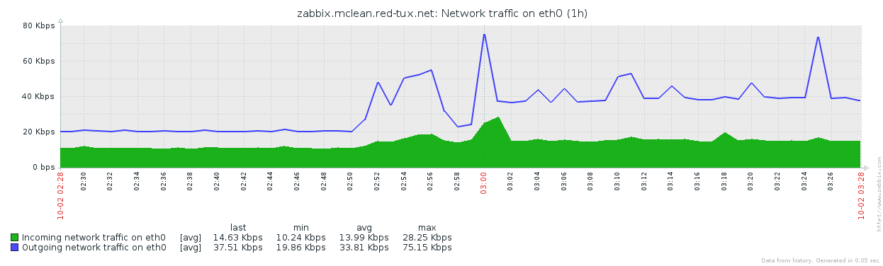
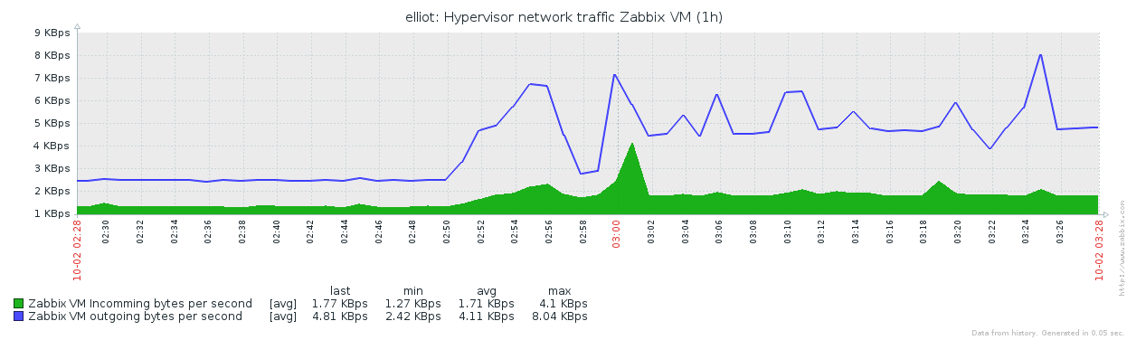
Let’s monitor something with PCP
Network values from the guest and the hypervisor. (guest is bps, hypervisor is Bps)

Slide 17
Creating derived checks with PCP
Using pcp for calculated items
“Derived Metrics” akin to “Calculated items” in zabbix
Configured in: /var/lib/pcp/config/derived
Zabbix specific ones in: /etc/zabbix/zbxpcp-derived-metrics.conf
Derived items have some requirements:
All data must be in the same instance domain
All data must have the same metadata type

Slide 18
Creating derived checks with PCP
Using pcp for calculated items
Some items are already defined as derived metrics:
disk.[dev|dm|md].await
disk.[dev|dm|md].r_await
disk.[dev|dm|md].w_await
disk.[dev|dm|md].avg_qlen
disk.[dev|dm|md].avg_rqsz
disk.[dev|dm|md].r_avg_rqsz
disk.[dev|dm|md].w_avg_rqsz
disk.md.avg_qlen = rate(disk.md.read_rawactive) + rate(disk.md.write_rawactive)
The rate function is akin to Zabbix’s “change over time”

Slide 19
eBPF, BCC and PCP oh my!
Tracing the kernel.
Extended Berkley Packet Filter allows for Linux Kernel tracing.
BCC is the BPF Compiler Collection
Provides a more straight forward interface to compiling eBPF traces
root@lenny-mclean-red-tux-net bcc]# pminfo -f bcc.runq.latency
[bcc.runq.latency
inst [0 or "0-1"] value 622
inst [1 or "2-3"] value 5696
inst [2 or "4-7"] value 9961
inst [3 or "8-15"] value 14202
inst [4 or "16-31"] value 2547
...

Slide 20
eBPF, BCC and PCP oh my!
[root@lenny-mclean-red-tux-net derived]# !549
pminfo -f bcc.runq.latency
bcc.runq.latency
inst [0 or "0-1"] value 26682
inst [1 or "2-3"] value 182745
inst [2 or "4-7"] value 224928
inst [3 or "8-15"] value 445640
inst [4 or "16-31"] value 87867
inst [5 or "32-63"] value 205554
…

Slide 21
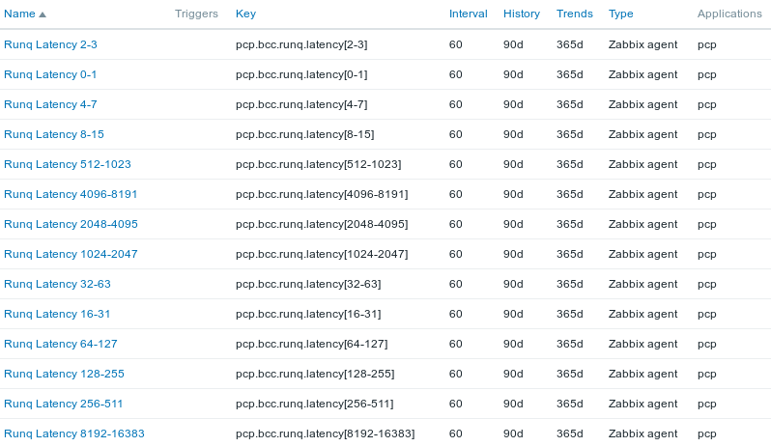
eBPF, BCC and PCP oh my!
Let’s link it to Zabbix

Slide 22
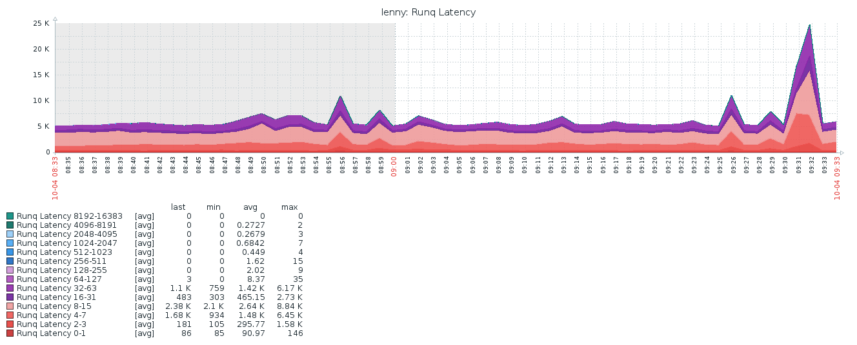
eBPF, BCC and PCP oh my!
Let’s link it to Zabbix

Slide 23
Resources
Main website
https://pcp.io/
Index of Performance Co-Pilot (PCP) articles, solutions, tutorials and white papers:
https://access.redhat.com/articles/1145953

Slide 24
THANK YOU
plus.google.com/+RedHat
facebook.com/redhatinc
linkedin.com/company/red-hat
twitter.com/RedHat
youtube.com/user/RedHatVideos

