Slide 1
PCP & Systemtap
An Intro to Performance Analysis Across Your Entire Network
Jonathan Lebon
Lukas Berk
Red Hat
Oct 25, 2013
Notes:
OMG WRONG MONITOR! ABORT! ABORT!

Slide 2
In Today's Talk
Introduction
Performance Co-Pilot
Demo
(Applause)
Systemtap
Demo
(More Applause)
Questions

Slide 3
Six Stages of Debugging
(With Two Bonus)
That can't happen
That can't doesn't happen on my machine
That doesn't shouldn't happen
Why does that happen?
Oh, I see.
How did that ever work?
Who wrote that?!
Oh... I wrote that.
Credit: http://web.archive.org/web/20051027173148/http://www.68k.org/~jrc/old-blog/archives/000198.html

Slide 4
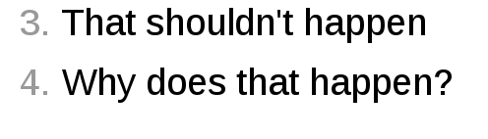
First Step is Acceptance...
But we're here to focus on

Slide 5
In Other Words
Our main objectives are:
  Early detection of a (potential) problem
  Rapidly drill down & pinpoint issue in specific program

Slide 6
Analyzing Performance
How is this typically/historically done?
  rsyslog/syslog-ng/journald
  top/iostat/vmstat/ps
  Mixture of scripting languages (bash/perl/python)
  Specific tools vary per platform
  Proper analysis requires more context

Slide 7

Analyzing Performance
Introducing:

Slide 8
Performance Co-Pilot
Points of interest
  Unix-like component design
  Complements existing system functionality
  Cross platform
  Ubiquitous unit measurement
  Extremely extensible
  Open Source!
Notes:
Complements – non intrusive

Slide 9
Performance Co-Pilot
At the core we have two basic components
Performance Metric Domain Agents
Performance Metric Collection Daemon
Agents
PMCD

Slide 10
Performance Co-Pilot
Agents
Kernel
Webserver
(apache/nginx)
PMCD
DBMS
Network

Slide 11
Performance Co-Pilot
Clients
pmie
pmstat
PMCD
Agents
pmval
pmchart
pminfo

Slide 12
Performance Co-Pilot
PMCD
Agents
Remote
PMCD
Clients

Slide 13
Performance Co-Pilot
Useful commands:
  $ pcp
    summary of PCP installation
  $ pmstat -h <hostname>
    high level system(s) overview
  $ pmchart -c <config> -h <hostnames>
    configurable metric chart

Slide 14
Performance Co-Pilot
[lberk@toium] $ pcp
Performance Co-Pilot configuration on localhost:
  platform: Linux toium 3.11.4-201.fc19.x86_64 #1 SMP Thu Oct 10 14:11:18 UTC 2013 x86_64
  hardware: 4 cpus, 1 disk, 1 node, 3841MB RAM
  timezone: EDT+4
  pmcd: Version 3.8.5-1, 8 agents, 1 client
  pmda: pmcd proc xfs linux mmv kvm bash systemd
  pmlogger: localhost: mysummary/20131022.19.06
Notes:
Note, timezone (globally important!)
Pmda's change per host, easy to install, samples

Slide 15
Performance Co-Pilot
[lberk@saturn:~ (git::master)] $ pmstat -h toium.local -h earth.local -h saturn.local
@ Mon Oct 21 21:21:38 2013
Node loadavg memory swap io system cpu
1 min swpd buff cache pi po bi bo in cs us sy id
saturn 0.00 0 3069m 368400 0 0 0 0 100 125 0 0 100
toium 0.10 4 997600 5614m 0 0 6 86 88 93 0 0 100
earth 1.54 0 7857m 4646m 0 0 0 0 6564 8774 26 3 71
saturn 0.00 0 3069m 368400 0 0 0 0 117 147 0 0 100
toium 0.09 4 997600 5614m 0 0 41 77 69 82 0 0 99
earth 1.50 0 7857m 4646m 0 0 0 14 6656 8891 26 3 70

Slide 16
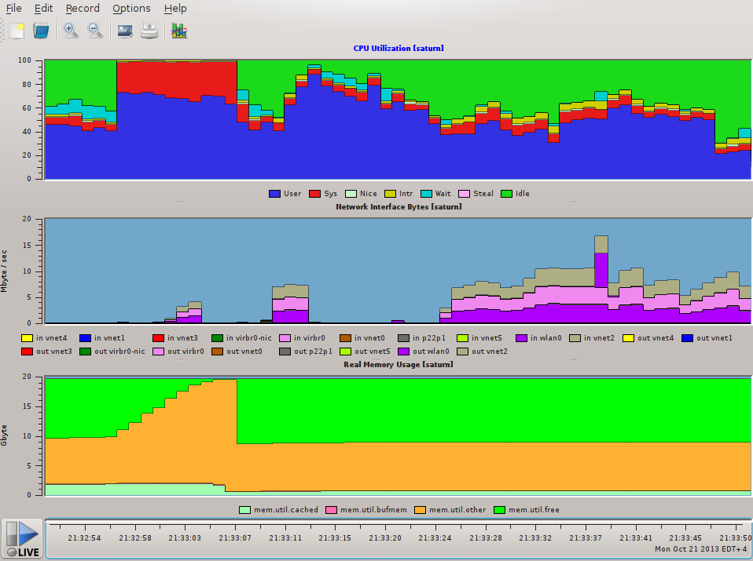
Performance Co-Pilot

Slide 17
Performance Co-Pilot
Great systems overview, but we need malleable, configurable metric tracking.
We have the technology!

Slide 18
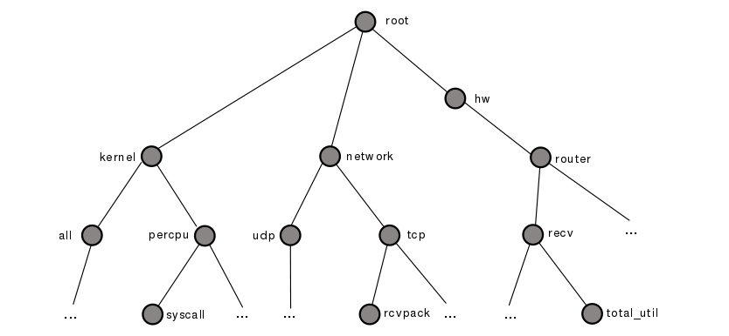
Performance Co-Pilot
Performance Metrics Name Spaces
  Subsystem based hierarchical naming scheme
network
.tcp
.rcvpack

Slide 19
Performance Co-Pilot
A few more useful commands:
  $ pminfo -F
    Full list of all available metrics
  $ pminfo -T -d <metric>
    Query the metric with help info
  $ pmval <metric >
    Query the current metric value

Slide 20
Performance Co-Pilot
Example outputs:
  $ pminfo -T -d kernel.all.sysfork
    kernel.all.sysfork
    Data Type: 64-bit unsigned int
    Semantics: counter Units: count
  Help:
    fork rate metric from /proc/stat

Slide 21
Performance Co-Pilot
Example outputs:
  $ pmval disk.all.write
    metric: disk.all.write
    host: localhost
    semantics: cumulative counter (converting to rate)
    units: count (converting to count / sec)
    samples: all
      0.0
      19.96
      95.67
      101.9

Slide 22
Performance Co-Pilot
pmie
events
pmlogger
PMCD
Log Archive
Agents
Remote
PMCD
Clients

Slide 23
Performance Co-Pilot
Performance Metrics Inference Engine
  Allow you to form metrics-based expressions for evaluation
  Ratios, counts, aggregates, conditionals
  Raise alarms, logging entries, shell commands
  Run on live data or logs
  Run rules across data from multiple hosts

Slide 24
Performance Co-Pilot
Possible expressions
  ( disk.all.write / disk.all.total) * 100;
    Percentage of disk operations that are writes
  disk.dev.total > 10 && disk.dev.write > disk.dev.read;
    If total disk operations are greater than ten, and
    there are more disk writes than reads

Slide 25
Performance Co-Pilot
Possible Rule
  What if we want to know if ethernet stops functioning?
  some_inst
    match_inst “^(eth|em)”
      network.interface.total.errors > 10 count / sec
  -> syslog “Ethernet Errors” “ %i”
Notes:
Are all hosts experiencing at least 20% of their disks busy either reading or writing?

Slide 26
Performance Co-Pilot
Demo!

Slide 27
Performance Co-Pilot
Guiding principle on extensibility:
“If it is important for monitoring system
performance, and you can measure it, you can easily
integrate it into the PCP framework.”
- someone famous
pcp user guide

Slide 28
Performance Co-Pilot
Several ways to extend PCP to your advantage
  Write your own agent
  Write your own gui/cli client (using pmapi)
  Directly adding sample/tracing instrumentation to application (using pcp library functionality)

Slide 29
Questions?

Slide 30
Performance Co-Pilot
At this point we've hopefully:
  Detected the (potential) problem
  Identified the possible culprit(s)
  How do we know what's causing the issue?

Slide 31


Slide 32

What is SystemTap?
Common tools: tracers, profilers, and debuggers
  SystemTap fills the gap between those
Allows you to write scripts to observe all sorts of events on your machine
Similar idea to DTrace
// SystemTap script
probe tcp.sendmsg { gather_info; print(info) }
Linux Kernel Module
Summary Report
sent packet of size ... to ...
sent packet of size ... to ...
...
the all-seeing Linux Kernel
Notes:
- PCP – monitor network health
- SystemTap is a great complement – lower level
- PCP to pinpoint, SystemTap to investigate
- Tracers: function calls only, overload you
- Profilers: like top, give you the big picture, but no details
- Debuggers: requires stopping executing, and/or modifying source, and recompiling
- SystemTap allows you to easily inspect a live system in details

Slide 33
Quick Introduction
Scripts are run at probe points
Example: Hello World
Example: detect when ls is started
probe <trigger> {
<handler>
}
probe begin {
print("Hello, World!\n")
}
probe process(“ls”).begin {
print("ls was started!\n”)
}
Notes:
- You have a point of interest you'd like to monitor
- Reflected ine the basic structure of a SystemTap script

Slide 34
Probe Point Types
SystemTap supports many types of probe points
  Kernel/process probes on statements/functions
  Java method probes
probe kernel.statement(“sys_read@fs/read_write.c:501”)
probe process(“/usr/bin/ls”).function(“main”)
probe java(PID).class(“CLASSNAME”).method(“PATTERN”)
Notes:
- The power of SystemTap: can detect whenever ANY process does a read() call
- Can probe kernel stuff, and process stuff, can do both at the same time
- Rich info requires debuginfo installed

Slide 35
Probe Point Types
Other noteworthy types
  Perf probes
  Timer probes
  Netfilter probes
  SDT marker probes
  And many more...
To list all supported probe types:
$ stap --dump-probe-types
Notes:
- Perf probes: hardware performance counter
- Timer
- Netfilter: monitor network packets

Slide 36
The Language
All the things you'd expect in a scripting language
  Variables, conditionals, loops, functions, arrays, casts, etc... similar to other high-level scripting languages
And a few nice-to-haves
  Tuple-keyed arrays and foreach loop
  Aggregates
  Macros
  Regex matching
Notes:
- Tuple-keyed arrays: arrays can be indexed by not just an integer, but multiple items
- Aggregates: allow you to collect sets of numbers and perform operations on them, e.g. min, man, mean
- Macros: identifiers that the preprocessor expands to something else during parsing

Slide 37
Accessing Variables
Process/kernel probes can access context variables
We can use the -L option to find out what's available:
Also useful to find functions:
probe kernel.function(“sys_write”)
$ stap -L 'kernel.function(“sys_write”)'
kernel.function("SyS_write@fs/read_write.c:516") $fd:long int $buf:long int $count:long int $ret:long int
$ stap -L 'process(“ls”).function(“*”)'
Notes:
- Great strength of SystemTap: access context variables

Slide 38
Tapsets – The Probe Library
Tapsets are libraries of high-level alias probes to help you write your scripts
They also contain helper functions
And helper variables
probe syscall.write --> probe kernel.function(“sys_write”)
probe syscall.write {
printf(“write() was called with data %s\n”,
user_string_n($buf, $count))
}
probe syscall.write {
printf(“write() was called with args %s\n”, argstr)
}
Notes:
Tapsets allow us abstract away architecture-specific differences when probing common functions of interest.
EXPLAIN DIFFERENCE BETWEEN $buf AND argstr, i.e. context vs helper variables.

Slide 39
Useful Tapset Functions and Variables
Retrieving strings
Retrieving main and function arguments
Retrieving probe point and function probed
probe process(“ls”).function(“main”) {
println(cmdline_str())
}
probe process(“nano”).function(“open_file”) {
println($$parms$$)
}
probe process(“ls”).function(“*”) {
printf(“probe point is %s\n”, pp())
printf(“function is %s\n”, ppfunc())
}

Slide 40
Useful Tapset Functions and Variables
Issue a system command
Filtering by PID using stap -x
probe process(“ls”).function(“main”) {
system(“echo main started!”)
}
probe syscall.write {
if (pid() == target())
printf(“process called write() with %s\n”,
user_string_n($buf, $count))
}

Slide 41
And now for some fun!
SystemTap examples

Slide 42
/usr/bin/stress
Q: How does it work?
  What functions does it have?
  When I do
  where does it spend its time stressing the CPU?
$ stress --cpu 3

Slide 43
/usr/bin/stress
Q1: What functions does it have?
A1:
$ stap -L 'process(“stress”).function(“*”)'

Slide 44
/usr/bin/stress
Q2: Where does it spend its time stressing the CPU?
A2:
global funcs, cur = “main”
probe process.function(“*”) {
cur = ppfunc()
}
probe timer.us(100) {
funcs[cur]++
}
probe end {
foreach (func in funcs-) {
printf(“Spent %d us in %s\n”,
funcs[func] * 100, func)
}
}
Notes:
- In fact, you can use this simple script with any command to get the timing breakdown.
- The point: we get rich information from a very simple script

Slide 45
/home/jlebon/my_app
01. #include <stdlib.h>
02. #include <limits.h>
03.
04. short next_number() {
05. static short counter = 0;
06. return counter++;
07. }
08.
09. void main(void)
10. {
11. int i, state;
12. for (i = 0; i < INT_MAX; i++) {
13. state = next_number();
14. }
15. }
returns a short, i.e.
counter ∈ (SHRT_MIN, SHRT_MAX)
called INT_MAX times
14. if (state < 0)
15. system(“echo `date +%s.%N` invalid state”);
16. }
17. }
for
demo
OK if on a system where sizeof(short) == sizeof(int)
Otherwise, state will wrap around before its time!
negative state = black hole created at CERN

Slide 46
/home/jlebon/my_app
Can't fix and recompile!
Q: How can we make sure that we never end up in an invalid (negative) state?
A: Perfect job for SystemTap!
Notes:
The idea here is that it's a running app. There's no adding print statements and recompiling. We need to do this on the fly!

Slide 47
/home/jlebon/my_app
How can we use SystemTap for this?
  1. Keep track of the state
  2. Intercept when next_number() returns and watch for invalid transition
  3. Reset counter to restart from a safe value
12. for (i = 0; i < INT_MAX; i++) {
13. state = next_number();
probe process("./my_app")
.statement("main@my_app.c:13")
probe process("./my_app")
.function("next_number").return
probe process("./my_app")
.function("next_number")

Slide 48
/home/jlebon/my_app
global state, reset_counter
probe process("./my_app").statement("main@my_app.c:13") {
state = $state
}
probe process("./my_app").function("next_number").return {
if ($return < 0) {
printf("Invalid state detected!\n")
printf("About to go from %d to %d!\n", state, $return)
printf("Resetting state to 0 and deploying LHC airbags!\n")
$return = 0
reset_counter = 1
}
}
probe process("./my_app").function("next_number") {
if (reset_counter) {
$counter = 0
reset_counter = 0
}
}
Notes:
- The points:
1. We were able to inspect variables at runtime
2. We were able to MODIFY values at runtime
- CRISIS AVERTED

Slide 49
Questions?

Slide 50
Get Involved!
IRC: irc.freenode.net
  #pcp
  #systemtap
Web:
  http://oss.sgi.com/projects/pcp/
  http://sourceware.org/systemtap
Email:
  systemtap@sourceware.org
  pcp@oss.sgi.com

Slide 51
Get Involved!
IRC: irc.freenode.net
  #pcp
  #systemtap
Web:
  http://oss.sgi.com/projects/pcp/
  http://sourceware.org/systemtap
Email:
  systemtap@sourceware.org
  pcp@oss.sgi.com

