Slide 1
Herding Penguins with Performance Co-Pilot
Ken McDonell
Performance Tools Group
SGI, Melbourne

Slide 2
Overview
  System-level performance management issues.
  Finding the useful performance data.
  Performance Co-Pilot - an open and extensible architecture.
  Automated performance monitoring.
  Monitoring and managing quality of service.

Slide 3
System-level performance management Issues
  Growing complexity of application architectures.
  Primary emphasis on end-user performance, not operating system performance.
  Centralized monitoring for distributed applications.
  Automate the mundane tasks, so people can tackle the hard problems.

Slide 4
Useful performance data
Like Chicken Man, it’s everywhere …
  Hardware instrumentation
  Operating system kernel
  Libraries
  Service layers, daemons, etc.
  Applications
Spanning multiple hosts.
Both real-time and historical data.

Slide 5
Performance Co-Pilot
  Client-server architecture for centralized monitoring of distributed processing.
  Integrated archive services for recording and replaying performance data.
  One API for all performance data.
  Public interfaces and extensible frameworks at all levels.
  Open source release at http://oss.sgi.com/projects/pcp/

Slide 6
PCP architecture
client
PCP Collector Host
Monitor
API
(PMAPI)
metrics
daemon
PCP Monitor Host

Slide 7
PMAPI features
  Namespace services to discover available performance metrics.
  Metadata to describe metrics.
  Set-based data model for multiple instances and values.
  Pull-based retrieval for client-specified subsets of performance metrics.
  Archives and hosts as interchangeable sources of performance metrics.

Slide 8
PCP collector architecture
Performance Metrics
Collector Daemon
pmcd
Collector
Plug-in
API
Linux &
proc
weblog
sendmail
trace
myapp
Collector Plug-ins or Performance Metrics Domain Agents (PMDAs)

Slide 9
Collector plug-in API features
  Most of the complexity is encapsulated in a library … very short development times.
  Communication with PMCD via procedure call (DSO plug-ins), pipes or sockets.
  To access the real data, the plug-in (not PMCD) chooses an appropriate mechanism.
  Lots of source code examples.
  Great value in “roll your own” PMDAs.

Slide 10
Some efficiency issues
  PCP has to be part of the performance solution, not part of the problem!
  Expect PCP and plug-ins to consume less than 1% of one CPU on a collector host.
  PMCD is single threaded with service to completion for each client request.
  Plug-ins must respond quickly.
  Little state maintained in PMCD, clients do interval timing and rate calculations.

Slide 11
Open source PCP components
pmlogger
pminfo
pmstat
pmie
pmtrace
Monitor Tools
Monitor API
Trace API
pmcd
Collector plug-in API
Linux &
proc
weblog
sendmail
mailq
example
trace
PCP Archive Logs
example
example
example
Collector plug-ins

Slide 12
vmstat across the cluster
@ Wed Nov 3 12:55:08 1999
node ld avg ... memory swap io system cpu
1 min ... cache si so bi bo in cs us sy id
leesa 2.00 ... 17676 0 0 0 2 113 15 0 0 100
troppo 1.76 ... 40856 0 0 0 192 290 181 19 81 0
moomba 1.08 ... ? 0 0 2512 467 674 280 13 18 70
gonzo 0.32 ... ? 8 0 160 2 2289 57 10 26 64
thebeas 8.00 ... ? 0 0 0 2 634 20 98 2 0
sandpit 0.00 ... ? 0 0 0 0 1217 11 0 0 100
kuku 0.02 ... ? 0 0 0 0 2468 108 2 1 98
snort 16.43 ... ? 25 18 578 1468 8007 423 32 66 2

Slide 13
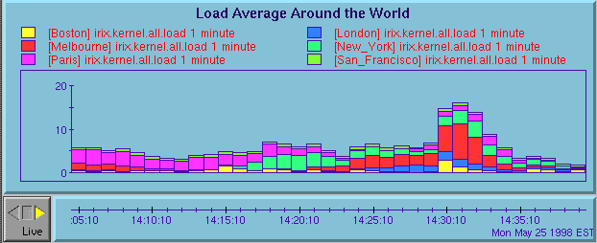
pmchart example

Slide 14
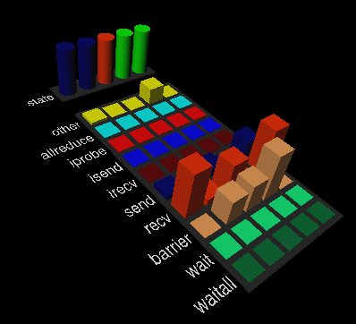
3-D visualization of application performance

Slide 15
Automated performance monitoring
  The PCP inference engine (pmie) evaluates predicate-action rules against a time series of performance data.
  Many common performance scenarios can be encoded in pmie predicates.
  Actions are very general … print, e-mail, insert event into management framework.
  Real-time for operations.
  Historical data for performance analysis.

Slide 16
Example pmie rules
  High 1 minute load average (over 1.2 per CPU)
    kernel.all.load #’1 minute’
    > 1.2 * hinv.ncpu
    → … arbitrary action …
  Single disk spindle busy (more than 60 I/Os per second)
    some_inst
    disk.dev.total > 60
    → … arbitrary action …

Slide 17
Monitoring and managing quality of service
  In many cases it is possible to emulate end-user service requests, e.g. “ping” a Web server or a DBMS or an inetd daemon.
  Construct a PMDA to periodically probe the service and measure the response time.
  Deploy the PMDA across the network and monitor the response times centrally.

Slide 18
Measuring end-user quality of service
ping
ping
WAN
service
monitor
service probe
ping
response-time data
LAN

Slide 19
Performance data from an application with libpcp_trace
Application
libpcp_trace
trace_obs(“tag”, value)
trace_begin(“other tag”)
trace_end(“other tag”)
TCP / IP
socket
client
pmcd
trace

Slide 20
Summary
  System-level performance management is a difficult undertaking.
  PCP provides an extensible framework, with a rich set of services and tools.
  Solving the hard problems requires
    customization to collect relevant performance data
    building customized monitoring tools
    real-time and retrospective analysis
  PCP assists with all of these tasks.

