Slide 1
PCP: Ingest and Export
pcp-conf2018 Mark Goodwin
mgoodwin@redhat.com
@goodwinos

Slide 2
PCP Ingest / Export
Ingest
Export
Standard Agents
CLI tools, scripts
PMCD libpcp
Specialized agents:
MMV
BCC
Trace
Prometheus
.. many others
Exporters:
pcp2xxx, pmwebd
Clients: pmrep,
pmchart, pmie etc
Tools, log rotation, merge, extract etc
Archive Logs
LOGIMPORT(3)
Ingest tools: xxx2pcp
pmlogger

Slide 3
PCP Ingest: Standard PMDAs
Ingest
Export
Standard Agents
CLI tools, scripts
PMCD libpcp
Specialized agents:
MMV
BCC
Trace
Prometheus
.. many others
Exporters:
pcp2xxx, pmwebd
Clients: pmrep,
pmchart, pmie etc
Tools, log rotation, merge, extract etc
Archive Logs
LOGIMPORT(3)
Ingest tools: xxx2pcp
pmlogger

Slide 4
PCP Standard PMDAs (Agents)
linux - kernel metrics. CPU, Disk, Network, Memory, Filesystem, etc. everything exported by /proc, /sys and most other kernel interfaces
proc - per-process metrics
XFS - XFS filesystem specific metrics
nfsclient - NFS client stats
mmv - memory mapped instrumentation
dm - device mapper and LVM
jbd2 - journal block device
lio - Linux I/O - iSCSI, FCP, FCoE
pmcd - PCP statistics
root - container, privileged PMDAs, etc
apache - web server stats
BCC - Extended Berkley Packet Filter metrics
docker - container management stats
KVM - libvirt
mysql and postgresql - database stats
prometheus - end-points
redis - system stats for redis daemons
samba - filesystem
smart - disk health
vmware - platform stats
… many more.
~ 75 plugins / agents (PMDAs)
  .. more being added every release
  Managed by the PCP pmcd service.
  DSOs and daemons. Lots of IPC options
Ingest data into PCP metrics
  Canonical, uniform name space
  strongly typed metadata and values
  Low overheads: “Pull” model: service to completion: client request -> pmcd -> agent -> pmcd -> client
Extensible API
  libpcp_pmda has C/C++, Python and Perl bindings
Separately Packaged: pcp-pmda-foo
  Isolate exotic dependencies
  Not all installed by default.

Slide 5
PCP Ingest: LOGIMPORT API and xxx2pcp
Ingest
Export
Standard Agents
CLI tools, scripts
PMCD libpcp
Specialized agents:
MMV
BCC
Trace
Prometheus
Exporters:
pcp2xxx, pmwebd
Clients: pmrep,
pmchart, pmie etc
Tools, log rotation, merge, extract etc
Archive Logs
LOGIMPORT(3)
Ingest tools: xxx2pcp
pmlogger

Slide 6
LOGIMPORT(3) - library to write PCP archives
libpcp_import API for writing PCP archive logs directly
  Provides a simple programmatic ingest interface to write PCP archives
  By-passes normal PMDA->PMCD->pmlogger->archive data flow
C/C++, Perl and Python bindings, with many examples
Resulting PCP archives can be replayed/exported by any PCP tools
  Exactly the same as standard pmlogger(1) archives
logimport(3) is the API library behind many xxx2pcp ingest tools:
  collectl2pcp(1)
  ganglia2pcp(1)
  iostat2pcp(1)
  sar2pcp(1)
  sheet2pcp(1)
  mrtg2pcp(1)
  pmrep(1) to write PCP archives, e.g. pmrep -o archive -F outputarchive

Slide 7
PCP Ingest “ Specialized PMDAs
Ingest
Export
Standard Agents
CLI tools, scripts
PMCD libpcp
Specialized agents:
MMV
BCC
Trace
Prometheus
.. many others
Exporters:
pcp2xxx, pmwebd
Clients: pmrep,
pmchart, pmie etc
Tools, log rotation, merge, extract etc
Archive Logs
LOGIMPORT(3)
Ingest tools: xxx2pcp
pmlogger

Slide 8
Specialized agents: instrumentation and tracing
mmv PMDA - memory mapped values PMDA and API
  Simple API documented in pmdammv(1), mmv(5) and mmv_stats_init(3)
  Application and pmdammv use a shm segment
    Suitable for very low latency instrumentation
  Creates dynamic metrics
trace PMDA - event counting / tracing PMDA and API
  Multiple language bindings (even Fortran!)
  pmtrace(1) can be used to instrument scripts
  Use pmdatrace(3) API to instrument applications
  Fixed namespace. trace.* metrics. Metric instances are trace points
BCC PMDA - Extended BPF (Berkeley Packet Filter) PMDA
  See pmdabcc(1) - stats from compiled eBPF programs loaded as kernel modules
  Very efficient, secure and powerful, e.g. disk device i/o latency histograms
  Extensible via ini format config file - best way to monitor kernel trace points, etc
  Creates dynamic metrics
  Requires pcp-4.1.0 and fairly new kernel. See bpf(2),

Slide 9
Specialized agents (cont.): PMDA Prometheus
PCP PMDA to ingest prometheus end-point data
  See pmdaprometheus(1)
  Dynamically extensible via config files in /var/log/pcp/pmdas/prometheus/config.d
    Each config file either contains a URL, or is an executable script.
      Both URLs and scripts should return prometheus formatted metric data
      file:// URLs are supported for ingesting local files.
    Prometheus end-point metric data is simple text strings, documented at https://prometheus.io/docs/instrumenting/exposition_formats
    Simple example:
PCP metric naming
  The base name of each config file name is used as the second level of the resulting PCP metric names, e.g. a config file named myserver.url results in metrics below prometheus.myserver in the PCP name space.
  Subdirectories in the config directory result in additional non-leaf namespace levels
# HELP mymetric Simple gauge metric with three instances
# Type mymetric gauge
mymetric {abc="0"} 456
mymetric {def="123"} 123
mymetric {hig="246",xyz="something"} 128

Slide 10
PMDA Prometheus (cont.): meta-data
PCP has strongly typed metrics and meta-data
  Prometheus formatted metrics have no formal metadata
    rely on loosely defined metric name hints and suffixes and the like
    E.g. a prometheus metric name may have “_count” as a suffix to indicate it’s a counter.
  All PCP metrics are strongly typed and have metadata
    metric type, semantics, units and help text, see PMLOOKUPDESC(3)
  The PCP Prometheus PMDA uses heuristics and tags to fill this in, e.g.
Labels in the prometheus metric (e.g. “interval”) are used as the instance name in the resulting PCP metric data. E.g. the PCP metric prometheus.myhost.loadavg would have three instances.
# HELP loadavg local load average
# Type loadavg gauge
loadavg {interval="1-minute"} 0.12
loadavg {interval="5-minute"} 0.27
loadavg {interval="15-minute"} 0.54

Slide 11
PMDA Prometheus (cont.): scripted configs
Scripted configs
  provide a simple yet powerful way to ingest metric data. E.g. given /proc/loadavg
As an example, create an executable script in a file named /var/lib/pcp/pmdas/prometheus/config.d/myserver
Results in a PCP metric named prometheus.myserver.loadavg with three instances.
  This is created dynamically - no restarts necessary
$ cat /proc/loadavg
0.18 0.31 0.40 1/1253 17801
#! /bin/sh
awk '{
print("# HELP loadavg local load average")
print("# Type loadavg gauge")
printf("loadavg {interval=\"1-minute\"} %.2f\n", $1)
printf("loadavg {interval=\"5-minute\"} %.2f\n", $2)
printf("loadavg {interval=\"15-minute\"} %.2f\n", $3)
}' /proc/loadavg

Slide 12
PMDA Prometheus (cont.): URL configs
Prometheus end-point URLs
  Perf data exported as a URL on a port in the range 9100 - 10000 below /metrics e.g. http://somehost:9100/metrics is the prometheus “node exporter” for a host named somehost.
  There are a huge number of prometheus exporters, PCP can ingest them all
    See https://github.com/prometheus/prometheus/wiki/Default-port-allocations
URL config files
  First line in the config file is an end-point URL (as above), with .url suffix
  PCP metrics are dynamically created - metrics are named same way as scripted configs.
  No need for PMDA restarts or anything - completely dynamic
  URL configs also support HEADER and FILTER syntax in subsequent lines in the config file
    HEADER lines specify http request headers to include in the GET request
      E.g. for authentication, content-type, proxy redirects, etc.
    FILTER lines allow metrics and/or labels in the response be included/excluded
      E.g. to exclude unwanted prometheus labels from the PCP instance domains
      E.g. Ignore uninteresting metrics in the response, etc

Slide 13
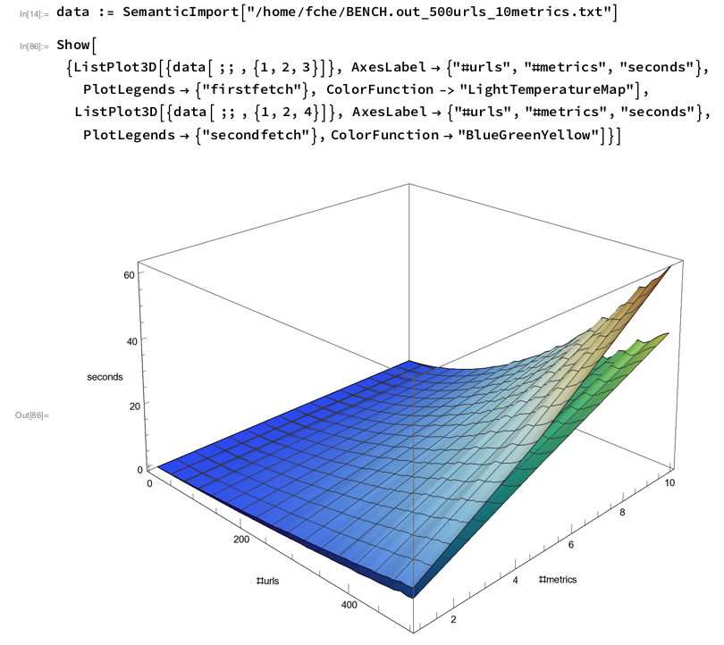
PMDA Prometheus (cont).): Scalability
Simple benchmark measuring wall clock fetch times
  1 to 500 URLs, with 1 to 10 metrics per URL
  localhost http requests returning constant data (script generated)
Scalability
  Fairly linear scalability for #URLs with only a few metrics/URL
  Non-linear for higher #metrics
Mostly resolved by using parallel threads for HTTP GET requests, but serialized response parsing (FIFO queue) - avoids the “Big Python Interpreter Lock”
Image courtesy Frank Ch. Eigler
fche@redhat.com

Slide 14
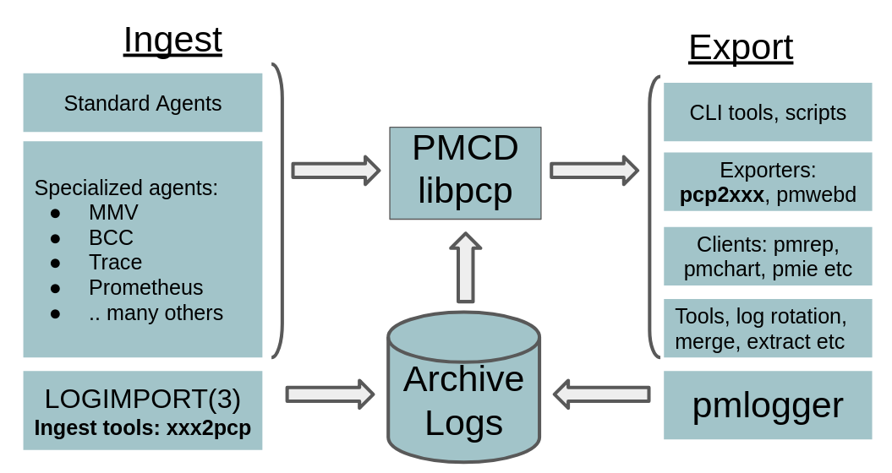
Future:
Redis Cluster
...
Redis Cluster
pmseries
Redis Cluster
pmseries
Grafana
Redis Cluster
...
Web APP

