Slide 1

Developments in PCP (Performance Co-Pilot)
Nathan Scott
Performance Tools, Red Hat
January 2015

Slide 2

Outline
Performance Co-Pilot (PCP)
  Overview
  PCP Basics
General
JSON access
Containers in PCP
New metric collectors (PMDAs) and monitor tools

Slide 3
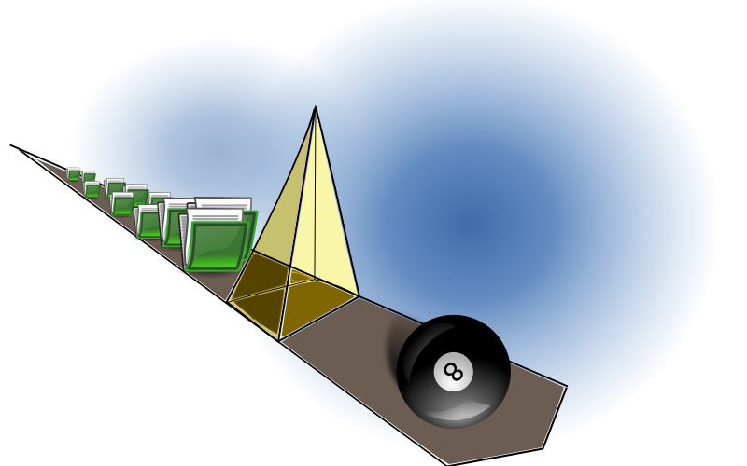
Overview
What is PCP?
  Open source toolkit
  System-level analysis
  Live and historical
  Extensible (monitors, collectors)
  Distributed

Slide 4
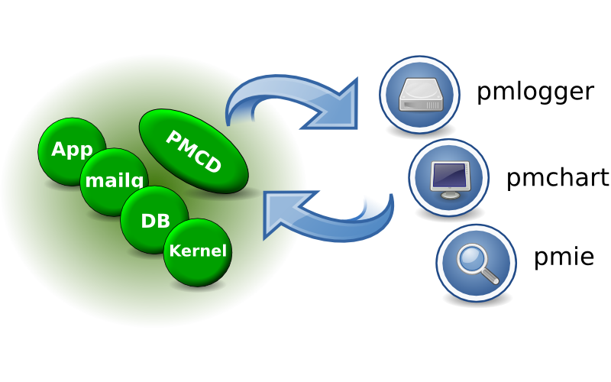
Architecture

Slide 5
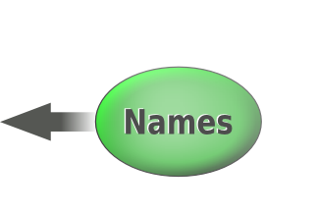


Metrics
pminfo --desc -tT --fetch disk.dev.read
disk.dev.read [per-disk read operations]
Data Type: 32-bit unsigned int
Semantics: counter
Units: count
Help: Cumulative count of disk reads since boot time
Values:
inst [0 or "sda"] value 3382299
inst [1 or "sdb"] value 178421

Slide 6

Recent Developments
(6-12 months)
Recent Developments
(6-12 months)

Slide 7
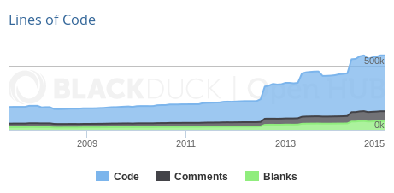
General
Supported in RHEL 6.6 and RHEL 7 onward
Tackling long-standing, difficult problems
Regular stable releases
Out-of-the-box experience

Slide 8
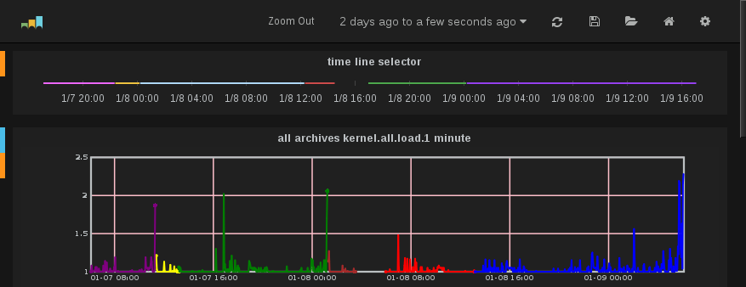
JSON access
pmwebd (HTTP/JSON)
Interactive web charts (graphite/grafana)

Slide 9
Monitoring containers
Zero-install inside containers
Wire protocol extensions for container naming
Simplifying access
  mapping dev_t to names
  data reduction to cgroups making up a container
  processes within a container, etc
Docker support, but written to allow use by others

Slide 10
New collector work
Metric collectors
  Lots of kernel metric additions
    dmcache, jbd2, gluster, zswap, gfs2, cifs, nfs4.1...
    cgroups, [hot]proc, nvidia, hardware event counters
  Web, DNS, elasticsearch, memcached additions
  Database server additions
  Python PMDA interfaces

Slide 11
New monitor work
Reporting tools
  Python tools
    iostat, free, numastat, atop, collectl and others
  Web tools
  GUI tools
    pmchart usability improvements
Ease of setup
Importing data from sar, iostat

Slide 12
Resources
http://www.pcp.io
  Source, downloads, books, FAQ, mailing lists
git://git.pcp.io/pcp dev

Slide 13
Questions?
[pcp.io]
Questions? pcp.io

