Slide 1
System Level Performance Management with PCP
Nathan Scott
<nathans@debian.org>

Slide 2

Overview
What is PCP?
  Open source toolkit for system level performance analysis
  Live and historical
  Extensible (monitors, collectors)‏
  Distributed

Slide 3
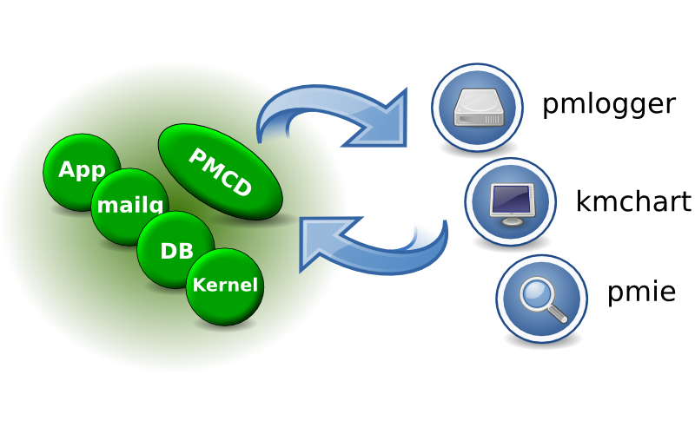
Architecture

Slide 4

Data Model
Metrics come from one source (host / archive)‏
Source can be queried at any interval by any monitor tool
Hierarchical metric names
  e.g. disk.dev.read and aconex.response_time.avg
Metrics are singular or set-valued (“instance domain”)‏
Metadata associated with every metric
  Data type (int32, uint64, double, ...)‏
  Data semantics (units, scale, ...)‏
  Instance domain

Slide 5
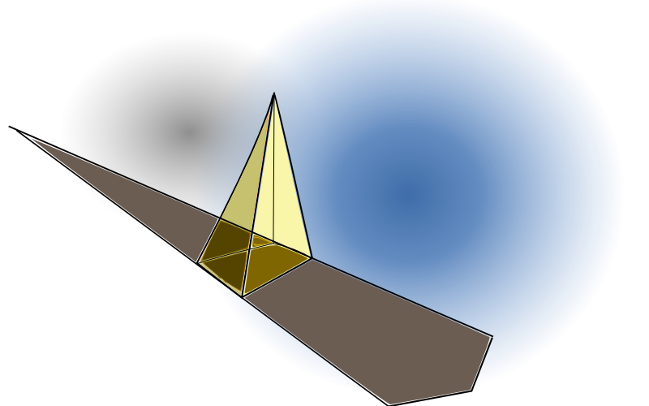
Performance Timeline
Where does the time go?
Where’s it
going now?
Where will it go?

Slide 6
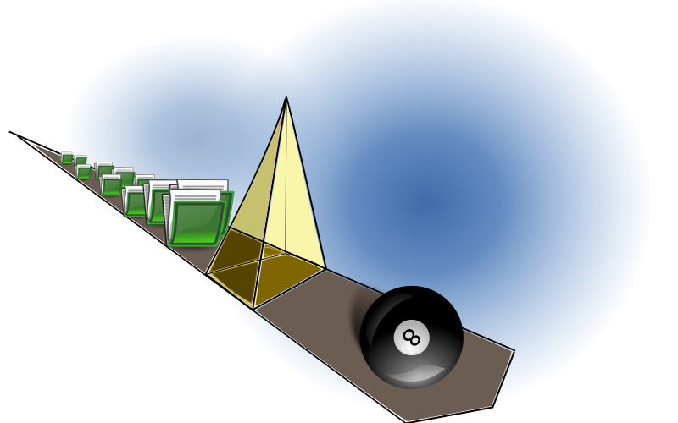
Performance Timeline - PCP Toolkit
Archives
Live
monitoring
Modelling and
statistical prediction

Slide 7
Performance Timeline - PCP Toolkit
Yesterday, last week, last month, ...
All starts with pmlogger
  Arbitrary metrics, intervals
  One instance produces one PCP archive for one host
  An archive consists of 3 files
    Metadata, temporal index, data volume(s)‏
pmlogger_daily, pmlogger_check
  Ensure the data keeps flowing
pmlogsummary, pmwtf, pmdumptext
pmlogextract, pmlogreduce

Slide 8
Performance Timeline - PCP Toolkit
Graphical tools – kmchart, kmtime
  Strip charts – align data from different subsystems on a single time axis
  Time controls
    VCR paradigm
    Multiple tools can share
[ Demo ]
  Tempdb growth (1)‏
Notes:
#!/bin/sh
logs="/home/nathans/archives/mel/db3"
cd $logs
cmd="ls"
echo '$ '$cmd
eval $cmd
echo -n '$ '
read
cmd="kmchart -a 20090106 -c CPU -c Diskbytes -t 30seconds"
echo '$ '$cmd
eval $cmd -geometry 370x425 &
echo -n '$ '
read
echo 'UI> Time Controls [11:15]'
echo -n 'UI> '
read
echo 'UI> New Chart -> per-disk utilisation stats.'
echo -n 'UI> '
read
echo 'UI> Options -> New Kmchart'
echo -n 'UI> '
read
echo 'UI> Open View -> SqlServer'
echo -n 'UI> '
read

Slide 9
Performance Timeline - PCP Toolkit
Inference Engine - pmie
  Evaluates arithmetic, logical and rule expressions at arbitrary frequencies
  Scan historical data looking for given conditions
Archive mode uses:
  Data reduction
  Alarm verification
[ Demo ]
  Tempdb growth (2)‏
Notes:
((sqlserver.databases.db.data_file_size #tempdb @0 -
sqlserver.databases.db.data_file_size #tempdb @1) != 0)‏
-> print "SqlServer tempdb file size changed: %v bytes";
#!/bin/sh
logs="/home/nathans/archives/mel/db3"
cd $logs
cmd="ls"
echo '$ '$cmd
eval $cmd
echo -n '$ '
read
conf="/home/nathans/talks/lca09/sqlserver.tempdb"
cmd="cat $conf"
echo '$ '$cmd
eval $cmd
echo -n '$ '
read
echo '$ for file in *.meta ; do'
echo '> pmie -a $file -c $conf -t 10min'
echo '> echo done $file'
echo '> done'
read
for file in *.meta
do
pmie -a $file -c $conf -t 10min
echo done $file
done
echo -n '$ '
read

Slide 10
Performance Timeline - PCP Toolkit
What’s happening right now?
Hardware, kernel, services, databases, ... application PMDAs.
  PCP toolkit provides many PMDAs and APIs for customisation
Important to be able to match user-perceived response time back to system activity
[ Demo ]
  Kernel, pmcd, shping PMDAs
  pmchart, pmval - monitor tools

Slide 11
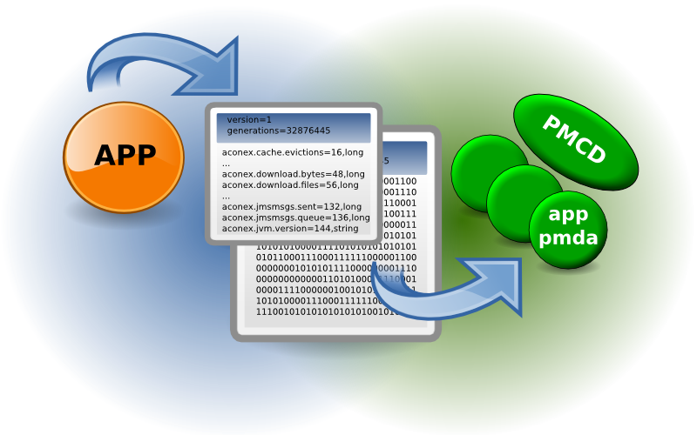
Custom Instrumentation (Applications)‏
Notes:
# Tag Shell command
null exit 0
pmcd pminfo -f kernel.all.pswitch
#!/bin/sh
cmd="pcp"
echo '$ '$cmd
eval $cmd
echo -n '$ ' && read
cmd="cd /var/lib/pcp/pmdas/shping"
echo '$ '$cmd
eval $cmd
echo -n '$ ' && read
cmd="cat ./example.conf"
echo '$ '$cmd
eval $cmd
echo -n '$ ' && read
cmd="./Install"
echo '$ '$cmd
eval sudo $cmd
echo -n '$ ' && read
cmd="pminfo shping"
echo '$ '$cmd && read
eval $cmd
echo -n '$ ' && read
cmd="kmchart -t 1sec -c CPU -c PMCD"
echo '$ '$cmd
eval $cmd -geometry 370x425 &
echo -n '$ ' && read
echo 'UI> New Chart -> shping.time.real[*].'
echo 'UI> [ Add title, etc ]'
echo -n 'UI> ' && read

Slide 12
Applied PCP
Establish performance baselines
    Setup constant logging
    Automate detection of known issues (pmie)‏
Monitor end-user perceived response time
    Custom collectors
    Generic collectors – shping, dbping
Understand where that time is spent
    Distributed systems, distributed queues
    Monitor for transient / unexpected events

Slide 13
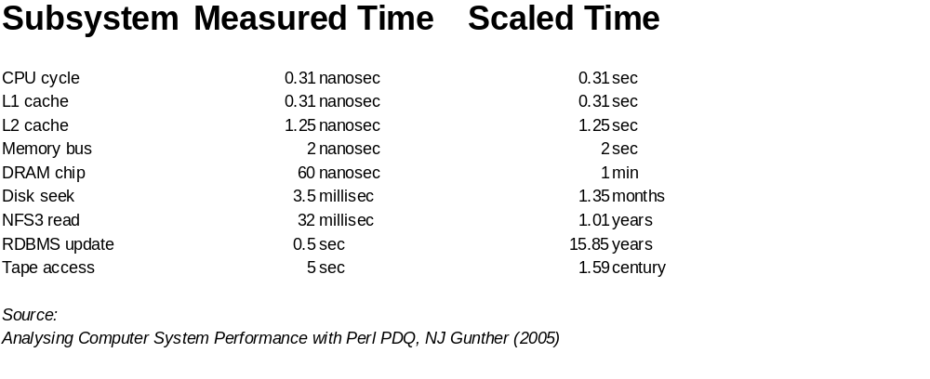
Tricks and Tips
Have a model of performance in your head, and evaluate new information against it
units(1)‏

Slide 14
Tricks and Tips
Use the “Scientific Method”
  Postulate, test hypotheses
  Record results, iterate
Find good (user) response time metrics
  Drive analysis based on issues they detect
  CPU and disk utilisation (time based metrics)‏

Slide 15
Tricks and Tips
Regularly apply “Little’s Law” to all data... generic (queueing theory) form:
        Q =  R
  Length = Arrival Rate x Response Time
  e.g. 10 MB = 2 MB/sec x 5 sec
  Utilisation = Arrival Rate x Service Time
  e.g. 20% = 0.2 = 100 msec/sec x 2 sec

Slide 16
Present and future
Recent past
  Development moved to git
  kmchart developed independently to PCP
  Included in Debian and Ubuntu (SuSE for ages)‏
Moving toward PCP 3.0
  Native Windows version, Perl APIs, new PMDAs
  New archive temporal reduction tool
Longer term
  SGI releasing 3D visualisation code
  Many more kmchart features planned
  Capacity planning ... PCP meets R? PDQ?

Slide 17



Finally...
Major corporate sponsors of PCP development
Thanks!
http://oss.sgi.com/projects/pcp/
  Docs, tutorials, git repos, mailing list, IRC channel
  Binaries - Mac, Windows, RPMs

Slide 18
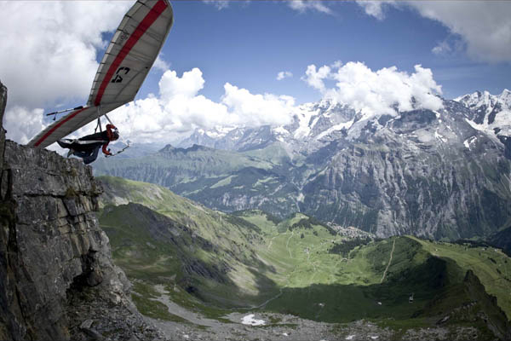
Questions...?

