Slide 1


Slide 2
Nathan Scott
What’s new
and
what’s planned?
https://pcp.io

Slide 3

What’s new – last 9 months
Some highlights ...
  Successful PCP 4.0 deployments!
    RHEL 7.6 onwards
    pmrep(1), dstat(1) – demo
  Vector
    eBPF/BCC metrics - demo
    Histograms - demo

Slide 4
What’s new – last 9 months
Some highlights ...
  Archive compression
    zeroconf ( ) vs compression ( )
    Data volumes (-v100Mb), .meta
    During-the-day compression, rotation
  selinux stability
  Many new metrics, e.g.
    Linux kernel “Pressure Stall Information”

Slide 5

What’s new – last 9 months
Scalable time series ...
  Async, non-blocking I/O
  Redis STREAMs
    Indexed, structured time series (v5+)
  Archive discovery
  REST APIs
Demo

Slide 6
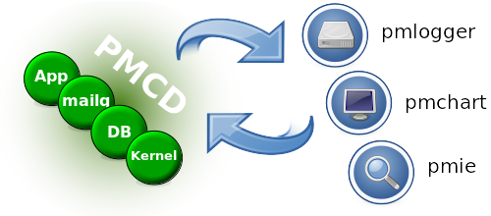
Recap: pmcd

Slide 7
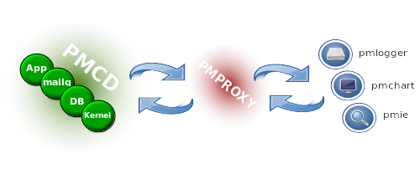
Recap: pmproxy

Slide 8
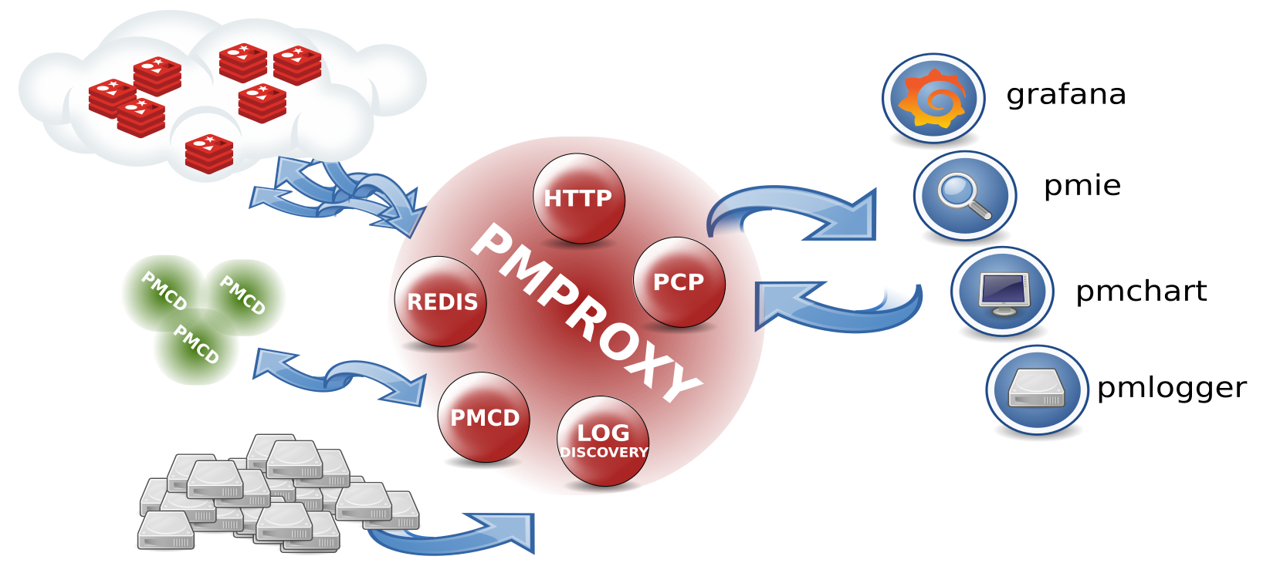
Modular pmproxy

Slide 9

What’s planned … next 9 months
REST APIs
  Asynchronous, more responsive
  Chunked-transfer-encoding
  Re-package webapps
  HTTPS support
Scalable time series
  Label-based querying 10s-100s of nodes

Slide 10
What’s planned … next 9 months
Process improvements
  Build, test and release automation
  Presence – continuing the conferences, talks, articles, blog posts …
Improved containers
  Lightweight, easier-to-use REST API
  Smaller, simpler base PCP container

Slide 11
What’s planned - 2020 & beyond!
Integration areas
  Grafana datasource features
  Kubernetes analysis
Research areas
  Scaling to 1,000+ nodes
  Query language refinement

Slide 12
Questions? https://pcp.io/roadmap

