Slide 1
Ubiquitous System Analysis
Performance Co Pilot
Abegail Jakop
Lukas Berk
Red Hat
Oct. 23, 2014

Slide 2
Introduction
PCP Overview
  Introduction
  Components
Recent Developments
  PAPI pmda
  pmwebd
  Deeper metrics
Questions?

Slide 3
Analyzing Performance
How is this typically/historically done?
  rsyslog/syslog-ng/journald
  top/iostat/vmstat/ps
  Mixture of scripting languages (bash/perl/python)
  Specific tools vary per platform
  Proper analysis requires more context

Slide 4

Introducing

Slide 5
Performance Co-Pilot
Points of interest
  Unix-like component design
  Complements existing system functionality
  Cross platform
  Consistent unit measurement
  Extremely extensible
  Open Source!
Notes:
Complements – non intrusive

Slide 6
Performance Co-Pilot
Two Underlying Components
  1) Performance Metric Domain Agents
  2) Performance Metric Collection Daemon

Slide 7
Performance Co-Pilot
Two Underlying Components
  1) Agents
  2) Performance Metric Collection Daemon

Slide 8
Performance Co-Pilot
Two Underlying Components
  1) Agents
  2) PMCD

Slide 9
Performance Co-Pilot
Agents
Kernel
Network
PMCD
Webserver
Application
Specific

Slide 10
Performance Co-Pilot
Number of metrics exposed by agents?
  A lot! (~1500 from a default fedora install)
  Huge variation in what they're measuring
  How do you reliably and predictably name them?

Slide 11
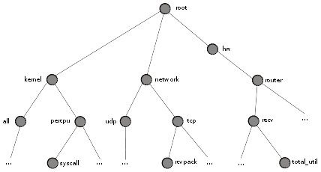
Performance Co-Pilot
Performance Metric Name Space
network
.tcp
.rcvpack

Slide 12
Performance Co-Pilot
Host A
Host B
Kernel
pmval
Network
pmstat
PMCD
Webserver
pmfind
Application
Specific
pminfo

Slide 13
Performance Co-Pilot
Where to start?
pminfo – display information about metrics
$ pminfo -t
  papi.system.REF_CYC [Reference cycles]
  papi.system.L3_TCA [L3 cache accesses]
  papi.system.L2_TCA [L2 cache accesses]
  papi.system.L3_TCH [L3 cache hits]
  papi.system.L2_TCH [L2 cache hits]
$ pminfo -t papi

Slide 14
Performance Co-Pilot
Where to start?
pmval – current value of a metric
$ sudo pmval papi.system.TOT_CYC
  metric: papi.system.TOT_CYC
  host: toium
  semantics: cumulative counter (converting to rate)
  units: none (converting to / sec)
  samples: all
      7.869E+04
      9.186E+04
      9.240E+04

Slide 15
Performance Co-Pilot
Host A
Host B
Kernel
pmval
pminfo
Network
pmstat
PMCD
pmlogger
Webserver
pmfind
Application
Specific
Archives
pminfo

Slide 16
Performance Co-Pilot
pmlogger creates logs for future analysis
  Enables us to use tools on older data, retrospectively
  Default around 5mb a day, rotates and compresses
  Metrics organized, no need to stick them into elastic search

Slide 17
Performance Co-Pilot
Recent and future developments
  PAPI pmda
  pmwebd
  Enabling deeper system introspection

Slide 18
Performance Co-Pilot – Recent Developments
“Only two hard parts of computer science, cache invalidation, naming things, and off-by-one errors”
        - Unknown

Slide 19
Performance Co-Pilot – Recent Developments
“Only two hard parts of computer science, cache invalidation, naming things, and off-by-one errors”
        - Unknown

Slide 20
Performance Co-Pilot – Recent Developments
PAPI – Performance API
  Cross platform
  Uses dedicated hardware counters for perf metrics
    Cache hits/misses, total instructions/cycles
  By writing a pmda (agent) for PAPI, we can expose these metrics
Webserver
PMCD
Application
Specific
PAPI

Slide 21
Performance Co-Pilot – Recent Developments
We could just view the raw values
$ sudo pmval papi.system.TOT_CYC
  metric: papi.system.TOT_CYC
  host: toium
  semantics: cumulative counter (converting to rate)
  units: none (converting to / sec)
  samples: all
      7.869E+04
      9.186E+04
      9.240E+04

Slide 22
Performance Co-Pilot – Recent Developments
We could just view the raw values
  Ratios and relative percentages are more insightful
  Perfect for the pmie tool!
pmtools
PMCD
pmie

Slide 23
Performance Co-Pilot – Recent Developments
Performance Metrics Inference Engine
  Allow you to form metrics-based expressions for evaluation
  Ratios, counts, aggregates, conditionals
  Raise alarms, logging entries, shell commands
  Run on live data or logs
  Run rules across data from multiple hosts

Slide 24
Performance Co-Pilot – Recent Developments
Example pmie expression:
some_inst
((papi.system.L3_TCM / papi.system.TOT_INS)
* 100)
-> syslog “Percentage of Level 3 Cache misses > 2%”
(papi.system.L3_TCM / papi.system.TOT_INS)
> 2

Slide 25
Performance Co-Pilot – Recent Developments
pmwebd
  We already ship a gui tool (pmchart)
  Several feature full graphing tools available
  PCP's architecture and design makes integration easy
pmtools
PMCD
Grafana/
Graphite
pmwebd

Slide 26
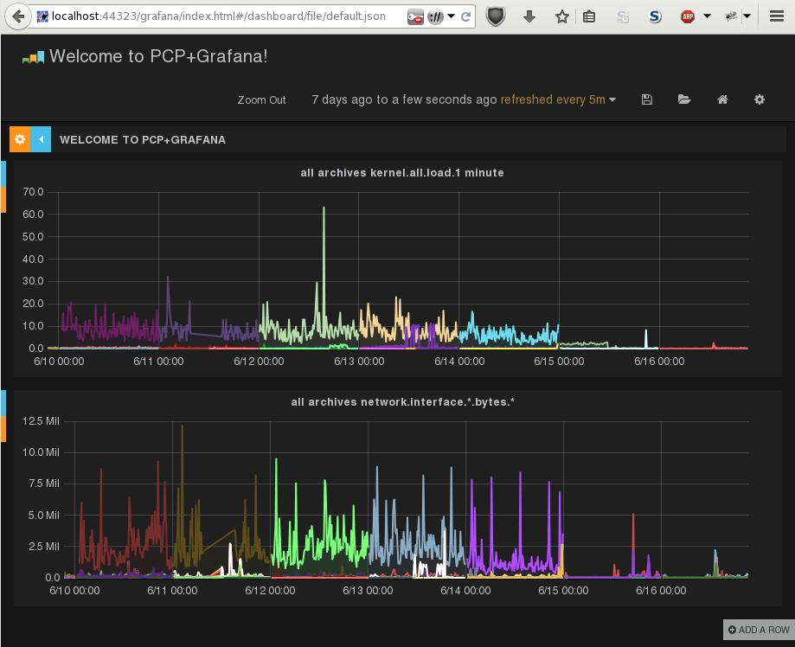
Performance Co-Pilot – Recent Developments

Slide 27
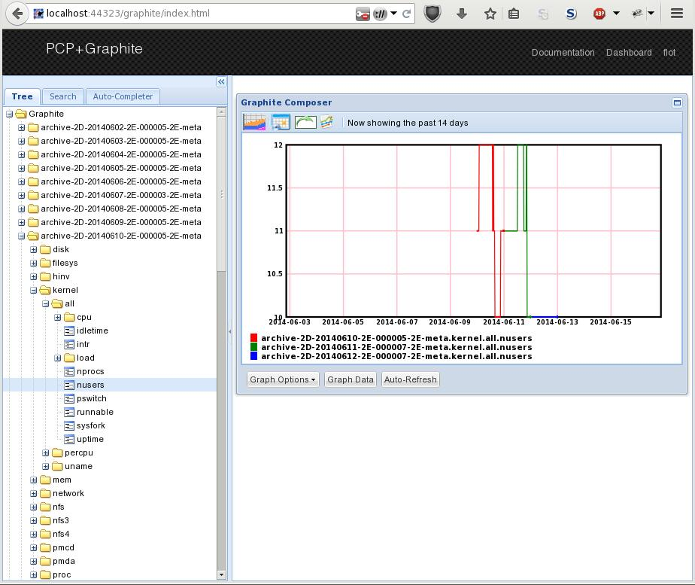
Performance Co-Pilot – Recent Developments

Slide 28
Performance Co-Pilot – Current Developments
PCP offers wide variety of metrics
  What if we want 'under the hood' metrics?
  Need a system-wide, tool with live data to help...

Slide 29

Introducing:

Slide 30

What is SystemTap
Tool for examining live system events
  Communicated through scripts
  Links the strengths of tracers, profilers, and debuggers.
// SystemTap script
probe tcp.sendmsg { gather_info; print(info) }
Linux Kernel Module
Summary Report
sent packet of size ... to ...
sent packet of size ... to ...
...
the all-seeing Linux Kernel

Slide 31
Usage
Two major components of scripts:
  1) Probe Points
  2) Handlers

Slide 32
Example Probe
Simple Hello world
probe begin {
println ("Hello, World!")
}
Or tracking when a new bash process is started
probe process("bash").function("main") {
println("A bash process has started")
}

Slide 33
Example Probe
Or something a little more complicated:
  Listing functions in the order that a process calls them
$ cat bash_functioncalls.stp
probe process("bash").function("*").call {
printf ("bash called function %s\n", ppfunc())
}
$ stap bash_functioncall.stp
bash called function _start
bash called function __libc_csu_init
bash called function _init
bash called function frame_dummy
bash called function register_tm_clones
bash called function main
bash called function xtrace_init
...

Slide 34
Getting Started
Where do you start? Figure out what you can probe.
If you don't know what probe points types there are:
$ stap --dump-probe-types
java(number).class(string).method(string)
kernel.function(number)
module(string).statement(string)
process(string).function(string).callees
procfs(string).read
timer.usec(number)
...

Slide 35
Language
What can you include in handlers?
  Ordinary features you'd find in a language:
  Globals, locals, string, integers, loops, conditionals, functions, arrays, error handling and more
Additional, handy features:
  Associative arrays, foreach loop, aggregates, macros, regex matching

Slide 36
Probe Points
How does one start writing a script?
  Listing mode is a great starting point
  Lists possible probe points
$ stap -l 'process("stap").function("symbol_*")'
process("stap").function("symbol_fetcher@elaborate.cxx:1092")
process("stap").function("symbol_table@tapsets.cxx:424")

Slide 37
Context Variables
Probes can access context variables
The context variables start with “$”
$ stap -L 'kprocess.create'
kprocess.create task:long new_pid:long new_tid:long $return:struct task_struct* $clone_flags:long unsigned int ...

Slide 38
Tapsets
A library for systemtap scripts
  Their purpose is provide a level of abstraction
  Users don't have to know the exact details
For example:
For a list of all the aliased probes
kprocess.create = kernel.function("copy_process").return
stap --dump-probe-alias

Slide 39
Tapsets
There are also helper functions
For a list of available helper functions
$ cat kprocess_list.stp
probe kprocess.create {
printf ("Process %s was started\n", pid2execname(new_pid))
}
$ stap kprocess_list.stp
Process bash was started
Process bash was started
Process soffice.bin was started
Process soffice.bin was start
Process udisksd was started
Process firefox was started
stap –-dump-functions

Slide 40
Tapsets
And helper variables
$ cat helper_vars.stp
probe syscall.* {
printf ("syscall: %s, parameters: %s\n",
name, $$parms$$)
}
$ stap helper_vars.stp
syscall: read, parameters: fd=4 buf=140736613309360 count=8196
syscall: fcntl, parameters: fd=4 cmd=4 arg=32770
syscall: kill, parameters: pid=4200 sig=10
syscall: fcntl, parameters: fd=4 cmd=4 arg=34818
syscall: read, parameters: fd=4 buf=140736613309360 count=8196
syscall: fcntl, parameters: fd=4 cmd=4 arg=32770
syscall: pselect6, parameters: n=5 inp=140736613308976 outp=0 exp=0 tsp=0 sig=140736613308864
...

Slide 41
Example

Slide 42
terminator.c
1:#include <stdlib.h>
2:#include <stdio.h>
3:
4:int sleeper () {
5: static int num = 0;
6: sleep(1);
7: return num;
8:}
9:
10:int main () {
11: int num = 0;
12: while (num < 10) {
13: num = sleeper ();
14: printf("a second has passed\n");
15: }
16: printf("10 seconds have passed\n");
17: return 0;
18:}

Slide 43
terminator.c
$ ./terminator
a second has passed
a second has passed
a second has passed
a second has passed
a second has passed
a second has passed
a second has passed
a second has passed
a second has passed
a second has passed
a second has passed
a second has passed
a second has passed
a second has passed
a second has passed
a second has passed
a second has passed
10th line == 10th second

Slide 44
terminator.c
Figure out what's going on
  Where to probe?
  Does function X ever call function Y? And with what parameters?
  What can be done if something's not quite right?

Slide 45
terminator.c
Where to probe?
Does main() ever call sleeper()?
  Check what functions main() calls.
$ stap -L 'process("terminator").function("*")'
$ stap -L 'process("terminator").function("main").callee("*")'
process("terminator").function("main@terminator.c:10").callee("sleeper@terminator.c:4") $num:int const

Slide 46
terminator.c
That was just a starting point!
  What determines when the loop ends?
  What about the return value from sleeper?
$ cat sleeper_return_check.stp
global old_num=-1
probe process("./terminator").function("sleeper").return {
if ($num <= old_num)
error("num is not increasing!")
old_num = $num
}

Slide 47
terminator.c
Running the script
Well, that explains things.
  So how can we fix this?
$ stap sleeper_return_check.stp -c ./terminator
a second has passed
a second has passed
ERROR: num is not increasing!
WARNING: Number of errors: 1, skipped probes: 0
WARNING: /home/ajakop/work/codebase/install/bin/staprun exited with status: 1
Pass 5: run failed. [man error::pass5]

Slide 48
terminator.c
1:#include <stdlib.h>
2:#include <stdio.h>
3:
4:int sleeper () {
5: static int num = 0;
6: sleep(1);
7: return num;
8:}
9:
10:int main () {
11: int num = 0;
12: while (num < 10) {
13: num = sleeper ();
14: printf("a second has passed\n");
15: }
16: printf("10 seconds have passed\n");
17: return 0;
18:}
num++; ?

Slide 49
terminator.c
Can't do that if the program can't be stopped.
  Alternative: write a script to do it!
$ cat fix_terminator.stp
global actual_num=-1
probe process("./terminator").function("sleeper").return {
if ($num <= actual_num)
{
actual_num++
$return = actual_num
}
else
actual_num = $num
}

Slide 50
terminator.c
The result:
Yay! It worked!
$ stap -g fix_terminator.stp -c ./terminator
a second has passed
a second has passed
a second has passed
a second has passed
a second has passed
a second has passed
a second has passed
a second has passed
a second has passed
a second has passed
a second has passed
10 seconds have passed

Slide 51
Performance Co-Pilot – Current Developments
Systemtap fits the bill for what we need
  Malleable output
  Able to specify various probe points
  Exposes low level information, safely
PAPI
PMCD
Application
Specific
Application
Specific
systemtap

Slide 52
Performance Co-Pilot – Current Developments
Example
  Can we determine network latency on a network device?
PAPI
PMCD
stap.ko
Application
Specific
Application
Specific
systemtap

Slide 53
Performance Co-Pilot – Current Developments
# stap ./net_xmit.stp eth0 dev1 dev2
# pminfo -df stap_json
stap_json.json.net_xmit_data.xmit_latency
Data Type: 64-bit int InDom: 130.0 0x20800000
Semantics: counter Units: none
inst [0 or "dev1"] value 0
inst [1 or "dev2"] value 0
inst [2 or "eth0"] value 319
stap_json.json.net_xmit_data.xmit_count
Data Type: 64-bit int InDom: 130.0 0x20800000
Semantics: counter Units: none
inst [0 or "dev1"] value 0
inst [1 or "dev2"] value 0
inst [2 or "eth0"] value 2304551

Slide 54
Performance Co-Pilot
Questions?

Slide 55
Get Involved!
IRC: irc.freenode.net
  #pcp
  #systemtap
Web:
  http://pcp.io
  http://sourceware.org/systemtap
Email:
  systemtap@sourceware.org
  pcp@oss.sgi.com

