Slide 1

Containers and
Performance Co-Pilot
Nathan Scott
Performance Tools, Red Hat
January 2015

Slide 2

Outline
Performance Co-Pilot (PCP)
  Overview
  PCP Basics
Kernel Instrumentation
  namespaces
  cgroups
Containers in PCP

Slide 3
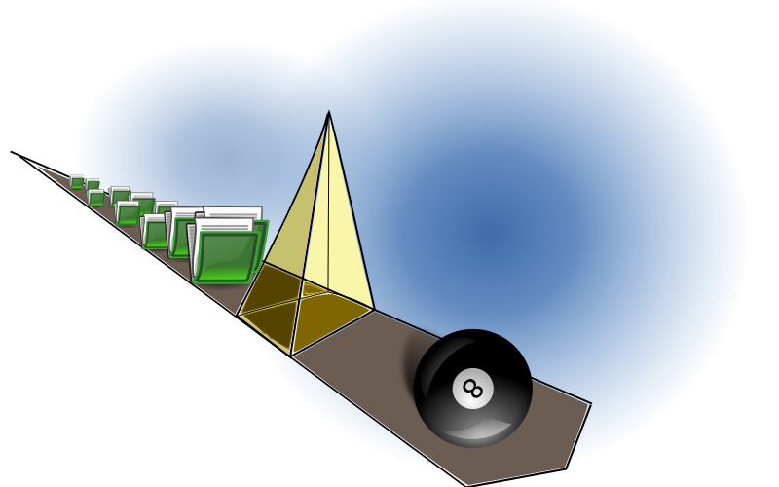
Overview
What is PCP?
  Open source toolkit
  System-level analysis
  Live and historical
  Extensible (monitors, collectors)
  Distributed

Slide 4
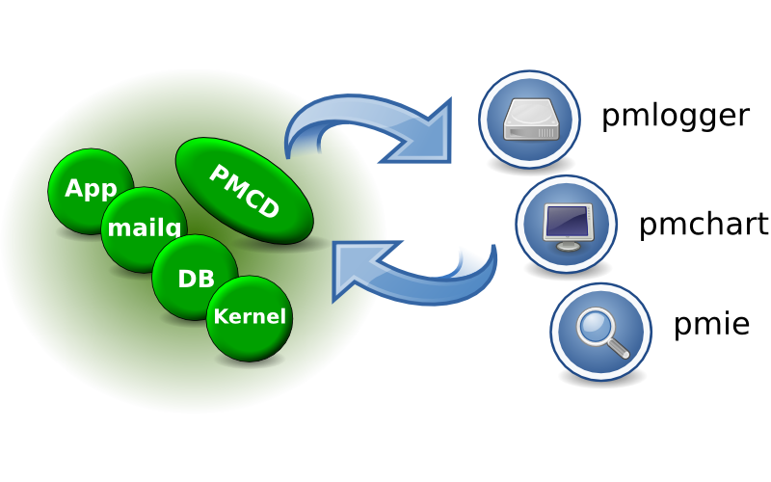
Architecture

Slide 5
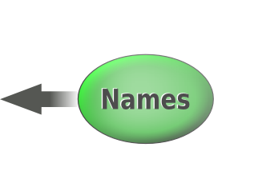


Metrics
pminfo --desc -tT --fetch disk.dev.read
disk.dev.read [per-disk read operations]
Data Type: 32-bit unsigned int InDom: 60.1
Semantics: counter Units: count
Help: Cumulative count of disk reads since boot time
Values:
inst [0 or "sda"] value 3382299
inst [1 or "sdb"] value 178421

Slide 6

Kernel Instrumentation for Containers
Kernel Instrumentation for Containers

Slide 7
cgroup accounting
[subsys].stat files below /sys/fs/cgroup
  individual cgroup or summed over children
blkio
  IOPs/bytes, service/wait time – aggregate/per-dev
  Split up by read/write, sync/async
cpuacct
  Processor use per-cgroup - aggregate/per-CPU
memory
  mapped anon pages, page cache, writeback, swap, active/inactive LRU state

Slide 8
namespaces
Example: cat /proc/net/dev
  Contents differ inside vs outside a container
Processes (e.g. cat) in containers run in different network, ipc, process, uts, mount namespaces
Namespaces are inherited across fork/clone
  Processes within a container share common view

Slide 9
Container Analysis using PCP
Container Analysis using PCP

Slide 10
Goals
Allow targeting of individual containers
e.g. /proc/net/dev
  pminfo --fetch network
  vs
  pminfo –fetch –container=crank network
Zero installation inside containers required
Simplify your life (dev_t auto-mapping)
Data reduction (proc.*, cgroup.*)

Slide 11
Mechanisms
pminfo -f –host=acme.com –container=crank network
  Wire protocol extension
  Inform interested PCP collector agents
  Resolving container names, mapping names to cgroups, PIDs, etc.
  setns(2)
Runs on the board, plenty of work remains
New monitor tools with container awareness

Slide 12
Resources
http://www.pcp.io
  Source, downloads, books, FAQ, mailing lists
git://git.pcp.io/pcp

Slide 13
Questions?
[pcp.io]
Questions? pcp.io

