Slide 1
System-level Performance Management
Ken McDonell
Engineering Manager, CSBU
kenmcd@sgi.com

Slide 2
Overview
  Status quo for system-level performance monitoring and management in Linux.
  Factors conspiring to change this.
  Features of a desirable solution.
  Porting considerations.
  Support for distributed processing environments.

Slide 3
Influence of Linux Philosophies
  Anti-bloat mantra … available instrumentation is very sparse.
  1-2p design center … many hard problems are off the radar screen.
  Developer-centric view leads to terse tools … and making them more like sar is not innovative.
  /proc/stat model is both good and bad.
  Bias towards running tools on system under investigation.

Slide 4
Challenges to the Status Quo
  Linux deployment on larger platforms.
  Linux deployment in production environments.
  Cluster and federated server configurations.
  More complex application architectures.
  Focus shift from kernel performance:
    applications performance is key
    quality of service matters
    systems-level performance mgmt

Slide 5
Large Systems Influences
  There may be a lot of data, e.g. for a large (128p) server 1000+ metrics and 30,000+ values from the platform & O/S.
  Data comes from the hardware, the operating system, the service layers, the libraries and the applications.
  Clustered and distributed architectures compound the difficulties.
  All of the data is needed at some time, but only a small part is needed for each specific problem.

Slide 6
Production Environment Influences
  Something is broken all of the time.
  Cyclic patterns of workload and demand.
  Transients are common.
  Service-level agreements are written in terms of performance as seen by an end-user.
  Environmental evolution changes the assumptions, rules and bottlenecks, e.g. upgrades, workload, filesystem age, re-organization.

Slide 7
Neanderthal Approaches
Making the Problem Harder
  Tool and data islands: ownership, functional, temporal and geographic domains.
  Primitive filtering and information presentation.
  Protocols and UIs that are not scalable.
  Emphasis on tools rather than toolkits.
  Very little automated monitoring that is useful for the hard problems.

Slide 8
Features of a Desirable Export Infrastructure
  Low overhead and small perturbation.
  Unified API for all performance data.
  Extensible (plug-in) architecture to accommodate new sources of performance data.
  Sufficient metadata to allow evolution and change.
  Support for remote access to performance data.
  Platform neutral protocols & data formats.

Slide 9
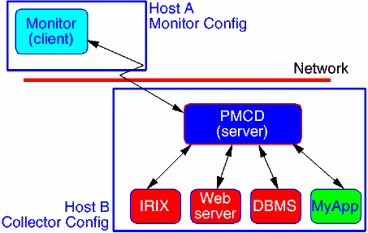
Plug-in Collector and Client-Server Architecture

Slide 10
Features of a Desirable Performance Tool Environment
  Complement, not displace, simple tools.
  The same tools for both real-time and retrospective analysis.
  Visualization and drill-down user navigation.
  Remote and multi-host monitoring.
  Toolkits not tools.
  Smarter reasoning about performance data.

Slide 11
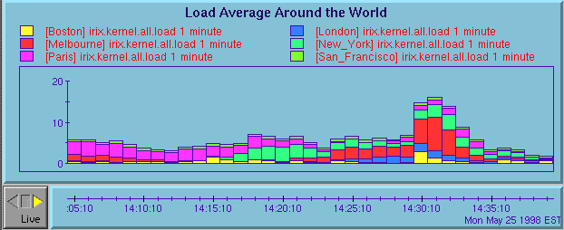
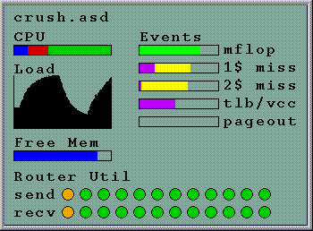
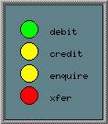
2-D Performance Visualization

Slide 12
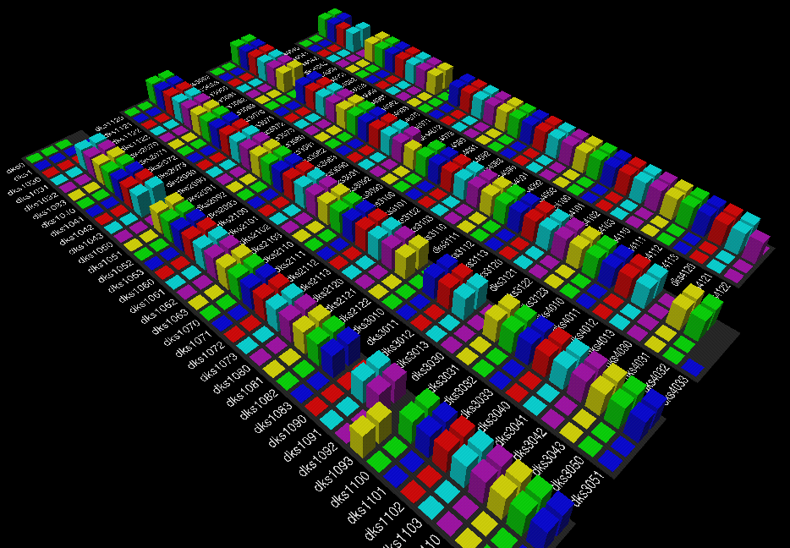
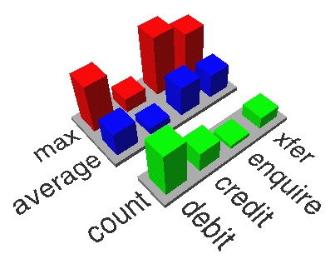
3-D Performance Visualization

Slide 13
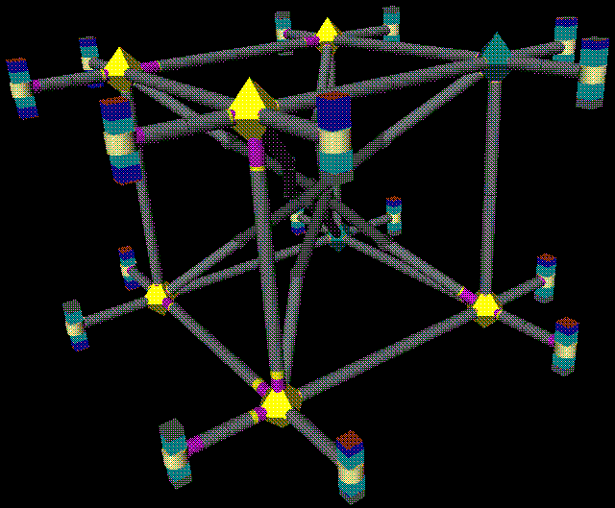
3-D Visualization of Platform Performance

Slide 14
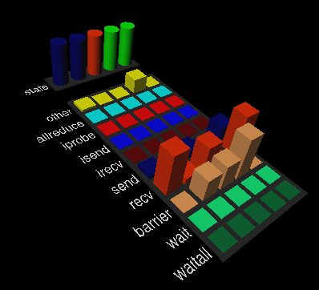
3-D Visualization of Application Performance

Slide 15
Reasoning About Performance Data
Thresholds are not enough
  Need quantification predicates: existential, universal, percentile, temporal, instantial.
  Multi-source predicates for client-server and distributed applications.
  Retrospection is essential.
  Customized alarms and notification.

Slide 16
Performance Co-Pilot Porting History
  Initial development for IRIX
  1994 Linux experiments
  1995-96 HP/UX port
  1998 NT port
  1998-99 Linux port

Slide 17
Performance Co-Pilot Porting
Some things that did not help
  For efficiency and historical reasons we’d chosen to avoid xdr and SNMP.
  HP/UX secrets.
  Lack of instrumentation in the Linux kernel.
  Tool frameworks used for IRIX development are not universally available, e.g. Motif, ViewKit, OpenInventor, XRT.

Slide 18
Performance Co-Pilot Porting
Some things that did help
  Programmer discipline.
  Obsessive attitude to automated QA.
  Orthogonal functionality, especially for APIs.
  Monitoring tools that are predominantly shell scripts in front of a small number of generic applications (the “toolkit” approach).

Slide 19
A Linux Performance Monitoring Architecture
pmcd
linuxpmda
Linux kernel
procfs and
/proc/stat

Slide 20
A Beowulf Perf Monitoring Architecture - Node View
pmcd
linuxpmda
beowulfpmda
cluster
infrastructure
Linux kernel
procfs and
/proc/stat

Slide 21
A Beowulf Perf Monitoring Architecture - Application View
pmcd
mypmda
my application
linuxpmda
beowulfpmda
cluster
infrastructure
Linux kernel
procfs and
/proc/stat

Slide 22
A Beowulf Perf Monitoring Architecture - Cluster View
Node A
monitor
pmcd
Node B
pmcd
Node C
pmcd

Slide 23
Some Concluding Comments
  System-level performance management for large systems is a hard problem.
  Simple solutions do not exist.
  Need an extensible collection architecture
  Monitoring tools should provide centralized control for distributed processing.
  Retrospection is not optional.
  Linux offers real opportunities for “better” solutions in this area.

