Slide 1


Slide 2
Ken McDonell
Reflections on Fifty Years of Performance Analysis
Notes:
50 years is a long time … the hard part of preparing this presentation has been deciding what to leave out.
I once watched Ross Bott do a presentation of almost 100 slides in an hour … this is going to move swiftly, but not quite that swiftly.
I have used ALL of the technologies mentioned in this presentation.

Slide 3
Computing Landscape circa 1969
Machines lived in warehouse sized computer rooms

Slide 4
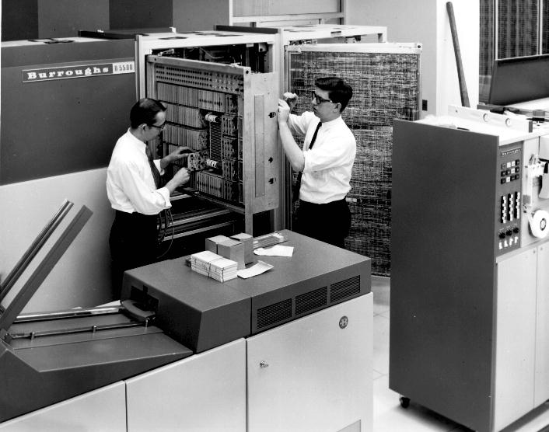
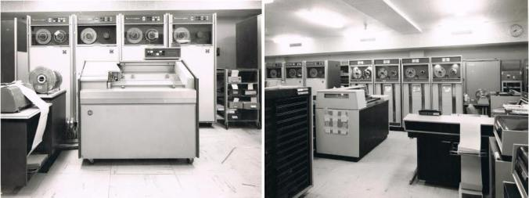
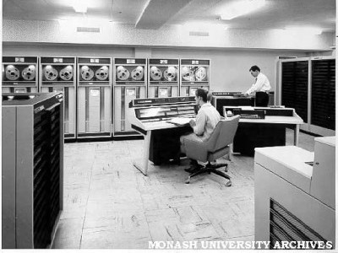
Computing Landscape circa 1969
Notes:
Earliest computers at Monash University
Ferranti Sirius installed Nov 1962 (not shown)
Control Data CDC 3200 installed 1964
1.25 microsecond cycle time => 0.8 MHz, aka 0.8MIPS
max RAM (core) 32K words, 24-bits per word => 96 Kbytes
Burroughs B-5500 installed 1969
max RAM (core) 32K words, 48-bits per work => 192 Kbytes (module shown above is 96 Kbytes or half the max memory)
Burroughs O/S was MCP, written in Algol (years before Unix rewrite and development of C at Bell Labs)

Slide 5
Computing Landscape circa 1969
Machines lived in warehouse sized computer rooms
VM from 1966 but only on very large machines
Small disk capacity in large boxes
Notes:
Virtual memory was only available on very large machines: Burroughs 6500 (1966), IBM 360/67 (1966), CDC 7600 (1967), GE 645 (1967)

Slide 6
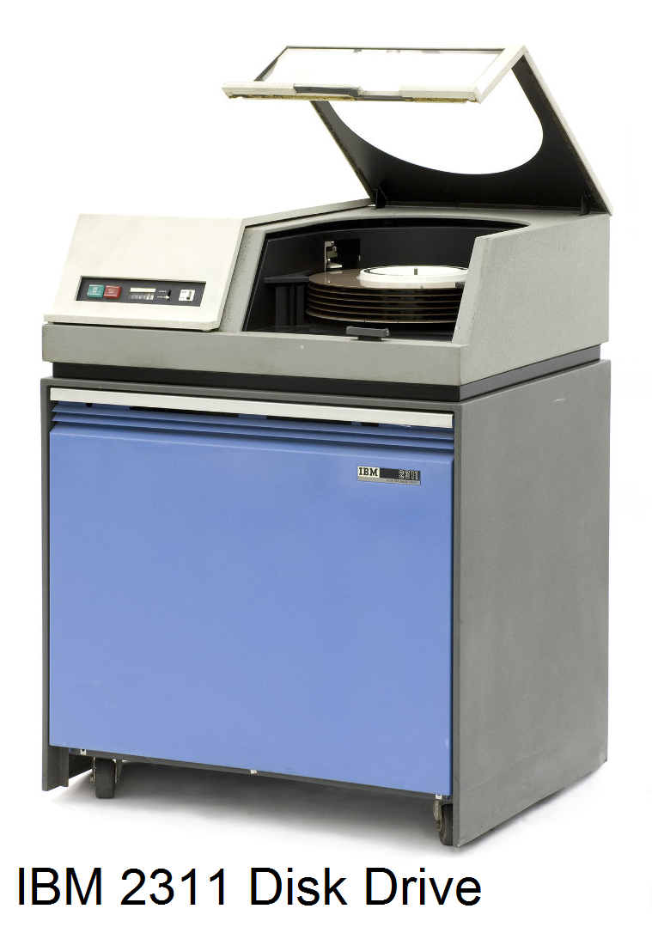
Computing Landscape circa 1969
Notes:
IBM 2311 disk drive
introduced in 1964
removable disk cartridge with six platters and 10 recordable surfaces
total capacity of a little over 7 Mbytes
washing machine dimensions at 96 x 102 x 64 cm
2400 rpm, so average rotational latency was 12.5 msec
track-to-track seek time 30 msec
average seek distance 67 cylinders (1/3 of 200)
average seek time 85 msec
transfer rate 156 Kbytes/sec

Slide 7
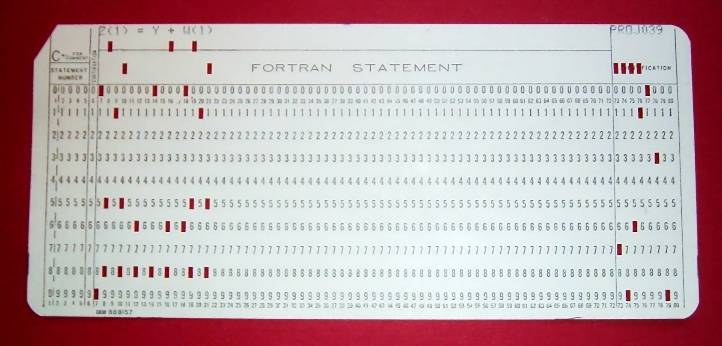
Precursor Technology and Tools
lines of source code
Notes:
Note Comment, Statement Number, Continuation and Sequence fixed width Fields!
80 column cards => 80 column x 24 rows (lines) for earliest CRT terminals (circa 1972) => default xterm window size today

Slide 8
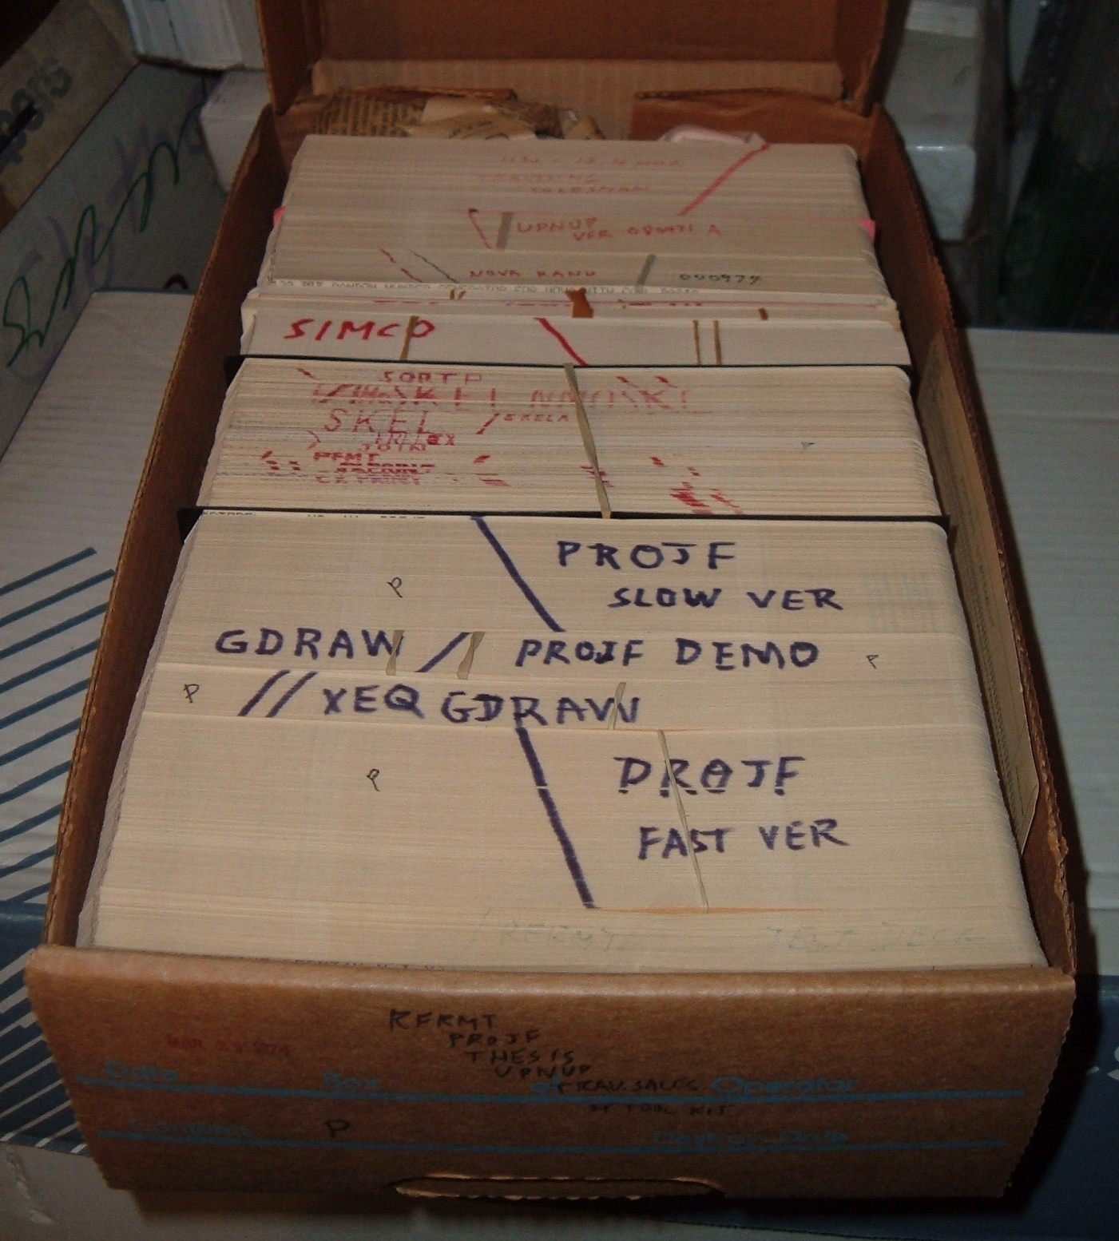
Precursor Technology and Tools
lines of source code
source file
Notes:
My major project in 1970 (interactive matrix manipulation using the new on-line terminals) required 2 boxes for the source code or about 4,000 lines of Fortran
The application was submitted to a batch system and if the compilation was OK, the executable was stored on disk and could be run from a terminal (typewriter) outside the computer room.

Slide 9
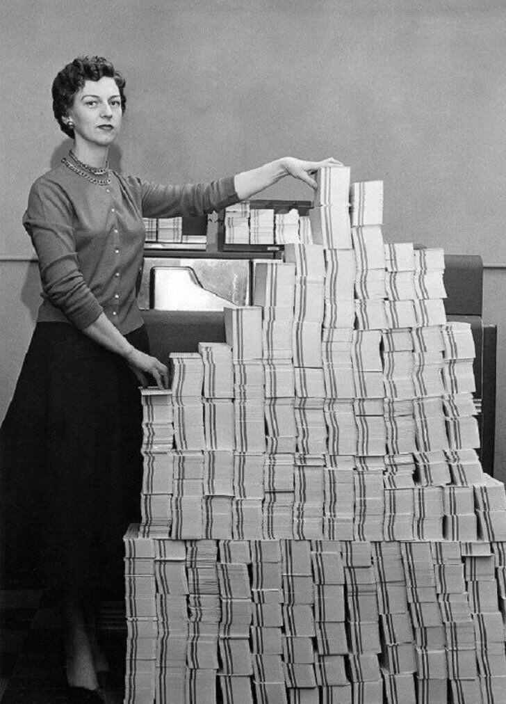
Precursor Technology and Tools
lines of source code
source file
sccs, cvs, git
Notes:
There are some 62,500 cards (lines of code) in this stack, approx the same as libpcp

Slide 10
Precursor Technology and Tools
lines of source code
source file
sccs, cvs, git
vi, emacs

Slide 11
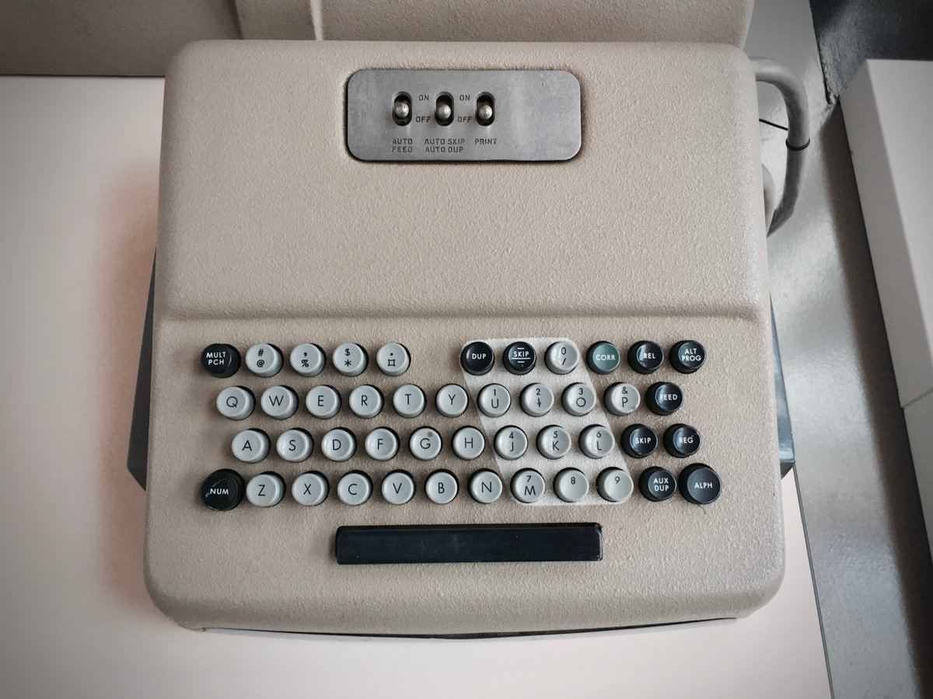
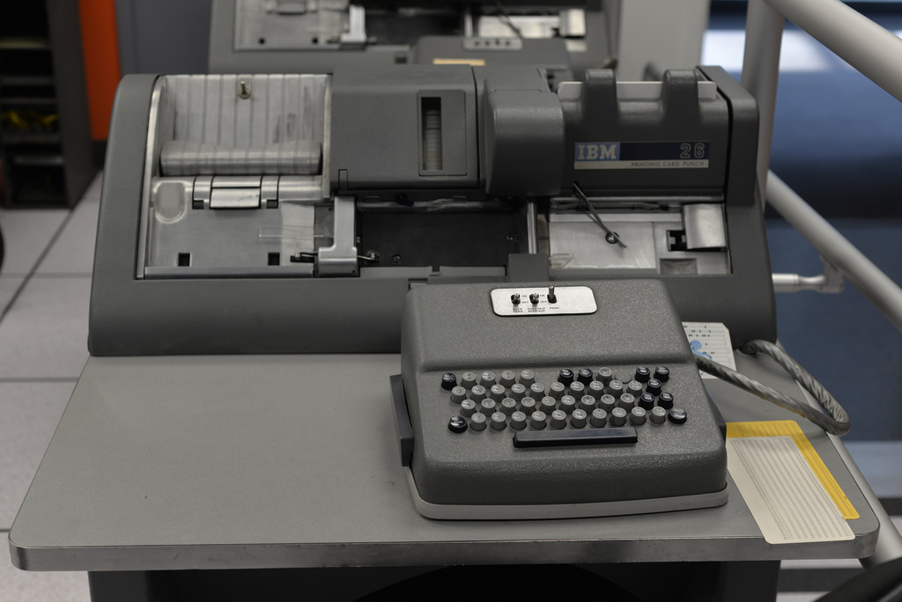
Precursor Technology and Tools
Notes:
Only edit mode is dup-hold-type-skip/dup
Note no lowercase or wanky non-Fortran characters, like [], {},#, :, ;, |, “, ‘, `, @, %, ^, &, _, …

Slide 12
Precursor Technology and Tools
lines of source code
source file
sccs, cvs, git
vi, emacs
relocatable binary device driver

Slide 13
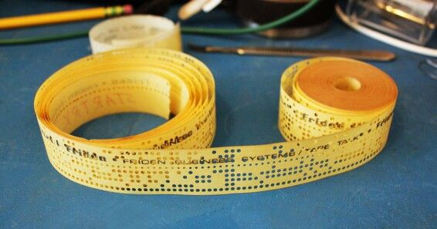
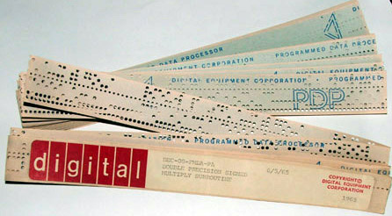
Precursor Technology and Tools
Notes:
Relocatable binary device driver
Note double precision signed multiply was done in software not hardware on a DEC System 10
When loading with a Teletype ASR-33 paper tape was read at 10 6-bit frames per second, so about 2 mins per Kbyte of code loaded

Slide 14
Precursor Technology and Tools
lines of source code
source file
sccs, cvs, git
vi, emacs
relocatable binary device driver
kernel debugger

Slide 15
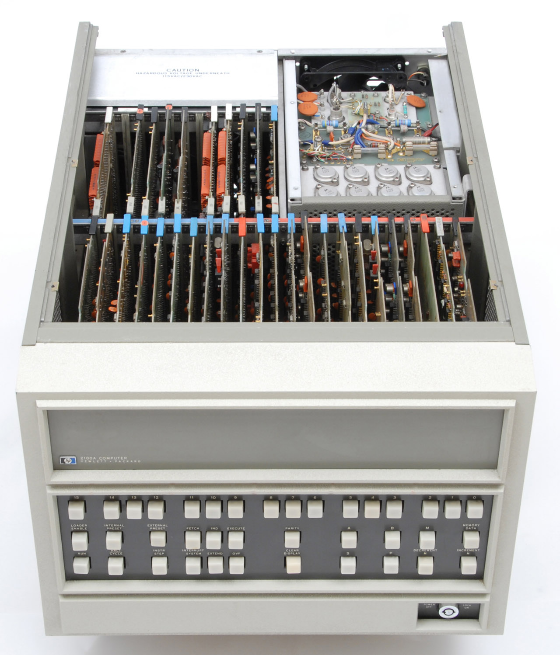
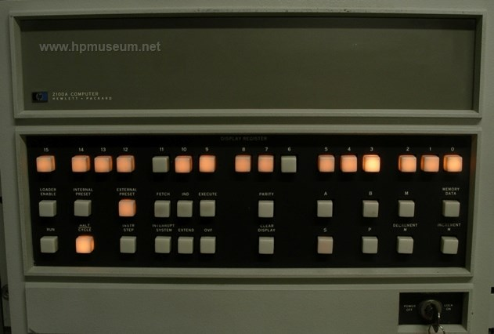
Precursor Technology and Tools
Notes:
Front panel was the only debugger (for kernel and/or one application, no memory protection), but only for instructions and data in octal [HP2100A front console]
If you cannot decode machine code, you’re out of luck
Can examine/modify A and B register and memory contents
Top-bit of memory address used for indirection, so can address at most 2^15 words or 64 Kbytes of RAM

Slide 16
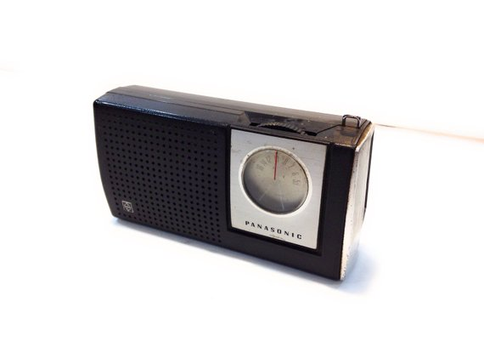
Precursor Technology and Tools
lines of source code
source file
sccs, cvs, git
vi, emacs
relocatable binary device driver
kernel debugger
performance monitor
Notes:
Tune AM radio to a gap between stations and frequency changed as computer changed from idle to normal execution to waiting for operator action to infinite loop.

Slide 17
Still in the Future in 1969
Codd’s first relational DB paper [70]
First PDP-11 [70]
LSI [70’s] and VLSI [80’s]
ARPANet (Internet precursor) [72]
DRAM replacing core memory [73]
Unix V4 [74] and V5 [75]
ICL Content Addressable File Store [75]
Notes:
Ted Codd's seminal paper of the Relational Data Model [1970]
The first PDP-11 [1970]
LSI and VLSI [1970's and 1980's]
Public demonstration of (the Internet precursor) ARPANet [1972]
DRAM replaces core memory [1973]
RFC-675 (Internet Transmission Control Program), initial TCP specification [1974]
UNIX V4 (the development of C and kernel rewrite in C) [1974]
UNIX V5 (first release outside Bell Labs) [1975]
ICL Content Addressable File Store (CAFS) [1975] … first hardware with augmented search logic integrated into the disk heads/controller
first of a long line of special purpose hardware machines that were going to solve a “performance problem” in hardware, rather than software
Other Examples:
Hardware accelerated Belle Chess engine, Joe Condon (hardware) and Ken Thompson (software) [1976]
Lisp machine from Symbolics (via MIT) [1980]
Britton-Lee release IDM 500 database machine [1983]
all were driven into the ditch by software solutions that leveraged general purpose CPUs that got faster quicker than you could make money on new releases of special purpose hardware

Slide 18
Still in the Future in 1969
DEC VAX 11/782 [82]
Ada [83]
C++ [85]
Berkeley TCP/IP code released [89]
Linux 1.0 [94]
multi-threading, POSIX, microprocessor, high-speed networking, solid-state disks, ...
Notes:
VAX 11/782 (first dual processor minicomputer) [1982]
First Ada compiler [1983]
Stroustrup publishes "The C++ Programming Language" [1985]
BSD UNIX TCP/IP code released to public domain [1989]
Linux 1.0 released [1994]
multi-threading, POSIX, microprocessor, solid-state disk, high-speed networking, ....

Slide 19
Performance Issues circa 1969
Memory footprint
File organisations: minimising IOPs and disk latency
Algorithms and computational complexity
Benchmarking as part of the hardware acquisition cycle
Notes:
Typical memory sizes were a few tens of Kbytes, so data size and code size was critical. This lead to unnatural acts like overlays and self-modifying code.
Disks were really slow, …
so cylinder locality (to avoid seeking) and track-level layout (to reduce rotational latency) and number of I/O transfers were all critical
Average seek distance for random access to a device of W cylinders is (W^2-1)/3W – first example of analytical performance analysis
simulation studies of index-sequential files – first example of pragmatic performance analysis
Benchmarking interest led eventually to MUSBUS [1978] which was the start of my interest in correlating end-user performance to platform-level resource demands and consumption.

Slide 20
Fast Forward ...
Computers are about 30 million times faster and bigger
Memory is a non-issue (except for very large data)
Disks and file organisations are invisible or largely irrelevant
CPU speed makes algorithms less critical (except for very large data)
Notes:
Moore’s Law suggest 2^25 improvement
some things have increased this, e.g. parallelism and MP machines
some things have decreased this, e.g. speed of light and software bloat
Comparison
CDC 3200: 0.8MHz, 96Kbyte RAM
Samsung S9 with Exynos 9810 CPU: 4 cores for performance, 4 cores for efficiency, 4x2.9 + 4x1.9 = 19.2GHz, 4Gbyte RAM
CPU 24,000 times faster
RAM 44,000 times bigger
No one can see on disk layout now, much less try to optimise for it

Slide 21
Genesis of PCP
Performance issues for SMP machines with 30 CPUs (hardware & software)
NUMA adding complexity
Performance problems in user space
Humans need help to manage systems
Performance analysis critical for sales revenue and support profitability
Scarring from the sleazy benchmarking era
Notes:
By 1992, Pyramid Technology was building MIPS R3000 based SMP machines with up to 24 CPUs (MIServer ES)
We had been battling with hardware and software parallelism for some time
Rich Hammons: “as harder problems emerge, intuition is less useful”
systems with more CPUs and finer grained parallelism actually run slower due to reduced CPU performance as a result of bus contention and cache trashing (load-link store conditional for spinlocks)
in-lining a function increased the memory footprint but the kernel ran much faster (less register-file flushing on a Pyramid 90x)
Hard performance problems were appearing in user space, especially for DBMS and fault-tolerant applications
The Systems Technology Laboratory was formed to plan for the next generation machine (Meshine) based on NUMA technology (wormhole routing from Caltech chosen over Stanford's DASH)
The complexity of these systems led naturally to the "co-pilot" analogy to keep them running smoothly ... we believed humans would very knowledgeable automated assistance
scarred by the era of sleazy benchmarking: gruntstones, bad benchmark design, dubious compiler and O/S optimisations, cheating
Whetstone: compiler specials to match parse tree and emit hand optimised loop unrolled code
AIM (and others): simple test code easy tricked in libraries, e.g. loops calling getpid() or getuid() to measure “system call overhead” that never did an (expensive) system call context switch, or disk I/O tests that never did I/O if the buffer cache was big enough
Neal Nelson: changed rules to stop aggressive optimisations, continued to compare old and new results
Bank of Amerca debit-credit benchmark => tp1 => tpc-A
SPEC
TPC

Slide 22
Experience from Real Production Environments
Something is broken all of the time
SLAs quote end-user performance metrics
Cyclic patterns of workload and demand
Transients are common
Natural evolution changes everything, so stay awake!
Notes:
“something” is hardware, database, service, application … different things are broken at different times, failures are NOT statistically independent => storms of cascading failures
Service Level Agreements (SLAs) are not written from the perspective of a sys admin or an app developer or a kernel engineer, but this is EXACTLY where the performance instrumentation and tools come from
Cyclic patterns may be every 10 secs, every min, every hour, every day, one day a week, one day a month, … performance is often characterised by “normal” steady state behaviour with an overlay of periodic disruptive behaviour
Transients are hard … typically need detailed instrumentation to diagnose but cannot afford to run this way all the time, plus Heisenberg phenomena of instrumentation slowing things enough to make the problem go away.
Natural evolution – upgrades, workload, file system/db age, re-organisation … these all have the potential to change the bottlenecks, rules and assumptions

Slide 23
Neanderthal Approaches Making the Problems Harder
Islands of performance data
Reporting tools with narrow focus
Emphasis on manual post mortem analysis with little automated real-time monitoring
Notes:
Performance data is accumulated in or at
the hardware (CPUs, I/O and network controllers, NUMA interconnect) … sometimes disabled for performance reasons
the core O/S
loadable modules (not necessarily always there)
system service layers, e.g. network packet assembly
3rd party services, e.g. DBMS, REST APIs, …
server-side applications
client-side applications and probes

Slide 24
PCP Milestones
STL paper designs at Pyramid [early 92]

Slide 25
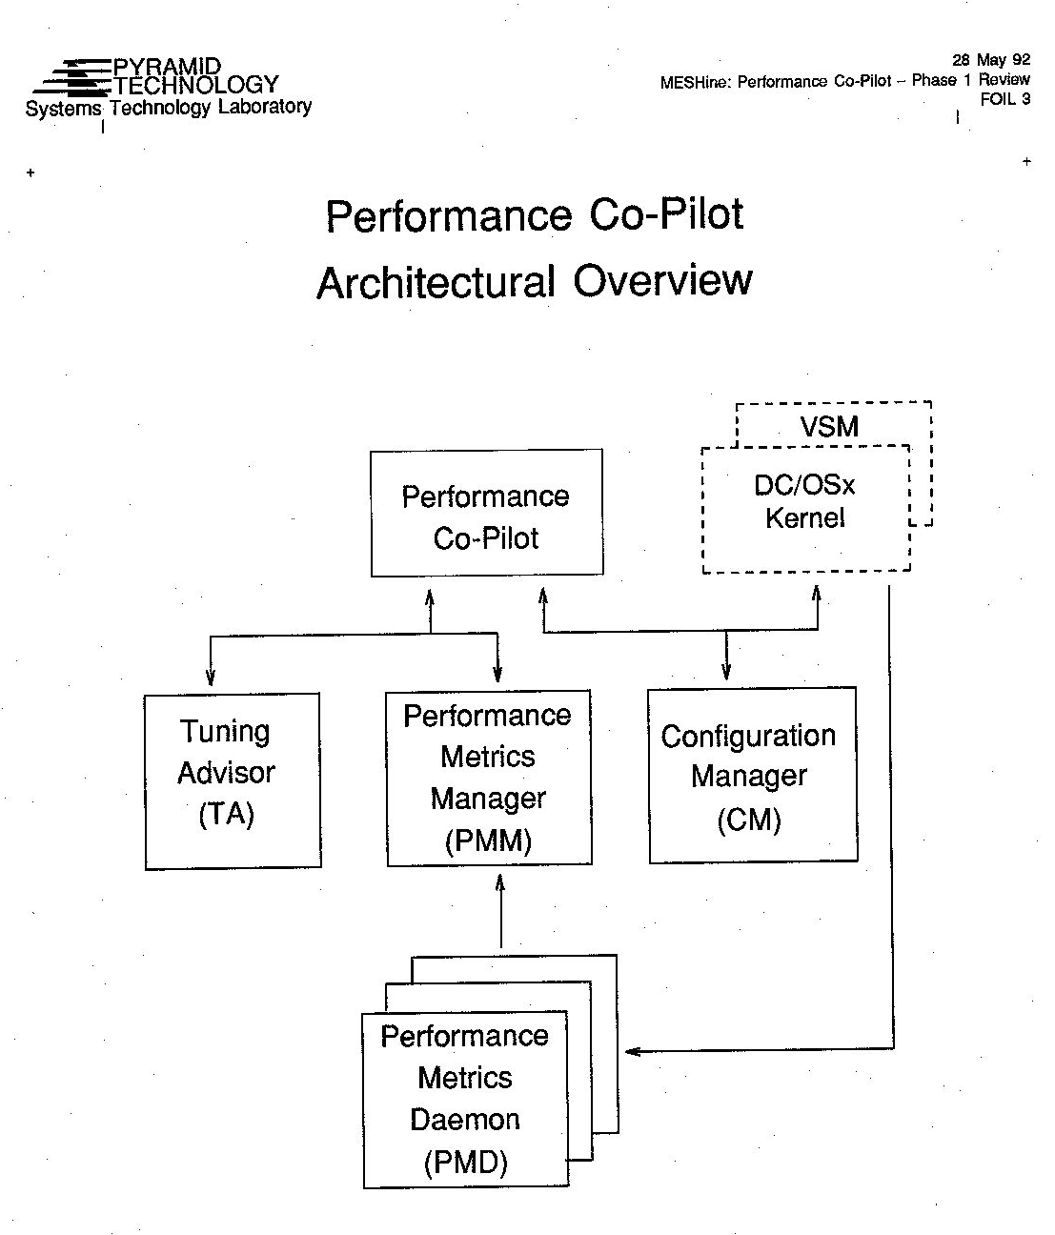
PCP at Pyramid - Architecture
Notes:
Note date – May 1992
Today’s basic PCP achitecture is already visible
PMD ~ pmcd (one per node)
TA ~ pmie
PMM is extra level of co-ordination across the nodes of a NUMA machine
PCP ~ pmchart, pmview, pmgadgets, pmdumptext, pmrep

Slide 26
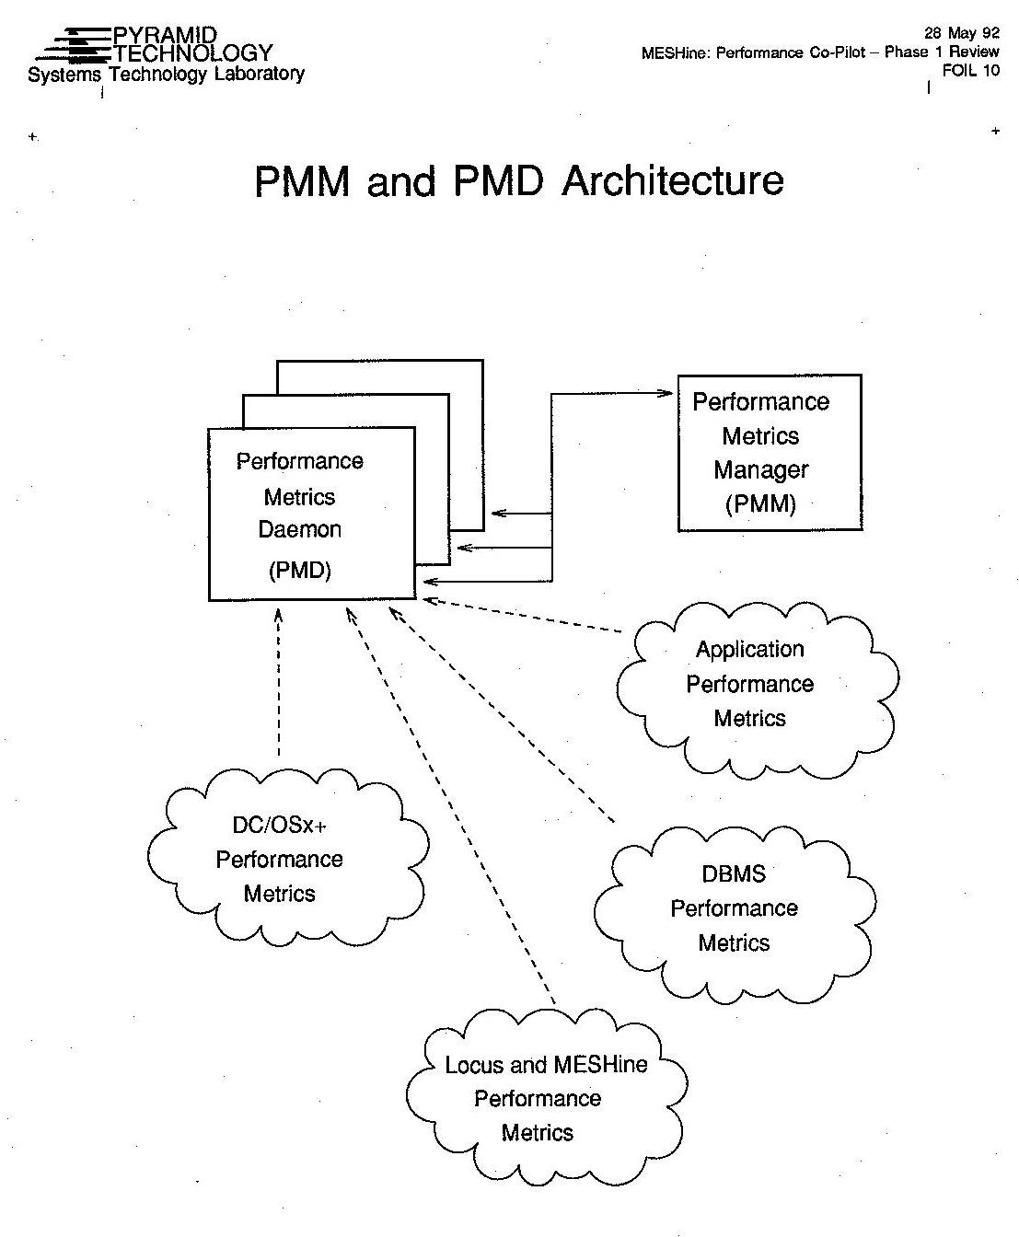
PCP at Pyramid – PMM (pmcd)
Notes:
Much of what we now know as PCP was already proposed:
PMD is pmcd and the “clouds” are PMDAs
Unification of performance data from different sources
Zooming … metrics breadth and depth model of PCP
rule-based inference to aid understanding and management

Slide 27
PCP Milestones
STL paper designs at Pyramid [early 92]
CMG paper [Aug 93]
SGI team formed in Melbourne [Oct 93]
PCP 1.0 SGI release [Apr 95]
Linux porting experiments [95]
PCP 1.2 SGI release [Aug 96]
PCP 2.0 SGI release [May 98]
Notes:
Distributed Performance Management in a Heterogeneous Environment, Ken and Neil Gunther, CMG Transactions, Aug 1993
Based on a Fred Brooks quote, we’re in the Intelligence Amplification camp, building systems that augment (not replace as in AI) humans by doing the things that the human mind has trouble grasping
SGI team was formed with the support of Ross Bott and an explicit objective to build the PCP that Pyramid did not commit to.
First hire was Mark Goodwin (came over from Pyramid). Then Jonathan Knispel and Seppo Keronen.
PCP 1.0 was proprietary, monolithic product. Over time this morphed into a range of inter-related products.
Mark did the initial Linux porting as a skunk works project, unbeknown to me.
PCP 1.2 included:
pmview rewrite including 2nd iteration of scene constructor language
PCP 2.0 included a bunch of innovations:
Distributed PMNS and IPC extensions to match
Version 2 archives (with their own PMNS)
libcp_pmda

Slide 28
PCP Milestones (continued)
CXFS driving ports to other systems
  Solaris, AIX, HP/UX [95-96]
  Mac, Windows, Linux [98]
Perl bindings for PMDAs [Sep 99]
Open source releases
  collector infrastructure, core libs and tools [Dec 99]
  QA suite [Oct 02]
  odds and sods [Mar 05]
Notes:
CXFS was a distributed, heterogeneous, clustered file system
We need PCP collector (pmcd, libraries, pmdas) on all the client nodes to allow cluster-wide performance monitoring
This drove a LOT of portability navel gazing
First open source release was just the collector infrastructure to run on the NUMA Altix Itanium (ia64) CPUs. The monitoring components were still SGI proprietary. Over time, SGI was persuaded to release almost all of the original proprietary code.

Slide 29
PCP Milestones (continued)
SGI Altix and ia64 porting [01]
Aconex [Oct 05]
Dynamic names in the PMNS [Oct 09]
RedHat: Mark [09], Nathan [12]
Security work [Oct 00, Aug 12, Feb 17]
Derived metrics [Jan 10]
Notes:
SGI hiatus was strategic to protect the Melbourne engineering team … we needed to do something else that was more “core”, so file systems, networking, appliances, ...
At Aconex, PCP slowly became the performance monitoring infrastructure layer for multiple data centers around the world, and this was the seed for integration of Java application and JVM data that lead to Parfait
RedHat engagement is key because it provides headcount (handing on the baton that has passed Pyramid => SGI => Aconex => RedHat), and ensures the feature set stays aligned with someone’s corporate interests (this is not a bad thing!)
Security work is on-going
Implementation of derived metrics did not happen until almost 14 years after initial white paper outlining the requirements (Mar 1996)!

Slide 30
PCP Milestones (continued)
Thread-safe libpcp [Mar 12 … Dec 18]
Python bindings [Aug 12]
On-the-fly decompression of xz archives [Sep 14]
Metric labels [Feb 19]
90 PMDAs in the source tree [Mar 19]
Notes:
Thread-safe libpcp is really hard (6 years so far) and I suspect not generally useful.
90 PMDAs in source tree as of Jan 2019

Slide 31
Stuff We Got Right
Client-server architecture and PMAPI
PMDA plug-in architecture
Metadata accessible via PMAPI
Data model
Interchangeable real-time and historical data sources
Flexible archive logging scope and frequency
Notes:
Client-server is only option; PMAPI is at the “right” level
Metadata
PMNS
metric type
metric semantics
instance domains
Real-time and archive contexts is really important
Data model
type (int, unsigned int, float, double, string, …)
dimensions of time x space x count
singular values
set-based values (instance domains)
missing metrics and/or instances is expected and OK
Plug-in is just the right thing to do
Logging flexibilty
shallow and broad coverage (no surprises)
narrow and deep coverage (anticipated problem areas)
coverage changes site-to-site and over time
different logging frequency for different subsets of the metrics

Slide 32
Stuff We Got Right (continued)
Archive replay interval independent of logging interval
Single threading for pmcd
Portability
QA infrastructure and obsession
Notes:
Semantics of archive interpolation is sound … despite complexity of interp.c
If you can’t answer a client request quickly, what’s the point? => single-threaded pmcd
Portability was never an option
QA … don’t get me started … this is both technically essential and a religious issue

Slide 33
Mistakes
Assuming we were secure behind a firewall
Putting all the AI eggs in the pmie basket
Adding features no one really wanted or used
Akmal-driven premature optimizations
Emasculated marketing
Notes:
Initial production environments were all in customer facilities off the Internet or behind locked down firewalls. Not addressing broader security scenarios has hurt, e.g. CVE storms, DOS exposure, Selinux, authenticated IPC
pmie is not a success … there has to be a better way
Is there really a case for:
pmlc – pmie-driven feedback never happened although I think it would have been very powerful
event records
thread-safe libpcp
local context
Akmal (my original SGI Engineering Director) would only countenance PCP as a replacement for sar/*stat if we used less than 10% extra CPU time compared to the alternative … this fails to acknowledge the value of the information and led to unnatural acts like
piggy-backed PDUs
PDU pool allocator instead of malloc()
word-aligned fields in PDUs (=> paddding may be needed)
DSO PMDAs
Marketing can make inferior technologies succeed, e.g. NFS (cf DFS), Oracle (cf System R), i386 (cf any other CPU design). But it is really hard to make superior technologies succeed without marketing muscle. The truth is PCP never was important enough (in the bigger corporate picture)

Slide 34
Things We Could Have Done Better
Instance domain mapping
Be strategic about non-Linux ports
Near-zero effort set up and configuration
pmie, pmlogreduce and pmgadgets
Push harder to keep pmview working and evolving
Notes:
Instance domains
map “string” → integer implemented via hashing and backed by pmdaCache (which came too late to be useful here). Would avoid the whole “how to map an N-dimensional instance domain onto an integer” question.
Similarly, the external instance names are unique to the first space (driven by the proc PMDA) could have been avoided of the proc PMDA used just the pid and proc.command value was the whole of the rest of the current instance name.
Kill of the ports no one really wants or uses, e.g. OpenIndiana, *BSD
One size will never fit all, but customisation is not economically or logistically feasible … some combination of base configuration and automated (over time) augmentation and revision of the configuration (especially for pmlogger).
Re-implementation is a key driver for evolutionary development and we did it a lot early on, but
never happened for pmie (needed language redesign) or pmgadgets (needed proper layout language and complete PMAPI integration)
pmlogreduce was broken from birth
Visualisation is so important, but … pmview won’t even run now.

Slide 35
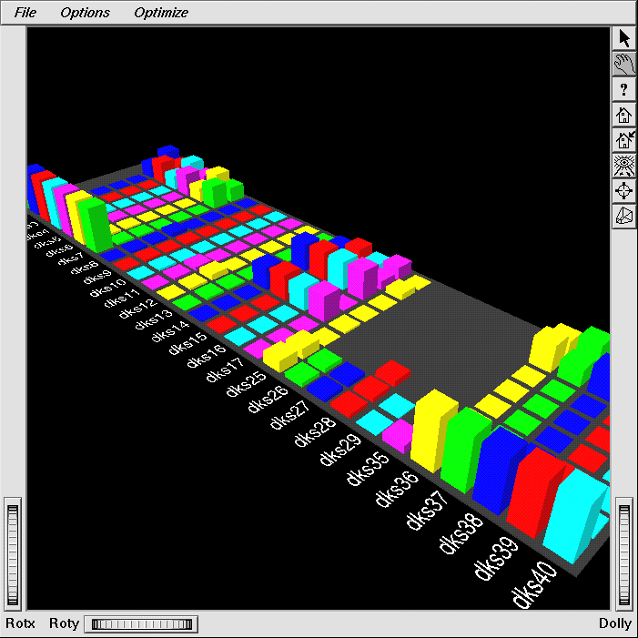
Visualisation and Big Disk Farms
Notes:
There are 186 disks on this machine
Colour and layout highlights disk per controller configuration
Activity modulates the height (and colour in the case of saturation/overload)
Disk activity as very non-uniform and some drives are working much harder than others

Slide 36
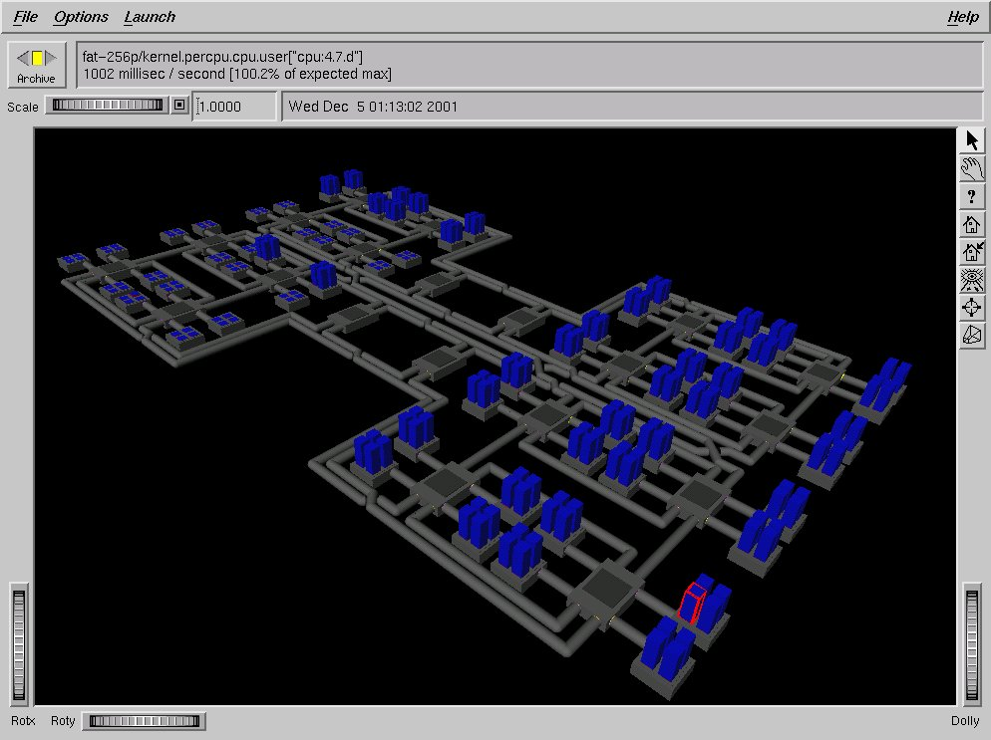
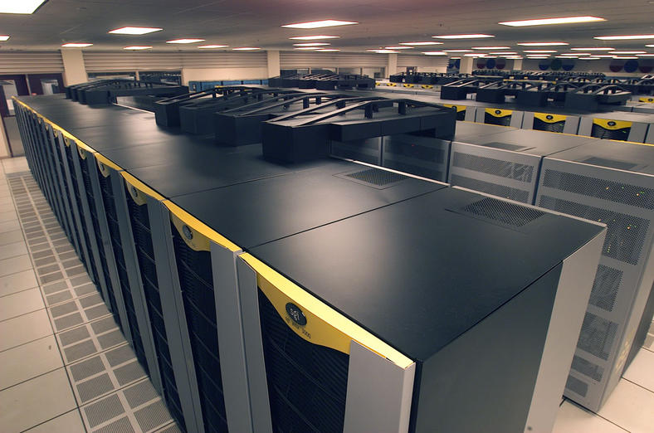
Visualisation and Big Machines
Notes:
Columbia for NASA (2004)
This is not a rack of machines, it is a 20 cache-coherent 512p NUMA machines (Altix 3700) connect together via Infinband
System had a total of 10,240 processors and 20 Tbytes of memory, 440 Tbytes of online storage, and 10 Pbytes of archival tape storage
The pmview scene is for a 256p machine, or 1/40th of the hardware installed for Columbia

Slide 37
The Co-Pilot Analogy
Humans are unable to fly modern aircraft without on-board avionics
Computer systems are just the same
We’ve only scratched the surface here
  the PCP data infrastructure is robust
  so far, only primitive reasoning and alerting
  no automated learning
  no tuning advisor
  we’ve lost the initiative in visualisation

Slide 38
Performance Analysis in the Future
PCP archives are a data source, not the end-game
  we have the information to populate huge repositories of historical data
  others will provide the query tools
Application of real machine learning techniques
Serious understanding through new performance visualisations

Slide 39
Questions?

