Slide 1
Parfait
Parfait
How it works +
where to from
here
(AKA “Through a glass, clearly”)
Paul Cowan
Aconex
September 2010

Slide 2
History of Parfait
Originally developed as
aconex-pcp-bridge
Specifically for getting PCP values into a custom agent
Expanded
Improved
Rewritten for MMV agent
Open-sourced
Notes:
Locking is a classic example
Subtle variations in 'big' request (printshops) may not affect its SLAs, but kill others
Get caught up in the noise – one 'central' problem can elevate ALL measurements, hard to pick out the actual cause

Slide 3
The Basics
Parfait has 3 main parts (for now):
  Monitoring
  DXM
  Timing
  Requests
Notes:
Locking is a classic example
Subtle variations in 'big' request (printshops) may not affect its SLAs, but kill others
Get caught up in the noise – one 'central' problem can elevate ALL measurements, hard to pick out the actual cause

Slide 4
Monitoring
This is the ‘original’ PCP bridge metrics (heavily modified)
Simple Java objects (MonitoredValues) which wrap a value (e.g. AtomicLong, String)
MonitoredValues register themselves with a registry (container)
Notes:
Locking is a classic example
Subtle variations in 'big' request (printshops) may not affect its SLAs, but kill others
Get caught up in the noise – one 'central' problem can elevate ALL measurements, hard to pick out the actual cause

Slide 5
Monitoring
When a value changes, a number of observers get told, and can output accordingly
  PCP
  JMX
  Other?
Very simple to use
‘Default registry’ (legacy concept)
Notes:
Locking is a classic example
Subtle variations in 'big' request (printshops) may not affect its SLAs, but kill others
Get caught up in the noise – one 'central' problem can elevate ALL measurements, hard to pick out the actual cause

Slide 6
Monitoring
Also worth pointing out: PollingMonitoredValue
This is used when the value is updated by something we don’t control, can’t ‘subscribe’
Thread checks periodically for new value, updates Registry if changed
Notes:
Locking is a classic example
Subtle variations in 'big' request (printshops) may not affect its SLAs, but kill others
Get caught up in the noise – one 'central' problem can elevate ALL measurements, hard to pick out the actual cause

Slide 7
DXM
This is the PCP output side of aconex-pcp-bridge
Rewritten to use the new non-custom MMV PMDA
Advantages:
  flexible, standardised, less maintenance work
Disadvantages
  have to assign ID to each metric
Notes:
Locking is a classic example
Subtle variations in 'big' request (printshops) may not affect its SLAs, but kill others
Get caught up in the noise – one 'central' problem can elevate ALL measurements, hard to pick out the actual cause

Slide 8
DXM
Map metrics names to ‘pseudo-PCP’ names, e.g.:
  aconex.controllers.time.blah →
  aconex.controllers[mel/blah].time
Placement of brackets is significant (determines PCP domains)
Notes:
Locking is a classic example
Subtle variations in 'big' request (printshops) may not affect its SLAs, but kill others
Get caught up in the noise – one 'central' problem can elevate ALL measurements, hard to pick out the actual cause

Slide 9
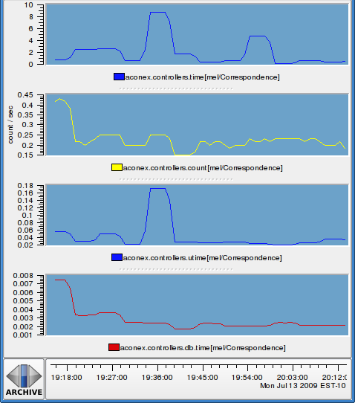
Monitoring + DXM
(Pretty graph time!)
Notes:
Not the database, even though that page hammers it
One's a CPU time spike
One's not CPU or database... blocking? something else?

Slide 10
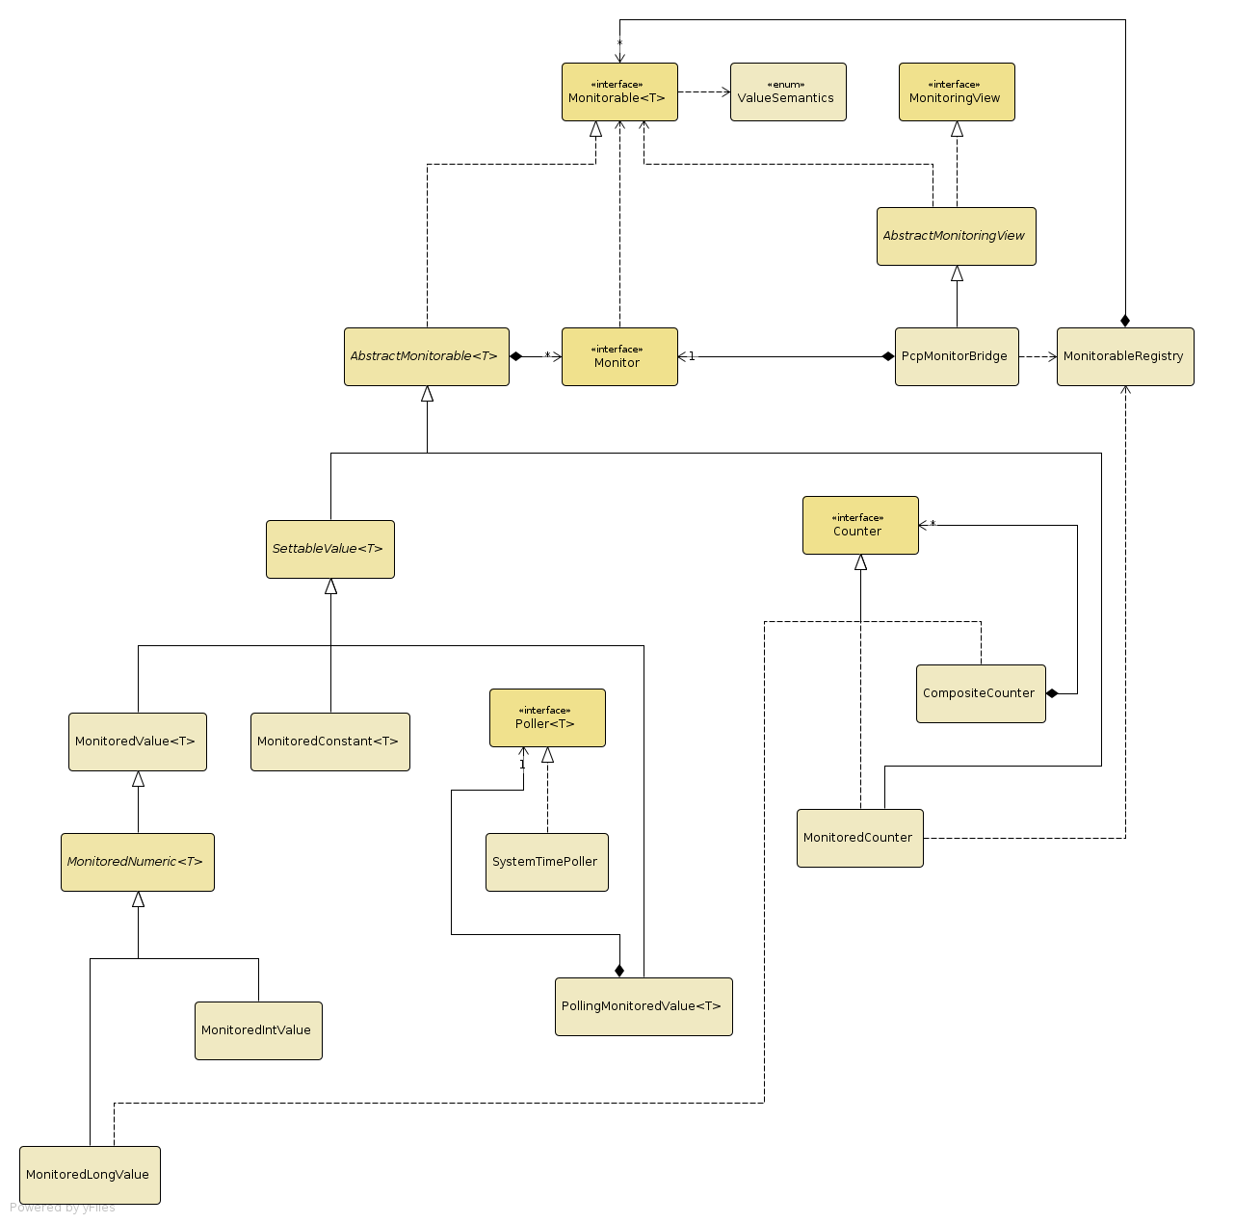
How it hangs together
Notes:
Not the database, even though that page hammers it
One's a CPU time spike
One's not CPU or database... blocking? something else?

Slide 11
Timing
Logs the resources consumed by a request (an individual user action)
Relies on a single request being thread-bound (and threads being used exclusively)
Notes:
Locking is a classic example
Subtle variations in 'big' request (printshops) may not affect its SLAs, but kill others
Get caught up in the noise – one 'central' problem can elevate ALL measurements, hard to pick out the actual cause

Slide 12
Timing
Basically need a Map<Thread, Value>
Take the value for a Thread at the start, and at the end
Delta is the ‘cost’ of that request
Notes:
Locking is a classic example
Subtle variations in 'big' request (printshops) may not affect its SLAs, but kill others
Get caught up in the noise – one 'central' problem can elevate ALL measurements, hard to pick out the actual cause

Slide 13
Timing
Deltas can be output a number of ways:
  Normal metrics
    Per ‘event’
    Total
  Logs (Log4jSink)
  HBase (HBaseSink) – in progress!
Notes:
Locking is a classic example
Subtle variations in 'big' request (printshops) may not affect its SLAs, but kill others
Get caught up in the noise – one 'central' problem can elevate ALL measurements, hard to pick out the actual cause

Slide 14
Timing: Example
[2010-09-22 15:02:13,466 INFO ][ait.timing.Log4jSink][http-8080-Processor3 gedq93kl][192.168.7.132][20][] Top taskssummaryfeatures:tasks taskssummaryfeatures:tasks Elapsed time: own 380.146316 ms, total 380.14688 ms Total CPU: own 150.0 ms, total 150.0 ms User CPU: own 140.0 ms, total 140.0 ms System CPU: own 10.0 ms, total 10.0 ms Blocked count: own 40, total 40 Blocked time: own 22 ms, total 22 ms Wait count: own 2, total 2 Wait time: own 8 ms, total 8 ms Database execution time: own 57 ms, total 57 ms Database execution count: own 11, total 11 Database logical read count: own 0, total 0 Database physical read count: own 0, total 0 Database CPU time: own 0 ms, total 0 ms Database received bytes: own 26188 By, total 26188 By Database sent bytes: own 24868 By, total 24868 By Error Pages: own 0, total 0 Bobo execution time: own 40.742124 ms, total 40.742124 ms Bobo execution count: own 2, total 2 Bytes transferred via bobo search: own 0 By, total 0 By Super search entity count: own 0, total 0 Super search count: own 0, total 0 Bytes transferred via super search: own 0 By, total 0 By Elapsed time during super search: own 0 ms, total 0 ms
Notes:
Locking is a classic example
Subtle variations in 'big' request (printshops) may not affect its SLAs, but kill others
Get caught up in the noise – one 'central' problem can elevate ALL measurements, hard to pick out the actual cause

Slide 15
Requests
As well as snapshotting requests after completion, for many metrics we can see meaningful ‘in-progress’ values
Simple JMX bean which ‘walks’ in-progress requests
Tie in with ThreadContext (MDC abstraction)
  Include UserID
  ThreadID
Notes:
Trend prediction is also important
Could spend a whole 'nother lecture talking about PCP...
Can collate data from 'for ever' – 'hey, this is the same problem we had last October – let's see if the data back then matches our hypothesis now'
Really really lightweight – 'cheap as free' (or at least RAM) – collect first, ask questions later

Slide 16
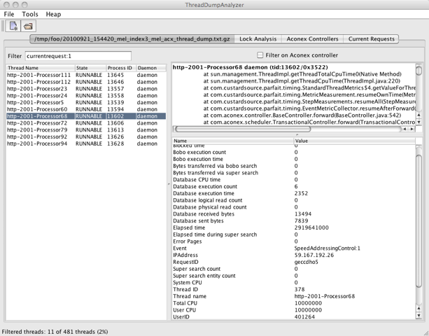
Requests - Example
Notes:
Trend prediction is also important
Could spend a whole 'nother lecture talking about PCP...
Can collate data from 'for ever' – 'hey, this is the same problem we had last October – let's see if the data back then matches our hypothesis now'
Really really lightweight – 'cheap as free' (or at least RAM) – collect first, ask questions later

Slide 17
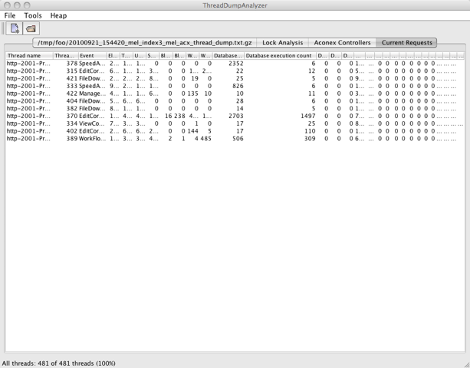
Requests - Example
Notes:
Trend prediction is also important
Could spend a whole 'nother lecture talking about PCP...
Can collate data from 'for ever' – 'hey, this is the same problem we had last October – let's see if the data back then matches our hypothesis now'
Really really lightweight – 'cheap as free' (or at least RAM) – collect first, ask questions later

Slide 18
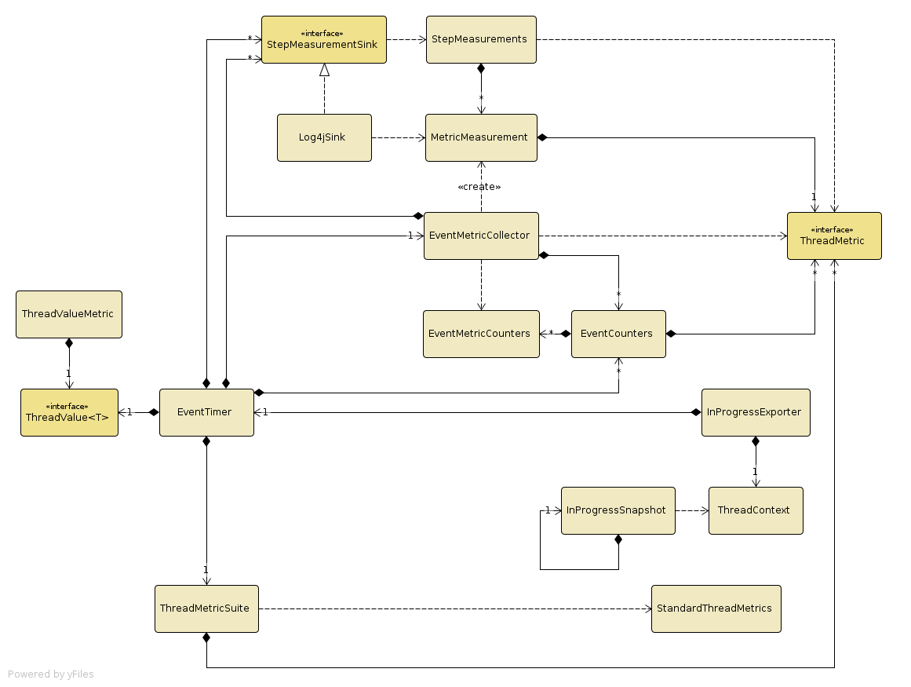
How it hangs together
Notes:
Not the database, even though that page hammers it
One's a CPU time spike
One's not CPU or database... blocking? something else?

Slide 19
Where do we use it?
Instrument the app itself (business actions) with metrics
Instrument third-party libraries (notably JDBC driver) for metrics/timings
Generate timings for inter-process events (supersearch, bobo)
Notes:
Trend prediction is also important
Could spend a whole 'nother lecture talking about PCP...
Can collate data from 'for ever' – 'hey, this is the same problem we had last October – let's see if the data back then matches our hypothesis now'
Really really lightweight – 'cheap as free' (or at least RAM) – collect first, ask questions later

Slide 20
How to use: Metrics
Adding a new metric is trivial:
public class FileIndexer {
private final MonitoredLongValue done =
new MonitoredLongValue(
“aconex.indexes.time”,
“Time spend indexing”,
MonitorableRegistry.DEFAULT_REGISTRY,
// injection = better!
0L, // initial value
SI.NANO(SI.SECOND));
Add a line to pcp-metric-ids.txt:
aconex.indexes.time 670
And use it!
done.inc(timeSpent);
Notes:
I mentioned that one of the other goals was to be unobtrusive... here's an example
OK, so we wouldn't use 'public'...

Slide 21
How to use: Timing
Adding a new measurement needs a new ThreadMetric
Easiest to use ThreadCounter (glorified ThreadLocal) and ThreadValueMetric:
public class CoolThing {
public final ThreadCounter coolThingsDone =
new ThreadMapCounter();
public void doCoolThing(...) {
coolThingsDone.inc();
}
}
Notes:
I mentioned that one of the other goals was to be unobtrusive... here's an example
OK, so we wouldn't use 'public'...

Slide 22
How to use: Timing
Then just add it to the ThreadMetricSuite
e.g. AconexMetricSuite
controllerSuite.addMetric(
new ThreadValueMetric("Cool things",
Unit.ONE, "things.done.cool",
"The number of cool things done",
coolThing.getCoolThingsDone());
);
Will automatically appear for all controllers
Notes:
I mentioned that one of the other goals was to be unobtrusive... here's an example
OK, so we wouldn't use 'public'...

Slide 23
The Magic Sauce
EventTimer has a bunch of metrics, PCP prefix, etc
Wired together by SpringEventTimerInjector:
  Finds all Spring beans which use an interface
  Tells the EventTimer about them
  Injects the timer into the bean
  Bean can now start/stop timing, with a ‘tag’
Notes:
I mentioned that one of the other goals was to be unobtrusive... here's an example
OK, so we wouldn't use 'public'...

Slide 24

Where to?
(what are the grand plans?)
Timing becoming ‘1st-class’ citizen
Multi-thread support
Outputs: JMX (++), Hbase, RabbitMQ (Rocksteady)?
Inputs: AOP,
Hibernate
Distributed (à
la Dapper)?
Notes:
Don't HAVE to use PCP. Can also expose through
JMX (rudimentary)
SNMP
anything else...

Slide 25
Staying Involved
Project uses Mercurial now (easy to branch/contribute)
Releases happen to central (much simpler to manage)
Adding others (psmith?) to repo uploaders
Follow the Google Code project!
  Mailing lists: -user and -dev
  Watch commits
Use, contribute, keep in touch!
Notes:
Don't HAVE to use PCP. Can also expose through
JMX (rudimentary)
SNMP
anything else...

