Slide 1

Programming the Performance Co-Pilot toolkit
Nathan Scott
Performance Tools, Red Hat
August 2014

Slide 2
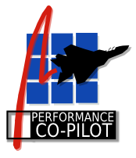
Outline
Performance Co-Pilot (PCP)
  Overview
  Exploring PCP
Extending with Python
  Collectors
  Monitors

Slide 3
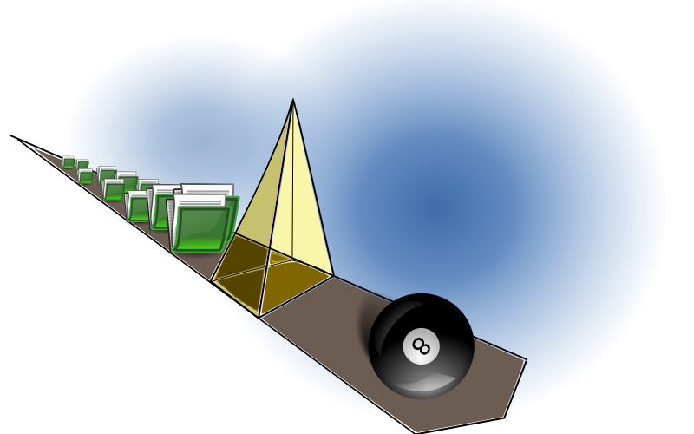
Overview
What is PCP?
  Open source toolkit
  System-level analysis
  Live and historical
  Extensible (monitors, collectors)
  Distributed

Slide 4
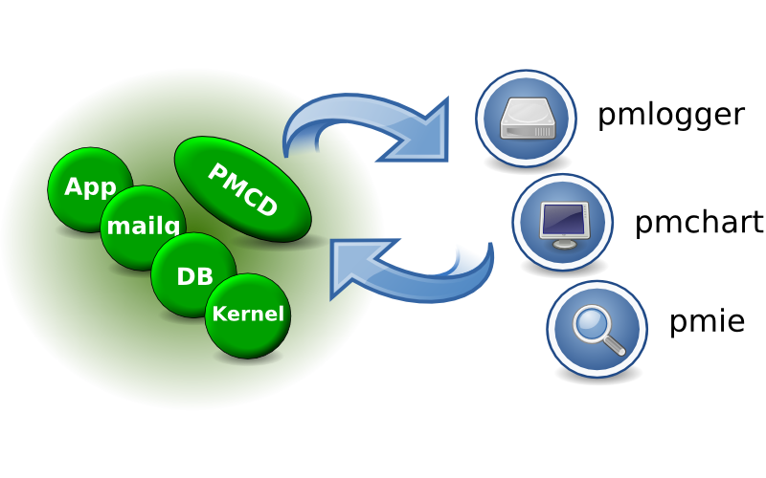
Architecture

Slide 5
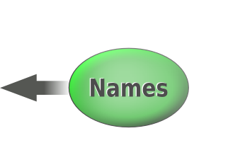


Metrics
pminfo --desc -tT --fetch disk.dev.read
disk.dev.read [per-disk read operations]
Data Type: 32-bit unsigned int InDom: 60.1
Semantics: counter Units: count
Help: Cumulative count of disk reads since boot time
Values:
inst [0 or "sda"] value 3382299
inst [1 or "sdb"] value 178421

Slide 6

Extending the toolkit, by example
Extending the toolkit, by example

Slide 7
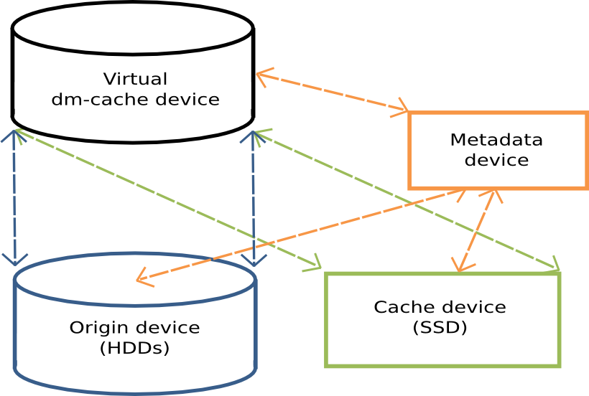
Device Mapper Cache target
“Linux Block Caching Choices [...]” (pdf)
Source: community.dell.com

Slide 8
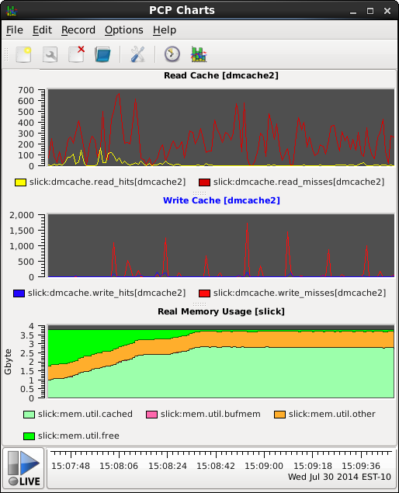
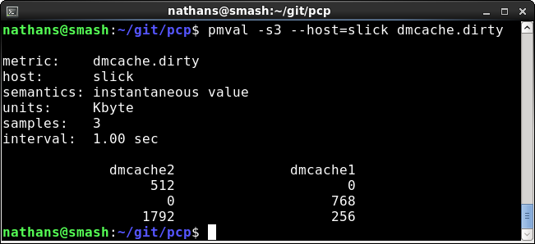
Collector extensions in Python
Goal: new dmcache metrics
  For recording, charting,
console tools

Slide 9
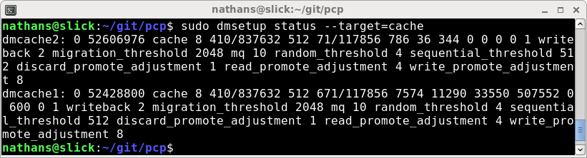
Collector extensions in Python
Domains, Metrics, Instances
import pcp.pmda
Create a PMDA subclass
add_metric (...names, IDs, units, etc...)
Fetch callback – turns metric IDs into values

Slide 10
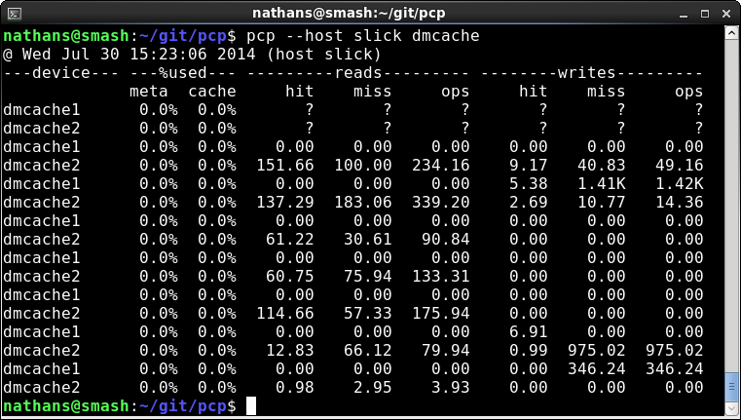
Monitor extensions in Python
Goal: a simple, custom dmcache stats tool...

Slide 11
Monitor extensions in Python
Report metrics (dmcache.* and disk.dm.*)
import pcp.pmcc
Create a MetricGroupManager object
Feed it metric names + a MetricGroupPrinter subclass
MetricGroupManager does all the heavy lifting:
  Sampling (fetch interval, count)
  Source (archives, local/remote hosts)
  Time window, timezones, options, etc.

Slide 12
Resources
git clone git.pcp.io/pcp dev
  src/pmdas/dmcache (collecting code)
  src/pcp/dmcache (monitoring code)
“PCP Programmer's Guide” book
dbpmda(1)
http://www.pcp.io
  Source, downloads, books, FAQ, mailing lists
http://developerblog.redhat.com
  PCP articles, demo videos

Slide 13
Demo &
Questions
Demo &
Questions

