Slide 1
Chatz <dchatterton@aconex.com>
Cowan <cowan@aconex.com>
Nathan <nscott@aconex.com>
System-Level
Performance
Analysis With PCP

Slide 2
Welcome to Aconex!
Scalable performance monitoring
Performance Co-Pilot
Brief introduction to Aconex
PCP integration into Aconex application
Practical examples

Slide 3
Scalable Performance Monitoring
SGI in Melbourne started developing Performance Co-Pilot 15 years ago
Goal was to help SGI users understand very complex system performance problems
Traditional tools
  fail to scale to large machines
  do not provide low level granularity
  difficult to perform retrospective analysis
  have poor visualisation of large data sets

Slide 4
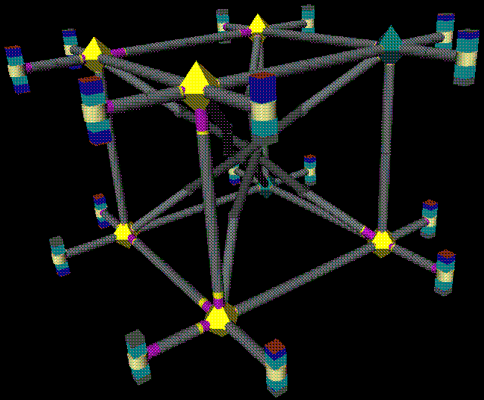
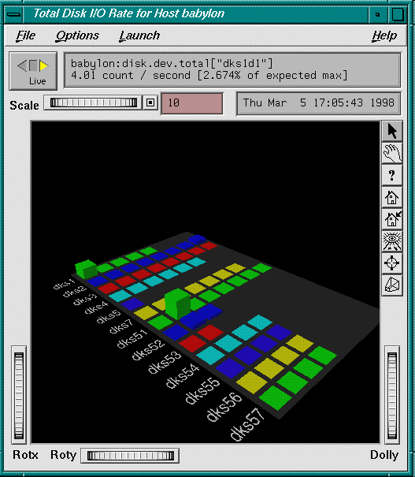
Scalable Performance Monitoring
Many resources
Complex architectures

Slide 5
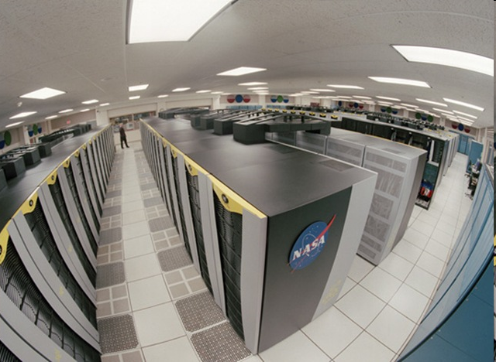
Scalable Performance Monitoring
How do you monitor a 512 processor machine
  top does not scale!
How do you monitor a cluster of 20x512 processor machines?
How do you know if what you are observing today has happened before?
How do you correlate today’s event with other activity on the system?

Slide 6
Our goal tonight
Demonstrate how Aconex has taken an open source performance monitoring toolset and integrated it into our Java application
  Overview of PCP and how it works
  How it is integrated
  Differences in monitoring a JVM to an Operating System
  Examples of how we have used PCP in anger
All the software you will see tonight has been developed here in Melbourne

Slide 7
PCP Overview
What is PCP?
  Open source toolkit for system level performance analysis
  Live and historical
  Extensible (monitors, collectors)‏
  Distributed

Slide 8
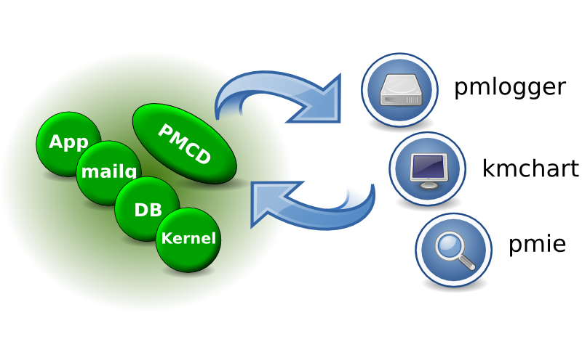
Architecture

Slide 9
Data Model
Metrics come from one source (host / archive)‏
Source can be queried at any interval by any monitor tool
Hierarchical metric names
  e.g. disk.dev.read and aconex.response_time.avg
Metrics are singular or set-valued (“instance domain”)‏
Metadata associated with every metric
  Data type (int, double, ...)‏
  Data semantics (units, scale, ...)‏
  Instance domain

Slide 10
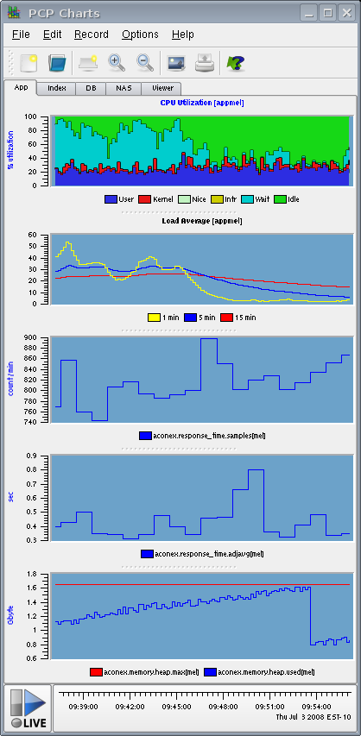
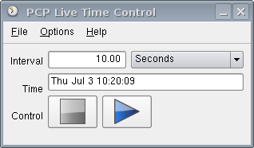
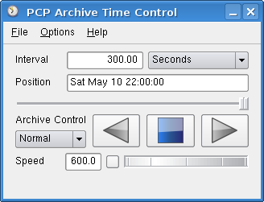
Monitor tools
pminfo, pmprobe, pmdumptext
pmlogextract, pmlogsummary, pmwtf
kmchart
pmstat
pmie
acxstat
acxtop

Slide 11

Aconex Overview
$210bn worth of projects in 70 countries
135,000 users and 3,500 client organizations
300 people, 24/7 local support, in 35 cities
Aconex provides online information management for construction, engineering & energy
A sophisticated workflow engine that supports established industry processes in complex, fast-moving project environments
SaaS application delivery, one login, multi project
Gartner (Oct 2007):
Collaboration market is evolving in response to demand for a coherent set of capabilities, processes and services that span communication, coordination, communities and informal social interactions.

Slide 12
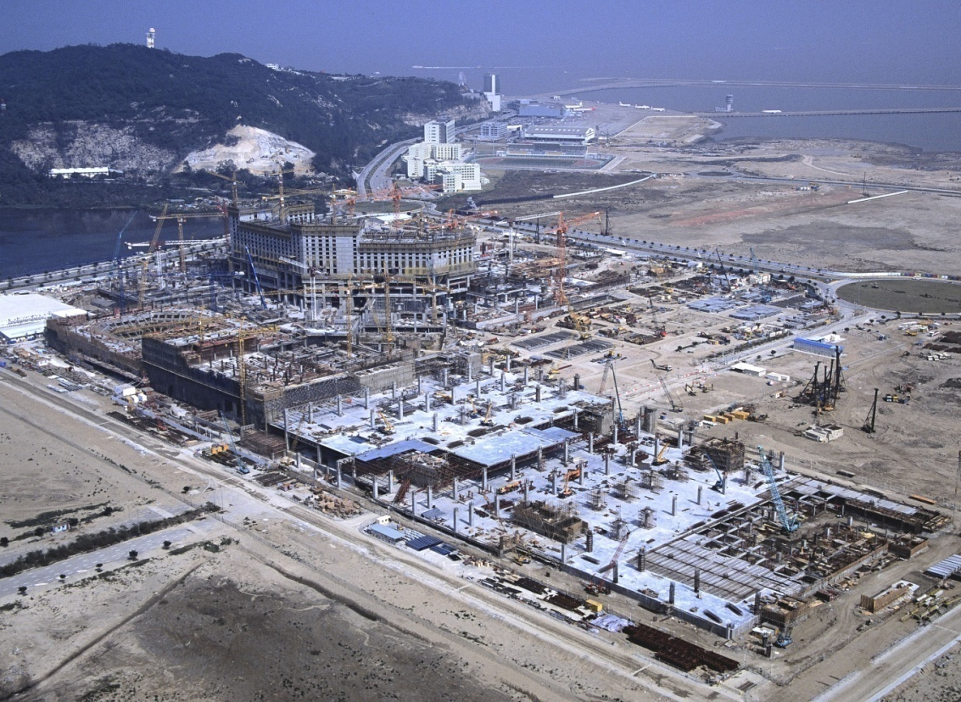
Large projects need collaboration systems to operate effectively and manage risk
Hundreds of companies come together on large projects
Most communication is between companies
The volume of documents and correspondence on projects is huge
Participants on large projects are increasingly geographically dispersed
Risk management / litigation necessitates keeping a strong audit trail of project information
Participants:
Locations:
Information:
Data managed:
3,030
US, Europe, Asia, ME
9.6m docs & correspondence
4.2TB

Slide 13
What's hard about monitoring Java?
Java's never standalone; interacts with
  OS
  Network
  Database
Can't monitor Java in isolation
The JVM makes things more complicated
  Java heap + GC means that native memory metrics are not so useful on their own
  One more layer of indirection between everything
  To the OS, JVM can just look like a big amorphous blob

Slide 14
How do we collect the data?
Needs to be
  Fast
  Low-impact
  Not stress the subsystems we're trying to monitor!
Basic monitoring framework is very simple + lightweight
  Observer/Listener pattern
  Monitor registers self with Monitorables
  Monitorables inform Monitors when they change value
  Most Monitorables are very lightweight
    MonitoredCounter = wrapper around an AtomicLong, monotonically increasing (e.g. event counter, cumulative tally)‏
    MonitoredValue = any sort of value, commonly AtomicLong/AtomicInteger (show current state – in-progress events)‏
    Also have a polling implementation to monitor third-party systems (uses Timer to poll, updates if value changes)‏

Slide 15
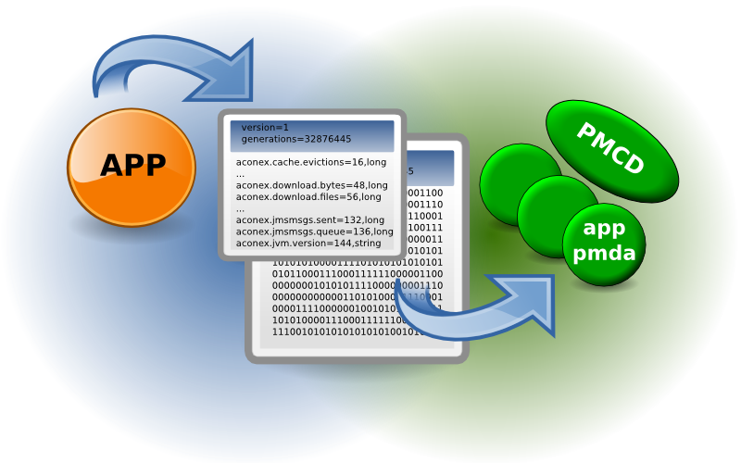
Aconex PMDA

Slide 16
How do we get the data to PCP?
PcpMonitorBridge is an (the only!) implementation of Monitor
Maintains an update queue of changed values
Creates a memory-mapped file (NIO) which gets mapped into PCP Agent's address space
  Shared memory between JVM and C agent (memory == fast, and no I/O-related system calls)‏
  As close to 0 overhead as we'll get
Keeps a Map of Monitorables ⇒ file offsets
Polling thread drains queue, writing new values to file
Changes then visible to custom PCP agent
Is also an Mbean (CompositeData), just for good measure

Slide 17
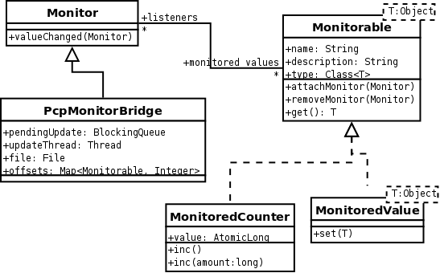
How it hangs together

Slide 18
aconex-pcp-bridge lifecycle
PCP requires a fixed set of metrics
  Need to assemble the list of metrics before handing over to PCP
  Cannot dynamically add metrics at runtime
MonitorableRegistry is (ugly) static class maintaining a singleton map of identifiers to Monitorables
Monitorables register themselves with the Registry on creation
Starting the PcpMonitorBridge 'freezes' the Registry, no more monitorables can be created
Dependency injection would be a lot less disgusting here (and let us have multiple Monitors)‏

Slide 19
External metrics we collect
System-level metrics
  network.interface.in.bytes
  kernel.all.cpu.sys
  disk.all.write_bytes
  ...
  Do these correlate with observed events?
  We've found JVM bugs this way...
3rd-party systems + software
  pdfq.length
  nfs4.client.reqs
  sqlserver.locks.all.wait_time
  ...
  Helps assess the impact of what we're doing in the JVM on other systems (or vice-versa)‏

Slide 20
JVM Internal metrics
Lots of information about the JVM, and what it's doing
Often stuff exposed through JMX anyway
  MBean polling Monitorable implementation
Kinda boring, but useful:
  aconex.memory.gc.full.count
  aconex.memory.gc.minor.time
  aconex.memory.permgen.used
  aconex.memory.survivor.committed
  aconex.jvm.compilations
  ...
Mostly memory-related, but a few more possible (and easy)‏
  Classloader info
  Thread counts
  etc...

Slide 21
Application-level stats
Where it gets interesting (for us!)‏
If in doubt, monitor it – it costs almost nothing and might be useful later
  Cumulative counters: .logins, .upload.files, .download.files
  Instantaneous state: .sessions.active
  Unchanging values for sanity checking/correlation: .jvm_version
  More advanced stats: .response_time.{min, max, avg, median, adjavg, samples}
  Monitor other libraries:
    .jmsmsgs.{sent, queued, processed}
    .cache.region.{misses, requests, evictions, load_time, ...}
  Instrument the DB (with JDBC Driver decorator):
    .connections.{in_use, available}
    .jdbc.queries.{active, total}
  ... and about a bazillion more...

Slide 22
And then we get tricky...
Implementations of InputStream and OutputStream which count bytes as they pass through
  Much more accurate than just counting instantaneously by filesize
SessionMonitor (normally off) – calculates sizeof(session object)‏
  .sessions.bin_256KB_2MB.{count, max, mean, min, total}
Per-controller metrics – time each request at start/end
  .controllers.controllername.{count, time}
But we also know that each request is served by 1 thread; can snapshot other values at start/end of request and use as counter deltas
  .controllers.controllername.{utime, stime, blocked.time, blocked.count, waited.time, waited.count}

Slide 23
Challenges still exist...
Getting transparency into completely isolated third-party systems is still difficult
e.g. one standalone 3rd-party (Java-based) system was misbehaving, needed profiling
How do we get that JVM monitored by PCP?
  "Cuckoo's Egg" approach
  Custom org.apache.log4j.Appender
  Hijack class <init> process to set up PCP bridge
  Monitor JVM
  Find problem!

Slide 24
Adding a new metric
private final MonitoredCounter fileRequestCounter = new MonitoredCounter("aconex.pdf.file_requests", "Number of file requests by the PDF server");
...
protected ModelAndView handleRequestInternal(...) {
...
fileRequestCounter.inc();
Produce new version of pmda
  Script runs against the memory-mapped file and produces new PMDA code, which is...
  ...compiled and released via RPM (concurrent with app release)‏
  Done!
$ pmval -r -t 1hour -a /archives/<...> aconex.pdf.file_requests
...
09:13:22.885 680
10:13:22.885 689
11:13:22.885 696

Slide 25
Aconex PMDA
Metric set extended on each release
  Both backward and forwards compatible, so production is usually updated (live) well in advance of new application releases
  Engineering aware of operational need for instrumentation, so new code is always instrumented up front now
Scripts largely automate the PMDA code changes
  Not completely automated
  Allows extra review and sanity checking :-)‏
What to instrument?
  Quailty of Service - application response time! throughput
  Resource utilisation (esp. time) – CPU, I/O, disk
  Activity (bytes, files transferred, emails sent)‏
  Problem parameters – queue length, size of file

Slide 26
Future directions
We really want to open-source this work!
  Monitoring framework (counters, values, etc)‏
  Utility classes (wrapping Input/OutputStreams, JDBC driver, MBean bridge)‏
  It's with the lawyers! We'll keep AJUG updated...
Tidy up and make more generic
  Custom controller metrics → generic (single-thread) event timing
More detailed interaction metrics (per-thread if possible)‏
  Time spent waiting for other servers, DB locks taken, etc
Architecture tidy-up (isn't there always?) -- e.g. get rid of (or clean up) Registry ickiness
Could easily extend to other Monitors
  Expose to JMX directly?
  Windows perfmon Monitor?

Slide 27
Final steps
pmie and Nagios – production alarms
  notifications = some_inst ( aconex.notification.jobs_failed > 0 ) -> shell "send_mail Notification jobs failed: %v";
  Archives used to verify rules
  Catch unusual resource utilisation, error conditions, and poor quality of service
pmie and pin-point monitoring
  Automate generation of threaddumps, heap capture, profiling
kmchart – live and historical production monitoring
pmdumptext / acxstat – ditto, console tools
Benchmarking, new system configuration
Planning for the future

Slide 28
Further Information
http://www.aconex.com [ /Careers.html ]
http://oss.sgi.com/projects/pcp
http://www.ohloh.net/projects/pcp
http://techpubs.sgi.com/ [ PCP Programmers Guide ]

Slide 29
Thank you

Slide 30
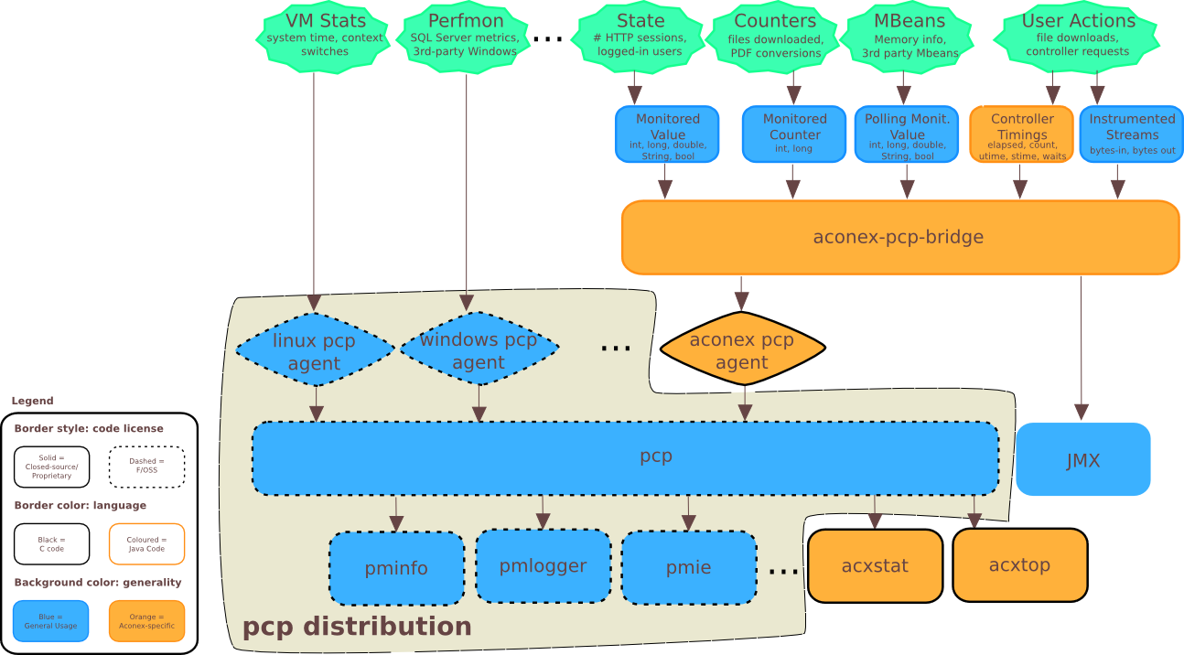
Appendix 1 – The present

Slide 31
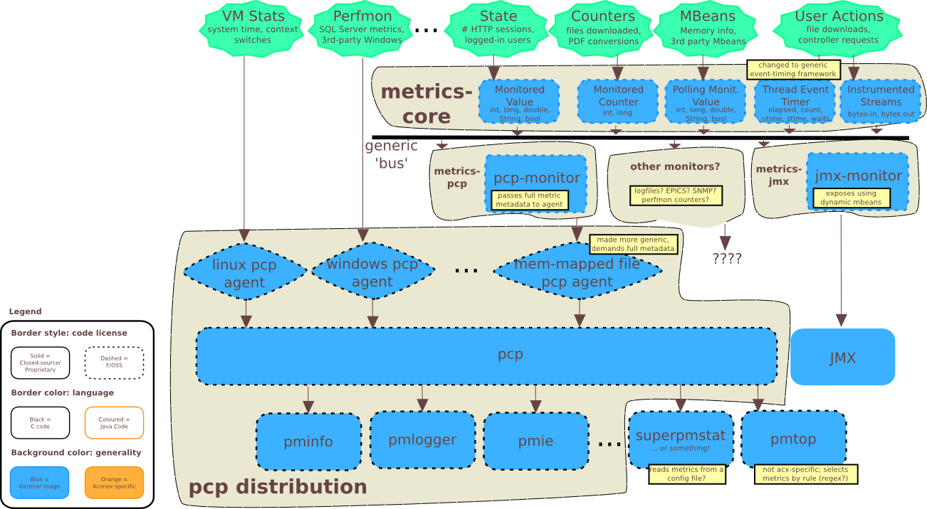
Appendix 2 – The future

