Slide 1


Slide 2
Nathan Scott
Practical
Performance Co-Pilot
https://pcp.io

Slide 3
Practical Performance Co-Pilot
PCP offers us alot, so ...
Let’s keep it practical
  Figure it out as we go
  Live demos all the way!
Learn from experience …
Production incident analysis

Slide 4
Practical Performance Co-Pilot
Strip charting tools
  pmchart(1)
  Vector web app
  Grafana / Graphite web apps
… demo
Notes:
pmchart:
- start up with -a syd/app3/xx -a syd/nas2/xx
- new chart: app.requests.akamai / nonakamai
- new chart: app.memory.gc
- time controls
- end up around 12:30!
Views:
- new linked pmchart
- network, CPU, memory
Explain CPU utilization

Slide 5
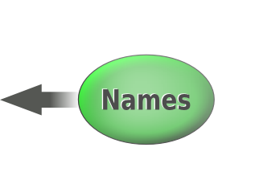
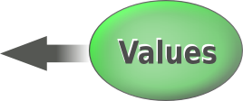
Practical Performance Co-Pilot
Metrics
  > pminfo –-fetch disk.dev.read
inst [0 or "sda"] value 3382299
inst [1 or "sdb"] value 178421
inst [4 or "sdj"] value 978245382299
Metadata
… demo
Notes:
pminfo --fetch disk.dev.read
pminfo –fetch –desc disk.dev.read

Slide 6
Practical Performance Co-Pilot
Command line analysis tools
  pmlogsummary(1)
  pmdiff(1)
… demo
Notes:
cd syd/app3
pmdiff -z -S@12:00 -T@12:10 \
-B@12:10 -E@12:20 \
-x aconex \
20120510
92x mem.vmstat.compact_success
53x mem.vmstat.compact_stall

Slide 7
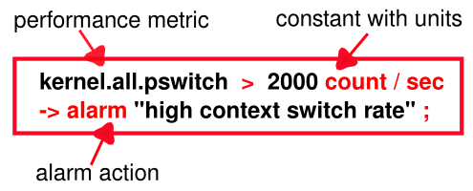
Practical Performance Co-Pilot
Alerting
  pmie(1)
  Test rules on historical data
  Operate live 24x7
… demo
Notes:
- pmie --timestamp --verbose –-interval=1sec
kernel.all.pswitch > 2000 -> print "context switch rate: %v/sec";
^D

Slide 8
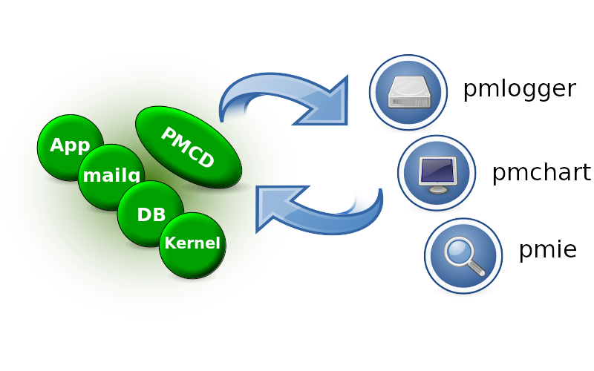
Practical Performance Co-Pilot
Site Configuration
  pmcd(1)
  pmie(1)
  pmlogger(1)
  Distributed, central
… demo
Notes:
- explain pcp(1)
- explain “/etc/pcp/pmlogger/control.d”
- explain default configuration generation
(and pmlogger config syntax in general).

Slide 9
Practical Performance Co-Pilot
Command line analysis tools
  pmrep(1)
  pcp-atop(1)
  pcp-dstat(1)
… demo
Notes:
pmrep kernel.all.pswitch
pmrep :vmstat
pcp dstat –list
pcp dstat –-time --mem -–cpu –-tcp –-udp

Slide 10
Questions?
More demos? https://pcp.io

