Slide 1


Slide 2
Nathan Scott
Practical
Performance Co-Pilot
https://pcp.io

Slide 3
Practical Performance Co-Pilot
PCP offers us alot, so ...
Let’s keep it practical
  Figure it out as we go
  Live demos all the way!
Learn from experience …
Production incident analysis

Slide 4
Practical Performance Co-Pilot
Scenario:
Complex web application
  Java app
  Storage, indexing, database
Serving 1000s of concurrent users
  Response time measures
  Platform measures
  Distributed

Slide 5
Practical Performance Co-Pilot
Strip charting tools
  pmchart(1)
  Vector web app
  Grafana / Graphite web apps
… demo

Slide 6
Practical Performance Co-Pilot
Command line analysis tools
  pmlogsummary(1)
  pmdiff(1)
… demo

Slide 7
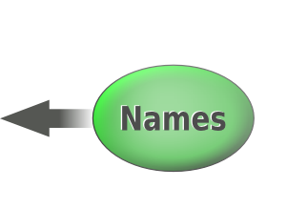

Practical Performance Co-Pilot
Metrics
  > pminfo –-fetch disk.dev.read
inst [0 or "sda"] value 3382299
inst [1 or "sdb"] value 178421
inst [4 or "sdj"] value 978245382299
Metadata
… demo

Slide 8
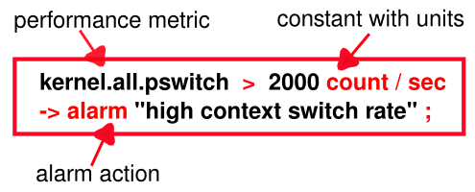
Practical Performance Co-Pilot
Alerting
  pmie(1)
  Test rules on historical data
  Operate live 24x7
… demo

Slide 9
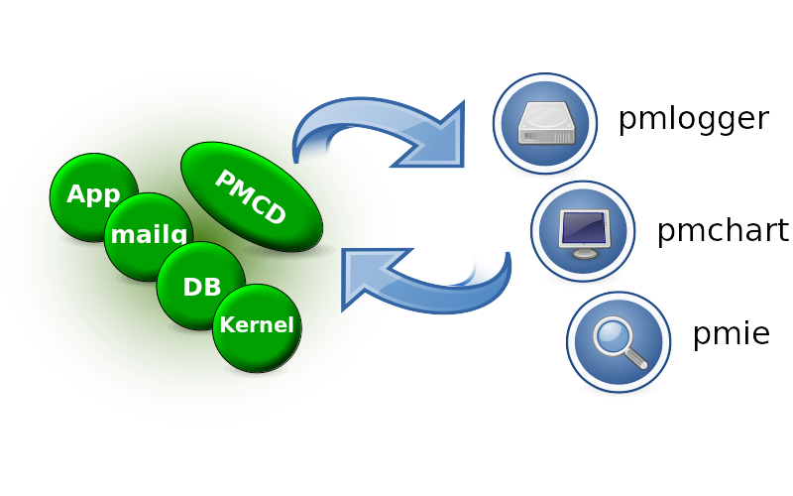
Practical Performance Co-Pilot
Site Configuration
  pmcd(1)
  pmie(1)
  pmlogger(1)
  Distributed, central
… demo

Slide 10
Practical Performance Co-Pilot
Command line analysis tools
  pmrep(1)
  pcp-atop(1)
  pcp-dstat(1)
… demo

Slide 11
Questions?
More demos? https://pcp.io

