Slide 1
Device Mapper statistics project
Fumiya Shigemitsu
Notes:
OK
Hello, everyone.
Thank you for doing my presentation on this conference.

Slide 2
Today’s topics
My Last Year’s Google Summer of Code Project
What I learned from experience of Google Summer of Code
Notes:
I have two topics today. I’d like to talk about Device-Mapper statistics project in Google Summer of Code 2017 mentored by Bryn and Mark.I also was helped the people in the community last summer. (put a short break between people and in ~) I’d like to take this opportunity to thank you all. I’ll also talk about what I learned from Google Summer of Code after talking about my project.

Slide 3
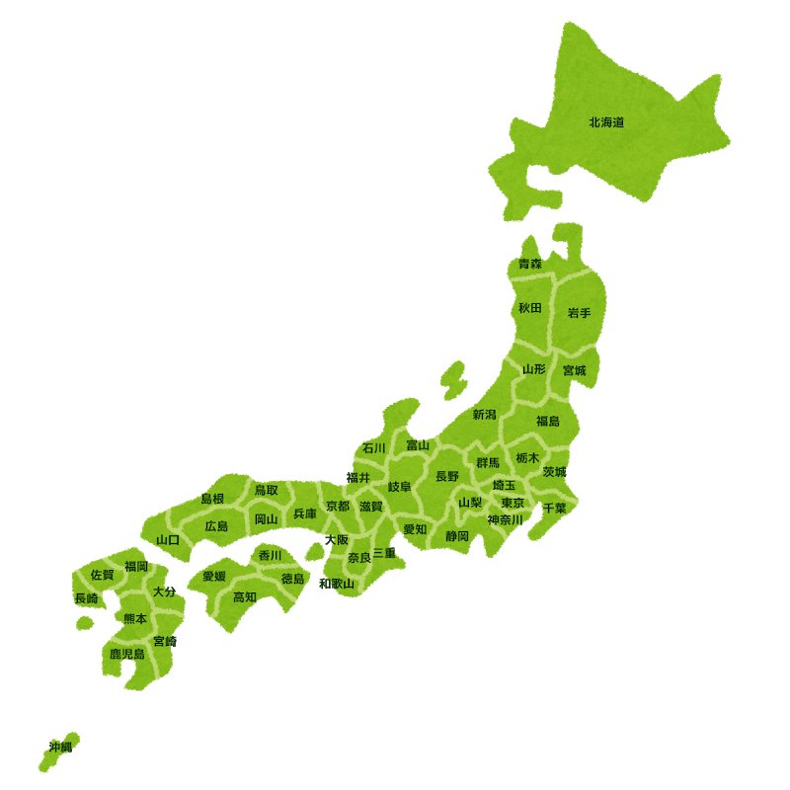
Who am I?
Fumiya Shigemitsu (重光 史也)
University Student in Japan (usually live in Shimane prefecture)
A Student of Google Summer of Code 2017 in PCP
Notes:
OK
Before beginning, I’ll introduce myself a little. (without a short break between myself and a little)
My name is Fumiya Shigemitsu. Though it is a little tips, my name is also looks like that in Japanese style, in kanji, in chinese character. I’m a graduate student in Japan. I usually live in Shimane prefecture. (BTW, it is also a little tips, Pointing Shimane and Tokyo and explaining, it takes 6 hours to move between cities by trains ) I’m interested in Linux, operating system, computer performance. I usually use C language and I like C. I am thinking to challenge RUST this year. I joined Google Summer of Code last year.

Slide 4
MY PROJECT
Notes:
OK
I’ll begin the first topic about my project. (ウィゥ)

Slide 5
What is Device Mapper?
Device Mapper is a framework for block devices.
  Mapping physical devices onto virtual block devices
Examples
/dev/dm
/dev/dm
Striping, mirroring...
Encryption/Decryption
/dev/sda
/dev/sdb
/dev/sdc
/dev/sdd
/dev/sda
Notes:
I will start from what the device mapper is. What is the device-mapper? I’ll review it. The Device-Mapper is the Linux Kernel framework provided by the Linux kernel for mapping physical block devices onto higher-level virtual block devices. It forms the foundation of the logical volume management, multipath IO, snapshot, disk encryption, software RAID and so on.

Slide 6

Device Mapper statistics project
(in Google Summer of Code 2017)
Provide flexible IO statistics of device-mapper devices for PCP users
Update the Device Mapper PMDA
  Named as pmdadm
Notes:
My project is for the people who wants to get the statistics values related to device-mapper devices and aims to give easily access to the data provided by device-mapper facility by updating the device-mapper pmda. This pmda is named as pmda-dm. This is the project of Google Summer of Code 2017.

Slide 7
Approaches
With dmstats API (libdevmapper)
  managing device-mapper statistics regions and obtaining counter values
  Get the data from API and convert it to a form that pmcd can manage
Manage regions
libdevmapper
dmstats/dmsetup
Device Mapper
To users
pmda
pmcd
Kernel
Userspace
Notes:
---DON’T FORGET ANIMATION---
Next, how does the pmda get the statistics values for device-mapper devices? I used a dmstats API. The dmstats API provide the function of managing device-mapper statistics regions and obtaining statistics values. The dmstats API can communicate with device mapper in Linux kernel and collect the values related to device mapper devices. The pmda-dm was implemented by using this API. After getting statistics values from API, pmda-dm pass these to pmcd, finally we can see the statistics values that we want from some pcp commands. When managing device mapper statistics regions, we can use the existing dmstats & dmsetup command that use dmstats API. We can get the statistics values of some specific regions that you set by using that commands. This is the entire architecture and the roughly way the pmda-dm gets the statistics values for device-mapper devices.

Slide 8
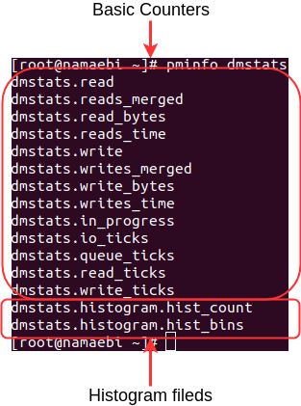
Metric types
Basic counters
  Raw counter data from the kernel
  13 types of counters for each statistics area
I/O histogram latency
  The frequency distribution of user specified I/O latency intervals
For details, see pmdadm(1) man page
Notes:
From now, I’ll mention what kind of values we can get from pmda-dm. The metric that pmda-dm can provide is roughly divided into two types. The basic counters and I/O latency histogram.
The picture on the right shows metrics from pminfo command. First area that are surrounded by red lines is metrics of basic counters. Second is metrics of IO latency histogram.
First I will mention about basic counters metric.
The pmda-dm provide basic counters for device-mapper devices. Raw counter data is raw data from Linux kernel and it has 13 types of counters for each statistics area that you want to get statistics value from. The eleven of these match the counters provided in process file proc/diskstats or sys/block directories. The remaining provides separate counters for read and write time.
Also the pmda-dm has another function. It is an I/O latency histogram. The I/O latency histogram can provide the frequency distribution of user specified I/O latency intervals. This provides the number of I/Os with latency times and number of latency histogram bins.
We can also read the detail of these from man page.

Slide 9
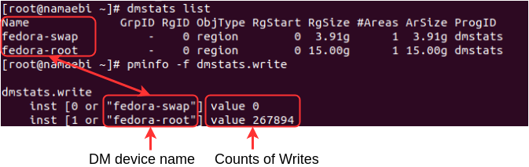
Basic counters
PMDADM recognizes created DM Devices statistics regions
Statistics values can be seen from PCP commands
Notes:
Let’s see some examples from now.
I will start from basic counters metric.
When there are some device mapper devices and statistics regions in a system, pmdadm recognizes created DM devices statistics regions.
Instance name is device mapper device name. In this picture case, metric of dmstats.write is used, it is a metric of counts of writes completed in device-mapper device.

Slide 10
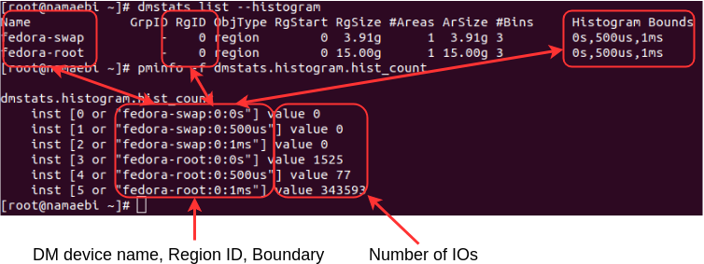
I/O latency histogram
The instances name include DM device name, Region ID, Histogram Boundary
Notes:
Next, let’s see IO latency histogram metrics.
In case of metrics of IO latency histogram, This metric, dmstats.histogram_hist_count, can provide the number of IOs with latency intervals.The instances name also represent the time range of user specified and statistics region ID. From left to right, that represents device mapper device name, statistics region ID, and bin boundary. Of course, this matches from dmstats list command. In this case, fedora-swap and fedora-root have 3 bins, range is between 0 and 50 microsecond, and 50 microsecond and 1 millisecond and these have one statistics regions. The value number represents the number of completed reads and writes, with latency and we can see it like that when using pminfo command. These values same as integrated values from dmstats.read and dmstats.write.

Slide 11
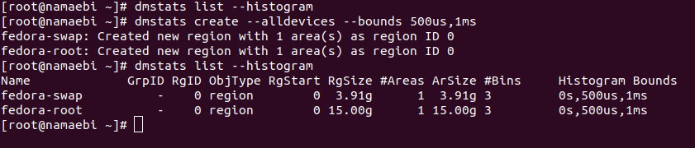
How to create statistics regions
“dmstats create” makes statistics regions
  Histogram boundary is created from --histogram bin boundaries
For details, see dmstats(8)
Notes:
I also will see how to create statistics regions.
We can create statistics regions from dmstats create commands.
When you want to create statistics regions with histogram boundary, you can use histogram options. We can create statistics regions more flexible. For details see dmstats man page written by Bryn.

Slide 12
DEMO
Notes:
From now on, I will do a short demo to confirm whether pmdadm works truely.
I have pseudo device mapper device.
OK,that’s it.
That’s all of my work last year. Thanks.

Slide 13
What I learned though the project
Notes:
(please have a look)
From now on, I’d like to talk about what I learned from joining Google Summer of Code.

Slide 14


What I learned through GSoC’17
To be positive is important for such activity
  Want to learn I/O technic in Linux
  Bring myself
  Get good opportunity
The project made my ability improved
  Learn much things
  Understanding source code deeply
  Fixing complex bugs
Notes:
---DON’T FORGET ANIMATION---
First, about the spirit when diving into such activity.
I wanted to join the project around system level because I feel it is interesting and I wanted to learn it. Then I was looking for something like that. When I found the project idea from Bryn in the PCP page in Google Summer of Code page, I felt it looks like cool and interesting, and I felt I can learn Linux I/O technic. So, I tried to hear about the project by sending a email to Bryn. This is the first time I have sent a email to professional developer, so I was so nervous but Bryn replied so kindly. He told me so many technical knowledge related to the project and some examples when using device-mapper, and I could study device-mapper more detail. I can write a accepted proposal, finally I can complete the project. I think it was good choice to bring myself to contact him. I can say that Google Summer of Code is a good opportunity if someone wants but hesitate to join a open source project. In addition, I couldn’t get a opportunity to take part in this conference and speaking if I didn’t join Google Summer of Code last year. It is good experience for me. From this experience, I really believe in bringing myself and acting with actively is so important to get new and good opportunity.
Second, about developing skills. (better : bera)
I had some experience to write code, develop simple software, but this is the first time to involve the open source project. So, I was anxiety if I could complete the project. Actually, at the first stage of developing, of course, much remains to be studied and I could not see the goal. I had to study C deeply, how to use the dmstats API, how to create a new pmda… But mentors and other community people told me so many technical knowledge and skills, so I felt better while discussing. I also needed to read lvm2 source code to understand dmstats API behavior. It was difficult tasks at the first time, but while reading code, my understanding was improved. In addition about bug, actually I made some bug into pmda-dm, particular in around problems of memory leak. But Mark worked for the bug that I can’t detect, and his patch made me realize when I write codes and detect bugs. I can learn a lot of technical knowledge and skills through the project. Joining a project made my technical skills improved.
Finally, As a former students of Google Summer of Code, I can definitely say Google Summer of Code program is suitable for every students who wants to develop software, join open source project, improve technical skills and have a good summer. Thanks.
That’s all of my presentation today. Thank you for listening.

Slide 15
Thank you for listening:)

