Slide 1

Laser-Guided Performance Management
MXUG #5
An introduction to Parfait
Paul Cowan
Aconex
paul@custardsource.com
July 2009

Slide 2

Our Problem
(and maybe yours too?)
Lots of users = lots of potential problems
Big database = big problems
Legacy codebase – not written with performance in mind
Wildly variable usage patterns
  Several orders of magnitude difference in amount of data
  Unpredictable hot spots
Notes:
No Google, but big enough to have our own problems
Concurrency problems – not so much slowness as bottlenecks and choke points
Have users who see a completely different set of data to other users – destroys indexes etc
Cultural + behaviour differences make prediction hard

Slide 3
Finding the Problems
(Not as easy as you’d think)
Approach #1: profile hotspots
  Not always easy (access to data, ability to reproduce, Heisenberg)
Approach #2: use a simple timing framework
  Time each request
  Look for patterns
  Not always accurate
    See victims, not causes
    Not always about wall time!
Notes:
Locking is a classic example
Subtle variations in 'big' request (printshops) may not affect its SLAs, but kill others
Get caught up in the noise – one 'central' problem can elevate ALL measurements, hard to pick out the actual cause

Slide 4
The Goal
(And the ace up our sleeve)
Want to get really deep performance metrics
Export into Performance Co-Pilot
  OSS framework built @ SGI
  Collects lots of data with low overhead
  Archive, search, compare patterns, fire alerts...
Want to easily instrument 3rd-party code
Notes:
Trend prediction is also important
Could spend a whole 'nother lecture talking about PCP...
Can collate data from 'for ever' – 'hey, this is the same problem we had last October – let's see if the data back then matches our hypothesis now'
Really really lightweight – 'cheap as free' (or at least RAM) – collect first, ask questions later

Slide 5
The Brainwave
Java Webapps have a feature which opens up a world of data
One request is pinned to one thread for the duration
And the thread likewise doesn't serve multiple requests
Whatever we can measure on the thread, we can extrapolate out to the action

Slide 6
How we measure
Have a bunch of per-thread counters
  Not aware of actions, don’t care
Snapshot values at request start
Snapshot again at request end
Delta is that action’s “cost”
Find expensive actions, kill fix them

Slide 7
Built-in sources
(Here's one they prepared earlier...)
JVM gives us a bunch of data sources
ManagementFactory.getThreadMXBean()
.getThreadCPUTime(...) /
.getThreadUserTime(...) /
.getThreadInfo(...)
.getWaitedCount() /
.getWaitedTime()/
.getBlockedCount() /
.getBlockedTime()
Suddenly, we can see which user actions are causing contention
Stats in aggregate, logs for detail
  Which user is eating our CPU?
Notes:
System time = CPU - User
Gives us a lot of insight into WHAT the problem is too
- e.g. saw a lot of System time (unusual for a Java app)
traced the system calls
found a horrible performance problem in a zip library – looking for footer block, seeking back 1 byte at a time

Slide 8
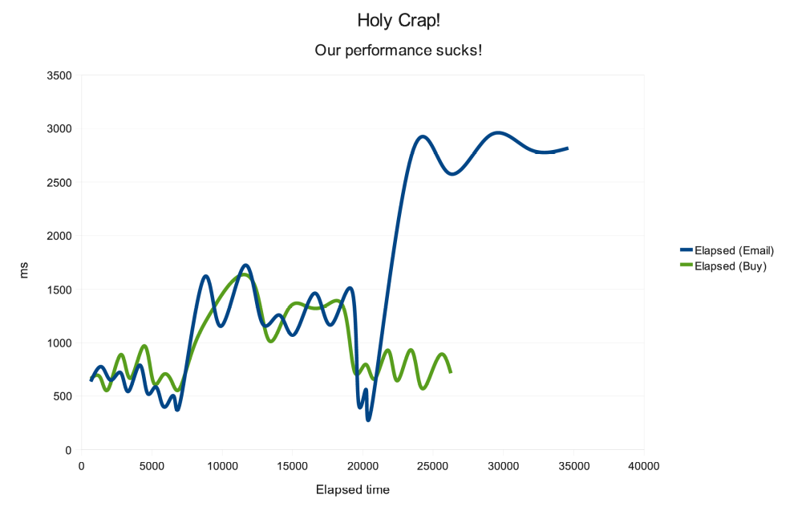
We've all been here...
Notes:
Two spikes
Something's probably chewing CPU...

Slide 9
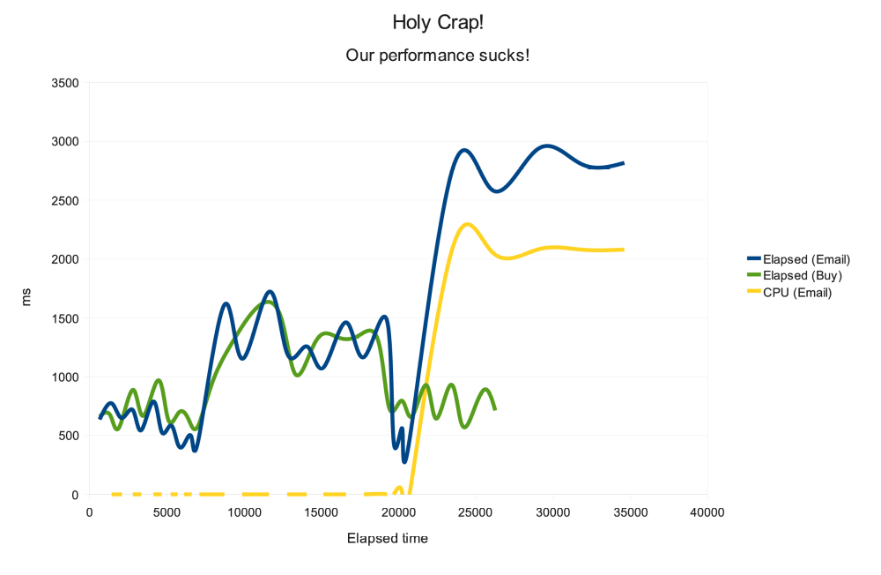
There's more to it...
Notes:
OK, so the second spike is directly attributable to the CPU use... but the first one isn't?
No way of telling in spike 1 which is the victim

Slide 10
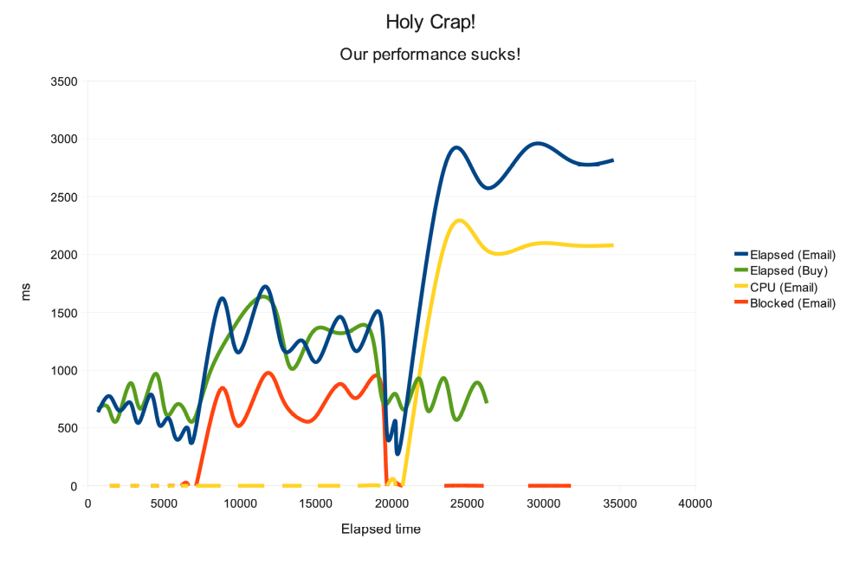
Mystery not solved
(But at least we know where to look)
EmailSender:sendMail Elapsed time: own 1078ms, total 1078ms
Blocked time: own 623ms, total 623ms Wait time: own 455ms,
total 455ms User CPU: own 0ms, total 0ms
Notes:
Turns out 'buy' is blocking 'send an email'
(Not showing 'buy' on this graph)

Slide 11
Adding your own
public class StatAppender implements Appender {
public ThreadLocal<Long> LOG_COUNT = …
public void doAppend(LoggingEvent e) {
LOG_COUNT.put(LOG_COUNT.get() + 1);
}
}
Notes:
I mentioned that one of the other goals was to be unobtrusive... here's an example
OK, so we wouldn't use 'public'...

Slide 12
Adding your own
public class StatAppender implements Appender {
public ThreadLocal<Long> LOG_COUNT = …
public void doAppend(LoggingEvent e) {
LOG_COUNT.put(LOG_COUNT.get() + 1);
}
}
… add to log4j.xml, then …
metricSuite.addMetric(
new AbstractThreadMetric(
"Log message count", "", "logcount", "…")
{
public long getCurrentValue() {
StatAppender s = (StatAppender)
Logger.getLogger(…).getAppender("blah");
return s.LOG_COUNT.get();
}
});
Notes:
This is a good example of how we can 'cuckoo's egg' performance monitoring into places that don't support it
Yes, 'good architecture' would be using IoC and passing around a handle to the monitoring system – but you have to go a long way down the stack
This lets us plug something very lightweight at the bottom, and something at the top to plug it together

Slide 13
More stuff to measure
(When all you have is a hammer...)
Custom JDBC driver gives us
  DB execution counts + times
  DB physical/logical I/Os
  DB CPU time (!)
Error counts through custom error handling mechanism

Slide 14
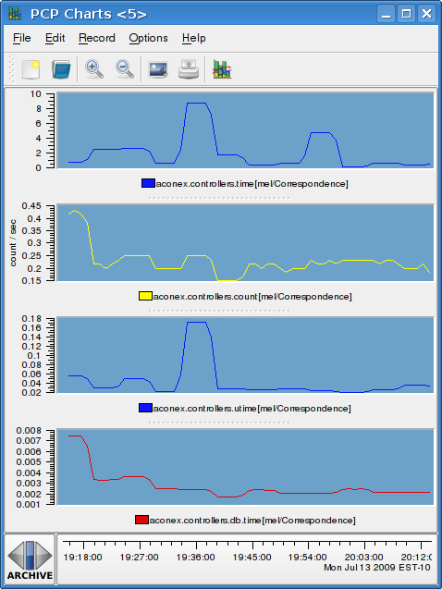
So what do we get?
(Pretty graph time!)
Notes:
Incoming request rate – largely constant
Two jumps in elapsed time
What was the cause?
Other controllers largely not affected

Slide 15
So what do we get?
(Pretty graph time!)
Notes:
Not the database, even though that page hammers it
One's a CPU time spike
One's not CPU or database... blocking? something else?

Slide 16
What COULD we do?
(There must be more nails somewhere)
More metrics:
  Bytes read/written to client
  Native library might expose some good OS metrics
If you can read the current thread, you can read other threads
  Write our own ‘top’
  Which threads are hogging resources – and doing what?
AOP advice – even more transparent
Deal with background worker threads
Notes:
Background threads – enrol to participate

Slide 17

Where's it going?
(And can I get on board, man?)
Now open-sourced as ‘Parfait’
Includes general PCP library (dxm)
Modular (not tied to any input/output mechanism)
Lives on Google Code
Hungry for
users and
contributors!
Notes:
Don't HAVE to use PCP. Can also expose through
JMX (rudimentary)
SNMP
anything else...

