Slide 1
Performance Co-Pilot
(PCP)
Nathan Scott

Slide 2
Overview
What is PCP?
  Toolkit for system-level performance analysis
  Open source project
  Live and historical
  Extensible (monitors, collectors)
  Distributed

Slide 3
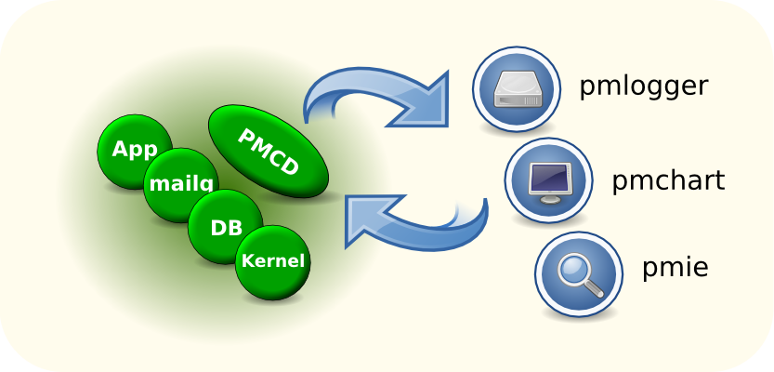
Architecture

Slide 4
Data Model
Metrics
  Come from one source (host/archive)
  Sources can be queried at any interval by any tool
  Hierarchical names
  Single valued or set-valued (”instance domain”)
  Metadata
    Data type (int, double, ...)
    Semantics (units, scale, ...)
    InDom

Slide 5
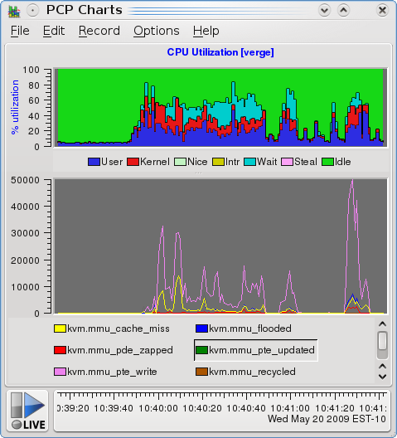
Toolkit Approach
Monitors
  Lightweight probes (pminfo/pmprobe)
  Reporting (pmlogsummary/pmdumptext/pmstat)
  Mining and alerting (pmie)
  GUI (pmchart/pmtime)
Collectors
  pmcd & pmdas
    Kernel, DB, ...
    Apps (MMV/...)
    Apache, Samba, ES, ...

Slide 6
Further Information
Web: http://oss.sgi.com/projects/pcp/
IRC: freenode.net #pcp
Mail: pcp@oss.sgi.com
Related projects:
  http://code.google.com/p/parfait/
  http://gitorious.org/bubbles/

