Slide 1
Monitoring with
Performance Co-Pilot
David Disseldorp
ddiss@suse.com

Slide 2
Presentation Overview
Introduction to Performance Co-Pilot (PCP)
Demonstration
Monitoring Your Application with PCP

Slide 3
What is Performance Co-Pilot?
PCP is a system level performance monitoring toolkit
Collection, monitoring and analysis of system metrics
  Cross platform: Linux, Mac OS and Windows
  End-to-end: Hardware, Core OS, services and applications
Distributed architecture
  Monitoring of local and remote nodes
Real-time or retrospective
  Live system or archive
Pluggable
  New agents system metrics within PCP

Slide 4


What is Performance Co-Pilot?
Roles broadly divided into two categories
        Producers: Collect and export performance metrics
        Consumers: Record, visualize, monitor and analyze performance data
Hosts may operate as producers, consumers or both
  Multiple consumers may connect with one or more producers

Slide 5
Core Components
  Performance Metric Domain Agents
    Extracts metric data from a system component for exposure within PCP
  Performance Metrics Collector Daemon (PMCD)
    Coordinates handling of fetch requests between monitoring applications and agents
  pmlogger
    Utility to capture and store metrics exported by PMCD
  pmchart
    GUI providing charting of metrics in real-time as well as retrospectively

Slide 6
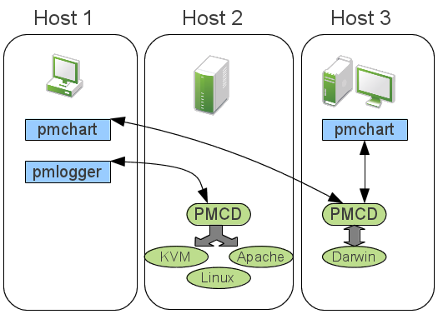
What is Performance Co-Pilot
Distributed Architecture

Slide 7
Use Cases
Administrative
  Tracking of resource utilization
    Understand how workload effects usage
  Capacity planning
  Benchmarking
Debugging
  System postmortem
  Identification of performance regressions
    Side by side comparison of behavior across application versions
  Isolation of problematic behavior

Slide 8
Performance Metric Domain Agents
Exports metrics obtained from underlying data source
  Each agent is responsible for a specific metrics domain
  Communicates with PMCD on the local system
Many agents currently available
  Linux & Windows
    CPU, Disk, Memory, Network, Filesystems, Per-process statistics
  Hypervisors
  Databases
  Sendmail

Slide 9
Performance Metrics Collection Daemon
One pmcd process running per-host
  Manages metrics extraction from all agents
    Routes client requests to one or more agents, aggregates response
  Maintains namespace for all metrics exposed
    Name space maps external metric names to internal numeric identifiers
Accepts connections from monitoring utilities
  Single point of contact for local or remote monitoring agents
  Listens on TCP port 44321 by default
  Primitive host based access control
    Authentication and encryption not currently supported

Slide 10
pmlogger
Command line utility for metrics archival
  Concurrent logging of local and remote hosts
  Simple list style configuration
    What metrics should be collected and how frequently
Archive playback via pmchart and pmval
  Retrospective analysis of system state
    Compare archives from working and non-working situations
    Archives self-contained allowing analysis off-site
Tools for archive management
  pmlogger_daily, pmlogger_check, pmlogger_merge
    Log rotation and aggregation, set and forget
  pmlc
    Dynamic runtime re-configuration

Slide 11
pmchart
Visualization of metrics
Fully Customizable charting canvas
  Multiple metrics (of same units) per chart
  Multiple charts per tab
    Line, bar, stacked bars, area plot, utilization
  Save window preferences as a “view”
    Collection of charts, metrics, graph styles, legends, labels
  Integrated time control
    VCR style stop, play, record, rewind paradigm
    Source metrics from one or more live systems
    Alternatively one or more archives

Slide 12
Other tools
pmie
  Evaluate rules or expressions
  Perform an action
  Automatic detection of performance anomalies
pmlogsummary
  Calculate statistics across an archive time window
pmstore
  Selectively modify state in an agent
  Toggle debug flags, enable optional instrumentation, etc.
pmval
  Command line based dumping of values in realtime or from archive
pmproxy
  Proxy PCP requests between a head node and an isolated network
Parfait[6]
  Externally maintained Java library capable of exposing metrics to PCP

Slide 13
Demonstration

Slide 14
Writing your own agent
What values am I capturing?
Metrics definition
  Semantics
    e.g. counter (value is monotonically increasing)
  Units
    e.g. bytes
  Data type
    e.g. 64-bit unsigned int
  Instances
    e.g. eth0, eth1
    Transient
  Value
    Instances
Namespace
  Each PMDA requires a unique domain identifier

Slide 15
Writing your own agent
What language?
  C, Perl, Java
Architecture
  Separate process managed by PMCD
  Dynamic Shared Object
    PMCD is latency sensitive and must be stable
How can the agent access these counters?
  Memory mapped file, kernel proc file, IPC
  Generic MMV agent
    Self descriptive memory mapped files

Slide 16
Agent Example
Clustered Trivial Database (ctdb)
ctdb already maintains per-node stats:
Metrics without instance domain
  Number of clients = instantaneous
  Total calls = monotonic increasing counter
  Pending calls = instantaneous
  Memory used = instantaneous, bytes units
  Maximum call latency = instantaneous, seconds units
hex-14:~ # ctdb statistics
num_clients 6
total_calls 77
pending_calls 0
memory_used 73691
max_call_latency 0.000549 sec

Slide 17
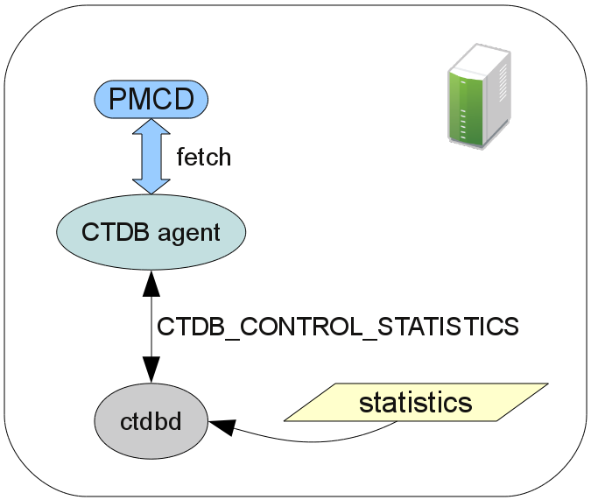
Agent Example
Clustered Trivial Database (ctdb)

Slide 18
Agent Example
Clustered Trivial Database (ctdb)
Namespace definition
  Per-metric identifiers
src> cat pmns
ctdb {
num_clients 155:0:0
total_calls 155:13:24
pending_calls 155:14:25
memory_used 155:19:30
max_call_latency 155:23:34
}

Slide 19
Agent Example
Clustered Trivial Database (ctdb)
Metrics definition
src> vi pmda_ctdb.c
static pmdaMetric metrictab[] = {
...
/* max_call_latency */
{ NULL, { PMDA_PMID(23,34),
PM_TYPE_DOUBLE,
PM_INDOM_NULL,
PM_SEM_INSTANT,
PMDA_PMUNITS(0,1,0,0,PM_TIME_SEC,0) }, },
};

Slide 20
Agent Example
Clustered Trivial Database (ctdb)
Main Program
Two fetch callbacks from the event loop
  Initial fetch request, then one per metric
pmdaDaemon() /* initialise daemon context */
pmdaSetFetchCallBack() /* register handler for PMCD fetch requests */
pmdaInit() /* export supported metrics */
pmdaConnect() /* establish an IPC connection with PMCD */
pmdaMain() /* main event loop */

Slide 21
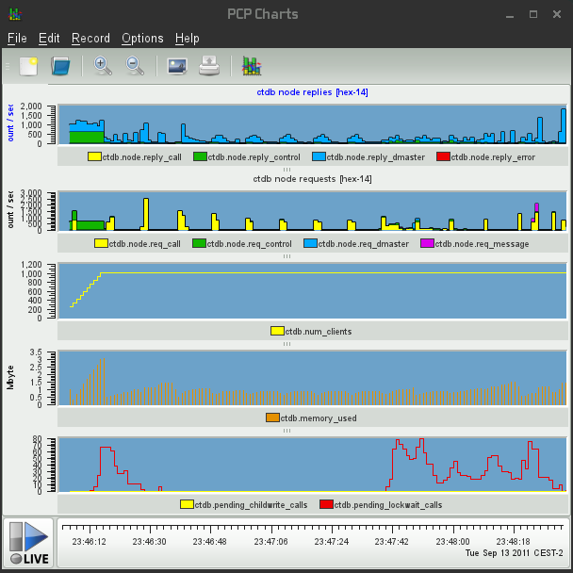
Agent Example
Clustered Trivial Database (ctdb)

Slide 22
Where can I get it?
SGI project page
  http://oss.sgi.com/projects/pcp/
openSUSE Factory
  Latest PCP base and GUI packages to ship with openSUSE 12.1
  Outdated (base only) version in 11.4
SUSE Gallery
  “openSUSE Performance Co-Pilot” appliance

Slide 23
References
Performance Co-Pilot Website
http://oss.sgi.com/projects/pcp/
PCP Manual
http://oss.sgi.com/projects/pcp/pcp-gui.git/man/html/index.html
Performance Co-Pilot User's and Administrator's Guide
http://oss.sgi.com/projects/pcp/documentation.html
Performance Co-Pilot Programmer's Guide
http://oss.sgi.com/projects/pcp/documentation.html
Parfait – Java monitoring library
http://code.google.com/p/parfait/
Authentication and ACLs proposal
http://oss.sgi.com/archives/pcp/2011-06/msg00026.html
PCPIntro(1) Man page
RCE Podcast: Ken McDonell on Performance Co-Pilot
http://www.rce-cast.com/Podcast/rce-53-performance-co-pilot.html
PCP FAQ
http://oss.sgi.com/projects/pcp/faq.html

