Slide 1

“Unifying Event Tracing and Statistical Sampling”
Nathan Scott

Slide 2
Overview
Terminology
Problem space
Review
Approach
Case studies
Conclusions
Crash & Burn – Demo!

Slide 3
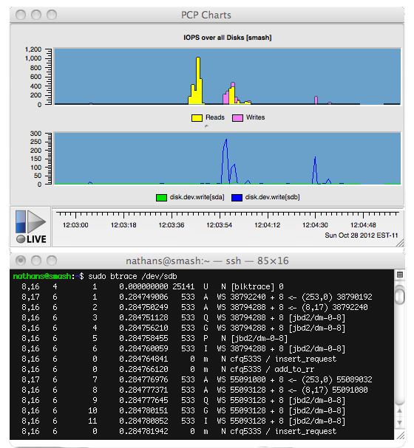
Some Terminology...
“Sampled
Values”
“Event
Traces”

Slide 4
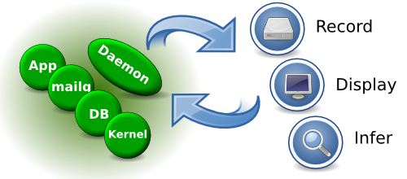
More Terminology...
“Independent Domains”
“Collector” (server)
“Monitor” (client)

Slide 5
What's The Problem?
System-level performance analysis
Predominantly sampling based today
  Flexible (retrospective, modelling, generic)
  Granularity becomes an issue
Tracing gaining popularity
  Active research area (relatively)
Discontinuity
  Disjointed tools, analysis “flow” broken

Slide 6
Review
Magpie and ETW
DTrace and SystemTap
X-Trace
Dapper
Performance Co-Pilot
  Production environments
  Visualisation techniques

Slide 7

Approach
Building on PCP:
  Existing sampling-based toolkit
  With recent tracing extensions
Case-study based research
  Multiple instrumentation points for each case
  Extend/refine monitor tools based on findings

Slide 8
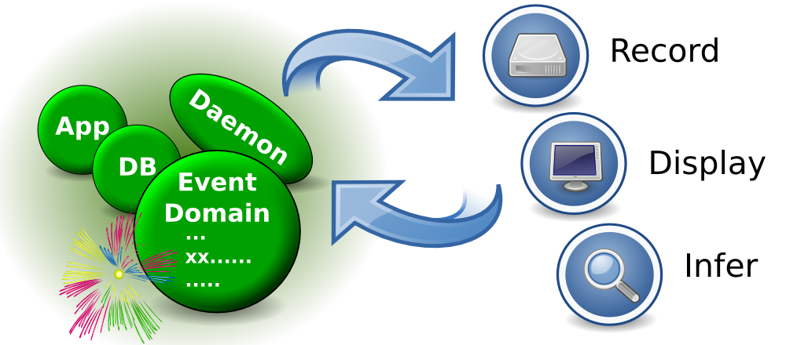
Event Queues

Slide 9
Case Studies
Distributed Log Streaming
  Sampling and tracing agent
  Importance of server-side event filtering
Data Warehouse Import
  Shell script instrumentation
  Visualisation
    Charts with event trees and spans
    Event selection

Slide 10
Conclusions
Event Parameters
    Security model impact
    Identifier significance
Event filtering
    Server side explored
    Client side needed (and for archives)
Visualisation
    Trace structure explored (identifiers)
    Selection model differences

Slide 11
Quick example – parent shell
#!/bin/bash
. /etc/pcp.sh
wired()
{
./test-wired.sh $@
sleep $1
}
pcp_trace on
for (( count=0 ; count < 10 ; count++ ))
do
wired 2 $count
[ $count -eq 5 ] && ./test-flood.sh $count
done

Slide 12
Quick example – children
test-flood.sh:
#!/bin/bash
. /etc/pcp.sh
pcp_trace on
sudo ping -q -f -i 0.00002 -c 30000 verge
test-wired.sh:
#!/bin/bash
. /etc/pcp.sh
pcp_trace on
for i in {0..4} ; do
./cpuburn &
done
wait

Slide 13
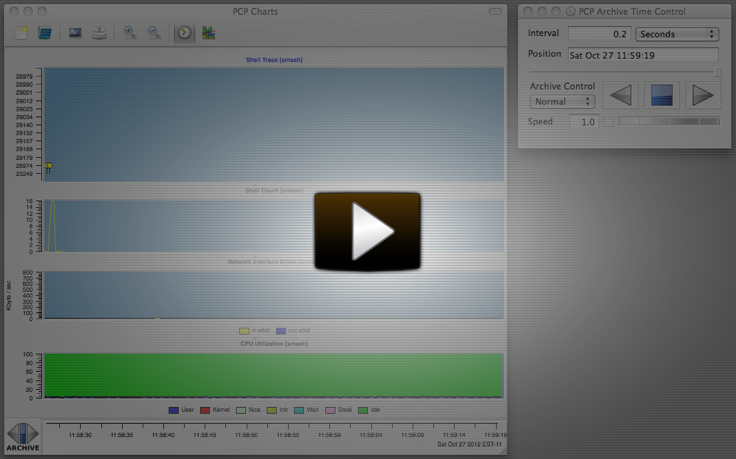
Quick example - visually
http://screencast.com/t/Xa5wmEq7

