Slide 1
S9 – AcS Detailed Design

Slide 2
Agenda
Activation System Review
Activation System Architecture
Provisioning Subscriber Data
Activation Use Cases and Call Flows
Viewing Activated Subscribers
Client Configuration Data

Slide 3
Activation System Review
What does the Activation System do?
Checks that the user is who they say they are and that they are authorized for the service
Provides configuration data and user credentials to the VoWiFi App
Manages the user database
Performs Reconfiguration of the App when configuration data is modified
The Activation procedure executes when the App is first run
App contacts the Activation System, authenticates and requests configuration data
If successful, the App receives configuration data and credentials
Otherwise the activation procedure fails and the user must restart the activation process
The Reconfiguration procedure executes periodically
App returns to the Activation Server every N days to check for new configuration data
Similarly, App checks for new configuration data if unable to register with network

Slide 4
Architecture

Slide 5
Activation System Architecture
HTTP(s)
interface to VoWiFi app
XML/HTTP(s)
Interface to provisioning system
Fault & configuration management
Highly scalable HA architecture:
Activation Server (AcS)
The Activation Server presents an HTTP(s) interface towards the App to handle the App activation process
Home Subscriber Manager (HSM)
Provides managed access to the Home Subscriber Database
Presents an XML/HTTP interface towards the network to interface with the MNOs Service Provisioning platform
Home Subscriber Database (HSDB)
High performance database for storage of user records and credentials
Admin Portal (AP)
Provides Configuration, Fault & Performance management for the Activation System
Active System
Standby System
Admin
Portal
(AP)
Admin
Portal
(AP)
Activation
Server
(AcS)
Activation
Server
(AcS)
SYNC
Home Subscriber Manager (HSM)
Home Subscriber Manager (HSM)
Home Subscriber
Database
Home Subscriber
Database
Home Subscriber
Database

Slide 6
Cassandra Key Feature Set
Decentralized
Every node in the cluster has same role. No single point of failure since data is distributed across the cluster (each node contains different data)
Replication support and Multi Data Center Replication
Designed as a distributed architecture for deployment of large number of nodes across multiple data centers
Flexibility in handling redundancy for failover and disaster recovery
Scalability
Read and Write throughput increase linearly as new nodes are added
Fault-tolerant
Data is automatically replicated to multiple nodes for fault tolerance. Failed nodes can be replaced with no down time
Query language
CQL (Cassandra Query Language) – simple API for Cassandra access

Slide 7
Server Platform Software
Application | AcS/HSM | Admin Portal | HSDB (Available in Release 10)
Taqua Platform Layer | T7100 |  | Apache Cassandra
Guest Operating System | RedHat Enterprise 6.7 |  | Redhat Enterprise 7.x
Hypervisor Option | VMWare vSphere Hypervisor (ESXi) 6.x
Subscriber Provisioning
Subscriber Provisioning
Subscriber Provisioning

Slide 8
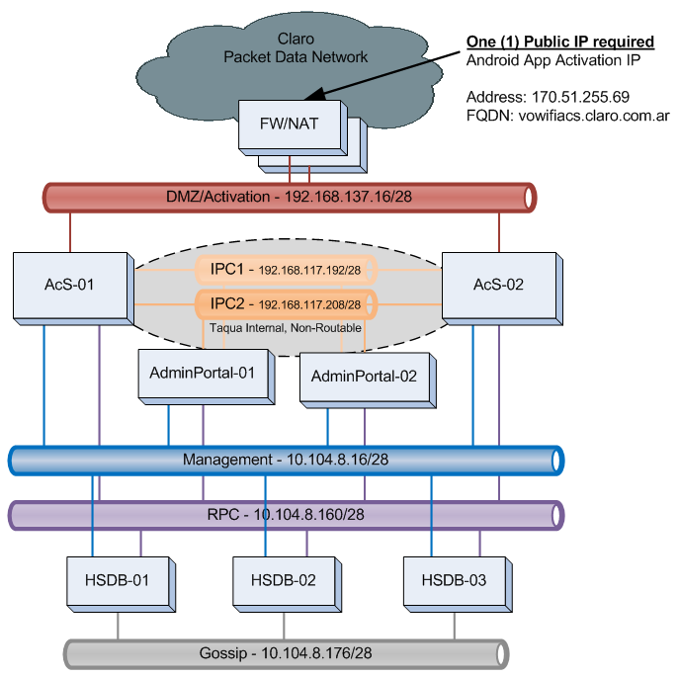
AcS Network Architecture
Seven (7) VMware-based Virtual Machines
Six (6) VLANs
Management
HTTP/S, SSH, SNMP, NTP
Activation
HTTP/S
IPC1/2
High-Availability, Data Synchronization
RPC
Subscriber Data Reads and Writes
Gossip
Intra-cluster data exchange and synchronization

Slide 9
Admin Portal VLANs and Protocols

Slide 10
AcS VLANs and Protocols

Slide 11
HSDB VLANs and Protocols

Slide 12
Provisioning

Slide 13
Provisioning Modes
Auto-Provisioned
All subscribers within a PLMN are allowed to perform activation, i.e. subscribers whose PLMN identifier (MCC+MNC) matches the provisioned PLMN-Id list.
The Activation Server generates subscriber data using the parameters provided by the client at the time of activation and the operator-configured template in the AcS.
Pre-Provisioned
Only pre-provisioned subscribers are allowed to perform activation.
The subscribers are pre-provisioned in the HSDB by the Service Provider’s Provisioning System.
The Activation Server verifies the IMSI and MSISDN provided by the client with the pre-provisioned data.

Slide 14
Auto-Provisioning
AcS will automatically create EAP and IMS credentials
SIP Digest Username/Password
EAP-MSCHAPv2 Username/Password
AcS will automatically create IMS Identities
IMPU (IMS Public Identity)
IMPI (IMS Private Identity)
Static passwords
All configuration data is sent to client (over secure channel) during Activation

Slide 15
Activation

Slide 16
Activation Methods - Comparison
Activation over Cellular
(AoC)
Activation over Internet
(AoI)
App contacts AcS over PS network
App contacts AcS over Internet
Network Access
Claro’s
Activation Method
PS network adds MSISDN to HTTP header
AcS sends SMS with OTP to app host device, app sends OTP to AcS
Authentication
AcS auto-generates subscriber data and stores in HSDB
AcS auto-generates subscriber data and stores in HSDB
AcS sends configuration data to VoWiFi App
AcS sends configuration data to VoWiFi App

Slide 17
Activation Phases
Activation consists of two phases.
Phase 1
Unencrypted HTTP request
User authenticated by Cellular Data network which inserts the user’s MSISDN into the body of the request and forwards to AcS.
AcS sends a response containing an http cookie to the Activation Client.
Phase 2
Encrypted HTTPS request
Cookie is verified
AcS creates configuration data for new subscriber.
AcS sends a response containing the configuration data.

Slide 18
Client Reconfiguration
The Activation System is also responsible for reconfiguration of the Client
Configuration checking occurs when:
The validity period of the current client configuration has expired (if set)
The Client is unable to register with the network for N times (for certain error codes)

Slide 19
Activation Call Flows

Slide 20
Call Flow Use Cases
Initial Activation
Re-configuration
SIM / IMSI Change
MSISDN Change
User Deletion and Deactivation
Assumptions for call flows
Auto-Provisioning
Activation over Cellular (AoC)
Common SIP Digest password for all users
Common MSCHAPv2 password for all users
Both passwords will be statically configured in the Activation Server

Slide 21
Initial Activation – Phase 1
Sonus
Client
DNS
P-GW
Activation
Server
HSD
1. Check UE as cellular connection
2a. DNS Query (AS FQDN)
2b. DNS Response (AS IP/Port)
3. http GET Activation-URL (no parameters)
4. HHE: Add MS-ISDN to HTTP Header
5. http GET Activation-URL (MS-ISDN header and no parameters)
6a. Query Subscriber Record (key)
6b. Response
7. Check local record for MS-ISDN does not exist
8. 200 OK (cookie A)
9. Store {MS-ISDN, Cookie A} & Start Timer

Slide 22
Initial Activation – Phase 2
Sonus
Client
P-GW
Activation
Server
HSD
10. Establish TLS connection to Activation Server
11. https GET Activation-URL (ver=0, request parameters)
12. Stop Timer. Check Cookie A
13. Verify PLMN
14. Check Device Blacklist
15. Generate Token
16a. Create Subscriber Record (key, data)
16b. Response
17. 200 OK (token, Configuration Data)
18. Store Data
19. Release TLS Connection
20. Begin IMS Registration Procedures

Slide 23
Reconfiguration
Sonus
Client
P-GW
Activation
Server
HSD
ConfigValidity timer expires
1. Check UE has cellular connection
2. http GET Activation-URL (no parameters)
3. HHE: Add MS-ISDN to HTTP Header
4. http GET Activation-URL (no parameters)
Phase 1
5. 200 OK (cookie A)
6. Store {MS-ISDN, Cookie A} & Start Timer
7. Establish TLS connection to Activation Server
8. https GET Activation-URL (version>0, request parameters)
9. Stop Timer. Check Cookie A
10. Check Device Blacklist
11a. Query Sub Record (key, data)
Phase 2
11b. Response
12. Check Config version
13. 200 OK (token, Configuration Data)
14. Store Data
15. Release TLS connection to Activation Server

Slide 24
SIM / IMSI Change
Sonus
Client
P-GW
Activation
Server
HSD
1. Client Activated and NOT Registered
2. New SIM Inserted
3. All previously stored configuration data is automatically deleted
4. Begin Initial Activation Procedures
5. http GET Activation-URL (no parameters)
6. HHE: Add MS-ISDN to HTTP Header
(New MSISDN/IMSI pairing)
7. http GET Activation-URL (MS-ISDN header and no parameters)
8a. Query Subscriber Record (key)
8b. Response
9. Remove existing MSISDN and IMSI records
9a. Delete Subscriber Record (key)
9b. Response
10. 200 OK (cookie A)
11. Complete Phase 2 Initial Activation procedures

Slide 25
MSISDN Change – Part 1: Update active SIP registration
Sonus
Client
Activation
Server
HSD
P/I/S-CSCF
Nokia PGW/UDC/HSS
1. Client Activated and Registered
2. Change MSISDN
3. Registration-Termination-Request
4. Registration-Termination-Answer
5. SIP NOTIFY (Event:reg, <contact state=”terminated”, event=”rejected”)
6. 200 OK
7. Client IPSec Tunnel is terminated
8. Client re-establishes IPSec
9. Client registers with IMS and receives new MSISDN in 200OK (P-Associated-URI)

Slide 26
MSISDN Change – Part 2: Update AcS Subscriber Data
Sonus
Client
P-GW
Activation
Server
HSD
ConfigValidity timer expires
1. Check UE has cellular connection
2. http GET Activation-URL (no parameters)
3. HHE: Add MS-ISDN to HTTP Header
(New MSISDN/IMSI pairing)
4. http GET Activation-URL (MS-ISDN header and no parameters)
5a. Query Subscriber Record (key)
5b. Response
6. Remove existing MSISDN and IMSI records
6a. Delete Subscriber Record (key)
6b. Response
7. 200 OK (cookie A)
8. Store {MS-ISDN, Cookie A} & Start Timer
9. Complete Phase 2 Initial Activation procedures

Slide 27
Subscriber Deletion and Deactivation
Sonus
Client
Activation
Server
HSD
P/I/S-CSCF
Nokia PGW/UDC/HSS
1. Client Activated and Registered
2. Delete User
3. Registration-Termination-Request
4. Registration-Termination-Answer
5. SIP NOTIFY (Event:reg, <contact state=”terminated”, event=”rejected”)
6. 200 OK
7. Client IPSec Tunnel is terminated
8. Client attempts IPSec establishment ‘n’ times; Failure
P-GW
9. Reconfiguration procedure: HTTP GET (version=0)
10. No response due to PDN authentication failure
11. Client De-activated; Goes back to the initial activation screen

Slide 28
Viewing Activated Subscribers

Slide 29
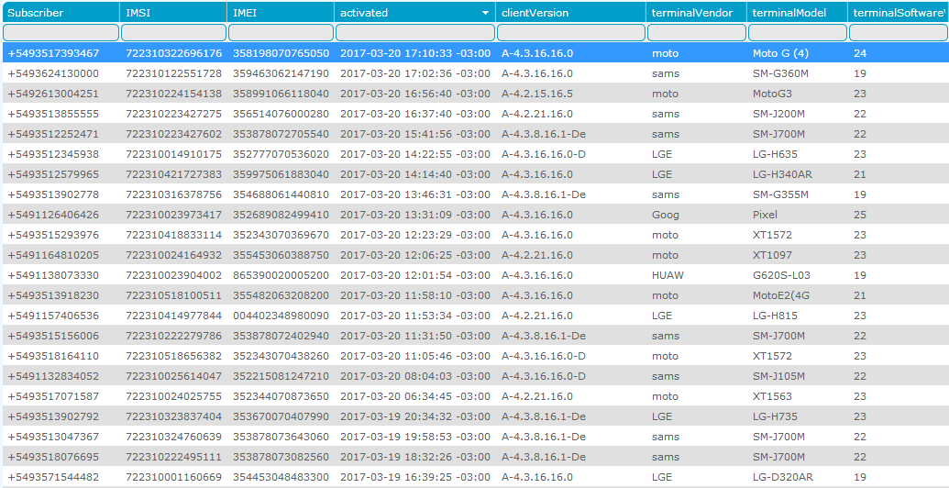
List of Activated Subscribers

Slide 30
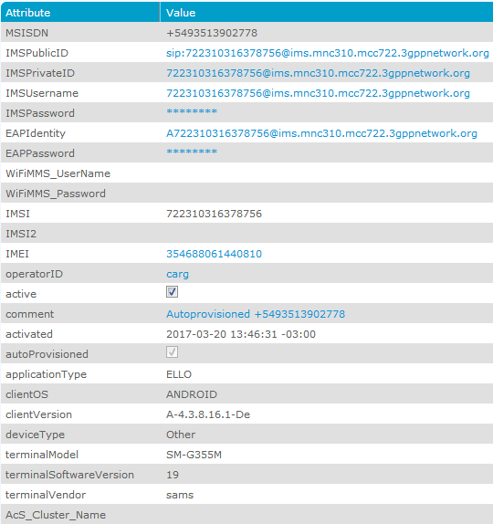
Activated Subscriber Record

Slide 31
Client Configuration Data

Slide 32
Client Configuration Data
Element | Content
Version | Configuration version (integer value, 0 or a positive integer)
Validity (version) | Pre-configured. Validity of current configuration (in seconds, 0 or a positive integer)
Token | Generated by the Activation Server. Token to be used in subsequent re-configuration requests, String (12 min, 24 max)
Validity (token) | Pre-configured. Validity of token (in seconds, a positive integer). Default value = 31536000 seconds.
Private User Identity | Generated by the Activation Server from the IMSI. It has the format IMSI@home network domain. String (64 max)
Public User Identity | Generated by the Activation Server from MSISDN. It has the format sip:MSISDN@home network domain. String (64 max)
Home Network Domain Name | Pre-configured. A fully qualified domain name or IPv4 address. String (64 max).

Slide 33
Client Configuration Data
Element | Content
PCSCFPort | Pre-configured. P-CSCF Port. Range 0 to 65535 with a default value of 5060.
wifiSignalling | Pre-configured. SIP signalling transport protocol over WiFi: SIPoTCP, SIPoTLS, SIPoUDP, SIPoUDPoIPSec, SIPoTCPoIPSec
wifiRTMedia | Pre-configured. Transport protocol used to carry real time media over WiFi: RTP or SRTP.
TLSPort | Pre-configured. TLS port number for SIP signalling Range 0 to 65535 with a default value of 5061
VoiceCallAuth | Pre-configured. Enables/Disables MMTEL telephony (wifi-calling) service. An unsigned 32 bit integer value that is mapped to a bit array indicating the radio technologies in which the service can be initiated.
NetworkName | Pre-configured. Name of the operator network that provides the service. String (32 max)

Slide 34
Client Configuration Data
Element | Content
SMS_Over_IP_Networks_Indication | Pre-configured. Indicates preference for selection of the domain to be used for short message service (SMS) originated by the UE 0 – Indicates that the SMS service is not to be invoked over IP networks. 1 – Indicates that the SMS service is preferred to be invoked over IP networks.
SMS_SegmentSize | Pre-configured. Maximum size of a short message segment in octets. Range is 70 to 140 octets and the default value is 140.
SM-SC_Uri | Pre-configured. SIP URI of short message service centre (SM-SC) to submit mobile originating short message over IP. String (64 max).
Timer_TR1M | Pre-configured. Timer value in seconds to wait for response after submitting mobile originating short message over IP. Range is 35 to 45 seconds with a default value of 40 seconds.
Timer_CW | Pre-configured. Timer value in seconds to limit the duration of a call in communications-waiting condition. Range is 10 to 60 seconds with a default value of 30 seconds.

Slide 35
Client Configuration Data
Element | Content
SecondaryIMSI | Pre-configured. A secondary IMSI of the subscriber in addition to the primary IMSI. The client will be operational (provide service) only if the IMSI read from SIM matches either the primary or secondary IMSI values. The secondary IMSI value for a subscriber is obtained from the HSM. String (15 max). A null string is returned if secondary IMSI is not present in HSM.
DefaultCellIdentity | Pre-configured. Default cell identity to be used in P-Access-Network-Info header. Encoded as a text string as follows: MNC(3 digits) + MCC(2 or 3 digits) + LAC (2 octets) + UMTS cell identity (5 octets) MNC(3 digits) + MCC (2 or 3 digits) +, LAC(2 octets) + cell identity(2 octets)
AccessType | Pre-configured. Access type to be used in P-Access-Network-Info header. Possible values are “3GPP-GERAN”, “3GPP-UTRAN-FDD”, “3GPP2-1X”..
PullbackAuth | Pre-configured. Enables/Disables pullback procedure. 0: Disabled 1: Enabled

Slide 36
Client Configuration Data
Element | Content
NumberExpansionAuth | Pre-configured. Enables/Disables phone number expansion to E.164 format. 0: Disabled 1: Enabled
MinDigits | Pre-configured. Minimum number of digits in the phone number to perform number expansion. Valid only if number expansion is enabled.
roveInTimer | Pre-configured. When the UE roves out, it starts roveInTimer and will not rove-in until this timer has expired, unless the UE has detected loss of cellular coverage. Range is 5 to 60 seconds and the default value is 15 seconds.
roveInWiFiRSSI | Pre-configured. UE will rove-in to WiFi network when WiFi signal strength is above this value. Range is 0 to -200 and the default is -75.
roveOutWiFiRSSI | Pre-configured. UE will rove-out from WiFi network when WiFi signal strength is below this value. Range is 0 to -200 and the default is -85.

Slide 37
Client Configuration Data
Element | Content
roveInCellularRSSI | Pre-configured. UE will rove-in to WiFi network when cellular signal strength is below this value. The value range of roveOutCellularRSSI is 0 to -200 and the default value is 0.
roveOutSmsAddress | Pre-configured. UE, on rove-out, sends an SMS to roveOutSmsAddress to cause a location update procedure on cellular network. The default value of the roveOutSmsAddress is a null string.
Conference_Factory_URI | Pre-configured. SIP URI used for setting up an IMS conference.
MaxUsers | Pre-configured. Maximum number of users allowed to participate in an IMS conference. Range is 2 to 6 with a default value of 3.
LocationInfoAuth | Pre-configured. Authorization to include location configuration information element in the P-Access-Network-Info header if Cell-Id is not available. 0: Disabled 1: Enabled

Slide 38
Client Configuration Data
Element | Content
Expiry | Pre-configured. The date and time in UTC timezone when the current client version expires (encoded in ISO 8601 format, YYYY-MM-DDTHH:MM:SSZ). The Activation server uses the following rule to decide on the expiry value. 1. The Activation Server has a provisioned list of (client_version, expiry) pairs sorted by ascending client_version values. 2. Find all the pairs whose client_version is greater than or equal to the client_version received in the first activation request and use expiry value of the pair with the lowest client_version. 3. If no pair is found, use an expiry value of 2100-01-01T00:00:00Z.
MMSC_URL | Pre-configured. URL of Multimedia Messaging Service Centre. String (64 max)
MMS_Proxy | Pre-configured. Domain name or IP address of MMS proxy. String (64 max)
MMS_Port | Pre-configured. Port number of MMSC or MMS proxy server. Range is 0 to 65535.
MMS_Maxsize | Pre-configured. The maximum size of Multimedia Message in Kilobyte (KB) that can be sent. Range is 0 to 10000.

Slide 39
Client Configuration Data
Element | Content
HandoutToCS | Pre-configured. The type of WiFi to cellular handout supported by UE. The values are disabled, manual, automatic.
HandoutToCSWiFiRSSI | Pre-configured. UE will handout to cellular network when the WiFi signal strength is below this value. The range is -200 to 0 with a default value of -200. A minimum value of -200 effectively disables handout based on WiFi RSSI.
HandoutToCSDlPktLoss | Pre-configured. UE will handout to cellular network when the downlink packet loss (in percentage) is above this value. The range is 0 to 100 with a default value of 5. A maximum value of 100 disables handout based on packet loss
HandoutToCSDlJitter | Pre-configured. UE will handout to cellular network when the downlink jitter (in ms) is above this value. The range is 0 to 1000 with a default value of 5. A maximum value of 1000 effectively disables handout based on DL jitter.
SBCCert_URL | Pre-configured. URL for root or intermediate certificate of a Certificate Authority (CA) to authenticate a session border controller (SBC). String (64 max). A value of NULL indicates that no certificate is available.
SeGWCert_URL | Pre-configured. URL for root or intermediate certificate of a Certificate Authority (CA) to authenticate a security gateway (SeGW). String (64 max). A value of NULL indicates that no certificate is available.

Slide 40
Client Configuration Data
Element | Content
MMICommandRouting | Pre-configured. UE behaviour when it detects MMI command in dialled string. Possible values are “routeOverCellular”, “routeOverIP” and “disabled” with a default value of “disabled”.
MmiCommandRoveOutTime | Pre-configured. The amount of time UE remains roved out after it detects an MMI command. The range is 30 to 180 seconds with a default value of 60 seconds.
SeGW_Address | Pre-configured. A fully qualified domain name or IPv4 address of security gateway. String (64 max)
EAPMethod | Pre-configured. The Extensible Authentication Protocol (EAP) authentication method. Possible values are “EAP-MD5”, “EAP-MSCHAPv2”, EAP-TLS”.
EAPPwd | Pre-configured. The password to be used in EAP procedures. String (64 max)
IKEEncryptionAlgorithm | Pre-configured. The encryption algorithm to be used for Internet Key Exchange (IKE) protocol. Possible values are “3DES-CBC”, “AES-CBC-128”.
IKEIntegrityAlgorithm | Pre-configured. The integrity algorithm to be used for Internet Key Exchange (IKE) protocol. Possible values are “HMAC-SHA1-96”, “AES-XCBC-MAC-96”.
IKEPseudorandomFunction | Pre-configured. The pseudorandom function to be used for Internet Key Exchange (IKE) protocol. Possible values are “HMAC-SHA1”, “AES-XCBC-PRF-128”.

Slide 41
Client Configuration Data
Element | Content
IKEDiffieHellmanGroup | Pre-configured. The Diffie-Hellman group to be used for Internet Key Exchange (IKE) protocol. Possible values are “2”, “14”.
IKEKeyLifetime | Pre-configured. The lifetime for IKE Security Association keys. A rekeying procedure is performed on its expiry. The range is 300 seconds to 86400 seconds with a default value of 28800 seconds. A value of 0 indicates that rekeying is disabled.
ESPEncryptionAlgorithm | Pre-configured. The encryption algorithm to be used for IP Encapsulating Security Payload (ESP) protocol. Possible values are “3DES-CBC”, “AES-CBC-128”, “AES-CTR”.
ESPIntegrityAlgorithm | Pre-configured. The integrity algorithm to be used for IP Encapsulating Security Payload (ESP) protocol. Possible values are “HMAC-SHA1-96”, “AES-XCBC-MAC-96”, “HMAC-MD5-96”.
ESPKeyLifetime | Pre-configured. The lifetime for ESP Security Association keys. A rekeying procedure is performed on its expiry. The range is 300 seconds to 86400 seconds with a default value of 28800 seconds. A value of 0 indicates that rekeying is disabled.
DPDIdleTimer | Pre-configured. When UE does not receive an inbound ESP packet for idle timer period it shall start a DPD procedure. The range is 20 seconds to 300 seconds with a default value of 60seconds. A value of 0 indicates that DPD is disabled.

Slide 42
Client Configuration Data
Element | Content
DSCPMarking | Pre-configured. Enable/Disable DSCP marking of signalling and media packets. 0: Disabled 1: Enabled (default value) The Activation Server obtains the DSCPMarking value by looking up a device configuration table using the “terminal_vendor”, “terminal_model” and “terminal_sw_version” parameters in the activation request. If not found in the table, the default value is returned.
SIPSignallingDSCP | Pre-configured. DSCP value used for SIP signalling packets. The range is from 0 to 56 with a default value of 32.
RTMediaDSCP | Pre-configured. DSCP value used for real-time media packets. The range is from 0 to 56 with a default value of 46.
AudioMode | Pre-configured. Audio mode type. Possible values are “IN-CALL” , “IN-COMMUNICATION” (default value). The Activation Server obtains the audiomode value by looking up a device configuration table using “terminal_vendor”, “terminal_model” and “terminal_sw_version” parameters in the activation request. If not found in the table the default value is returned”

Slide 43
Client Configuration Data
Element | Content
HandsetUplinkAudioGain | Pre-configured. Audio gain value. The range is from 1 to 6 with a default value of 2. The Activation Server obtains the audiogain value by looking up a device configuration table using the “terminal_vendor”, “terminal_model” and “terminal_sw_version” parameters in the activation request. If not found in the table the default value is returned.

Slide 44
Thank You
Sonus Networks
978-614-8100 Office
978-614-8100 Mobile
email@sonusnet.com
www.sonus.net

