Slide 1
Integrating Traceroute Information with BWCTL and OWAMP
Andy Lake, Jeff Boote

Slide 2
Motivation
Short term
  Associate traceroute data with measurements (i.e. OWAMP and BWCTL) so we can identify a path and not just two endpoints.
  Informative and makes for prettier GUIs
Longer term
  Associate measurement data with any type of path data.
  Path may come from analyzing underlying network protocols (BGP, OSPF, etc) or from circuit service that knows the path (i.e. OSCARS)

Slide 3
Path, Measurements and Topology
Three pieces of information to link:
  Measurement Data
  Path
  Topology elements in path
No way for packet/frame being measured to record its path as it travels the network
Two pieces of common information link these items:
  Endpoints (IP, hostname, etc)
  Time

Slide 4
Architectural components
Measurement
    Something to perform the measurements (BWCTL,OWAMP)
    Something to collect the results (master/collector scripts)
    Somewhere to store measurements between endpoints at certain time (pSB MA)
Path
  Something to discover/define the path (traceroute, OSCARS, BGP, etc)
  Something to collect the results (TBD)
  Somewhere to store paths between endpoints at certain time (TBD)
Topology
  Something that provides the topology (SNMP, TL1, flat file, etc)
  Something to collect the topology (Topology Agent)
  Something to store the topology (Topology Service)

Slide 5
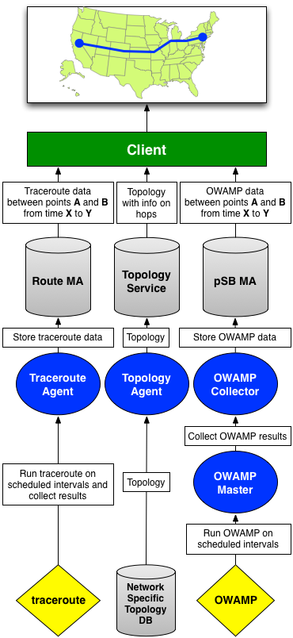
Architecture (Scheduled Intervals)

Slide 6
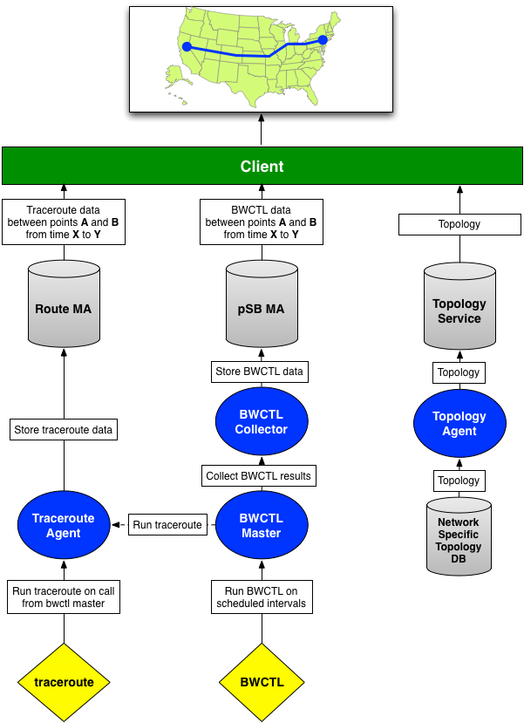
Architecture (Externally Initiated)

Slide 7
Traceroute Agent
Traceroute triggered in two manners:
  Scheduled test
  Initiated by external program
Scheduled intervals
  Interval could be set small so traceroute runs almost continuously
  Investigation needed of best default intervals
Externally initiated
  BWCTL test starts
  Change detected (i.e. TTL change)
In both scenarios chance of missing a short-lived path change exists
Is there a reason to divide this into a master and collector?

Slide 8
Route MA
Separate from pSB MA
Has its own set of MySQL tables for storing route information
  DB schema should be flexible enough that could store non-traceroute data as well
Ideally could share components from the pSB MA (dependent on re-organization tasks)
How should we write to the MA?
  Direct write to MySQL (i.e. OWAMP and BWCTL collector)
  XML message that MA converts to SQL.

Slide 9
Schema
Exists here: http://anonsvn.internet2.edu/svn/nmwg/trunk/nmwg/schema/rnc/traceroute.rnc
Metadata
  Subject: Endpoint pair
  Parameters: maxTTL, packetSize, etc
Data
  Time
  Hops
  Various other attributes

Slide 10
Beyond Traceroute
Separating traceroute functionality leaves open possibility for other source of path information in future
No dependence in BWCTL/OWAMP that measurement have a path with a meaningful traceroute (i.e. a circuit)

