Slide 1

gLS Overview
Jason Zurawski
perfSONAR-PS Developer Meeting
April 30, 2009

Slide 2
Agenda
gLS (as a service) Architecture
hLS/gLS Service Differences
gLS (as a framework) Architecture
Summarization
Synchronization

Slide 3
gLS (Service) Architecture
Imagine the hLS …
  Same exact architecture and procedures
  root = 1 setting in the configuration file
Minor Differences
  Messages Accepted
  Sync/Summarization Procedures

Slide 4
gLS (Service) Architecture - Messages
Note – Keep in mind that the ‘service’ you register to a gLS is an hLS.
Message structures are the same:
  LSRegister
  LSDeregister
  LSKeepalive
  LSQuery
  LSKey
  LSDiscovery

Slide 5
gLS (Service) Architecture - Sync
LSRegister Message (with an eventType change) acts as a sync message between gLS instances
  http://ogf.org/ns/nmwg/tools/org/perfsonar/service/lookup/registration/synchronization/2.0
Works on a periodic cycle (still)
  ls_registration_interval = 3 hours (hLS), I recommend this or longer

Slide 6
hLS/gLS Service Differences
Each Message has a different eventType than the hLS since we are interested in different underlying storage
Mismatch message type/eventType is an error for gLS/hLS

Slide 7
hLS/gLS Service Differences
LSRegister
  hLS
    http://ogf.org/ns/nmwg/tools/org/perfsonar/service/lookup/registration/service/2.0
  gLS
    http://ogf.org/ns/nmwg/tools/org/perfsonar/service/lookup/registration/summary/2.0
    http://ogf.org/ns/nmwg/tools/org/perfsonar/service/lookup/registration/synchronization/2.0

Slide 8
hLS/gLS Service Differences
LSDeregister
  hLS
    http://ogf.org/ns/nmwg/tools/org/perfsonar/service/lookup/deregistration/service/2.0
  gLS
    http://ogf.org/ns/nmwg/tools/org/perfsonar/service/lookup/deregistration/summary/2.0

Slide 9
hLS/gLS Service Differences
LSQuery
  Any
    http://ggf.org/ns/nmwg/tools/org/perfsonar/service/lookup/xquery/1.0
    http://ogf.org/ns/nmwg/tools/org/perfsonar/service/lookup/discovery/xquery/2.0
    http://ogf.org/ns/nmwg/tools/org/perfsonar/service/lookup/discovery/control/xquery/2.0
  hLS
    http://ogf.org/ns/nmwg/tools/org/perfsonar/service/lookup/query/xquery/2.0
    http://ogf.org/ns/nmwg/tools/org/perfsonar/service/lookup/query/control/xquery/2.0

Slide 10
hLS/gLS Service Differences
LSKey
  hLS
    http://ogf.org/ns/nmwg/tools/org/perfsonar/service/lookup/key/service/2.0
  gLS
    http://ogf.org/ns/nmwg/tools/org/perfsonar/service/lookup/key/summary/2.0

Slide 11
hLS/gLS Service Differences
LSKeepalive
  hLS
    http://ogf.org/ns/nmwg/tools/org/perfsonar/service/lookup/keepalive/service/2.0
  gLS
    http://ogf.org/ns/nmwg/tools/org/perfsonar/service/lookup/keepalive/summary/2.0

Slide 12
gLS (Framework) Architecture
hLS Layer
gLS Layer
Combined
Use Cases

Slide 13
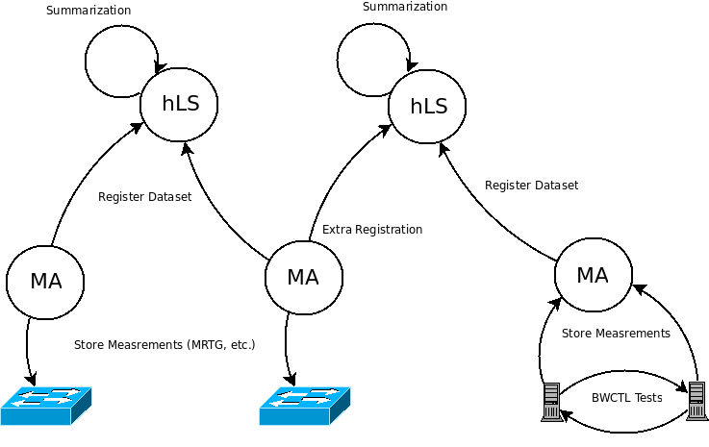
gLS (Framework) Architecture - hLS

Slide 14
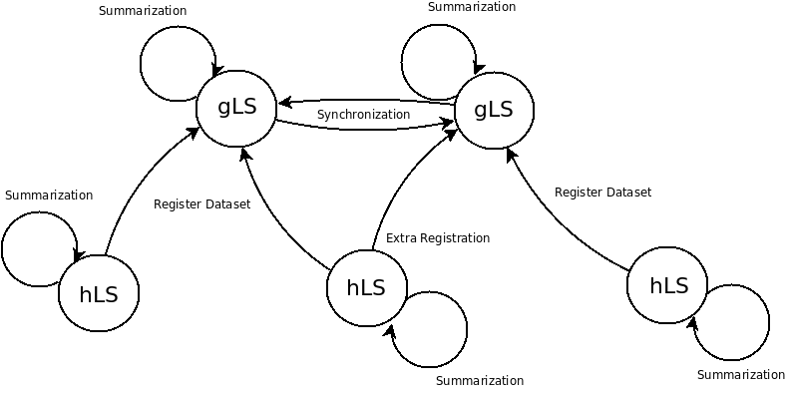
gLS (Framework) Architecture - gLS
_x0018_

Slide 15
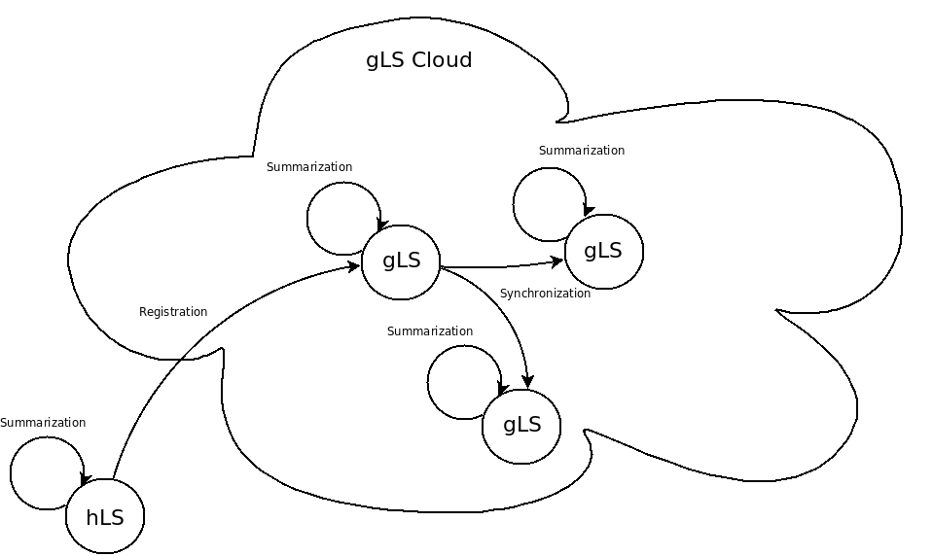
gLS (Framework) Architecture - All

Slide 16
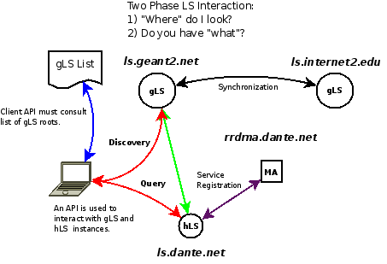
gLS (Framework) Architecture – Use

Slide 17
Summarization
Similar to hLS ‘summary of summaries’
  Summarize all hLS content
  Same procedures
Uses the same ‘maintenance’ periodic event
  maintenance_interval = 2 hours for hLS, could be same for gLS instances

Slide 18
Synchronization
Also a periodic event
  Think ‘registration’
  ls_registration_interval = 3 hours (for hLS, should use the same or greater)
Send *all* information for hLSs that you are *authoratative* for
  If the hLS contacts you directly
  Don’t pass along non-auth information

