Slide 1
Network Service Interface and IDC
A Comparison
May 1, 2009
John Vollbrecht

Slide 2
Network Service Interface and IDC
Tom suggested that we try to focus on how IDC and NSI compare – this is to start
Quick look at NSI --
Goal is to standardize interface to dynamic circuit network
  our perspective is to use IDC as a base for what is required
  Requires using NML for naming
NSI is a work in progress
  First step is an architecture document which is underway (first draft due end of May at OGF)
  Needs feedback and comments from IDC developers
    the intent is to standardize IDC as much as possible
    Important to coordinate IDC and NSI development
GLIF GOLE pilot will focus on NSI as “standard” way of implementing dynamic circuits
  Some implementations likely to be IDC based – extending IDC to larger community

Slide 3
NSI Architecture document
Architecture document describe the Interface and the capabilities controlled by the interface
The interface defines what needs to be supported
The expectation is that networks using NSI may be deployed in a number of ways
    Tree and chain models and combinations
IDC is one (very important) input for requirements
  Not the only input
Most IDC concept are included, but some names are different
The following attempts to describe some of the NSI concepts and compare them with IDC and names.
Notes:
Point is that Nets may organized in many ways, and some may be part of many federations or VOs that are unaware of each other. There are significantly different views of the way this capability will be deployed and the goal is for NSI to support most if not all

Slide 4
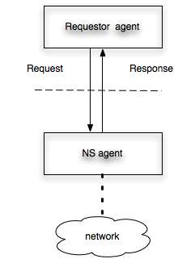
First a Definition NSI
NSI is defined as the interface between a requestor agent and a Network Service Agent
NSI is concerned with connection oriented networks - Technically a Connection Oriented Network Service “CO-NS”
Interface is not so simple as shown here - this is very high level

Slide 5
What is a Connection Oriented Network Service
Data
Provide connection between edge points
  Reserve
  Activate
  Tear down
  Concatenate with other connections
Information
Capabilities
Reachable edge points
Status
  Availability
  Performance

Slide 6
Infrastructure Data Elements
IDC
Domains
Nodes
Ports
Links
NSI
Networks
--
Edge points
Links
Notes
- NSI does not deal with Nodes; I do not think this is a problem for IDC
- Link seems to have slightly different meaning

Slide 7
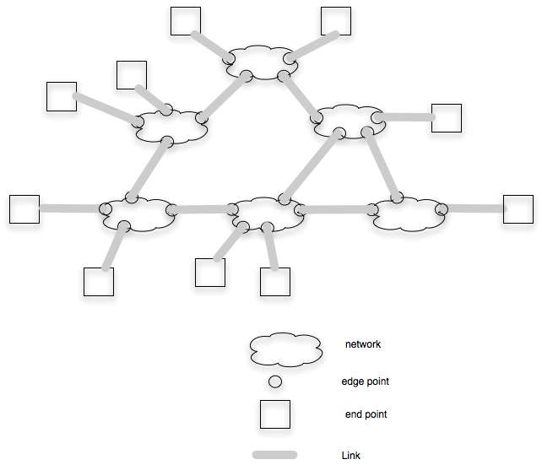
Connection Oriented Network Infrastructure with multiple networks

Slide 8
Topology and pathfinding using infrastructure
Networks and Links create a topology which can be used to find paths between end points
As far as I can tell differences at pathfinding level between IDC/ NMWG and NSI are
  naming (edge point vs port/link)
  Networks are “supernodes” – equivalent for pathfinding

Slide 9
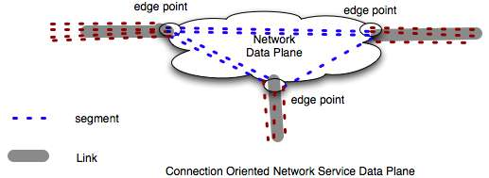
NSI Service Elements
What is provide by Network Service
NSI Data Service = segment
  Networks and Links are elements which provide segments
In NSI Networks and Links have resources which can allocated to segments
From a IDC view I think a segment maps to a hop
  NSI deals with resources on segments
  IDC deals with resources on Node/port/Link – resources are not aggregated to describe hop specifically

Slide 10

CO-NS Data Element
Link
NSI Link
  Permanent connection between Edge points
  Edge points belong to network not Link
  Links are allocate segments on the link resources
  Segments have capabilities which can be described by attributes
IDC Link is defined at the node/port level
  Doesn’t seem possible for link to have different owner than node
Names for NSI are “under discussion”
  Need to align concepts and names

Slide 11
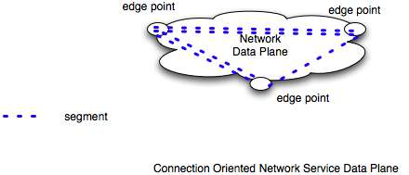
CO Data Element
Network
Provides segments dynamically between edge points
Edge points belong to network
Edge points or cross connect segments from Network to segments from Link
Edge Point may perform adaptation between techologies at different edgepoints on the network
Adaptation is a capability to be reserved and instantiated
Multiple adaptations may occur
  VLAN translation
  Ethernet VLAN to GFP encoded VLAN over SONET

Slide 12
Some Data PlaneTerminology
NSI
Network
Link
Segment
EdgePoint
ETE Connection
EndPoint
Topology
Host
IDC
Domain
Link??
Hop
Link/Port
Path
Link/Port
Topology
Host

Slide 13
Connsection Oriented-NS
Service Plane
Control Plane - NS agent manages conversations with User agent
Control plane manages and allocates resources
- reserves segments
- activates segments
  Concatenates segments
  Adapts segments
- deletes segments

Slide 14
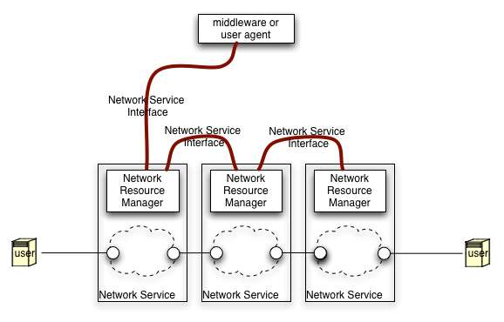
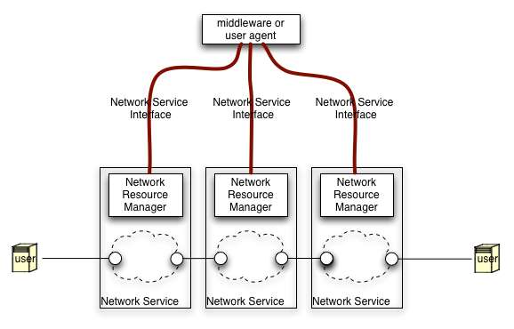
Multiple Domain
Connection Oriented Infrastucture
CO networks Linked at data plane may provide ete connection between edge points on any of the networks
NS Agents must be coordinated to create such a connection
How coordination is done is up to collaborating network
  Some multidomain models have been called tree or chain
NSI supports many different models of coordinating network agents

Slide 15
Some Control Plane requirements and issues for IDC and NSI
Trust
  between infrastructure elements
  Between segment reservation and instantiation
Authorization and Policy
  for segment reservation and instantiation
Scheduling and Reservation
  Calendar information
  Reserving resources/ instantiating connections
Job Control
  Two phase commit that includes resources outside network
Monitoring
  Infrastructure and connections
Resource Discovery
  Sharing edge points links to other edge points
  Sharing resource availability with others
Path computation
  Collecting resources
  Finding potential connections that include adaptations

