Slide 1
Overview of New Features in perfSONAR 4.0
perfSONAR Project: http://www.perfsonar.net
April 20, 2017
This document is a result of work by the perfSONAR Project (http://www.perfsonar.net) and is licensed under CC BY-SA 4.0 (https://creativecommons.org/licenses/by-sa/4.0/).

Slide 2
What is perfSONAR?
perfSONAR is a tool to:
Set (hopefully raise) network performance expectations
Find network problems (“soft failures”)
Help fix these problems
All in multi-domain environments
Over 2000 public hosts on many different networks
http://stats.es.net/ServicesDirectory/ [note: takes a long time for data to load]
These problems are all harder when multiple networks are involved
Focus on Research and Education (R&E) Networking, 1Gbps links or higher
perfSONAR provides a standard way to publish active and passive monitoring data
This data is interesting to network researchers as well as network operators

Slide 3
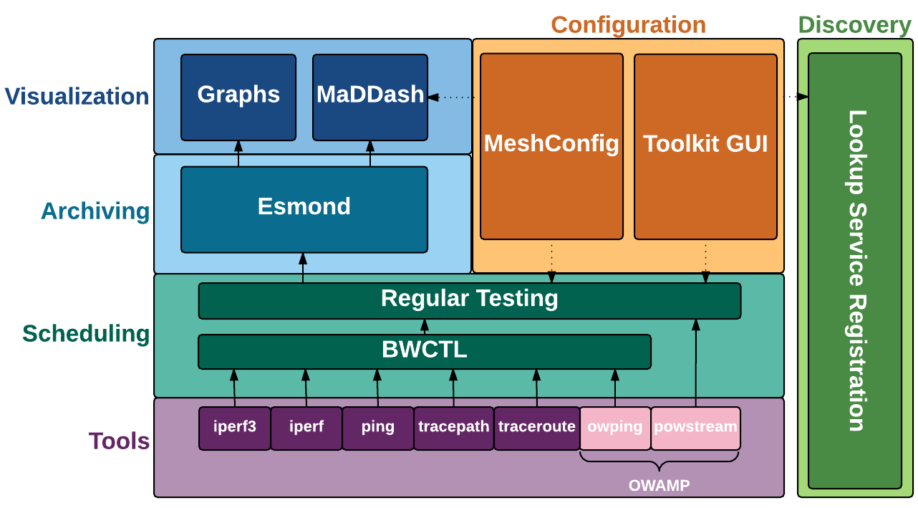
perfSONAR 3.5 Components
Notes:
Toolkit is most of these components (no maddash)
- Also have bundles that allow you to install just parts of it

Slide 4
New in perfSONAR 4.0
pScheduler
Replaces scheduling layer with new component that adds many new features and improves on a number of old ones
New Graphs
Cleaner display of multiple types of data
MaDDash 2.0
Added alerting features
CentOS 7 and Debian 8 support
Notes:
Highlight NDT getting dropped. Also highlight that even in 3.5 diagram not shown because it was on an island and had 0 interaction with other pieces.

Slide 5
Removed from perfSONAR 4.0
Web100 and NDT no longer included in new perfSONAR 4.0 installs
CentOS 7 kernel does not support web100
Upgrade does NOT remove NDT or web100 packages from existing installs
Will continue to build web100 kernels until October 17, 2017
The Measurement Lab project (https://www.measurementlab.net/) will be updating their platform, including new hardware, modern kernels and cluster management software. This includes migrating key tools (including NDT) from Web100 to TCP_INFO.
https://www.ietf.org/proceedings/98/slides/slides-98-maprg-refreshing-mlab-matt-mathis-00.pdf
Notes:
If you want just an NDT box, perfSONAR hasn’t been the best way to do that for awhile.

Slide 6
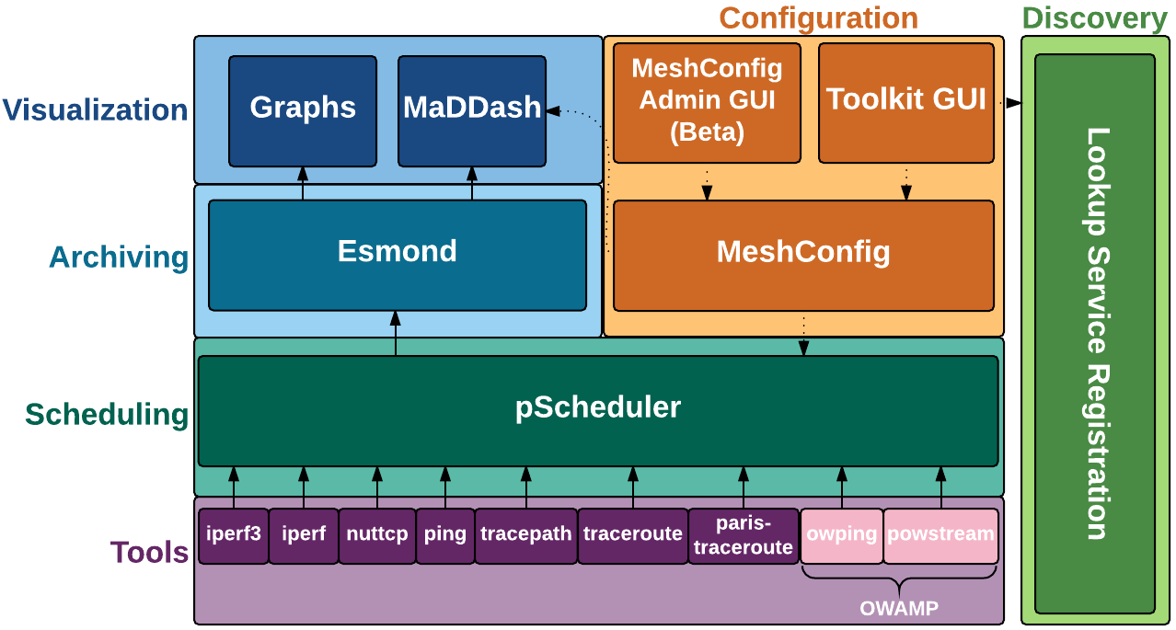
perfSONAR 4.0 Components
Notes:
- Big change is pScheduler is now the entire scheduling layer
Notice that we a) have all tools going through same component at scheduling layer and b) there are more tools supported by the ENTIRE system (before just BWCTL supported some and not regular testing and vice versa)
Also note these are just the default tools, other can write their own
Also note that there is a REST interface to pScheduler itself
Also changes in configuration layer
- Added MeshConfigGUI which is still in beta at time of release
- Funnel both GUIs through meshconfig for simplicity. Not required and is possible to access pscheduler API directly
- Imporvements at Visualization layer, though not a significant architechtural change.
- Improvementat other layers as well but largely the same

Slide 7
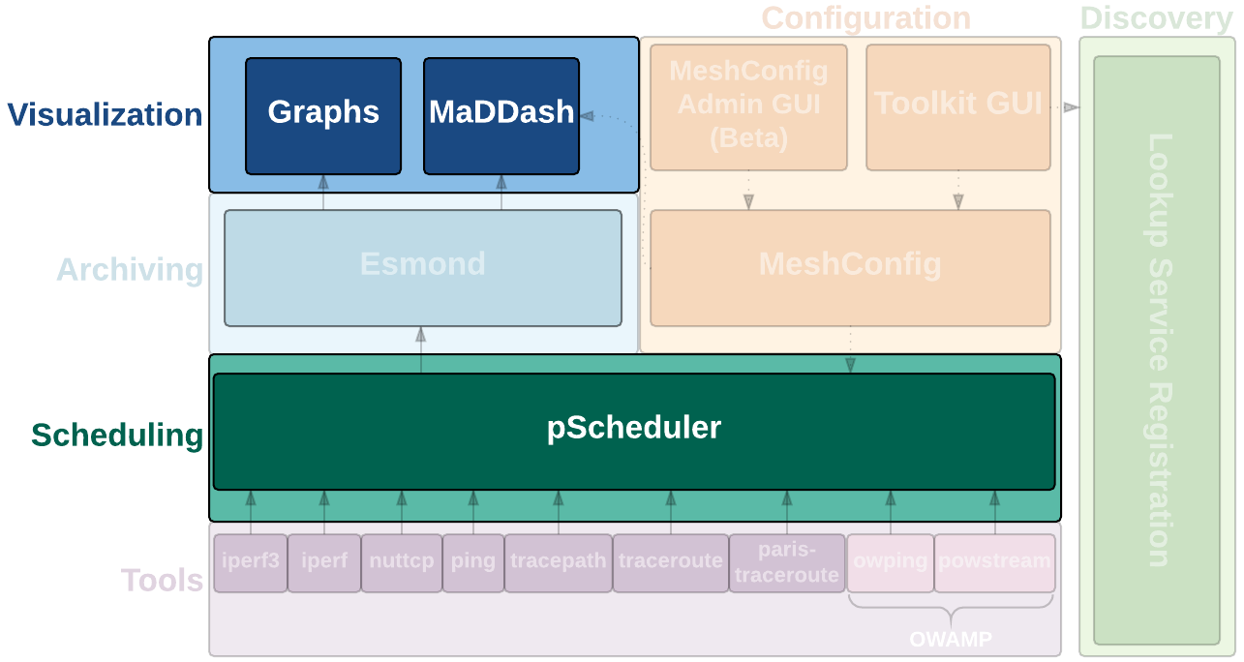
Today’s Focus
Notes:
Focus on Graphs, MaDDash and pScheduler
- These are likely the most significant changes most of audience will notice on a day-to-day basis
- May do feature presentation focusing on the Configuration box. Again worth noting that if you are using meshConfig or the Toolkit GUI now, not huge change changes (though some)

Slide 8
MaDDash 2.0

Slide 9
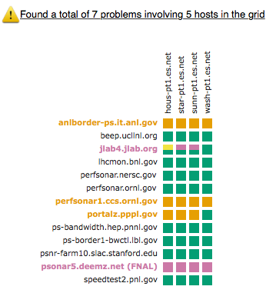
New: MaDDash 2.0
MaDAlert developed at University of Michigan as subproject of PuNDIT project
Looks at dashboards and scans for patterns
Example: If every box for a host is orange, good indication host is down
Provides REST API to reports
Integrated with MaDDash UI to make identifying common problems easier
Native email notifications as well as Nagios checks available
Notes:
Biggest request from previous version of was email alerts. We didn’t want to flood people with alerts every time half a box on the dashboard changed though. One of the strengths of dashboards is the ability to see patterns. We wanted the ability to detect patterns in dashboards and alert on those.
MaDAlert developed by umich added ability to define and identify those patterns. It was integrated into the main MaDDash code base, including new options in the configuration file and GUI.
- Image on right shows GUI. Problematic hosts are highlighted using a configurable set of rules (don’t worry we ship with examples and mesh-config sets-up a sane default you probably don’t need to change)
Since these reports can be queried via REST apis we did this two ways: natively and by writing a nagios plug-in

Slide 10
MaDDash Alert Emails: Native
New notifications section in /etc/maddash/maddash-server/maddash.yaml
notifications:
-
name: "All alerts"
type: "email"
schedule: "0 * * * ?"
problemReportFrequency: 86400
minimumSeverity: 1
parameters:
dashboardUrl: "http://…”
from: "dashboard@domain.example"
to:
- "admin@domain.example"
- name: "Collaboration Performance Issues"
type: "email"
schedule: "0 * * * ?"
problemReportFrequency: 86400
minimumSeverity: 1
filters:
- type: "category"
value: "PERFORMANCE"
- type: "dashboard"
value: "Collaboration Dashboard"
parameters:
dashboardUrl: ”http://…”
from: "dashboard@domain.example"
to:
- “list@collaboration.example"
Notes:
Possibly the simplest way to get started is with native emails. Also provides a lot of flexibility.
Notifications is a list property, so can have multiple defined
First column sends all reports, second columns just sends problems marked as performance in collaboration dashboard (other category is CONFIGURATION)
Filter types are dashboard, grid, site, and category. You can have multiple of the same type under one “filters” heading. Multiple of the same type treated as “OR” condition.
You have to add by hand currently and it wont be overwritten by meshconfig-guiagent

Slide 11
MaDDash Alert Emails: Nagios
Command structure:
check_maddash.pl -u MADDASH_URL -g GRID_NAME
check_maddash.pl -u MADDASH_URL -g GRID_NAME –s SITE_NAME
Example commands:
$ /usr/lib64/nagios/plugins/check_maddash.pl -u http://ps-dashboard.es.net/maddash -g "ESnet - ESnet to DOE Site Throughput Testing”
MADDASH OK - No problems to report
$ /usr/lib64/nagios/plugins//check_maddash.pl -u http://ps-dashboard.es.net/maddash -g "ESnet - ESnet to DOE Site Throughput Testing" -s jlab4.jlab.org
MADDASH CRITICAL - [PERFORMANCE] Outgoing throughput is below warning or critical thresholds to a majority of sites
Notes:
May also use provided nagios checks to integrate with environment
These can only look at one grid at a time currently
Giving it just a grid will only alert on rules that affect the entire grid (which likely is only useful in a few very specific, very catastrophic cases where entire grid is down)
Giving is a site name (the name you see in the row or column) is the preferred way to do it I will give you any reports associated with that grid in that row
May be a bit more cumbersome to setup if not familiar with nagios

Slide 12
New Graphs

Slide 13
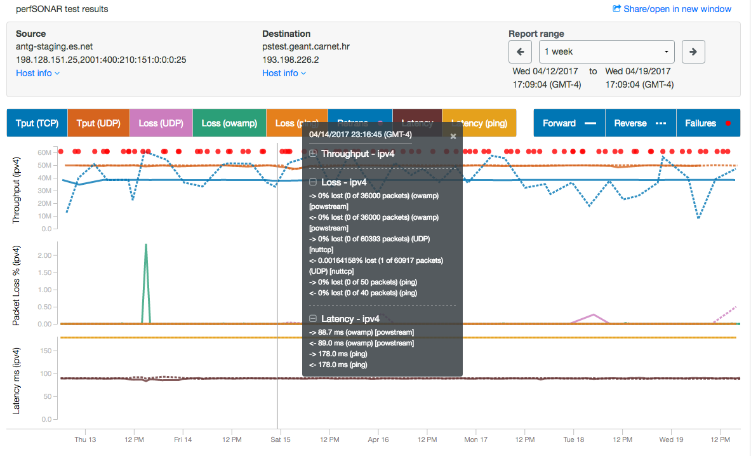
New: Graphs
Notes:
List change highlights.
Complete redesign with input from usability designer and web designer
Shows more information in a less-cluttered way
* all tests selectable
* retransmits, errors shown in mouse-over detail
Views of number of packet lost
Indications of which tools ran which tests
Much improved performance
* Built using open-source interactive time-series charting from Esnet

Slide 14
New Plots Demo
Live demo here.
Notes:
Introduction
In 4.0, we have entirely new graphs
Improved looks and usability
More or less responsive, but good resolution is recommended
Much improved performance
Built using the React Timeseries Charting library from ESnet
Developed in collaboration with a usability designer and web designer (the same team that worked on the new Toolkit GUI in the perfSONAR 3.5 release)
More extensible than the framework we previously had
overall new graph
allows the user to see all throughput results on one graph, loss on another graph, and latency on another
separate graphs for ipv4 and ipv6
Header
Host list (hostname, addresses)
Click Host info to get more details
MTU
Interface capacity
Traceroute link, if available
Click X or click outside the Host info box to close
Share/open in new window link (upper-right corner)
Click to pop open graph in a new window (particularly useful from within MadDash)
Right click -> copy to copy the page URL
Report range
Start date/time to End date/time (including timezones)
Use left arrow to go back in time, Right arrow to go forward
Use dropdown to select a range
Graph
Selector bar
Indicates the following, and lets you enable/disable them (turning grey when disabled)
Throughput, Retransmits, Loss, Latency, TCP vs UDP, one-way versus round trip ping
Forward/Reverse directions
Failures (show up as red dots)
Graph scales automatically adjust as you enable/disable different values, so you can narrow in on specific results
If some lines run together, try disabling other lines on the same graph for a better view
Values overlay/tooltip
Timestamp of current cursor position
Sections for Throughput, Loss, and Latency (ipv4 and ipv6 separately if applicable)
Shows results for every test - it shows values for all tests it knows about, showing the value you've hovered over most recently.
If it gets confusing trying to find which values occur at which time, unfreeze and move the cursor back and forth, and watch for the values to change
Additional usability improvements coming in this area
For Throughput, it shows:
Direction of test,
Value, unit, protocol (tcp vs udp), tool [iperf3, nuttcp, etc.)
If it says "bwctliperf3" or otherwise has bwctl in the tool name, you know that that is a 3.5 host in backwards-compatibility mode.
Retransmits (for TCP Throughput test only)
For Loss, it shows:
Direction of test
Percent loss
Protocol (TCP vs UDP)
Tool (owamp, iperf3, nutttcp, etc.)
For Latency, it shows:
Direction
Latency in ms
Whether the test is owamp (one-way latency) or ping (round trip latency)
For Failures:
Direction
[Test type]
Protocol
Error message
[tool]
Click anywhere on the background to "freeze" the overlay
Click again to "unfreeze", or click the X in the upper-right corner
While frozen, you can:
Collapse/expand sections (see the +/- signs)
Scroll up and down more easily
Example error messages under Failures
Copy and paste the text/values
Future
Usability improvements, especially to selecting which values are displayed in the overlay
More control over what values are displayed
More details about test parameters that were specified
More details about the hosts involved in the tests

Slide 15
pScheduler The perfSONAR Scheduler

Slide 16
What is pScheduler?
Software for scheduling, supervising and archiving measurements.
Complete replacement for the Bandwidth Test Controller (BWCTL) as a component of perfSONAR

Slide 17
Why replace BWCTL?
Parts of it are becoming creaky with age.
Architecture makes many community-requested features difficult to implement.
After extensive evaluation, a clean slate with an eye toward the future was determined to be the best option.

Slide 18
Highlighted Improvements
Full support for all tools supported by BWCTL and more
Visibility into prior, current and future activities
Measurement diagnostics provided with results
Full-featured, repeating testing for all measurement types baked into the core of the system
More-powerful system for imposing policy-based limits on users
Reliable archiving (with multiple archivers, including Esmond, RabbitMQ and HTTP)

Slide 19
Major Improvement: Extensibility
Plug-in system allows integration of new…
Tests Things to measure
Tools Things to do the measurements
Archivers Ways to dispose of results
Well-documented API
Easily brings new applications into the perfSONAR fold
Core development team doesn’t need to be involved other than in an advisory role
Notes:
This is probably the most important pScheduler slide.

Slide 20
Test Abstraction
pScheduler abstracts the tests you do from the tools that do the measurements.
throughput not bwctl or iperf
latency not owamp
rtt not ping
trace not traceroute
There are provisions for tool-specific features and selection of specific tools.

Slide 21
Technical Improvements
Considerably-simplified code base designed for reliability and maintainability.
Most of the hard work done by a well-proven RDBMS
REST API
Standardized, documented data formats using JavaScript Object Notation (JSON)
Notes:
Most of the simplification comes from the fact that the database underpinning pScheduler does most of the hard work.

Slide 22
Sample pScheduler Throughput Command
Old:
bwctl -c receive_host -s send_host -t 30
New:
pscheduler task throughput --source send_host
--dest receive_host --duration PT30S
For more details on commands see http://docs.perfsonar.net/pscheduler_intro.html

Slide 23
Sample pScheduler Packet Loss/Latency Test Command
Old:
bwping -s send_host -c receive_host
bwping -T owamp -s send_host -c recv_host -N 1000 -i .01
New:
pscheduler task rtt --source send_host
--dest recv_host
pscheduler task latency --source send_host
--dest recv_ host --packet-count 1000
--packet-interval .01

Slide 24
Sample pScheduler Traceroute Command
Old:
bwtraceroute -c receive_host -s send_host
New:
pscheduler task trace --source send_host --dest receive_host

Slide 25
Other Useful pScheduler Commands
pscheduler plugins tests (Or tools or archivers.)
List all tests/tools/archivers available on the server
pscheduler task clock —source host1 --dest host2
Measure the clock difference between two hosts
pscheduler task dns --query www.es.net --record a
Measure the time to do a DNS lookup
pscheduler schedule --filter-test=throughput
Show the upcoming throughput tests
pscheduler schedule --filter-test=throughput
-PT1H --host somehost
Show the throughput tests run in the past hour on somehost

Slide 26
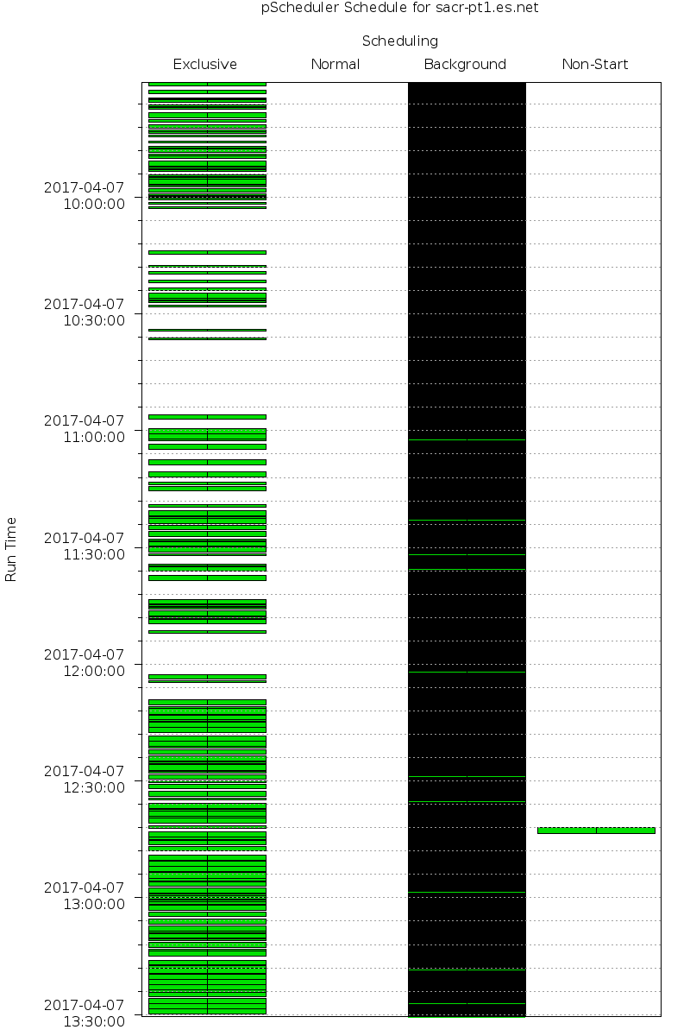
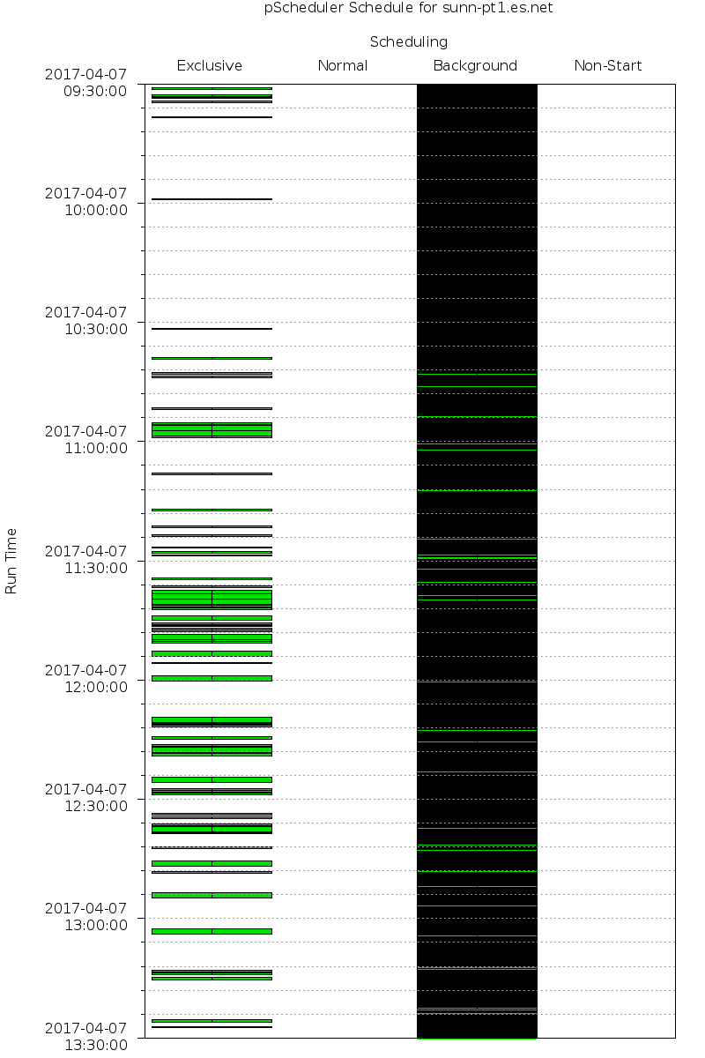
Plotting the Schedule
pscheduler
schedule-plot
+PT2H
> plot.png
From these plots, decided to move some tests from sacr-pt1.es.net to sunn-pt1.es.net
Notes:
XXX Add appropriate pscheduler command to produce a plot

Slide 27
BWCTL Backward Compatibility
Available but not recommended.
Needed so that 4.0 hosts can run tests to 3.5 hosts
You can still run BWCTL from the command line
No guarantee they won’t collide with pScheduler tests (similar for BWCTL to a 4.0 host)
BWCTL to be retired in perfSONAR 4.1

Slide 28
pScheduler Archivers
Support for Esmond, HTTP GET/PUT, RabbitMQ and Syslog included
Like tools and tests, archivers are pluggable
Well-defined API
Easy to add additional archive targets
Archiving is now reliable to reduce data loss during failures

Slide 29
pScheduler Packaging
pScheduler is designed to be standalone
Test, tool and archiver plugins are individually-installable packages
Can add plugins to systems that need them.
Removing a plugin package renders pScheduler unaware that it exists.
Notes:
XXX This slide perhaps can be elided for this presentation

Slide 30
Upgrading to 4.0

Slide 31
perfSONAR Bundles
perfsonar-tools
Just the measurement tools: iperf, iperf3, nuttcp, pScheduler client, bwctl, owamp
perfsonar-testpoint
Tools + pScheduler, Lookup Service registration
perfsonar-core
testpoint + esmond (for storing results)
perfsonar-toolkit
Perfsonar-core + Web, scripts to apply tuning and security settings
Available as a full suite of tools for Debian

Slide 32
perfSONAR Toolkit
Currently most people run the perfSONAR Toolkit
Full suite of perfSONAR tools to configure, execute, collect, and visualize measurement results
CentOS-based ISO pre-tuned and configured with default system and security settings
Notes:
CentOS 7? CentOS 6? Both?

Slide 33
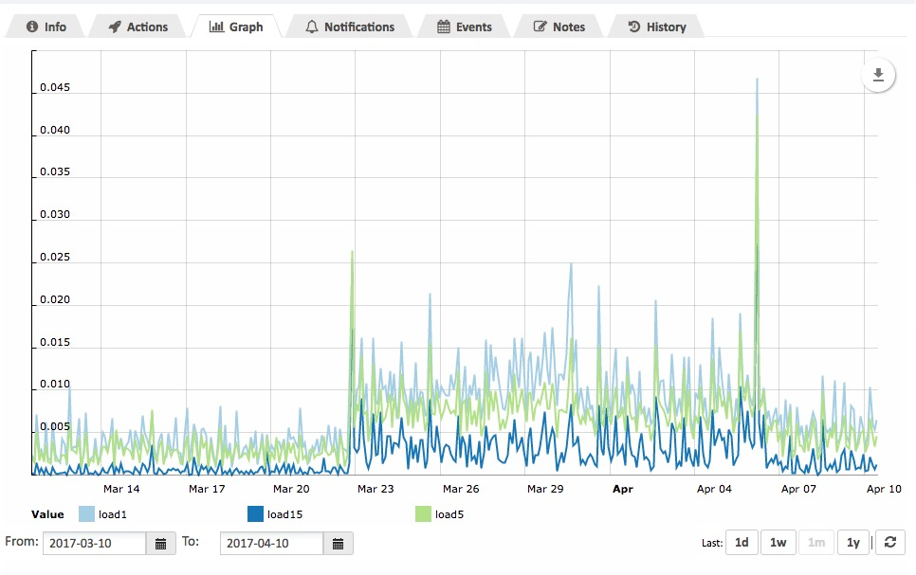
perfSONAR 4.0 resource requirements
CPU load for 4.0 is about double 3.5
New features in pScheduler add load
Memory usage is about the same
Plot shows 8core, 2.5GHz host; Upgraded to 4.0 on March 23
Notes:
XXX unpack pScheduler uses considerably more CPU than bwctl

Slide 34
perfSONAR bundle requirements
Hardware requirements depend on which bundle you are using:
perfsonar-tools: 1 core and 1GB RAM
perfsonar-testpoint: 2 cores and 2+GB RAM
May work with 2GB, but 4GB recommended
perfsonar-core: 2 cores and 4GB RAM
perfsonar-toolkit: 2 cores and 4GB RAM
Notes:
Cores should be at least 2GHz for 1G testers, and 2.8GHz for 10G tester
central management for a large mesh will need 8 cores and 16GB RAM or more.
XXX Andy: verify cores above (especially toolkit – is that 4?)

Slide 35
Time to Update to CentOS7?
Lots of reasons to upgrade to CentOS7
Python 2.7
FQ-based pacing and other TCP enhancements (3.10.x kernel vs 2.6.x)
Allows you to set max throughput limits for your perfSONAR host
systemd and firewalld
Higher default process count ulimit
Much better virtualization/container support
EOL 2024 vs 2020
Unfortunately must reinstall
See: http://docs.perfsonar.net/install_migrate_centos7.html
Notes:
Recommend everyone running CentOS6 begin plans to upgrade.

Slide 36
perfSONAR on Low Cost Hardware
New resource requirements means more possible bottlenecks using small nodes
Small nodes still not a replacement for server-class gear (yet)
Recommend perfsonar-tools or perfsonar-testpoint bundle installs
Recommend as much CPU as possible 1.8+GHz, 4 cores, and 4GB memory
For more deployment examples look at: http://docs.perfsonar.net/deployment_examples.html
Notes:
Should we include this or not? ….
XXX slide from Syzmon

Slide 37
Important Dates
April 17, 2017
perfSONAR 4.0 final released
July 2017*
perfSONAR 4.0.1 bugfix and minor feature release
October 17, 2017
perfSONAR 3.5.1 end-of-life
No longer providing new web100 builds
NDT with perfSONAR end-of-life
January 2018*
perfSONAR 4.1 released, will not be available for CentOS 6
BWCTL support dropped
July 2018*
perfSONAR 4.0 end-of-life
CentOS 6 support officially dropped
* Exact date subject to change

Slide 38
Email Lists and Reference Materials

Slide 39
Mailing Lists…
Announcement Lists:
https://mail.internet2.edu/wws/subrequest/perfsonar-announce
Users List (developers also monitor):
https://mail.internet2.edu/wws/subrequest/perfsonar-users

Slide 40
More Descriptive Information
perfSonar 4.0 feature tour talk by Andy Lake:
http://meetings.internet2.edu/2016-technology-exchange/detail/10004491/ (includes video)
Introducing pScheduler talk by Mark Feit:
http://meetings.internet2.edu/2016-technology-exchange/detail/10004321/ (also includes video)

Slide 41
Useful URLs
http://docs.perfsonar.net/
http://www.perfsonar.net/
http://fasterdata.es.net/
http://fasterdata.es.net/performance-testing/network-troubleshooting-tools/
https://github.com/perfsonar
https://github.com/perfsonar/project/wiki

Slide 42
Extra Slides

