Slide 1
Northern Norway
Where to place a capital in the Northern region?

Slide 2
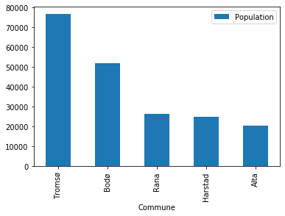
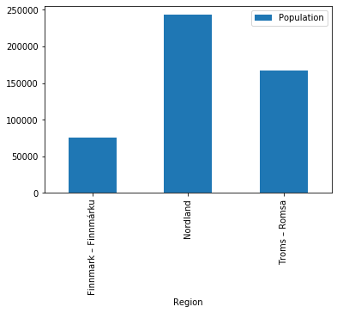
Nordland as most inhabitants
But Troms has the biggest town Tromsø!

Slide 3
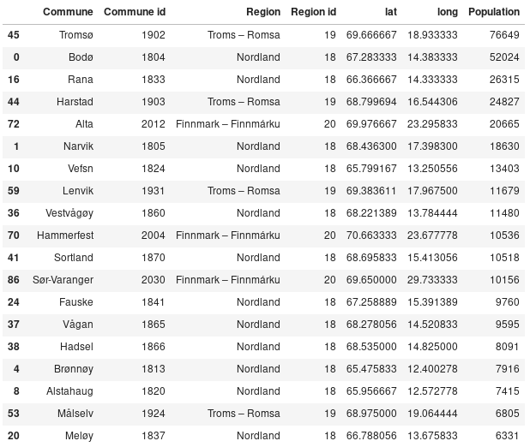
The data gathered
Most populated Communes after data gathering, cleaning and perpering.

Slide 4
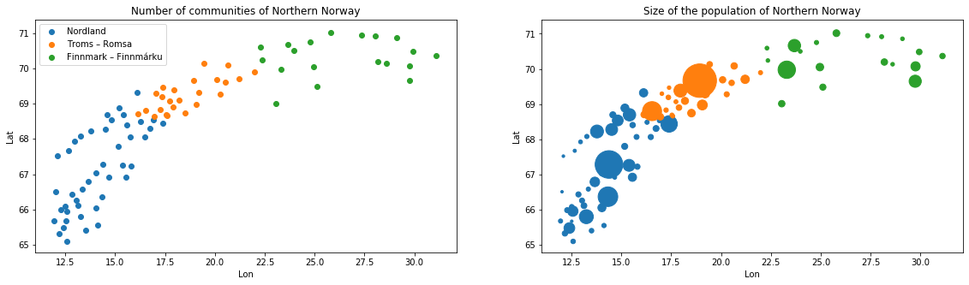
All the communities and population
The biggest region is Nordland in the south It also has the biggest communes.

Slide 5
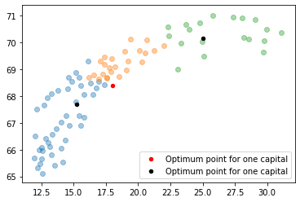
Kmean on distance only
If we a doing a Kmean messurement with one centroid, we are getting a center far from a big city (red dot).
When making two centroids we are getting one near Bodø (biggets community in Nordland) and one far north far from a big community in the north.

Slide 6
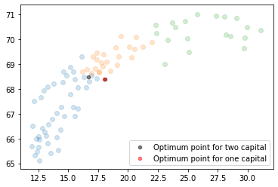
Kmean on distance and population
When adding the population the two centroids moves towards the center of the northern part.

Slide 7
Conclusion
The northern norway has few innhabitants with log distances.
It is difficult to reorginize to one region.
It is dificult to have one region, maybe it is best to have at least two.

