Slide 1
Agenda
10. continuous Integration and Deployment with AWS
11. Building a multi container Application
12. Dockerizing multiple services
13.A continuous integration workflow for Multiple images
14. Multi container deployments to AWS.

Slide 2
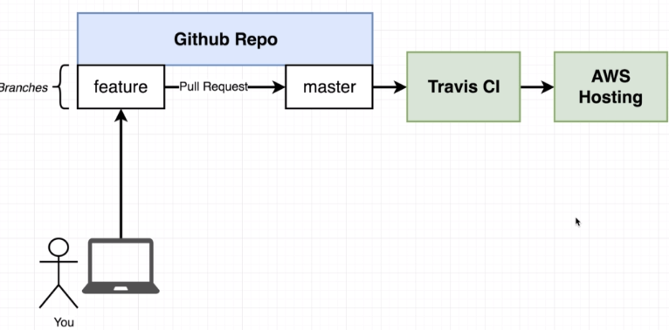
Continuous integration and deployment with AWS
This is the flow where we want to work with

Slide 3
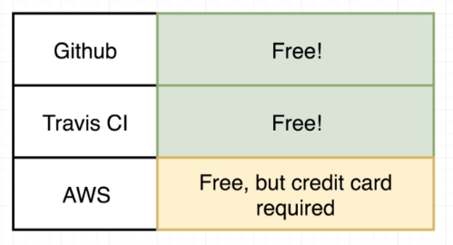
Contd..
So before setting up the below tools as part of our CI process.
Lets check the costs of each tool:
Lets understand that all Github and travis ci
All are free ware
But AWS need credit card, lets walk
through without it to some extent.
Note that we can deploy our code to AWS/google cloud /digital ocean. We chose AWS as .

Slide 4
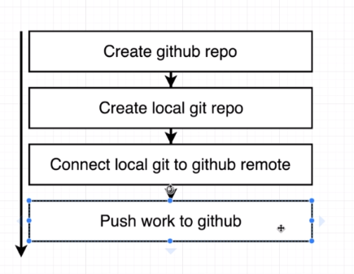
Contd..
We chose AWS, as they are one of the most popular providers for hosting.
Lets set up direct-react repository using github with the following steps

Slide 5
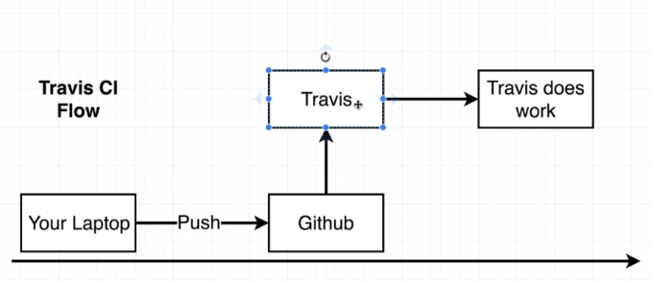
Travis CI integration with github

