Slide 1
AI-Powered Daily Routine Redesign
An energy-aware, machine-learning scheduler for a student's day
Periyannan Ratish N
B.Tech AI & Data Science, III Year | Dhanalakshmi College of Engineering
Value Added Course | October 2026
Notes:
Introduce yourself and the project: an AI system that redesigns a daily routine using energy patterns and ML predictions.

Slide 2
The problem: days are planned by habit
Hard work, wrong hours
Health slips
Generic advice
Deep work lands in low-energy evenings, after the peak has passed.
Late dinners, no exercise, 6.5 h of irregular sleep.
Productivity tips ignore your timetable, energy and trade-offs.
Goal: turn a person's task list into a better schedule, and prove the improvement with a model.
Notes:
Explain that students know what to do but not when to do it. The project builds a system to answer 'when'.

Slide 3
Approach: four stages
1
2
3
4
Input
Energy model
Optimizer
Evaluator
Tasks, durations, priority, focus level, fixed commitments, sleep
15-minute circadian curve for morning / neutral / night types
Constraint-based scheduler places work by energy and adds essentials
Gradient Boosting predicts Productivity and Wellbeing
Notes:
Walk left to right through the pipeline. Stage 4 is used to score both the original and the redesigned day.

Slide 4
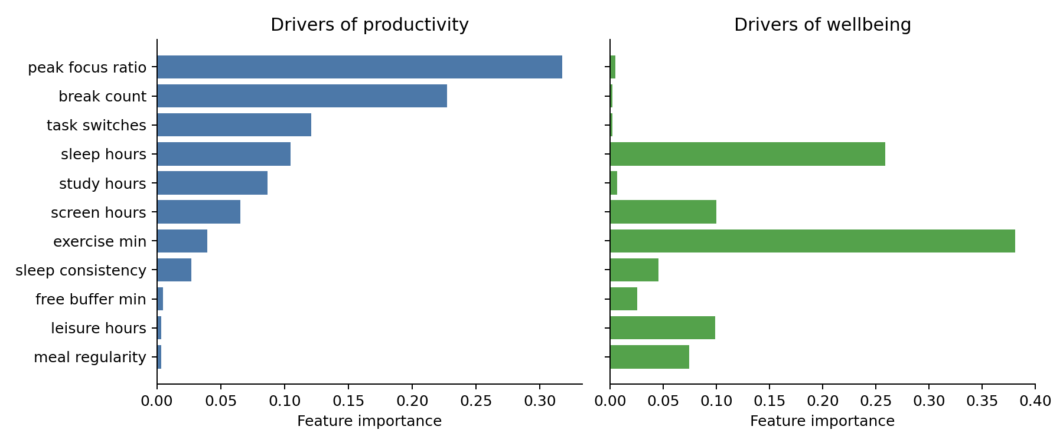
Learning what drives productivity and wellbeing
3,000 simulated daily logs, 11 features
Built from published sleep and focus findings, plus noise
Two Gradient Boosting models, 80/20 split
0.76
Productivity R²
MAE 3.1 points
Productivity: timing of focus work and breaks. Wellbeing: exercise and sleep.
0.75
Wellbeing R²
MAE 2.9 points
Notes:
Be upfront that the data is simulated from published findings. R-squared of about 0.75 is expected because noise was injected.

Slide 5
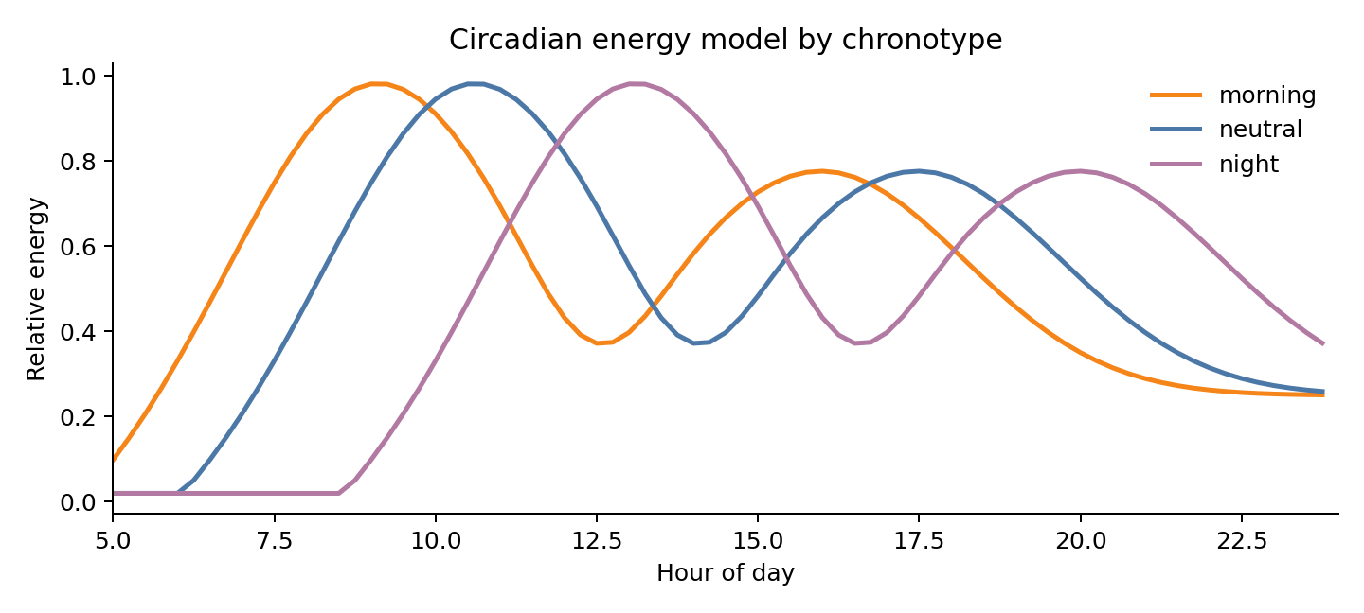
Energy model: when are you at your best?
Late-morning peak, post-lunch dip, smaller evening peak
Morning types shift 1.5 h earlier
Night types shift 2.5 h later
Deep work goes to peaks; light tasks to dips
Notes:
The curve is a template; future work personalizes it from the user's own ratings.

Slide 6
Optimizer: simple rules, clear reasons
1
Fixed tasks (lectures, commute) never move
5
Leisure only after 17:00; chores in dips
2
Missing breakfast, lunch, dinner and 30 min exercise are added
6
15-minute break after each focus block of 60 min or more
3
Meals anchored near 07:30, 13:00, 19:30
7
Tasks that do not fit are reported, not hidden
4
Hardest, highest-priority tasks pick energy peaks first
Notes:
Greedy and priority ordered: fast and explainable, though not guaranteed globally optimal.

Slide 7
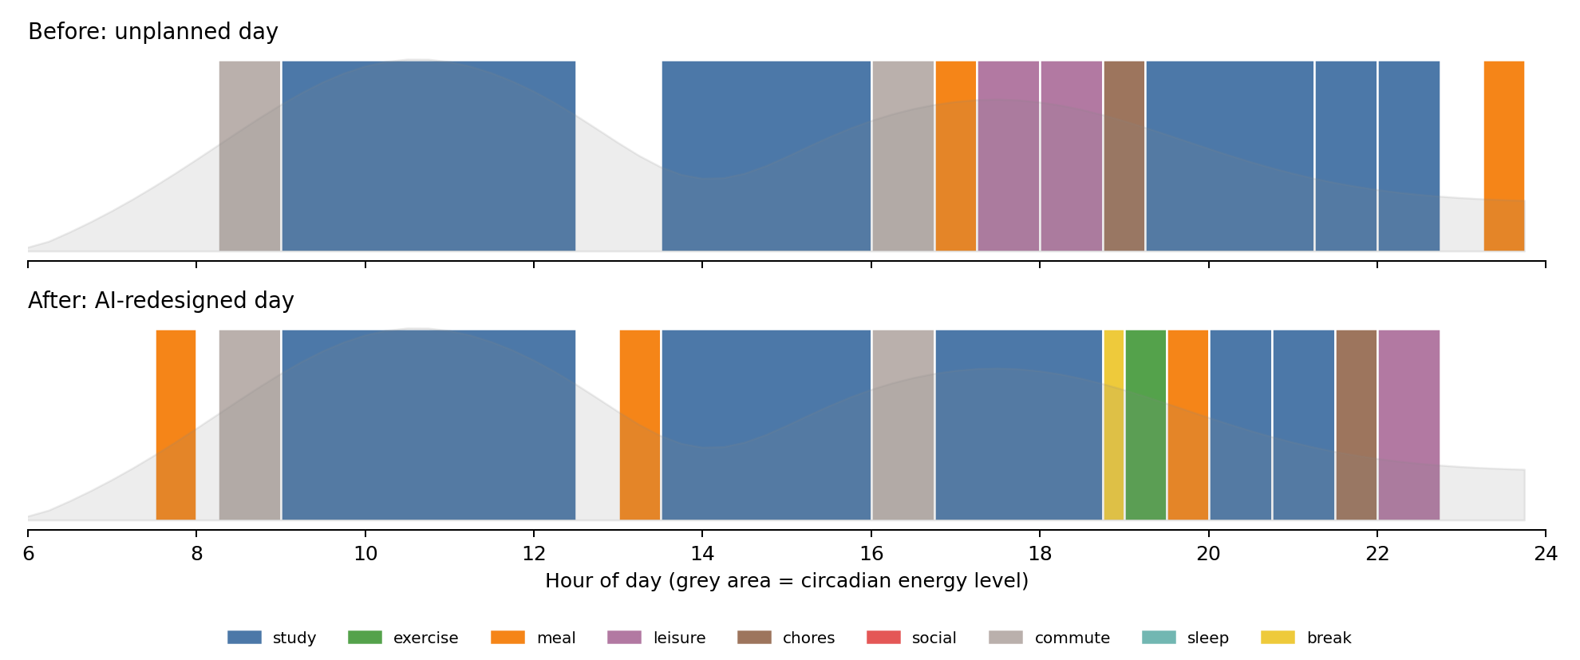
Same tasks, rearranged
Coding assignment moves to the 76% energy window at 16:45. Exercise, a break and regular meals are added; bedtime moves to 22:45.
Notes:
Point out the assignment: 19:15 to 21:15 originally, now 16:45 to 18:45. Mention the social media block was dropped to protect sleep.

Slide 8
Predicted impact
+9.1
productivity
58.2 to 67.3
+13.1
wellbeing
50.9 to 64.0
+1.25 h
sleep
6.5 h to 7.75 h
Notes:
All three chronotypes improve: productivity roughly +7 to +11, wellbeing roughly +13 to +14.

Slide 9
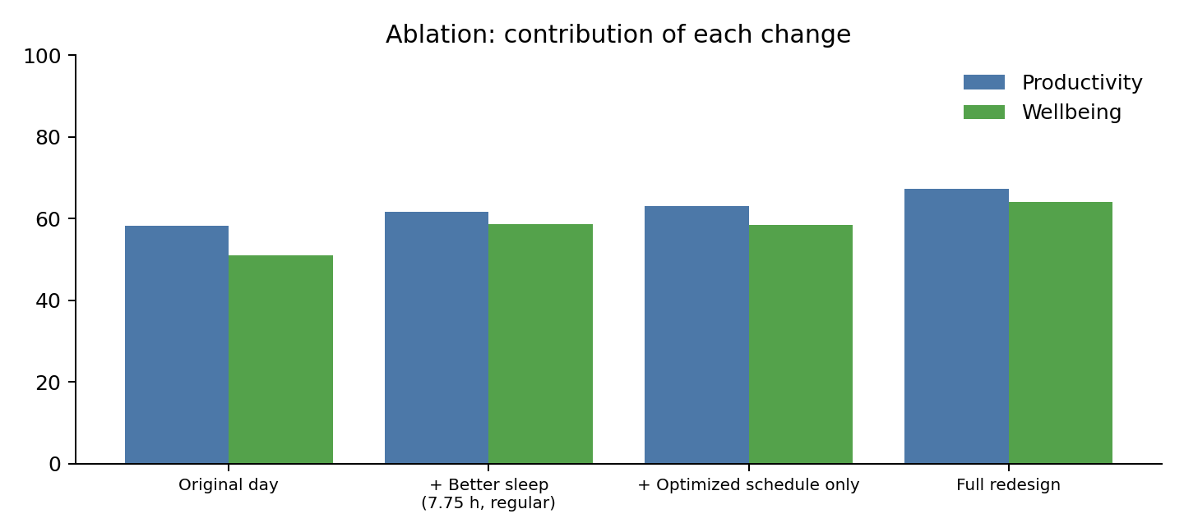
Ablation: sleep and scheduling reinforce each other
Better sleep alone: wellbeing 50.9 to 58.7
Schedule alone: productivity 58.2 to 63.1
Both together: 67.3 and 64.0
Notes:
The ablation shows each change contributes and the full redesign is best.

Slide 10
Implementation
Python 3
Streamlit app
pandas, NumPy, scikit-learn
editable task table, before/after timeline, explanations
Reproducible
Files
run_experiment.py regenerates every figure
engine.py, app.py, README, requirements
Notes:
Demo the app here: edit a task, press Redesign my day, show the timeline.

Slide 11
Limitations and future scope
Limitations
Future scope
Training data is simulated
Greedy search, one day at a time
Generic energy curve; screen time estimated
Guidance, not medical advice
Train on real, consented user data
Global search: ILP, genetic algorithm, RL
Personal energy curve from daily ratings
Calendar integration and weekly planning
Notes:
Be honest about the simulated data; it is the main limitation and the first thing to fix with real data.

Slide 12
Plan the day around your energy
Predicted +9.1 productivity and +13.1 wellbeing on a typical student day by moving deep work to peak hours, adding exercise, breaks and regular meals, and protecting sleep.
Thank you | Questions?

