Slide 1

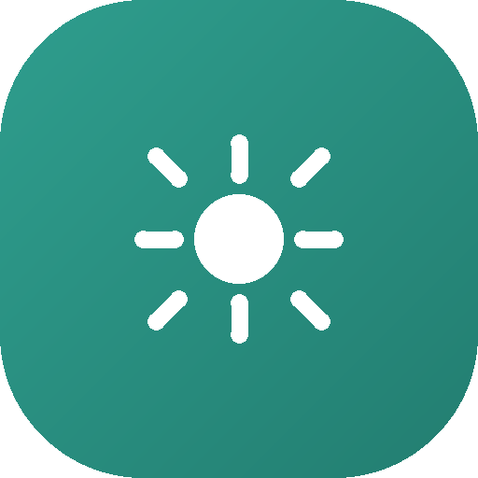
Restwise
A watch that guards sleep — instead of stealing it.
No Wi-Fi
No Bluetooth
No Notifications
National Children's Science Congress · Food, Agriculture and Health
Notes:
Open here. Restwise is a wearable for students that protects sleep. The three pills are the point of difference — it has no radios at all. Our NCSC theme is Food, Agriculture and Health, and we're taking on the Health side: student sleep.

Slide 2

THE PROBLEM
School ends at 3.
The day doesn't.
WHAT A TEENAGER NEEDS
8–9 hours
Between tuition, homework and travel, a student's day quietly stretches past midnight.
WHAT MOST STUDENTS GET
5–6 hours
Sleep is the only block in that day with no fixed start time. So it becomes the one that gets cut — every single night.
A shortfall of roughly 3 hours — repeated every school night, for years.
Restwise
2
Notes:
Point at the two bars. The gap is about three hours a night. Multiply that across a school year and it stops being a small thing.

Slide 3
WHERE THE IDEA CAME FROM
We noticed it before
we could prove it.
“
The pattern was everywhere around us — classmates falling asleep in class, skipping breakfast, carrying tuition bags into the evening.
Why is the hardest-working
student in class always
the most exhausted one?
But 'everyone seems tired' is not evidence. Before designing anything, we wanted to know how big the problem actually was.
The question that started this project.
Restwise
3
Notes:
Keep this personal — this is the story of how the idea began, not a statistic yet.

Slide 4




OUR METHOD
We didn't assume.
We asked.
What we asked them
Their real daily schedule
School, tuition, homework and travel — hour by hour.
Sleep on school nights
100+
What time they sleep, what time they wake.
Stress and its triggers
How often, and what sets it off.
school students surveyed, across
multiple classes and age groups.
Break and wind-down habits
Whether any rest is built into the day at all.
Collected on paper and online — every answer came from a real student.
Restwise
4
Notes:
Stress that this was a real survey with real students — collected both on paper and through our own website, not guessed at. Over 100 responses gives us something solid to design against.

Slide 5
WHAT WE FOUND · 01
Most students are running on empty.
7 in 10
students sleep 8 hours or
less on a school night.
Nearly 3 in 10 get less
than 5 hours on some
school nights.
Restwise
5
Notes:
This is the headline finding. Read the orange bar out loud — nearly 3 in 10 students are under five hours a night, which is genuinely alarming for a growing child.

Slide 6

WHAT WE FOUND · 02
It isn't just the hours. It's the relentlessness.
Nearly 1 in 3
More than half
Nearly 1 in 3
say they feel stressed almost every day because of school, tuition or exams.
report low or very low energy levels during the day.
never get a proper break between school, tuition and homework.
A student who never gets a break never gets to recover — so the tiredness compounds instead of resetting.
Restwise
6
Notes:
Three findings, one sentence each — stress frequency, daytime energy, and breaks. The last line is the bridge into the insight slide — no recovery time means tiredness stacks up.

Slide 7


THE INSIGHT
Students already know
they need sleep.
Nothing in their day protects it.
Awareness posters don't fix this. A schedule that actually holds the line does.
Notes:
Pause here. This is the turn in the presentation — from problem to solution. Say the second line slowly.

Slide 8

THE SOLUTION
Meet Restwise.
A low-cost smartwatch that carries one job: hold a student's day to a schedule that leaves room for sleep.
Protects sleep
Forces real breaks
No radios at all
Every schedule is checked for a full 8-hour sleep block before it can be saved.
A gentle buzz for water and rest during long stretches of study.
No Wi-Fi, no Bluetooth, no notifications. Nothing to scroll, nothing to be distracted by.
Restwise
8
Notes:
Introduce the product in one breath. Three pillars — protect sleep, force breaks, no radios. The third one is what makes it different from every other smartwatch.

Slide 9

THE DIFFERENCE
Every other smartwatch
adds one more screen.
A typical smartwatch
Giving a distracted, sleep-deprived student a device that buzzes with messages solves nothing. So we removed the radios entirely.
Constant wireless signal · notifications · games and apps · another thing to check at midnight
The watch talks to exactly one thing: a parent's computer, over a cable, when the parent chooses.
Restwise
Zero radio emission · a schedule and a clock · nothing to open, nothing to scroll, nothing to notify
Restwise
9
Notes:
This is the slide judges will ask about. The answer: a device meant to reduce distraction cannot itself be a source of distraction. Removing the radio is a design decision, not a limitation.

Slide 10



HOW IT WORKS
Three steps. Once a week.
01
02
03
The parent plans
The plan is checked
The watch is updated
A guided chat on our website builds the week around the child's real school and tuition timings.
Restwise refuses any schedule that leaves less than 8 hours of sleep, and adds water breaks automatically.
One cable, one click. The schedule is compiled and sent to the watch — then the cable comes off.
After that, the watch runs on its own — offline, all week.
Restwise
10
Notes:
Walk through left to right. Emphasise step 2 — the software will not let a parent save a schedule that starves the child of sleep. That check is the heart of the project.

Slide 11



INSIDE THE BUILD
Simple parts, carefully chosen.
ESP32 microcontroller
A single USB cable
The brain of the watch. Capable of Wi-Fi and Bluetooth — we deliberately switch both off and never use them.
The only way data reaches the watch. No pairing, no network, no chance of remote access.
Our own mini-language
Companion website
A compact binary format we designed, so a whole week's schedule fits in a few hundred bytes.
Where parents plan, review and send the schedule. Built with Python and a secure cloud database.
Every part is off-the-shelf and low-cost — this is meant to be buildable, not theoretical.
Restwise
11
Notes:
If asked why ESP32 when we don't use its radio: it's cheap, widely available, low power, and easy for students to work with. Turning the radio off costs us nothing.

Slide 12
THE COMPANION APP
Built for a parent
who has five minutes.
A guided plan, in plain language
No settings to learn and no jargon. A parent answers a few plain questions about their child's week, and the schedule builds itself.
An automatic sleep-safety check
Water breaks added for you
If the plan risks the child's sleep, the app says so — before anything reaches the watch.
A weekly timetable you can edit
One-click update to the watch
Restwise
12
Notes:
Keep this short. The message is that the parent does almost nothing — the app does the thinking and the checking.

Slide 13

WHY IT MATTERS
Sleep is the cheapest health
intervention we have.
It costs nothing
It protects everything else
It can reach every home
Unlike supplements, tutors or clinics, protected sleep is free. It only needs to be scheduled and defended.
Memory, mood, immunity, appetite and concentration all depend on it — the whole health theme in one habit.
Built from low-cost parts, with no subscription and no internet needed on the child's side.
Food, Agriculture and Health — this is the health of the child who has to sit through the school day.
Restwise
13
Notes:
Tie it back to the NCSC theme explicitly here — the judges are listening for that connection.

Slide 14
WHAT'S NEXT
From prototype to wrist.
Now
Next
Then
Later
Working prototype
Trial with real families
A gentler wake-up
A school edition
The watch, the protocol and the parent website are built and running end to end.
Put it on wrists for a month and measure whether sleep actually improves.
Wake the child at a light point in their sleep, not mid-dream.
One dashboard for a class, so a school can see the pattern and act on it.
The prototype works today. The next step is proving it changes behaviour.
Restwise
14
Notes:
Be honest here — the prototype is real, the trial is the next milestone.

Slide 15
Restwise
Protect the sleep,
and the rest follows.
Thank you.
National Children's Science Congress · Food, Agriculture and Health
Notes:
Close on the line, then open for questions.

