Slide 1
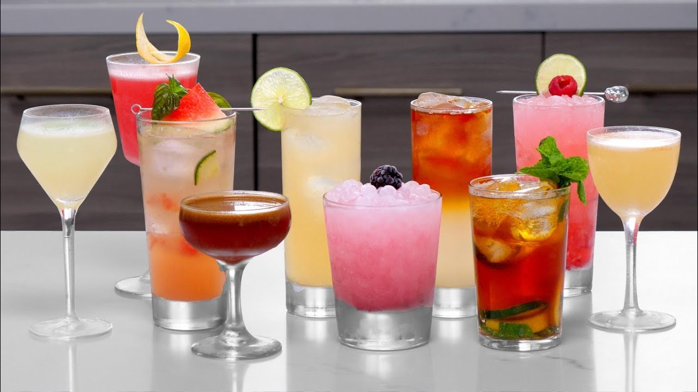
COCKTAILS
A NUTRITIONAL APPROACH

Slide 2
INTRODUCTION
Nutritional approach
Based on data coming from IBA (International Bartenders Association)
Journey: data analysis using different sources mixing DA techniques as web scrapping / API
Aim: Nutritional impact of cocktails

Slide 3
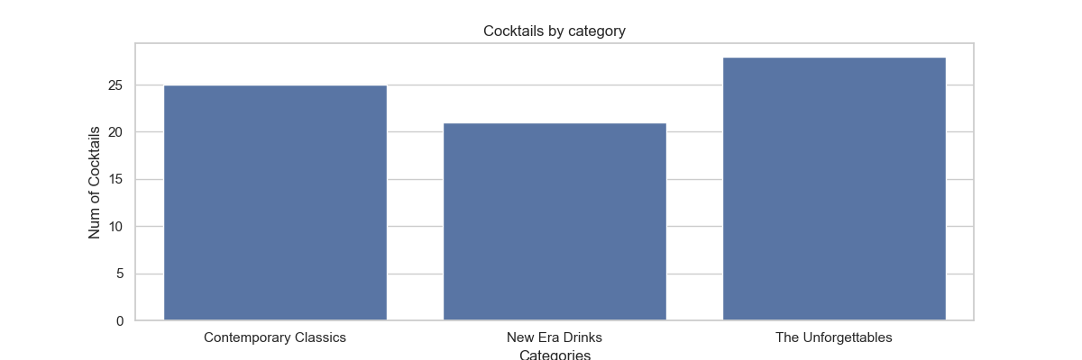
Classification
IBA has defined 3 categories to group all official cocktails:
Contemporary Classics
New Era Drinks
The Unforgettables

Slide 4
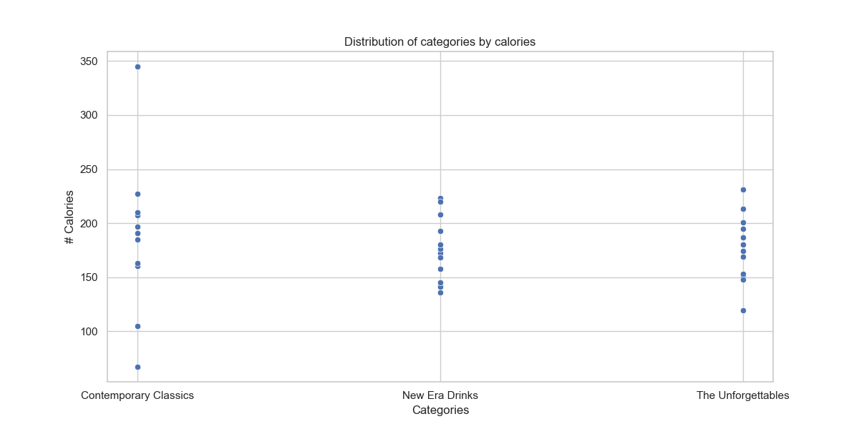
Nutritional approach by category
All cocktails seems to be well balanced around similar caloric range in every category

Slide 5
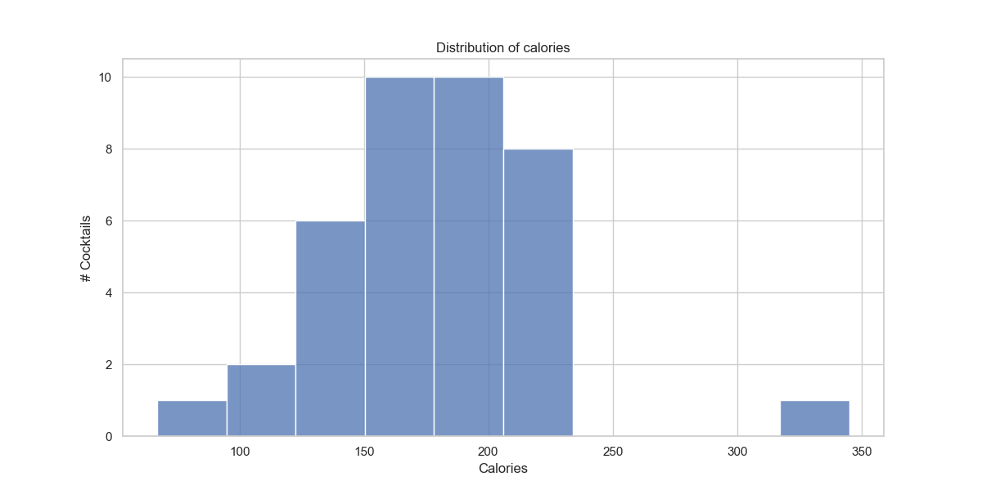
Nutritional approach by calories
Most of cocktails are grouped between 150 to 200 calories

Slide 6
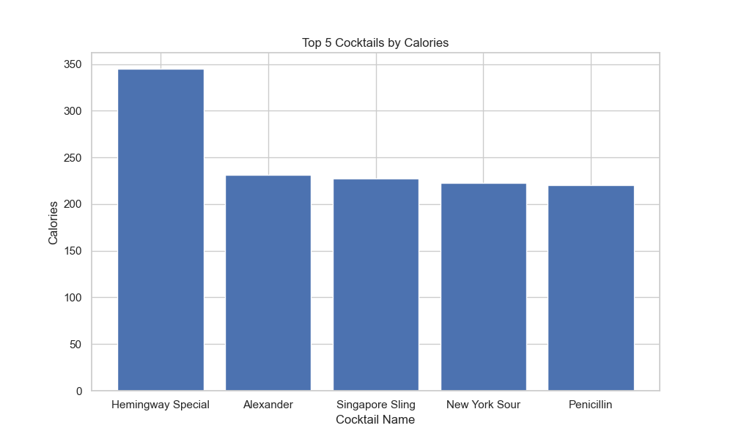
Top 5 caloric cocktails
There is a cocktail hypercaloric, Hemingway Special, made with Gold Rum, Pink grapefruit juice, Luxardo Maraschino liqueur, Lime juice (freshly squeezed) , Sugar syrup 'rich'

Slide 7
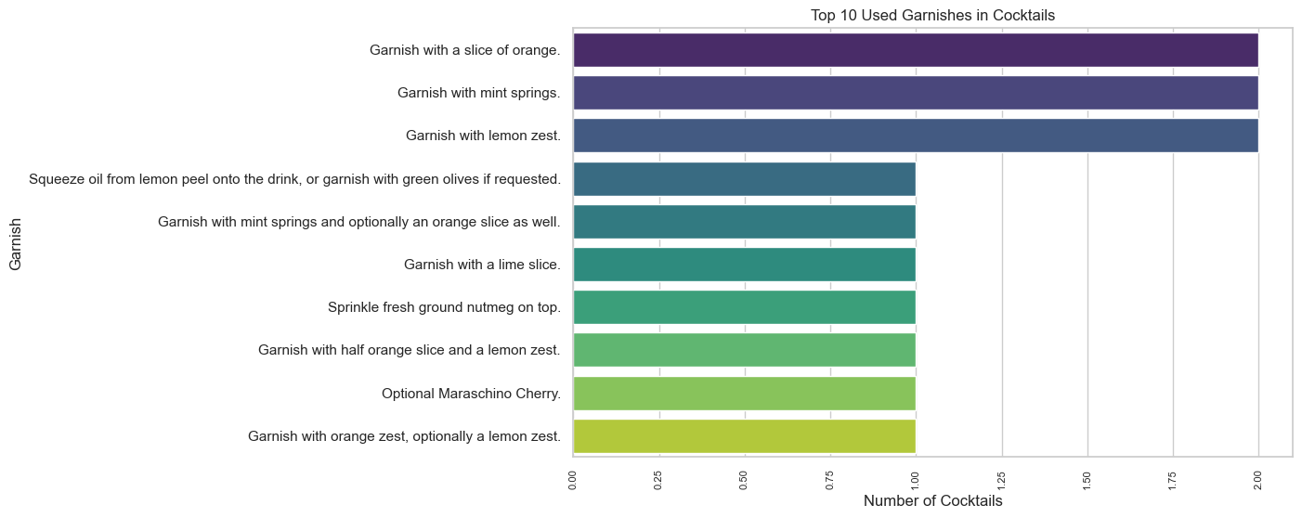
Top 10 Garnish
Garnish are part of caloric cocktail. Some garnish has high caloric level (e.g. olives)
There are 3 main garnishes used in our list: Orange slice, mint springs and lemon zest.

Slide 8
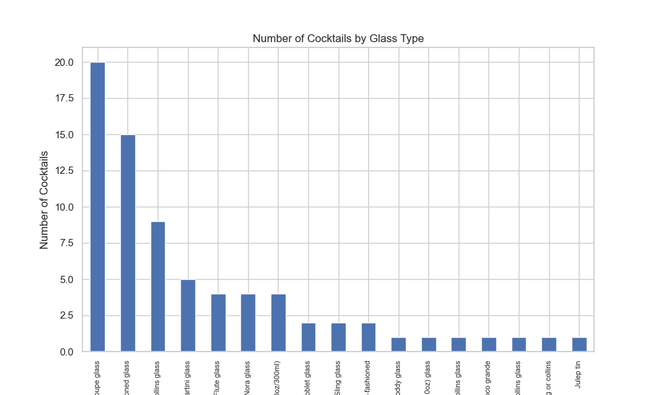
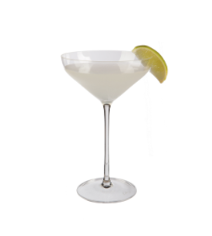
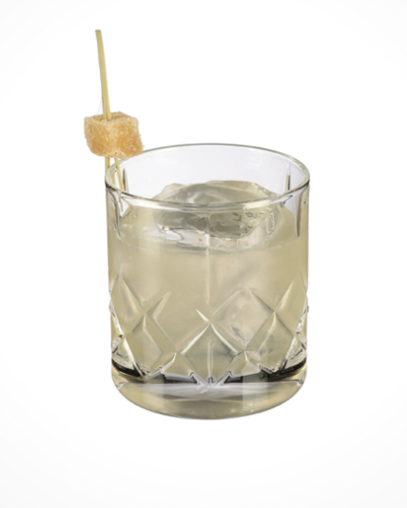
And...which glass?
There are many types of glasses to serve a cocktail, but Coupe Glass and Old-fashioned glass are most common
Coupe Glass
Old-Fashioned Glass

Slide 9
Conclusions
There is a large list of Cocktails but they are moving around same nutritional level.
Sometimes garnish can be more caloric than cocktail itself.
All parts are relevant in any cocktail: e.g. many glass types.

Slide 10

THANKS!

