Slide 1
Protocol Criticims of Internet: IPFS & Scuttlebutt
Pierre Depaz – THALIM / Paris-3
1/38

Slide 2
Protocols refer specifically to standards governing the implementation of specific technologies. Like their diplomatic predecessors, computer protocols establish the essential points necessary to enact an agreed-upon standard of action.
Alexander Galloway, Protocol: How Control Exists After Decentralization, University of Chicago Press, 2004.
2/38

Slide 3

Gupta, Harsh. “(Lack Of) Representation of Non Western World in Process of Creation of Web Standards.” ArXiv:1609.01996 [Cs], August 29, 2016. http://arxiv.org/abs/1609.01996.
3/38

Slide 4
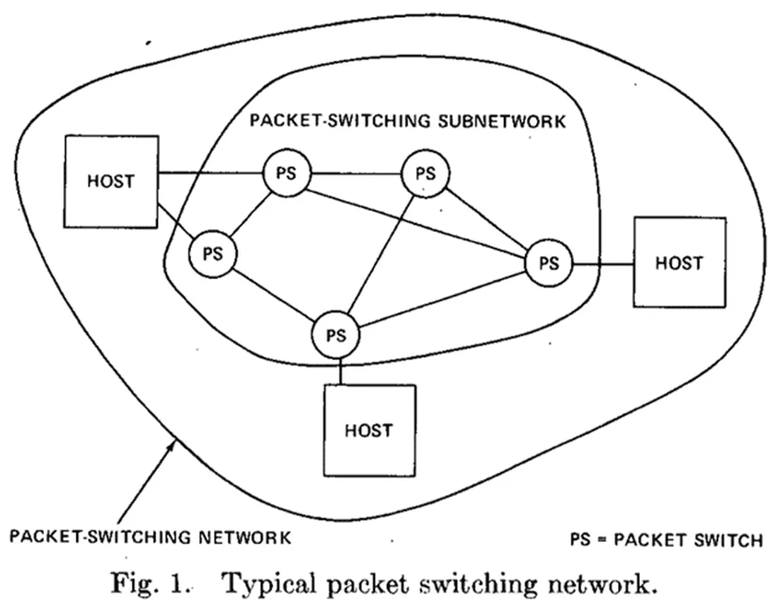
HTTP - FTP - DNS – SSH - ...
TCP - UDP - ...
IP
LAN - CAT 5 - ...
Vinton G. Cerf, A Protocol for Packet Network Intercommunication, 1974
4/38

Slide 5
The web and the internet are shaped by technical, legal, social and market influences.
The core technical component are protocols.
5/38

Slide 6
Discursive criticism (e.g. M. Padlipsky, A Critique of x25, RFC 874, 1982)
Legal criticism (e.g. GPL, CC)
Programming criticism (e.g. uBlock Origin, Sci-Hub, Consent-O-Matic)
6/38

Slide 7
Case studies
InterPlanetary File System (IPFS)
2014, Protocol Labs, 80,000 nodes in 2019.
Secure Scuttlebutt (SSB)
2014, Secure Scuttlebutt Consortium, 10,000 nodes in 2019.
7/38

Slide 8
To what extent do technical components influence the presentation and implementation of new means of information exchange?
8/38

Slide 9
Approaches
Technical analysis – close-reading of the protocol
Discourse analysis – representation of the idea
Implementation analysis – practical applications
9/38

Slide 10
IPFS

Slide 11
IPFS - Protocol
“IPFS is similar to the Web, but IPFS could be seen as a single BitTorrent swarm, exchanging objects within one Git repository. In other words, IPFS provides a high through-put content-
addressed block storage model, with content-addressed hyperlinks. This forms a generalized Merkle DAG, a data structure upon which one can build versioned file systems, blockchains,
and even a Permanent Web.”
- Juan Benet, Content-Addressed, Versioned, P2P Filesystem, 2014
11/38

Slide 12
IPFS - Protocol
→ disappearance of content (error 404)
→ waste of bandwidth
→ centralization of services
12/38

Slide 13
IPFS - Protocol
Cryptographically-backed content organization
- Distributed Hash Tables (where to find things)
- BitSwap exchange (how to get them)
- Merkle DAG (how to connect them)
- Public Key Infrastructure (how to identify them)
13/38

Slide 14
IPFS - Protocol
→ the constant availability and immutability of content
→ efficiency measured as throughput (vs. client/server architecture)
14/38

Slide 15
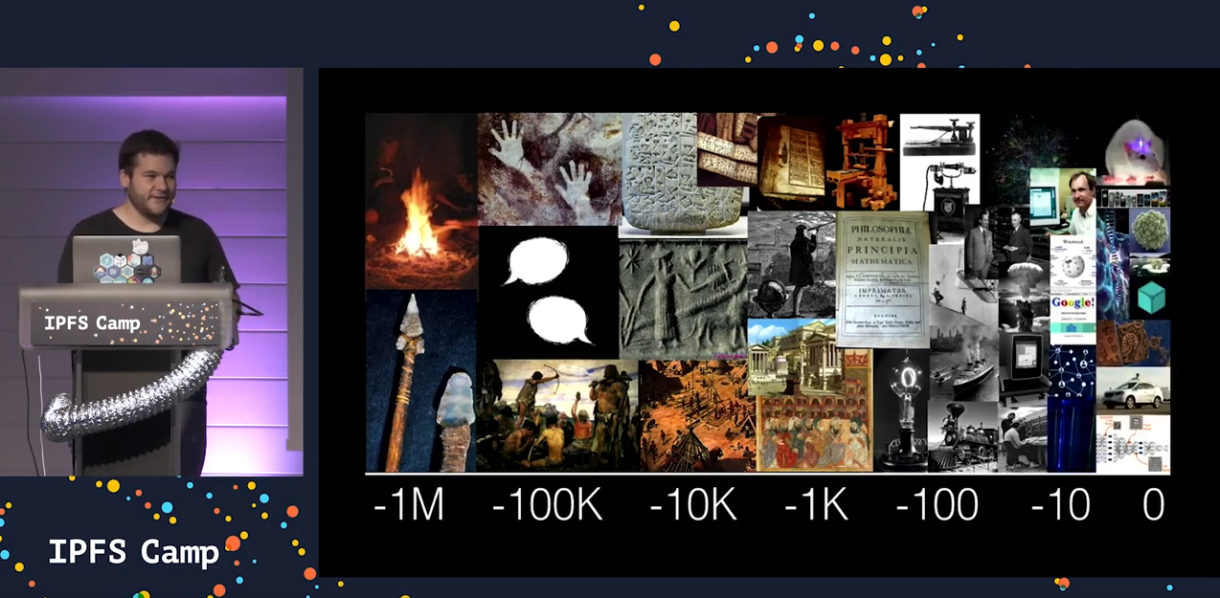
IPFS - Discourses
→ teleology (“Building the next generation of the internet”)
→ decentralization (“Powers the distributed web”)
IPFS Camp, 2019
15/38

Slide 16
IPFS - Discourses
“The IPFS is not just a theoretical or academic experiment. It is a working software system (although still in alpha) that can be downloaded and switched on right now.”
- Tony Willenber, IPFS advocate, 2016.
16/38

Slide 17
IPFS - Applications
→ bitswap and filecoin (raised over $200M in ICOs)
→ backbone for blockchain and decentralized applications (opensea storage)
→ high-speed content delivery (Netflix CDN)
17/38

Slide 18
IPFS - Applications
-> backing up https://archive.org (2015)
-> circumventing censorship on https://tr.wikipedia.org (2017)
18/38
Notes:
https://news.ycombinator.com/item?id=9148576

Slide 19
IPFS - Discourses
”If you don’t pin your content to IPFS, it goes bye-bye. And if the server pinning your resources ever goes offline and no one else has it pinned, it’s gone forever. [...] So you still end up with a centralized business framework even if the technology itself is decentralized, in that, if you don’t have the means to provide your own distributed infrastructure, you’re going to have to pay someone who does.”
-@selfagency
19/38

Slide 20
IPFS - Discourses
Every single file that could exist on IPFS has the potential to offend someone. -@geebotron
It is not my intention to start a political philosophy discussion—but rather only to articulate the design space and why IPFS falls in a particular set of decisions. If the issue gets more off topic, i’ll just close it, or rename it. -@jbenet
20/38

Slide 21
IPFS
The protocol focuses on the constant, ubiquitous availability of the object.
The discourse is a teleological and deterministic approach to technology.
The current applications are still limited, as they remain entangled with centralization and deletion.
21/38

Slide 22
SSB

Slide 23
SSB - Protocol
“SSB has become a stable service for over 10,000 users offering them rich media community applications with strong cryptographic protection (end-to-end encryption and metadata privacy) and running in pure peer-to-peer mode.”
- Dominic Tarr et. al., Secure Scuttlebutt: An Identity-Centric Protocol for Subjective and Decentralized Applications, 2019
23/38

Slide 24
SSB - Protocol
→ a centralized authority
→ being online as a necessary requirement to operate
24/38

Slide 25
SSB - Protocol
→ local encryption of user identity
→ UDP WLAN broadcasting
→ message feeds as a log chain
25/38

Slide 26
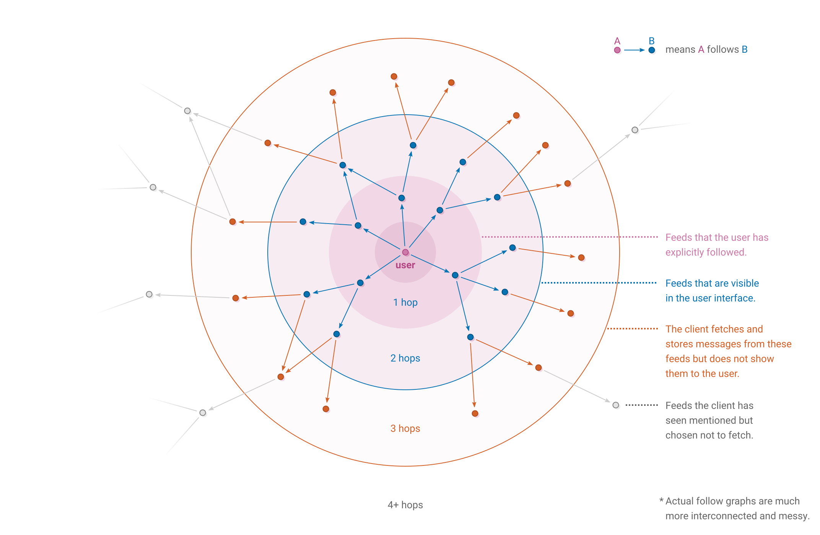
SSB - Protocol
26/38

Slide 27
SSB - Discourses
Embedding technology and community
“Scuttlebutt aims to harmonize four perspectives of life: Environment reflecting Technology reflecting Community reflecting Society.
We acknowledge the natural, the virtual, and the social environments. Our responsibility is to recognize which resources are abundant, which are sufficient, and adapt accordingly through efficiency.”
SSB documentation front-page, 2019
27/38

Slide 28
SSB - Discourses
Locality
We use local-first publishing so that each person owns their words and actions.
- Scuttlebutt documentation homepage, 2019
The group is following a new and interesting volunteer coordination model, the Village Issue Tracker, in which each volunteer commits to a limited but significant time per week and are assigned packages to review.
- Scuttlebutt newsletter #1, 2019
28/38

Slide 29
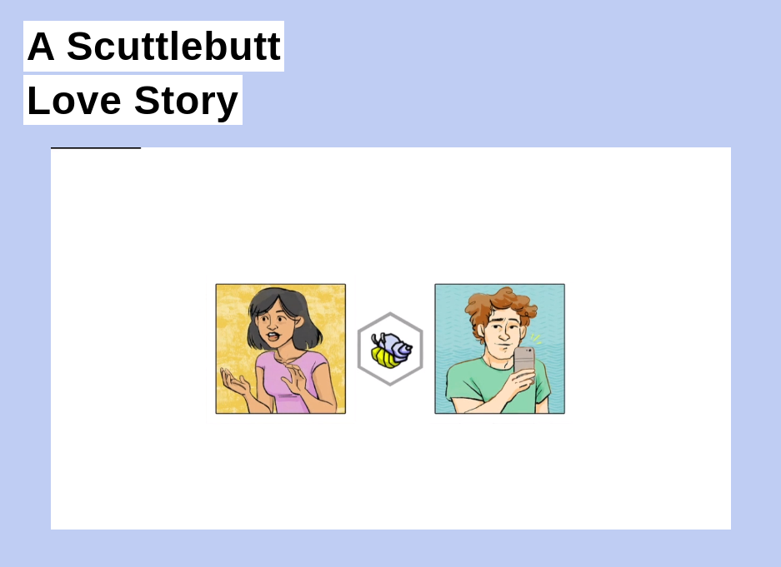
SSB - Discourses
Secondary technology
“You are comforted by the simplicity of this interaction, but also by something deeper. The message you sent was on an encrypted channel, readable only by Sol. This map is one that only your friends have access to, which is why they're comfortable sharing their location. […] Your technology feels as intimate as your dinner party, because y'all built the whole thing yourself.”
- Zach Mandeville, The Future Will Be Technical, 2016.
29/38

Slide 30
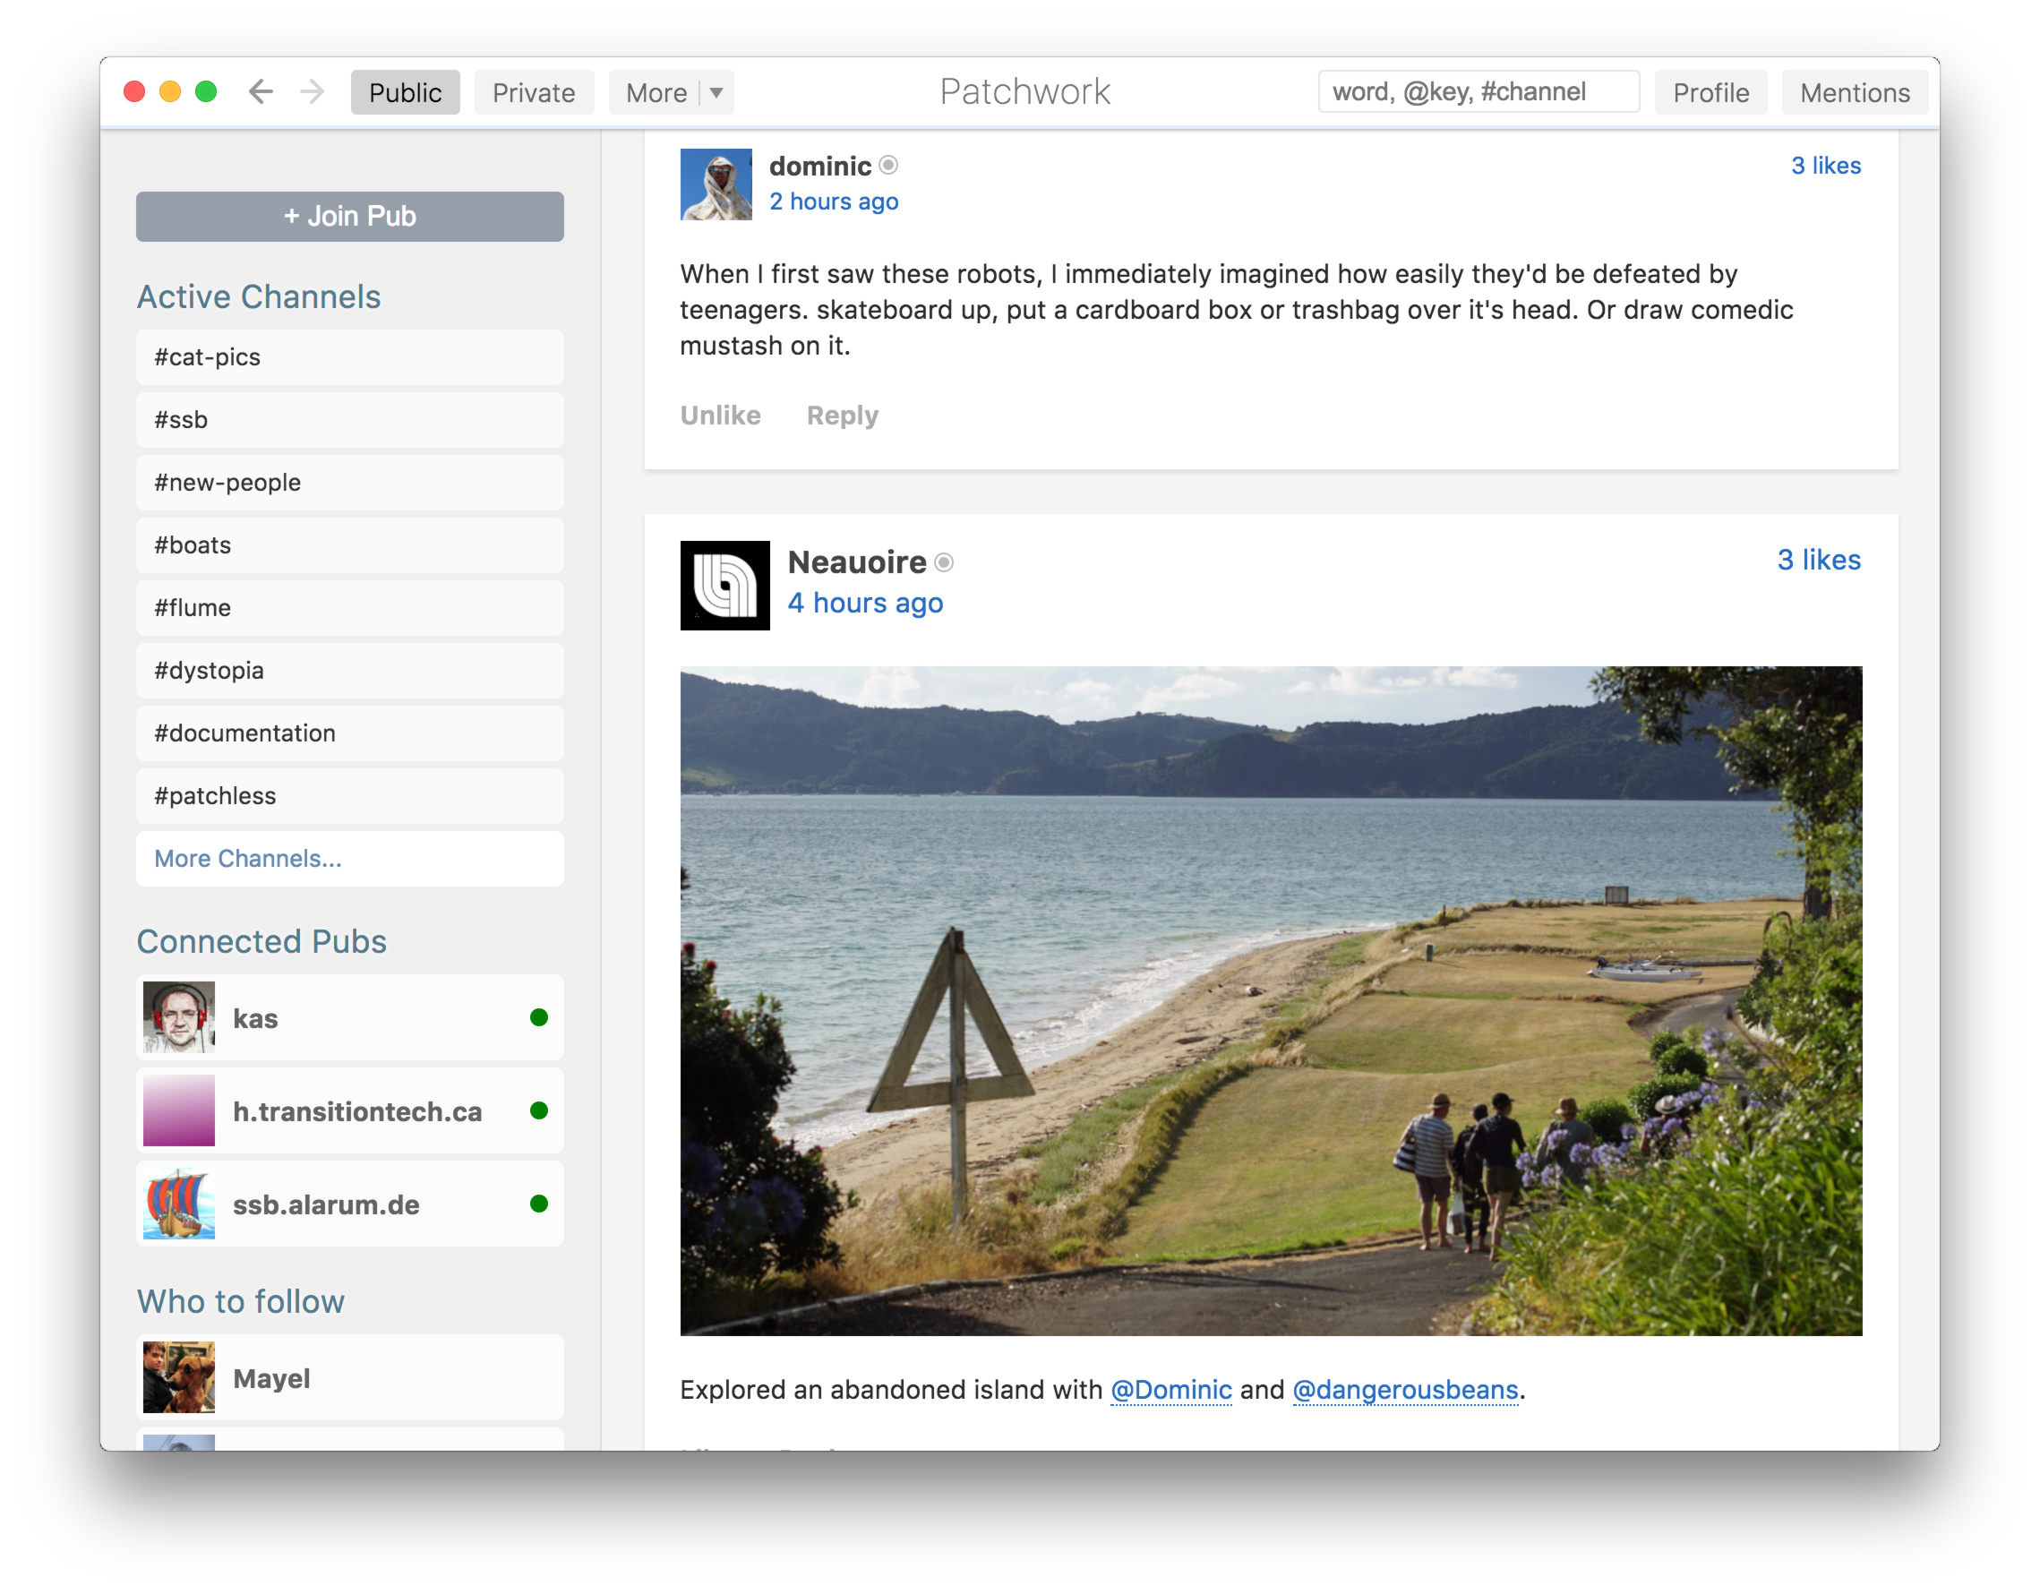
SSB - Applications
→ first a social network
→ then an infrastructure
30/38

Slide 31

SSB - Applications
Scuttleverse
The integration of SSB with the fediverse, the federated set of interoperable, decentralized platforms.
31/38

Slide 32
SSB
A focus on the subject, rather than the object.
A storytelling about the process, rather than the ends.
A restricted set of applications, but similar deletion issues.
32/38
Notes:
https://github.com/ssbc/patchwork/issues/815

Slide 33
Conclusion

Slide 34
The append-only log is a core technology for both protocols.
The difference is in the application domain.
34/38

Slide 35
Each protocol has their own concepts of
time, both permanent and similar issues faced.
space, between a ubiquitous filesystem to a local broadcast,
agents, between an object-oriented protocol and a subject-oriented one.
35/38

Slide 36
The technology seems to lead to similar issues of deleting content. IPFS proposes a technological solution, SSB a social one.
The presentation and narratives seems to affect the scope of applications and the resolution of issues.
36/38

Slide 37
Cultural context and practices influence a project along a particular gradient, but do not overcome shared technical difficulties.
What are the other cultural context of protocol criticisms (e.g. GNUnet/Mastodon)?
37/38

Slide 38
References
Roy T. Fielding and Julian Reschke. Hypertext Transfer Protocol (HTTP/1.1): Message Syntax and Routing. Request for Comments RFC 7230, Internet Engineering Task Force, June 2014. Num Pages: 89.
Lawrence Lessig. Code and Other Laws of Cyberspace. Basic Books, Inc., USA, 1999.
Dominique Cardon. Culture numérique. Presses de SciencesPo, March 2019.
Harsh Gupta. (Lack Of) Representation of Non Western World in process of creation of Web standards. arXiv:1609.01996 [cs], August 2016. arXiv: 1609.01996 version: 1.
Niva Elkin-Koren. Creative Commons: A Skeptical View of a Worthy Pursuit. SSRN Scholarly Paper ID 885466, Social Science Research Network, Rochester, NY, February 2006.
Rohit Gupta and Rohit Panda. Block the blocker: Studying the effects of Anti Ad-blocking. arXiv:2001.09434 [cs], January 2020. arXiv: 2001.09434.
Critical Art Ensemble. Electronic Civil Disobedience & Other Unpopular Ideas, 1996.
Alexander R. Galloway. Protocol: How Control Exists after Decentralization. Leonardo. MIT Press, Cambridge, MA, USA, February 2004.
Ian Bogost. Persuasive Games: The Expressive Power of Videogames. MIT Press, August 2010. Google-Books-ID: uLdNEAAAQBAJ.
Dianna R. Mullet. A General Critical Discourse Analysis Framework for Educational Research. Journal of Advanced Academics, 29(2):116–142, May 2018. Publisher: SAGE Publications
Juan Benet. IPFS - Content Addressed, Versioned, P2P File System. arXiv:1407.3561 [cs], July 2014. arXiv: 1407.3561.
Sebastian Henningsen, Martin Florian, Sebastian Rust, and Björn Scheuermann. Mapping the Interplanetary Filesystem. arXiv:2002.07747 [cs], February 2020. arXiv: 2002.07747.
Protocol Labs. History | IPFS Docs.
Tim Berners-Lee. One Small Step for the Web..., 2018.
Protocol Labs. Bitswap | IPFS Docs, 2019.
Protocol Labs. Filecoin: A Cryptocurrency Operated File Storage Network. Self-published, Protocol Labs, 2014.
Tony Willenberg. IPFS: The Internet Democratised, May 2018.
Juan Benet. Editing/deletion of content and power dynamics - Help / Old FAQ, May 2017.
Zenna Fiscella. 35C3 - Scuttlebutt, December 2018.
Web3 Foundation. Secure Scuttlebutt Peer to Peer Infrastructure by Dominic Tarr at Web3 Summit 2019, September 2019.
Zach Mandeville. A Scuttlebutt Love Story.
Scuttlebutt, scuttlebutt.nz
Scuttlebutt Protocol Guide, dev.scuttlebutt.nz
Dominic Tarr, et. al.. Secure Scuttlebutt: An Identity-Centric Protocol for Subjective and Decentralized Applications. In Proceedings of the 6th ACM Conference on Information-Centric Networking, ICN ’19, pages 1–11, New York, NY, USA, September 2019.
Zach Mandeville. The Future Will be Technical.
38/38

