Slide 1
The role of aesthetics
in understanding source code
Pierre Depaz
Paris-3 Sorbonne Nouvelle
20.12.2023

Slide 2
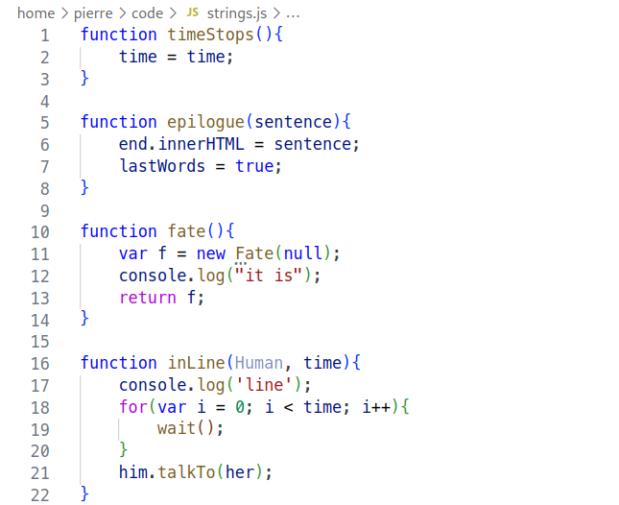

Slide 3
Early questions
What are the conditions of appreciation of source code?
Notes:
Since the static text gets translated into (human)-unreadable signs and ultimately into a dynamic system, it both means the text becomes meaningless at some point and that it had some meaning at some point. Is it only for programmers? Does the quality of such text ever transpire beyond compilation/interpretation?
It quickly becomes clear that it’s mostly programmers who care about how code is written. Could this be narrowed down further?
For instance, there seems to be a good amount of code poetry circulating online, but I was not able to find code novels, going beyond 50+ lines. Why is that? Why can one write code poems but not code books? Where is the line between text-as-machine-language and text-as-prose?

Slide 4
State of the art
Only a subset of digital humanities includes examples of source code (Montfort et. al., XXX; Marino, XXX; Paloque-Bergès, XXX)
There are practical mentions of beauty in code (Kernighan, XXX; Knuth, XXX; Oram & Wilson, XXX)
Notes:
So I started to look into more stuff
List the overview of the lit review, with a highlight on few things, mostly about not showing the code, and varieties of sources but no direction connection/overlap/coherence
On one side, however, there were a lot of different practical opinions and discussions online on the existence of beautiful code, but this was rather disparate and not so comprehensive
Also this cognitive psychology study that said that code is not so much text
At this point, though, we need to check what is it exactly that we are talking about?

Slide 5
What are we talking about?

Slide 6
Definition of source code
Notes:
Definition of source code
Textuality, human-machine, actionable, root of software
Explain what are the implications of this definition for the rest of the work/its direction

Slide 7
Definition of aesthetics
Notes:
Short definition focused on appearance, formal manifestation
But also involve experience and judgment
And make a point about the “everyday aesthetics” and the “nice vs. beautiful”

Slide 8
More refined questions
Notes:
Here we show our research questions, and we develop a bit more on each of them

Slide 9
empirically
Notes:
Pragmatic discourse analysis: assume everyone talks about the same thing: writing nice code
Then describe the terrain a little bit (which texts, when and how)

Slide 10
theoretically
Notes:
But once I had this empirical data, I also had to make sense of it from a theoretical perspective: how come aesthetics help figuring things out?
Here it’s mostly Goodman, with his padawan, and there’s a further aspect I would have liked to get more into is the relationship between aesthetics and technics in simondon

Slide 11
FIRST FINDING
There multiple aesthetics, as there are multiple practices
Aka different people find different things nice
Notes:
List out all the different contexts which can affect aesthetic judgment (professional, intent, language, domain)

Slide 12
SECOND FINDING
Aesthetics are related to cognition and understanding
Notes:
This is the part that gave the thesis its title. There are few ways one can have an aesthetic experience: value, emotion, cognition. Clearly here it’s cognition
But how come??? how does that actually, practically happen?

Slide 13
Multiple aesthetics, one common point?
There are different references (arch, math, etc.) but similar adjectives
So there has got to be an overlap
Notes:
Dive into more details of the result of the Discourse Analysis, show some tables.

Slide 14
THIRD FINDING
Having to deal with multiple things
Machine, domain, humans
Notes:
Could this be two slides?
Could there be a nice graphic?

Slide 15
FOURTH FINDING
Enabling navigation
Structure of the text
Notes:
Also the impact of the tools on navigation

Slide 16
SUMMARY/TRANSITION
This is what we have found so far, what does it actually mean for the rest of the world?

Slide 17
IMPLICATION #1
Contextualizing aesthetics

Slide 18
IMPLICATION #2
The mutual dependence of function and form

Slide 19
IMPLICATION #3
The structure of digital texts

Slide 20
IMPLICATION #4
The point of view of the computer

Slide 21
Conclusion and thanks

Slide 22
EXTRA: Mental models

Slide 23
Extra: epistemic actions

Slide 24
Extra: function of a program

Slide 25
Code examples
I should put a lot of the listings around here, to potentially serve as support for discussions

