Slide 1
INTRODUCTION TO ECONOMICS II · 26-2
Exam 2 Review
Ch29 The Monetary System
Ch30 Money Growth and Inflation
Ch33 Aggregate Demand and Aggregate Supply
Ch28 Unemployment

Slide 2
CHAPTER 29
The Monetary System
Multiple Choice
7 Bank T-Account
13 Currency Holding · Reserves
14 Excess Reserves · Loans
15 Bank Balance Sheet · Loans
Short Answer
5 Money Multiplier
6 Leverage · Bank Capital
10 Money Multiplier · Reserve Requirement
11 Open-Market Operations
2

Slide 3
Ch29 Application MC 14 · Excess Reserves
14. People hold $400 million of bank deposits but no currency. Banks have made $380 million dollars of loans and only hold enough reserves to satisfy reserve requirements. Because of uncertainty, banks choose to hold $10 million more in reserves. The Fed takes no action. What happens to bank loans?
a. they fall $220 million
b. they fall $200 million
c. they rise $200 million
d. they rise $220 million
Money Multiplier Stays;
r = 20/400 = 0.05(5%)
1/r = 20
Deposit changes by 10:
−$10 × 20 = −$200
3

Slide 4
Ch29 Application Short Answer 10 · Money Multiplier · Reserve Requirement
10. Assume that the banking system has total reserves of $100 billion. Assume also that required reserves are 10 percent of checking deposits and that banks hold no excess reserves and households hold no currency.
a. What is the money multiplier? What is the money supply?
b. If the Fed now raises required reserves to 20 percent of deposits, what are the change in reserves and the change in the money supply?
Money Multiplier Changes
1/0.1 = 10 → 1/0.2 = 5
4

Slide 5
M1: Currency(지폐), Demand deposit, etc
M2: M1 + Saving deposits, etc
Ch29 Application Short Answer 5 · Money Multiplier
5. You take $100 you had kept under your mattress and deposit it in your bank account. If this $100 stays in the banking system as reserves and if banks hold reserves equal to 10 percent of deposits, by how much does the total amount of deposits in the banking system increase? By how much does the money supply increase?
Money Supply
= Currency + Demand Deposits
$100 already in the money supply.
Deposit + 100 : $100 × 1/10 = $1,000
Money supply increase by $900
(+$1,000 if $100 is 본원통화)
시장의 통화량에 영향을 주는 것:
Monetary Policy(reserve requirements, OMO)
5

Slide 6
Ch29 Application Short Answer 11 · Open-Market Operations
11. Assume that the reserve requirement is 20 percent. Also, assume that banks do not hold excess reserves and there is no cash held by the public. The Fed decides that it wants to expand the money supply by $40 million.
a. If the Fed is using open-market operations, will it buy or sell bonds?
b. What quantity of bonds does the Fed need to buy or sell to accomplish the goal? Explain your reasoning.
Open-Market Operation:
본원통화(M0) 조절 수단
1/0.2 × 본원통화 = $40
6

Slide 7
Ch29 Application MC 15 · Bank Balance Sheet · Loans
Scenario 29-1
The monetary policy of Namdian is determined by the Namdian Central Bank. The local currency is the dia. Namdian banks collectively hold 100 million dias of required reserves, 25 million dias of excess reserves, 250 million dias of Namdian Treasury Bonds, and their customers hold 1,000 million dias of deposits. Namdians prefer to use only demand deposits and so the money supply consists of demand deposits.
15. Refer to Scenario 29-1. Assuming the only other item Namdian banks have on their balance sheets is loans, what is the value of existing loans made by Namdian banks?
a. 625 million dias
b. 875 million dias
c. 1,125 million dias
d. None of the above is correct.
Assets
Liabilities
Required reserves
Excess reserves
Loans
Treasury bonds
Deposits
Bank Capital
7

Slide 8
Ch29 Application Short Answer 6 · Leverage · Bank Capital Advanced
6. Happy bank starts with $200 in bank capital. It then accepts $800 in deposits. It keeps 12.5 percent (1/8th) of deposits in reserve. It uses the rest of its assets to make bank loans.
a. Show the balance sheet of Happy bank.
b. What is Happy Bank’s leverage ratio?
c. Suppose that 10 percent of the borrowers from Happy Bank default and these bank loans become worthless. Show the bank’s new balance sheet.
d. By what percentage do the bank’s total assets decline? By what percentage does the bank’s capital decline? Which change is larger? Why?
Assets
Liabilities
100
Reserves
Loans
Treasury bonds
Deposits
800
Asset / Capital
900
=1000/200 = 5
Bank Capital
200
Loans
810
Bank Capital
110
9%, 45%.
Defaulted loans are covered by bank capital.
(= 9% × Leverage Ratio)
8

Slide 9
CHAPTER 30
Money Growth and Inflation
Multiple Choice
10 Classical Dichotomy
21 Unexpected Inflation · Redistribution
8 Velocity of Money
9 Value of Money · Inflation Rate
19 Inflation · Capital Gains Tax
Short Answer
1 Quantity Theory · Money Supply Rule
2 Money Demand Shift · Price Level
4 Relative Prices · Inflation
5 After-Tax Real Interest Rate
9

Slide 10
Ch30 Concept MC 10 · Classical Dichotomy / MC 21 · Unexpected Inflation · Redistribution
10. According to the classical dichotomy, which of the following is not influenced by monetary factors?
a. nominal GDP and nominal interest rates
b. real wages and real GDP
c. the price level and nominal GDP
d. None of the above is correct.
21. Wealth is redistributed from debtors to creditors when inflation is
a. high, whether it is expected or not.
b. low, whether it is expected or not.
c. unexpectedly high.
d. unexpectedly low.
통화 ↛ 실질
Expected inflation → interest rates에 반영
Debtor(채무자): 예상보다 높으면 이득 (덜 냄)
Creditor(채권자): 예상보다 낮으면 이득 (채무자가 더 냄)
10

Slide 11
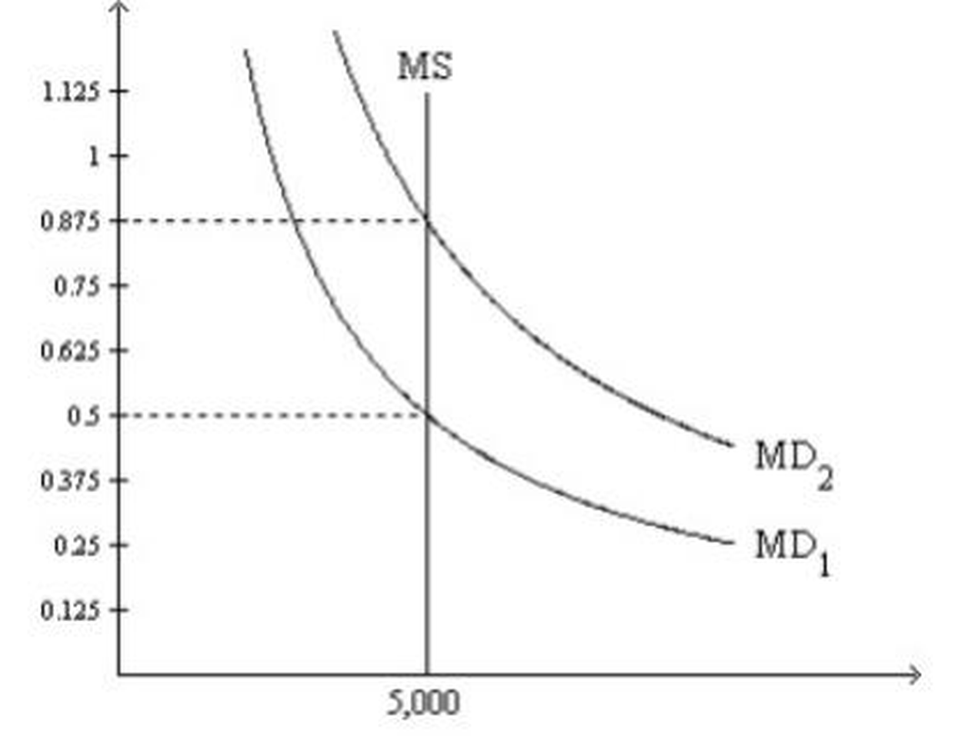
Ch30 Application MC 8 · Velocity of Money / MC 9 · Value of Money · Inflation Rate
Figure 30-2. On the graph, MS represents the money supply and MD represents money demand. The usual quantities are measured along the axes.
8. Refer to Figure 30-2.
Suppose the relevant money-demand curve is the one labeled MD₁; also suppose the economy’s real GDP is 30,000 for the year.
If the money market is in equilibrium, then how many times per year is the typical dollar bill used to pay for a newly produced good or service?
a. 4 b. 6 c. 8 d. 12
9. Refer to Figure 30-2.
At the end of 2009 the relevant money-demand curve was the one labeled MD₂.
At the end of 2010 the relevant money-demand curve was the one labeled MD₁.
Assuming the economy is always in equilibrium, what was the economy’s approximate inflation rate for 2010?
a. -43 percent b. -57 percent c. 57 percent d. 75 percent
1/P
P1 = 1/0.875
P2 = 1/0.5
Inflation: (P2 / P1) - 1
11

Slide 12
Ch30 Application Short Answer 5 · After-Tax Real Interest Rate
5. if the tax rate is 40 percent, compute the before-tax real interest rate and the after-tax real interest rate in each of the following cases.
a. The nominal interest rate is 10 percent, and the inflation rate is 5 percent.
b. The nominal interest rate is 6 percent, and the inflation rate is 2 percent.
c. The nominal interest rate is 4 percent, and the inflation rate is 1 percent.
Taxed on the nominal rate
10% × (1 − 0.4) − 5%
12

Slide 13
Ch30 Application MC 19 · Inflation · Capital Gains Tax Advanced
19. The country of Robinya has a tax system identical to that of the United States. Suppose someone in Robinya bought a parcel of land for 10,000 deera (the local currency) in 1970 when the price index equaled 100. In 2010, the person sold the land for 100,000 deera, and the price index equaled 500. The tax rate on nominal capital gains was 20 percent. Compute the taxes the person paid on the nominal gain and the change in the real value of the land in terms of 2010 prices to find the after-tax real rate of capital gain.
a. -20 percent b. 20 percent c. 42 percent d. 64 percent
(1) Tax on Nominal Gain:
(100,000 – 10,000) × 0.2 =18,000
(2) 1970 price to 2010 price
10,000 × 500/100 = 50,000
(3) Change in the Real Value
(100,000 – 50,000 – 18,000) / 50,000
= 0.64
해설 생략
13

Slide 14
Ch30 Application Short Answer 1 · Quantity Theory · Money Supply Rule
1. The money supply is $500 billion, nominal GDP is $10 trillion, and real GDP is $5 trillion.
a. Find the price level and the velocity of money.
b. If velocity is constant and real output rises 5% a year, what happens to nominal GDP and the price level next year if the Fed keeps the money supply constant?
c. What money supply keeps the price level stable next year?
d. What money supply gives 10% inflation next year?
M V = P Y
가격수준 × 실질생산량
= 명목GDP
M V = P Y
-5% 5%
Nominal GDP : +0%
+5%
+15%
10% 5%
14

Slide 15
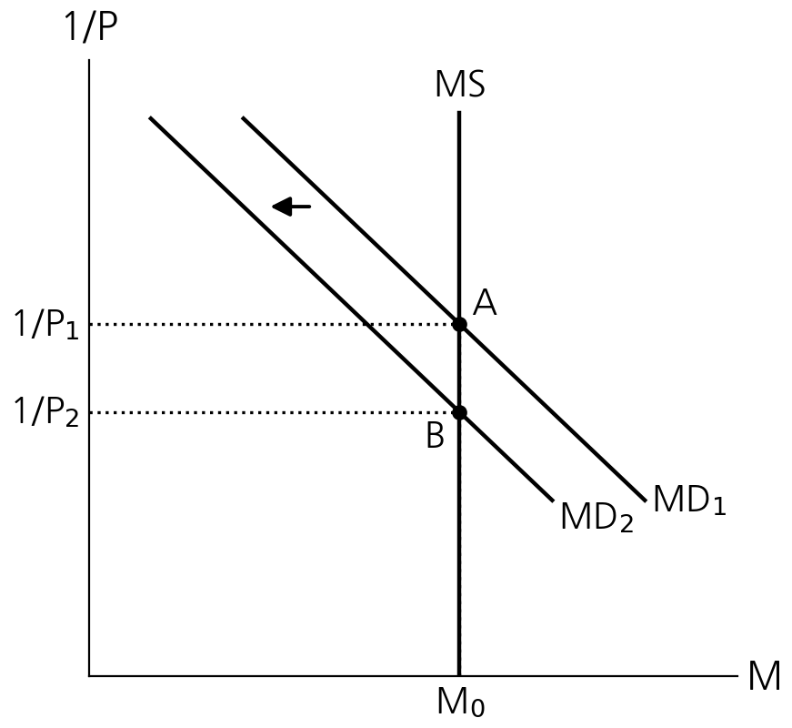
Ch30 Application Short Answer 2 · Money Demand Shift · Price Level
2. Suppose that changes in bank regulations expand the availability of credit cards so that people need to hold less cash.
a. How does this affect the demand for money?
b. If the Fed does not respond to this event, what will happen to the price level?
c. If the Fed wants to keep the price level stable, what should it do?
Value of Money
15

Slide 16
CHAPTER 33
Aggregate Demand and
Aggregate Supply
Multiple Choice
11 Expected Price Level · SRAS
16 Multiple Shocks · AD Shifts
7 Capital Inflow · Exchange Rate
8 Net Exports · AD
17 Stock Market Boom · Long-Run Equilibrium
Short Answer
1 Long-Run Aggregate Supply Shifters
2 Money Neutrality · Sticky Wages
4 Short-Run vs. Long-Run Effects
5 Investment Boom · AD–AS
16

Slide 17
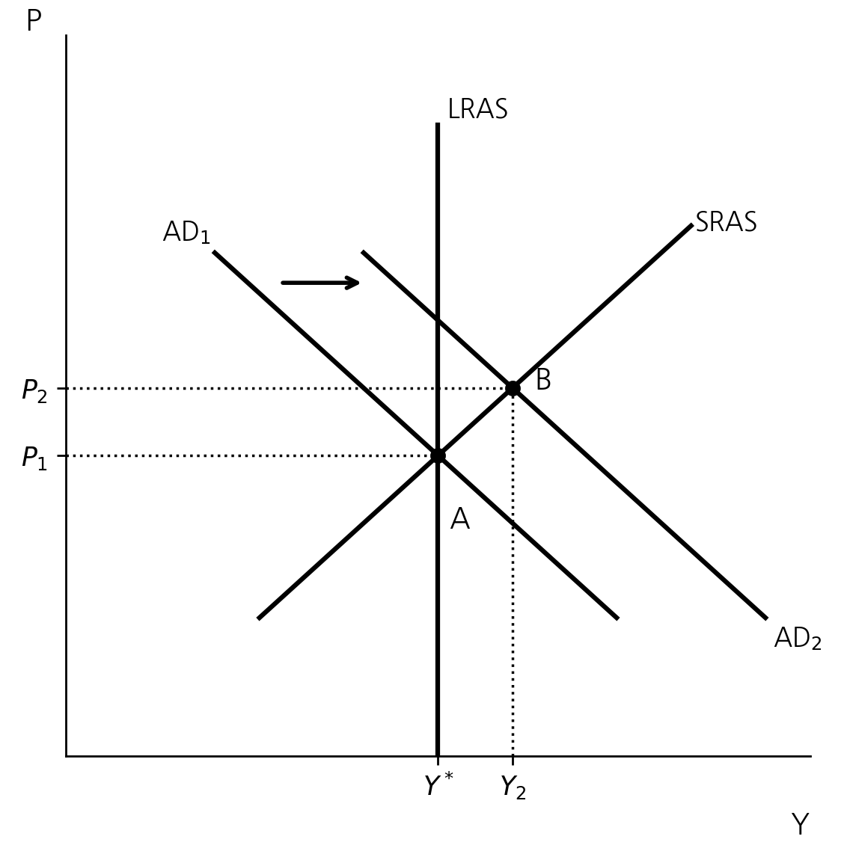
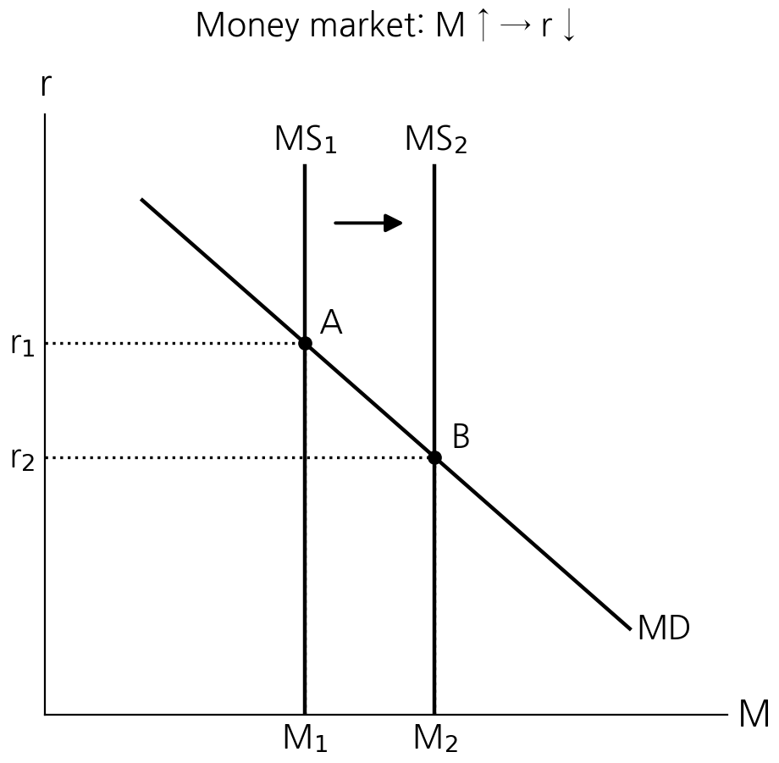
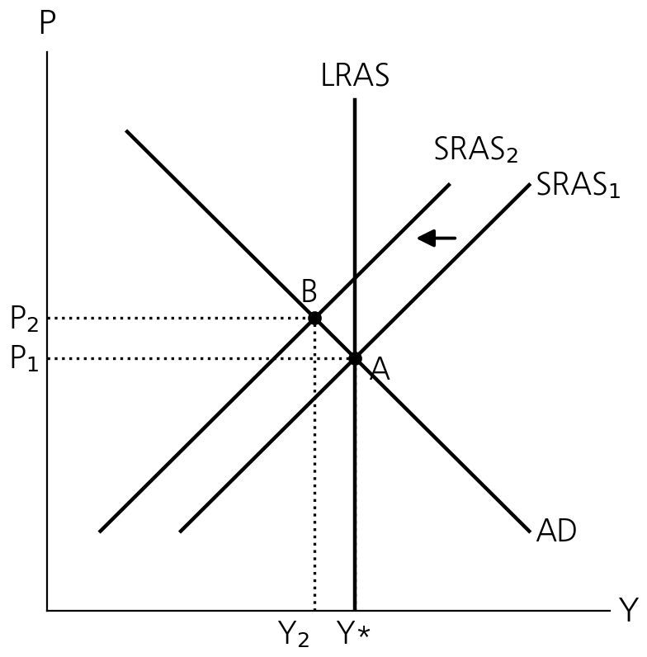
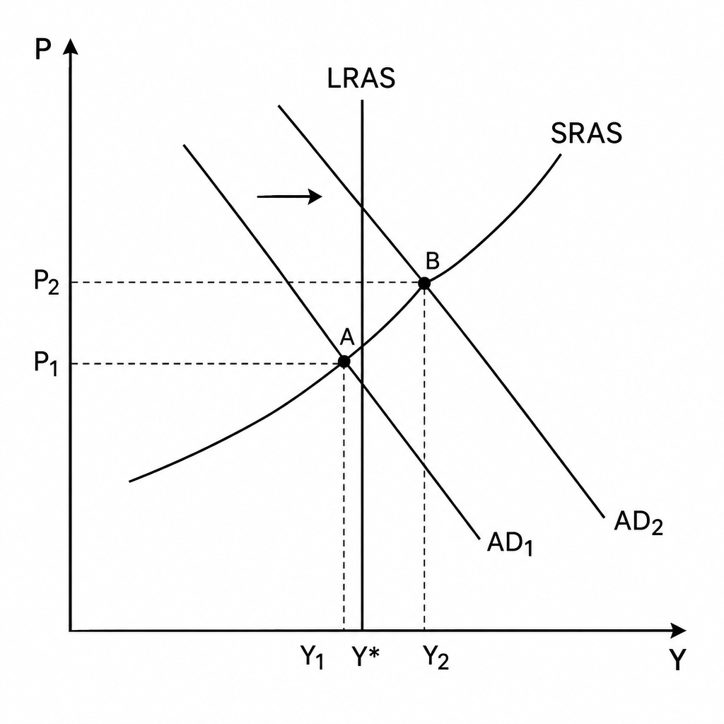
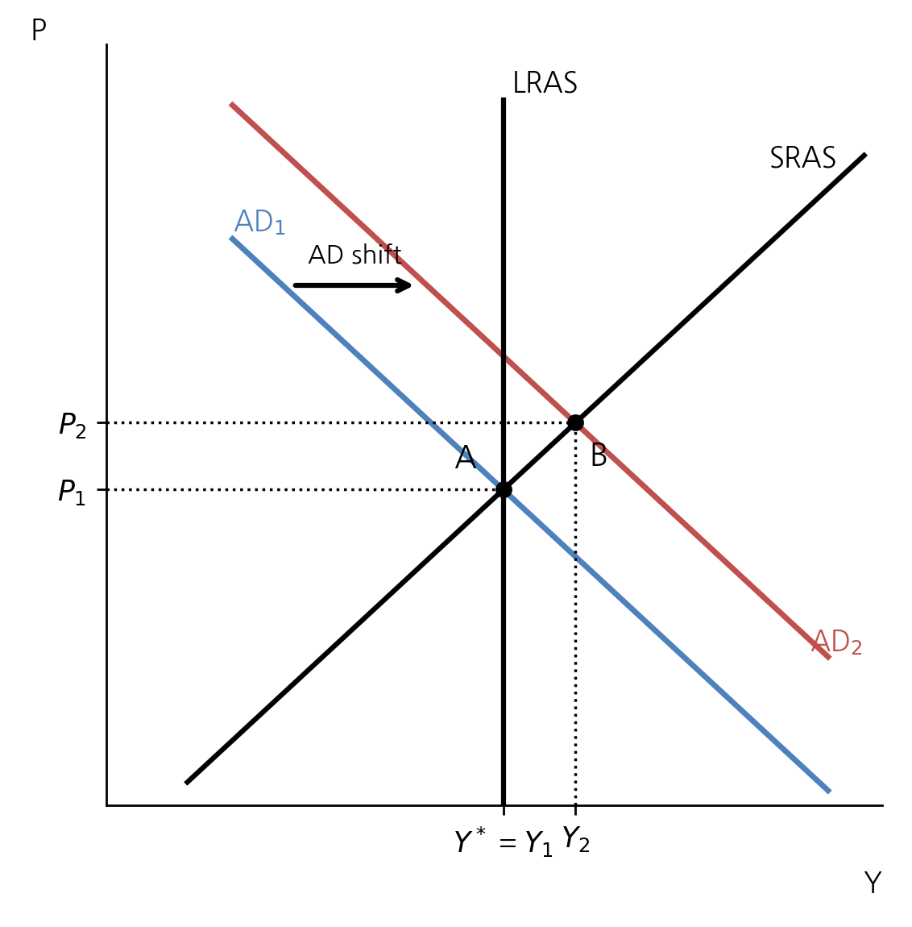
Ch33 AD–AS Overview · Curve Shifters
Why AD Slopes Downward: P에 의한 변화
• Wealth Effect (P↓ → real wealth↑ → C↑, Y↑)
• Interest-Rate Effect (P↓ → MD↓ → r↓ → I↑, Y↑)
• Exchange-Rate Effect (P↓ → r↓ → capital outflow → depreciation → NX↑, Y↑)
AD Shifters: C, I, G, NX changes
• C: Stock boom → wealth ↑, income taxes, consumer expectations
• I: M ↑ → r ↓, investment tax credit, firm expectations
• G: Government purchases
• NX: Exchange rate, foreign income
Change in P = movement along AD / SRAS, not a shift
17

Slide 18
Ch33 AD–AS Overview · Curve Shifters
Why SRAS Slopes Upward: P에 의한 변화
• Sticky-Wage (P↑ → real wage↓ → hire↑, Y↑)
• Sticky-Price (P↑ → relative price of sticky firms↓ → sales↑, Y↑)
• Misperception (P↑ → firms see higher relative price → produce↑, Y↑)
Y*: Natural rate of output,
full-employment output, potential output
장기: P = Pe, Y= Y*
Y = Y* + α(P-Pe)
단기 P > Pe 생산↑
SRAS Shifters: Pe, Cost, LRAS factors
• Expected price level ↑ → [SRAS ←]
• Nominal wages, input costs(ex. oil shock) ↑ → [SRAS ←]
• Productivity ↑→ [LRAS & SRAS →]
LRAS Shifters
• L, K, H, N, technology ↑ → [LRAS →]
• Y* ↑ (natural output)
• M or P alone: no shift
SRAS shifts left:
Stagflation
Change in P = movement along AD / SRAS, not a shift
17
Notes:
Y: 실제 생산량, Y*: 자연산출량(LRAS), P: 실제 물가. Pᵉ: 예상 물가
α > 0: 물가 차이에 대한 생산의 반응 정도. α가 클수록 SRAS가 완만

Slide 19
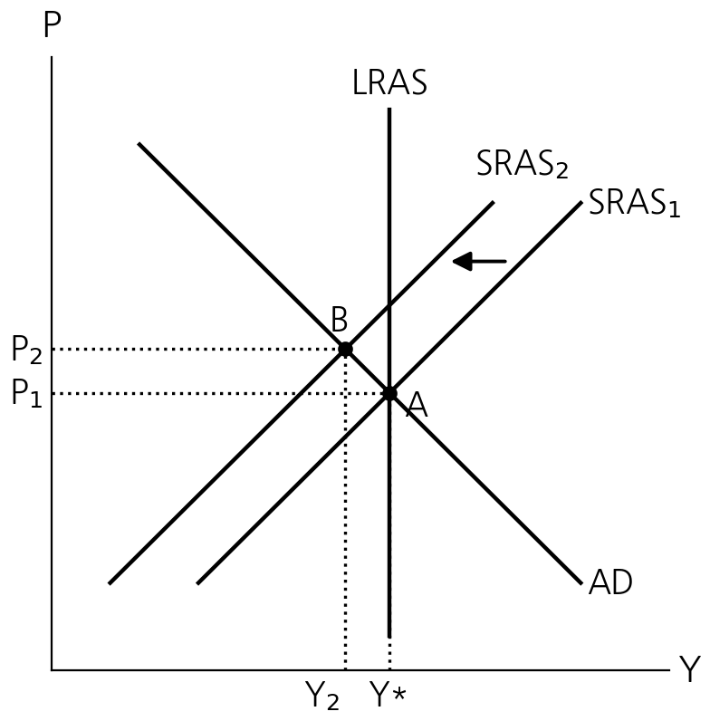
Ch33 Concept MC 11 · Expected Price Level · SRAS
11. An increase in the expected price level shifts the
a. short-run and long-run aggregate supply curves left.
b. the short-run but not the long-run aggregate supply curve left.
c. the long-run but not the short-run aggregate supply curve left.
d. neither the long-run nor the short-run aggregate supply curve left.
18

Slide 20
Ch33 Application MC 7 · Capital Inflow · Exchange Rate
Political Instability Abroad
Suppose that political instability in other countries makes people fear for the value of their assets in these countries so that they desire to purchase more Korean assets.
7. Refer to Political Instability Abroad. What would happen to the Korean won?
a. It would appreciate in foreign exchange markets making Korean goods more expensive compared to foreign goods.
What would the change in the exchange rate make happen to Korean net exports and Korean aggregate demand?
d. Net exports would fall which by itself would decrease Korean aggregate demand.
Factor other than P → AD Shifter (vs P’s Exchange-Rate Effect → AD Slopes Downward)
평가절상 → → Y=C+I+G+NX↓ → AD 하락(왼쪽)
원화가치 상승
달러가치 하락
수입 증가
수출 감소
19

Slide 21
Ch33 Application Short Answer 1 · Long-Run Aggregate Supply Shifters
1. Explain whether each of the following events will increase, decrease, or have no effect on long-run aggregate supply.
a. The United States experiences a wave of immigration.
b. Congress raises the minimum wage to $15 per hour.
c. Intel invents a new and more powerful computer chip.
d. A severe hurricane damages factories along the East Coast.
L, N, H, K
L
Natural Rate of Unemployment → LRAS
Productivity
Capital Stock(K)
20

Slide 22
Ch33 Application Short Answer 2 · Money Neutrality · Sticky Wages (1/3)
2. Suppose an economy is in long-run equilibrium.
a. Use the model of aggregate demand and aggregate supply to illustrate the initial equilibrium (call it point A). Be sure to include both short-run and long-run aggregate supply.
b. The central bank raises the money supply by 5 percent. Use your diagram to show what happens to output and the price level as the economy moves from the initial to the new short-run equilibrium (call it point B).
Price level
LRAS
AD₂
AD₁
SRAS₁
P₂
B
P₁
A
Y₁
Y₂
Real GDP
21

Slide 23
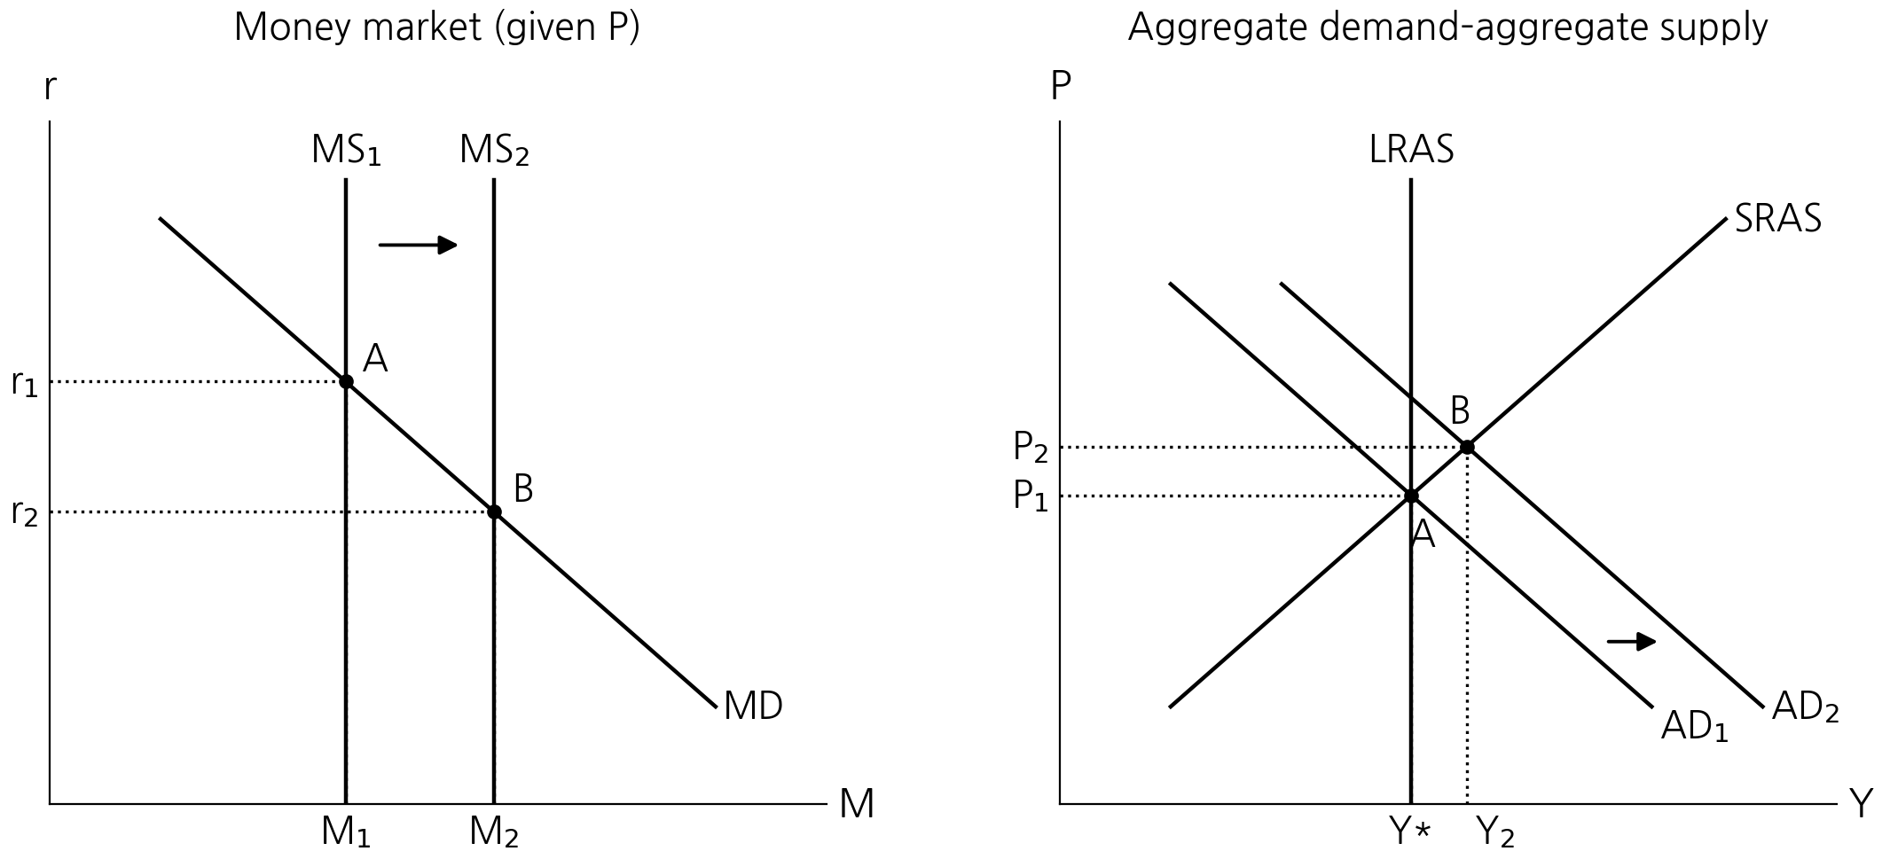
Ch33 Money Supply → Aggregate Demand
MS ↑ → r ↓ → Investment ↑
→ AD shifts right → Short-run Y ↑ and P ↑
22

Slide 24
Ch33 Application Short Answer 2 · Money Neutrality · Sticky Wages (2/3)
2. Suppose an economy is in long-run equilibrium.
c. Now show the new long-run equilibrium (call it point C). What causes the economy to move from point B to point C?
d. According to the sticky-wage theory of aggregate supply, how do nominal wages at point A compare to nominal wages at point B? How do nominal wages at point A compare to nominal wages at point C?
Price level
LRAS
SRAS₂
AD₂
AD₁
SRAS₁
P₃
C
P₂
B
P₁
A
Y₁
Y₂
Real GDP
Nominal Wage sticky in the short run (same at A, B)
Nominal Wage adjust to higher price level (higher at C)
As production cost increase, LRAS shift left.
23

Slide 25
Ch33 Application Short Answer 2 · Money Neutrality · Sticky Wages (3/3)
2. Suppose an economy is in long-run equilibrium.
e. According to the sticky-wage theory of aggregate supply, how do real wages at point A compare to real wages at point B? How do real wages at point A compare to real wages at point C?
f. Judging by the impact of the money supply on nominal and real wages, is this analysis consistent with the proposition that money has real effects in the short run but is neutral in the long run?
Price level
LRAS
SRAS₂
AD₂
AD₁
SRAS₁
P₃
C
P₂
B
P₁
A
Y₁
Y₂
Real GDP
At B, real wage decrease as nominal wage stays the same and P increase
At C, real wage is back to A as nominal wage adjusts.
24

Slide 26
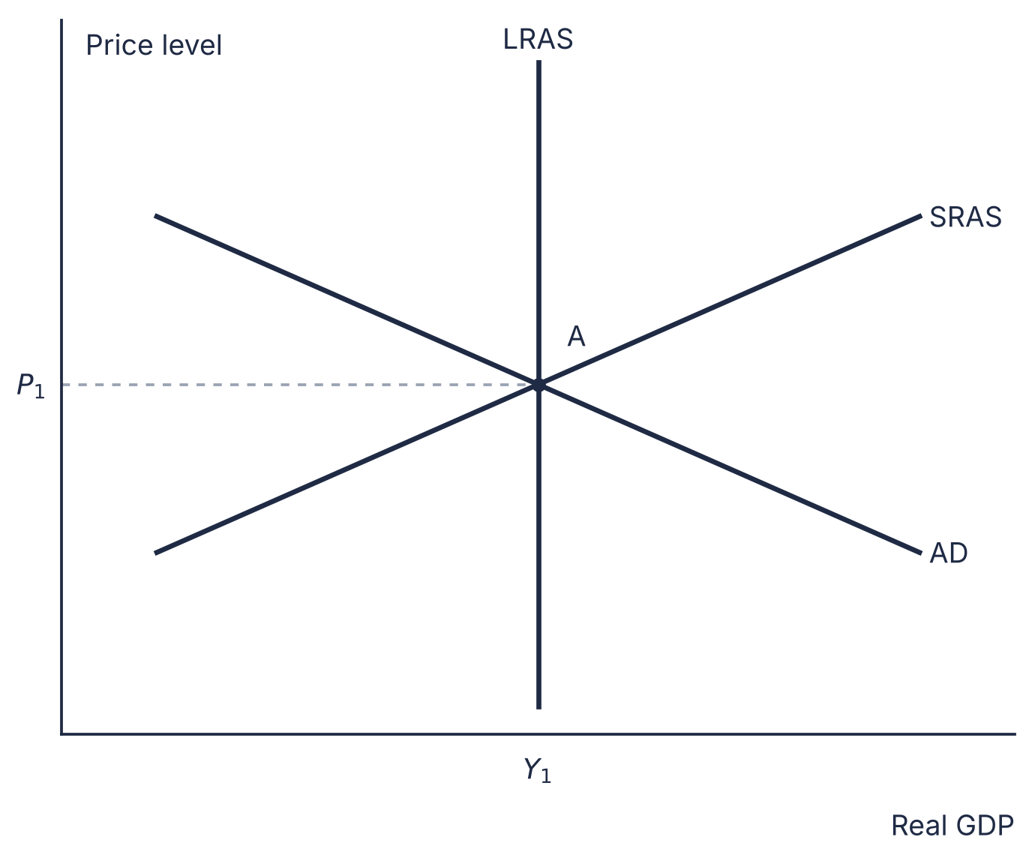
Ch33 Application Short Answer 5 · Investment Boom · AD–AS / Short Answer 4 · Short-Run vs. Long-Run Effects
5. Suppose firms become very optimistic about future business conditions and invest heavily in new capital equipment.
a. Draw an AD–AS diagram to show the short-run effect of this optimism. Label the new price level and real output. Explain in words why the aggregate quantity of output supplied changes.
b. Using the diagram from part (a), show the new long-run equilibrium (assume no change in LRAS). Explain in words why the aggregate quantity of output demanded changes between the short run and the long run.
c. How might the investment boom affect the long-run aggregate-supply curve? Explain.
= why does SRAS slopes upward?
SRAS moves to the left, as wage, price, misperception adjusts
4. (Short Answer 4) Practice
a. The stock market declines sharply, reducing consumers’ wealth.
b. The federal government increases spending on national defense. (vs tax cut)
c. A technological improvement raises productivity.
d. A recession overseas causes foreigners to buy fewer U.S. goods.
Might shift right as Capital Stock increases.
25

Slide 27
CHAPTER 28
Unemployment
Multiple Choice
1 Labor-Force Participation
5 Classification · Unemployment Rate
10 Unions · Wages and Employment
14 Efficiency Wages · Natural Rate
Short Answer
1 Labor Force Statistics
2 Employment vs. Unemployment
4 Sectoral Shifts · Wage Adjustment
26

Slide 28
Ch28 Concept MC 1 · Labor-Force Participation / MC 5 · Classification · Unemployment Rate
1. Sheamous loses his job and decides to sit on the beach rather than look for work during the next few months. Other things the same, the unemployment rate
a. increases and the labor-force participation rate decreases.
b. increases and the labor-force participation rate is unaffected.
c. is unaffected and the labor-force participation rate decreases.
d. and the labor-force participation rate are both unaffected.
5. Suppose that some people are counted as unemployed when, to maintain unemployment compensation, they search for work only at places where they are unlikely to be hired. If these individuals were counted as out of the labor force instead of as unemployed, then
a. both the unemployment rate and labor-force participation rate would be higher.
b. both the unemployment rate and labor-force participation rate would be lower.
c. the unemployment rate would be lower and the labor-force participation rate would be higher.
d. the unemployment rate would be higher and the participation rate would be lower.
Unemployed
Employed + Unemployed
Labor Force
Unemployed
Adult population
Employed + Unemployed
27

Slide 29
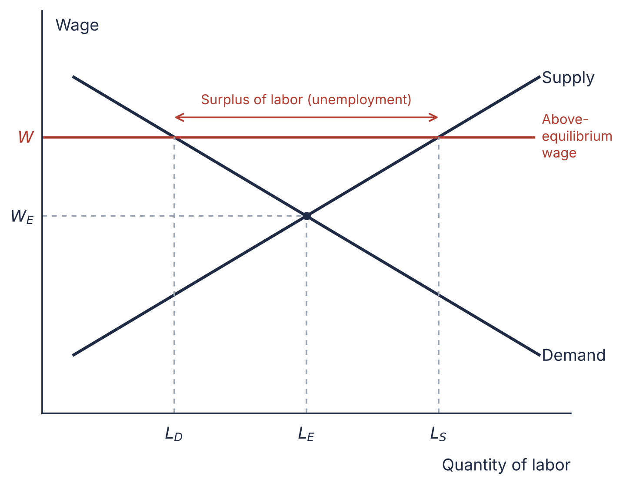
Ch28 Concept MC 10 / MC 14 3 Situations when wage is higher than the equilibrium wage Advanced
10. Suppose that autoworkers are unionized in one region of the country but not in the other. If the (1)unionized workers abolished their unions, employment
a. and wages of autoworkers in that region would rise.
b. of automobile workers in that region would rise, but wages of automobile workers in that region would fall.
c. and wages of autoworkers in that region would fall.
d. of automobile workers in that region would fall but wages of automobile workers in that region would rise.
+ (2)Efficiency wages contribute to
c. structural unemployment and the natural rate of unemployment.
+ What if the (3)minimum wage is set below the equilibrium wage?
natural rate of unemployment = structural + frictional (cyclical X)
28

Slide 30
Ch28 Application Short Answer 1 · Labor Force Statistics
1. In June 2009, at the trough of the Great Recession, the Bureau of Labor Statistics announced that of all adult Americans, 140,196,000 were employed, 14,729,000 were unemployed, and 80,729,000 were not in the labor force. Use this information to calculate:
a. the adult population
b. the labor force
c. the labor-force participation rate
d. the unemployment rate
+ (MC 4) What is the adult female labor-force participation rate?
Adult population
Not in..
Labor force
Unemployed
Employed
전체(분모)를 adult female 만 대상으로
(여성 인구 중 참가율)
29

Slide 31
Ch28 Application Short Answer 4 · Sectoral Shifts · Wage Adjustment
4. Frictional unemployment is said to result from a mismatch between employers’ and workers’ skills. Consider two industries: auto and aircraft manufacturing.
a. If workers can choose which industry to train for (similar training needed), what happens to wages in the two industries? How long does it take?
b. If the economy starts importing autos and exporting aircraft, what happens to labor demand in each industry?
c. If workers cannot be quickly retrained, how do these shifts affect equilibrium wages in the short run and the long run?
d. If wages fail to adjust to the new equilibrium, what occurs?
임금이 동일해질 때까지 노동자가 다른 산업으로 이동 (낮은임금 → 높은임금)
수입 → 국내산업 쇠퇴 → 노동수요 감소
Workers cannot move between industries;
Wage differs in SR(higher in aircraft), equals in LR after training.
균형이 아닐 경우 임금 높은 곳에 노동의 초과공급 (=실업)
30

Slide 32
Answers 1 / 2 Ch29 · Ch30
Ch29
Ch30
Multiple Choice
14 b
15 a
Short Answer 5
Deposits +$1,000
Money supply +$900
Short Answer 6
a. Reserves $100, Loans $900
Deposits $800, Capital $200
b. Leverage = 5
c. Loans $810, Capital $110
d. Assets −9%, Capital −45%
Short Answer 10
a. 10 · $1,000B
b. ΔR = 0, ΔM = −$500B
Short Answer 11
a. Buy bonds
b. $8 million
Multiple Choice
10 b
21 d
8 d
9 d
19 d
Short Answer 1
a. P = 2, V = 20
b. P −4.76%; nominal GDP same
c. M +5% ($525B)
d. M +15.5% ($577.5B)
Short Answer 2
a. MD shifts left
b. P rises
c. Cut MS
Short Answer 5
Real: pre-tax → after-tax
a. 5.0% → 1.0%
b. 4.0% → 1.6%
c. 3.0% → 1.4%
31

Slide 33
Answers 2 / 2 Ch33 · Ch28
Ch33
Ch28
Multiple Choice
11 b
7 a
8 d
Short Answer 1
a. ↑ b. ↓ c. ↑ d. ↓
Short Answer 2
b. Y↑, P↑
c. Y back, P↑ (SRAS ←)
d. Nominal A = B < C
e. Real B < A = C
f. Yes
Short Answer 4
a. SR Y↓P↓ · LR Y same, P↓
b. SR Y↑P↑ · LR Y same, P↑
c. Y↑, P↓
d. SR Y↓P↓ · LR Y same, P↓
Short Answer 5
a. AD →: Y↑, P↑
b. SRAS ←: Y back, P↑
c. LRAS may shift →
Multiple Choice
1 a
5 b
10 b
14 c
10 +
Below W*:
non-binding,
no surplus
* UR ↓; LFPR ↓
Short Answer 1
a. 235,654,000
b. 154,925,000
c. 65.7%
d. 9.5%
+ (MC 4) Female LF ÷ female pop.
Short Answer 4
a. Wages equalize
b. D auto ↓, aircraft ↑
c. SR: auto ↓, aircraft ↑
LR: wages equalize
d. Aircraft shortage, auto surplus
32

