Slide 1
Metabolites and metabolomics
Data generation and pre-processing

Slide 2
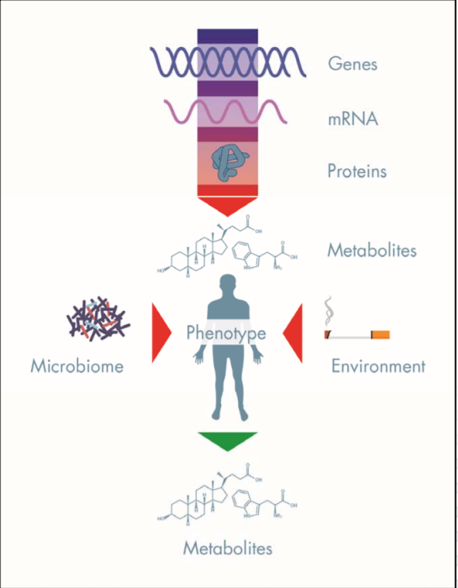
Metabolomics
Metabolites are produced in the body as the result of chemical processes
They give a fine-grained snapshot of a person's metabolic state – offering molecular insight on health and disease
Peptides, oligonucleotides, sugars, organic acids, ketones, aldehydes, amines, amino acids, lipids, steroids, and alkaloids
No universal instrument or method capable of measuring the entire metabolome (yet...)
Two main types: nuclear magnetic resonance (NMR) and mass spectrometry (MS)
https://www.metabolon.com/application/files/2415/0388/1050/The-5-Key-Elements-of-a-Successful-Metabolomics-Study.pdf
Notes:
Concerned with small molecules from urine, blood, saliva and tissues
Two main types in epidemiology*

Slide 3
NMR and MS
NMR and MS have distinct strengths and weaknesses, and both uniquely benefit the study of metabolomics.
NMR | MS
Quantitative | Higher resolution
Less sensitive (but improving!) | More sensitive
Cheaper | More expensive
Can only detect most abundant metabolites ~200 | More metabolites can be detected ~1200
Non-destructive (sample can be used again!) | Destructive
Highly reproducible | Becoming more widely used
Rarely done in epidemiology, but by combining the approaches you can enhance coverage of the metabolome and the accuracy of metabolite identification
Notes:
NMR = usually targeted – less sensitive than MS (although has increased) – much cheaper (around 13£ a sample) - quantitative so does not require extra steps for sample preparation, such as separation or derivatization – high reproducibility (because biomarker quantification directly from serum, without any sample extraction procedures)
MS = usually untargeted – v high sensitivity and good sensitivity and specificity balance
Researchers are starting to realize they can be complementary and by using both you can cover more of the metabolome and have both strengths – see case study

Slide 4

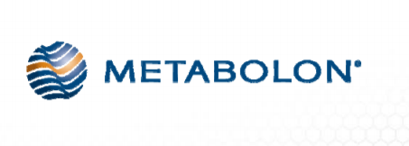
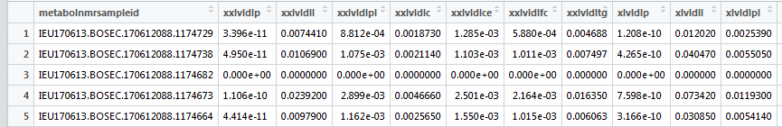
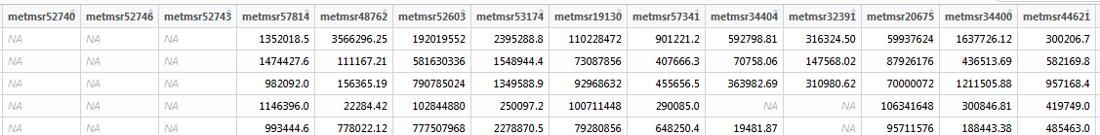
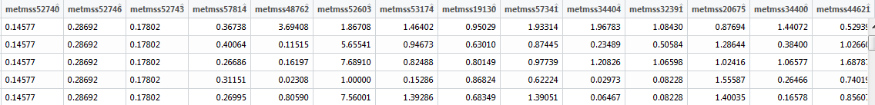
Examples
Nightingale NMR output
Concentrations for each NMR-derived metabolite, measured in mmol/L
Metabolon MS output
Raw area counts
Metabolon MS output
Scaled and imputed using multiples of the median
Notes:
Examples of the output you get back from Nightingale or Metabolon
Pre QC and normalization is carried out by Nightingale and Metabolon. Metabolon can provide you with data analysis and interpretation, help with study design, and you get back at least raw and imputed data. Missing data because a) metabolite isn’t present b) metabolite is present but in too low quantity or c) technical effects

Slide 5
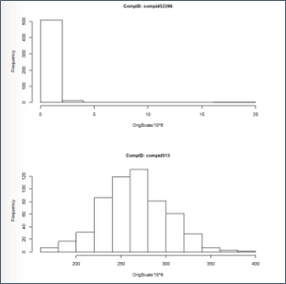
What you do with your data
Checks for normality
Plotting your data e.g. histograms, QQ plots
Statistical tests e.g. Shapiro-Wilk
Outlier detection e.g. principal components analysis (PCA)
Log transform – transforms the data - but will not ‘fix’ all distributions (often not helpful because it can't deal with 0 values)
Scale – standardizes the data to z scores
No agreed 'best practice' yet...
Example of MS-profiled metabolite distribution
Notes:
Checks for normality can be done by eye, or setting thresholds e.g. excluding those more than 4 x SD from the mean
Can talk about how ‘new’ metabolomics is to epidemiology and how things will probably change. Laura Corbin and David Hughes are working on a universal QC script for Metabolon data as we speak.

